Slide 1
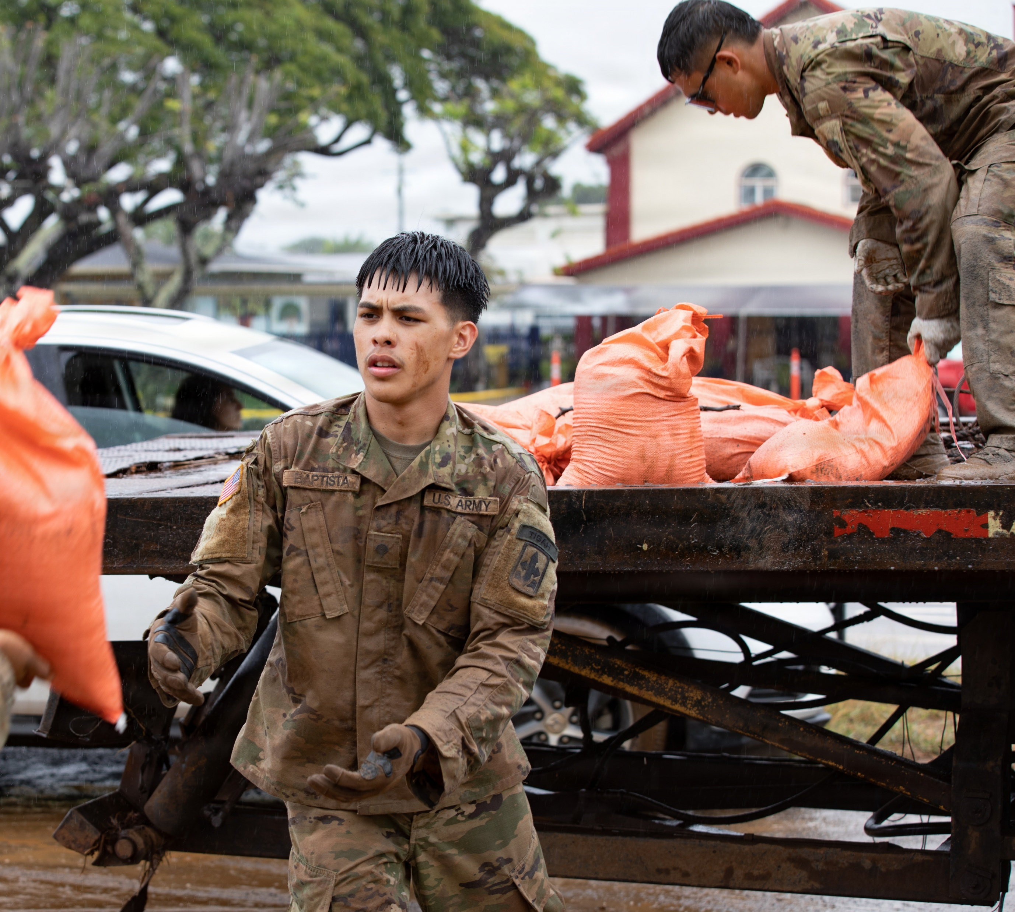


Hawaiʻi National Guard
UPAR Training

Slide 2
Agenda
In the Beginning…
Policy
UPAR Responsibilities
  Public Affairs Preparedness
  Public Affairs Liaison
  Take Photos, Write Captions, & Get Published
  Record Basic Video
  Understanding Media and Social Media
Where do PA products go?
Final Notes
Introduction / UPAR Training

Slide 3
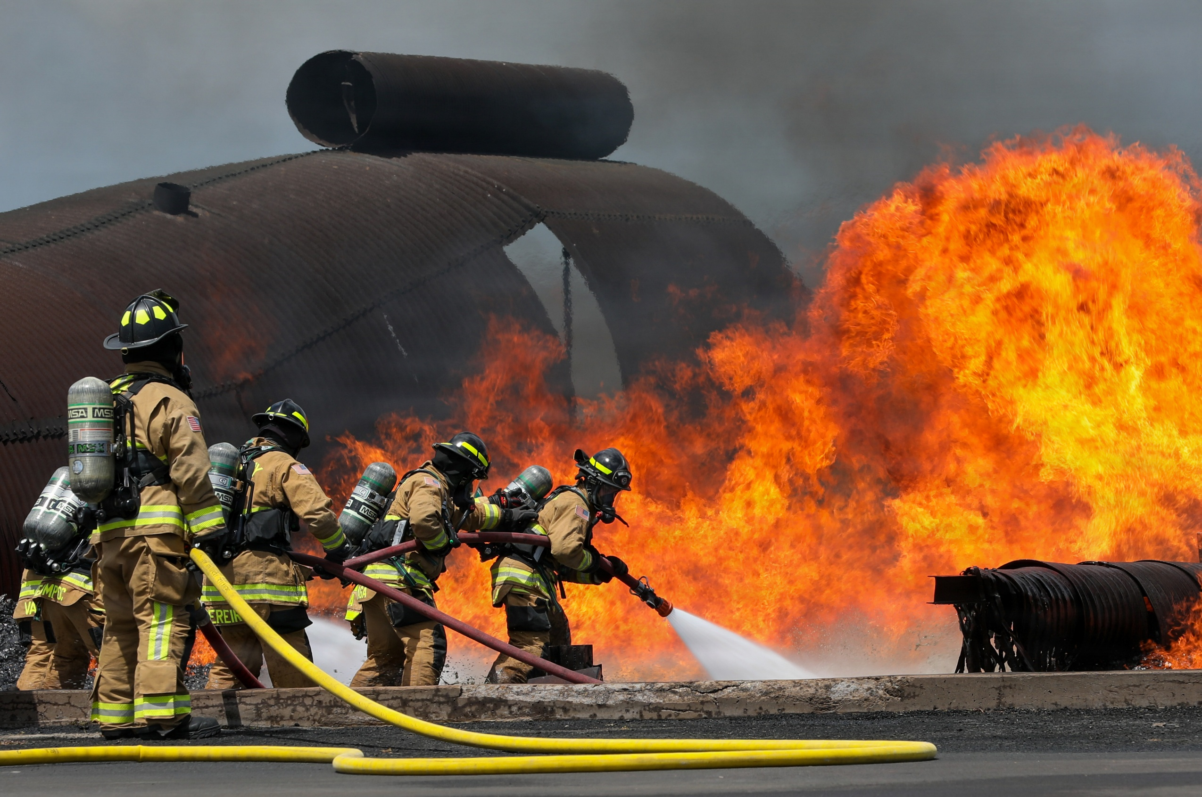
In the Beginning…
Introductions
  Rank, full name, unit, and favorite hobby
Mahalo!
Building a foundation (for you and your unit’s PA program)
The HING UPAR Handbook
Introduction / UPAR Training
Notes:
- tell all of us your rank, first and last name, unit, favorite snack.
Thank you all for being here
learn the basics of how to be a UPAR. advanced UPAR class offered. UPAR It nests with the slides
The highest PA element is the State Public Affairs Office, if they can get 3-5 pics from UPARs a quarter, help share the HIARNG story

Slide 4
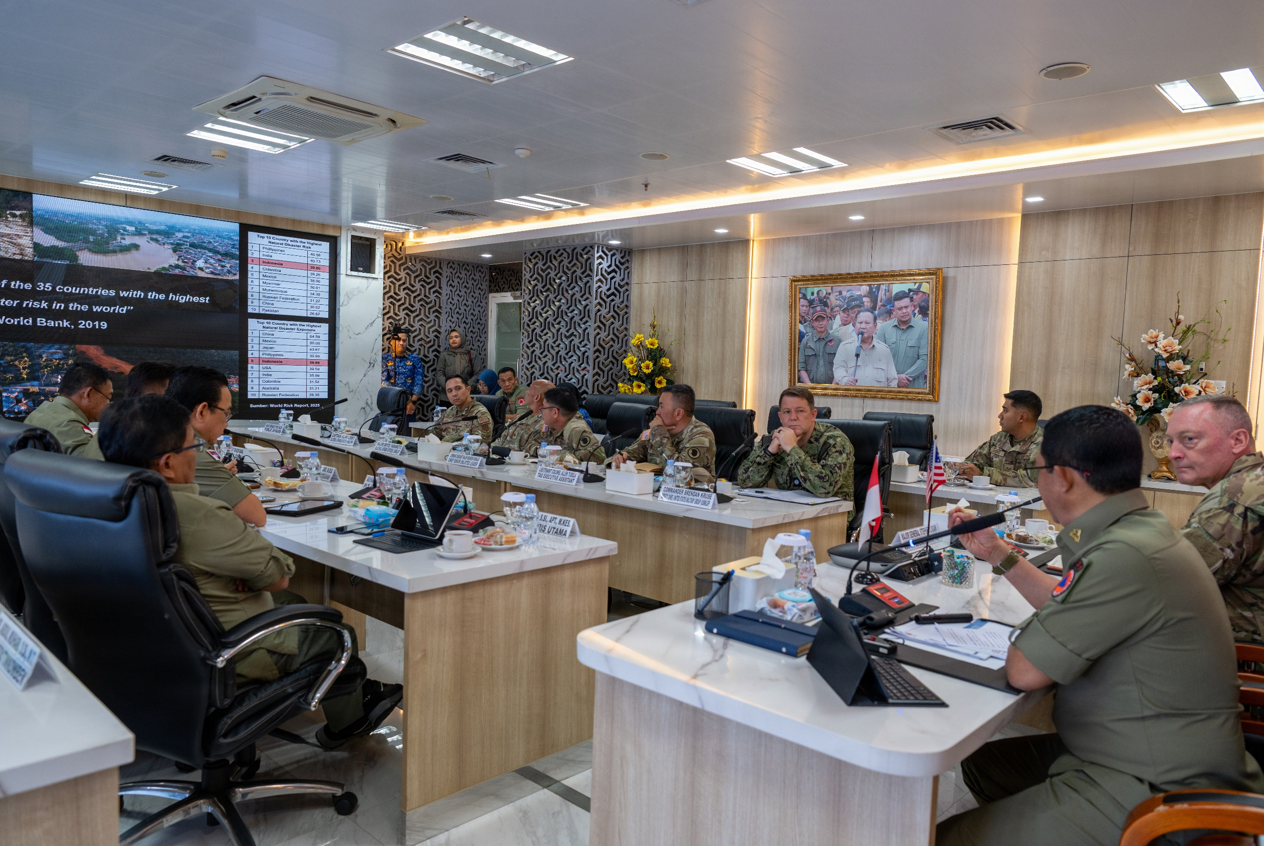
Why UPAR?
Support HING Public Affairs program
We need your help in telling your units, and “Hawaiʻi National Guard story”
  HIARNG 20 PAO positions
  HIANG 12 PAO positions
  Appx. 5,500 guardsman
History of HING
UPARs need two important things from the commander and the unit:
  Time
  Support
Introduction / UPAR Training
Notes:
There are over 5,500 stories to tell.
PA Specialists cannot cover everything.
Commanders will need to provide you UPARs two things….
Time: for a UPAR to plan and carry out tasks, to meet with the UPAR to plan and initiate the unit’s PA Plan.
Support: The unit’s staff need to know the UPAR and that command supports the UPAR's efforts. Involve the UPAR in unit meetings, access to info

Slide 5

Policy
In the beginning
Policy
UPAR Responsibilities
Public Affairs Preparedness
Public Affairs Liaison
Take Photos, Write Captions, & Get Published
Record Basic Video
Understanding Media & Social Media
Where do PA products go?
Final Notes
Policy / UPAR Training

Slide 6
DOD Policy
Free-flow of general / military information, without censorship or propaganda
Information will not be classified or withheld to protect Government from criticism or embarrassment
Information will be withheld only when:
  adversely affect national security
  threatens safety or privacy of the Armed Forces
  directed by law or regulation
DoD’s obligation: provide public with information, may require detailed public affairs planning
Propaganda has NO place in DOD public affairs
Policy / UPAR Training

Slide 7
DOD Policy
Standalone or portions of classified and unclassified information have potential to compromise security
Information for public release is cleared via security and policy review (conducted by PAO)
Effective communication is required
  Increase public awareness of the mission, goals, policies and programs
  Foster community relations and build good will
  Accountable to taxpayers and rely on their support
Release of accurate information must be done with speed, efficiency and through variety of mediums (different audiences)
Policy / UPAR Training

Slide 8

OPSEC
Operations Security
Exact # of troops, exact times of departure, radio frequencies, which vehicles are mission ready, what route a unit will take…
Practice security at the source
Be aware of OPSEC and responsible for safeguarding sensitive information
OPSEC applies to:
  media interviews
  sharing info/imagery with family & friends, including email & social media
Policy / UPAR Training

Slide 9
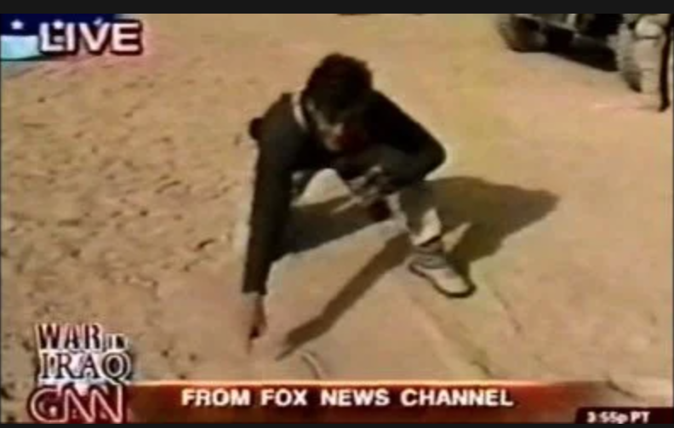
What Not To Do
For example:
2003, Geraldo Rivera traveling with 101st Airborne Division in Iraq as a war correspondent for Fox News and made major tactical error
Rivera drew map during a live broadcast, pinpointing exact location and revealing time and details of upcoming operation
Policy / UPAR Training

Slide 10
Misc. & Things to Consider
Photos of children from events must have parental permission
Copyright and Fair Use of your products
If you are a service member, working with government equipment and/or on government time - it belongs to the government
Policy / UPAR Training

Slide 11
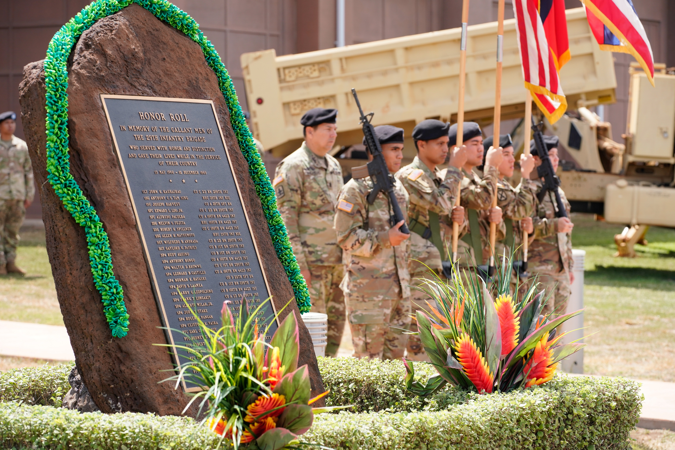
UPAR RESPONSIBILITIES
In the beginning
Policy
UPAR Responsibilities
Public Affairs Preparedness
Public Affairs Liaison
Take Photos, Write Captions, & Get Published
Record Basic Video
Understanding Media & Social Media
Where do PA products go?
Final Notes
UPAR Responsibilities / UPAR Training

Slide 12
UPAR Responsibilities
Public Affairs Preparedness – meet with Commander to set goals and create a plan
Public Affairs Liaison – POC for all things public affairs
Take Photos, Write Captions and Get Published - #1 job
Record Basic Video – film short clips
Understanding Media and Social Media– comprehend the framework of media and social media
UPAR Responsibilities / UPAR Training

Slide 13
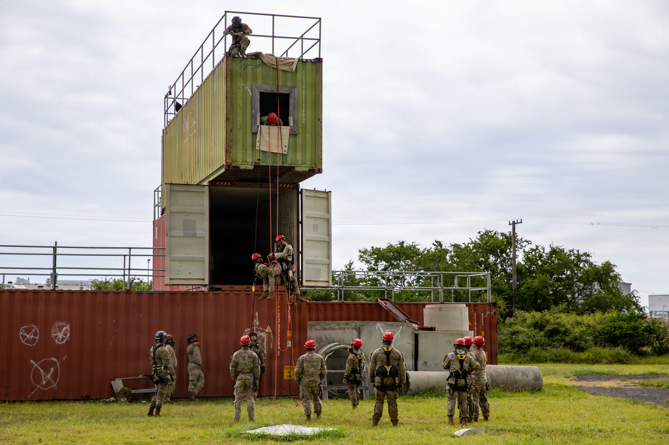
PA PREPAREDNESS
In the beginning
Policy
UPAR Responsibilities
Public Affairs Preparedness
Public Affairs Liaison
Take Photos, Write Captions, & Get Published
Record Basic Video
Understanding Media & Social Media
Where do PA products go?
Final Notes
Public Affairs Preparedness / UPAR Training

Slide 14
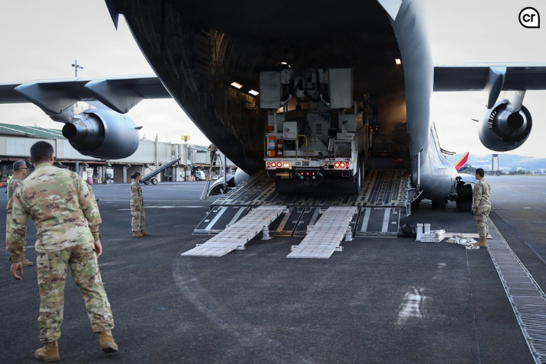
PA Planning
Talk to unit Commander
Get info from YTB and training schedules
Make a plan together
Pitch ideas
Choose events, coordinate with POC
Prepare, have a schedule
Annual Training = Goldmine
Look at social media to get ideas
PA plans are fluid
Public Affairs Preparedness / UPAR Training

Slide 15
Important Events
Community projects
Promotions
Award ceremonies
Changes of command/responsibility
Re-enlistments
Yellow Ribbon events
Retirement ceremonies
Family readiness events
Holiday functions
Training
Exercises
Public Affairs Preparedness / UPAR Training

Slide 16
PA Plan Sample
OCT 2026
Dec Newsletter - Start designing layout and looking at past socials for story ideas
DEC 2026
Dec Newsletter - Do final draft. Get commander approval. Distribute newsletter
SEP 2026
Quarterly Photos – SEL retirement Take photos. Write caption. Send to PAO
NOV 2026
Dec Newsletter - Draft content and pics. Get Commander to write a column
Coordinate with higher PA, about new equipment, Reach out to contact with story idea and details (5 W’s)
Annual Training
Quarterly Photos – New equipment Take photos. Write caption. Send to PAO
Public Affairs Preparedness / UPAR Training

Slide 17
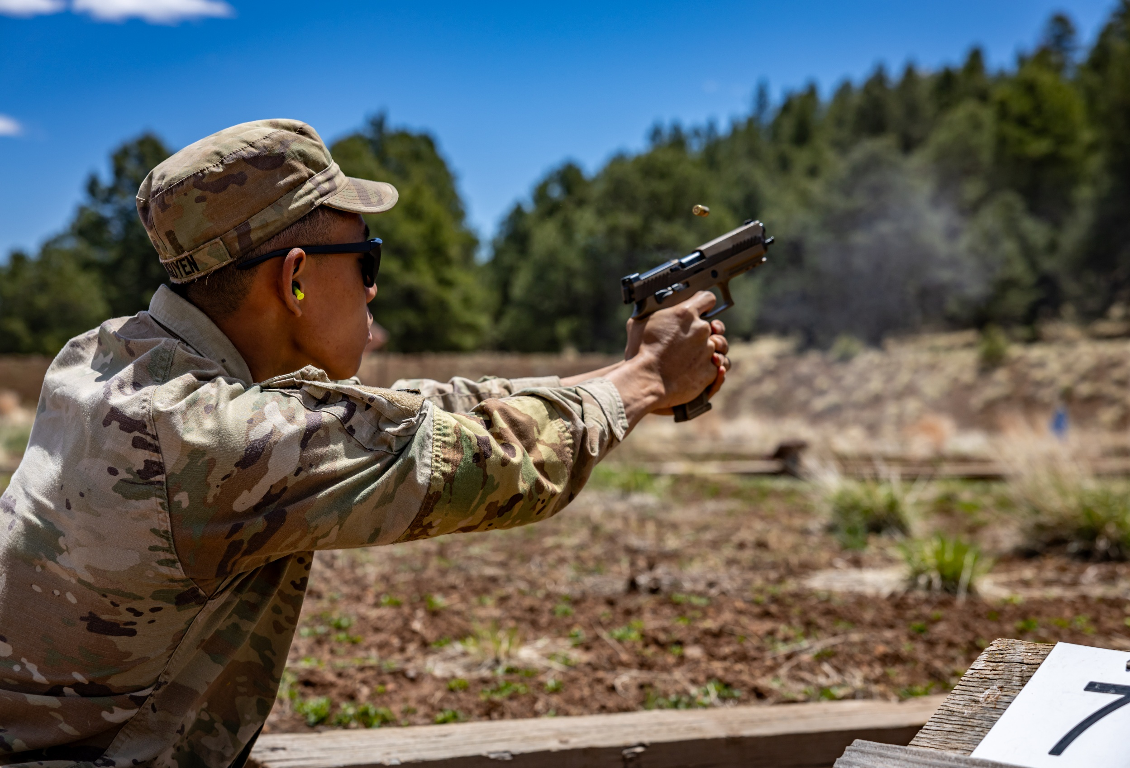
Release Authority
Approving of content- Release Authority
  Unit level = Commander for unit
  This step protects you
Higher PA Element = 117th MPAD, 154th WG, State PAO
Public Affairs Preparedness / UPAR Training

Slide 18
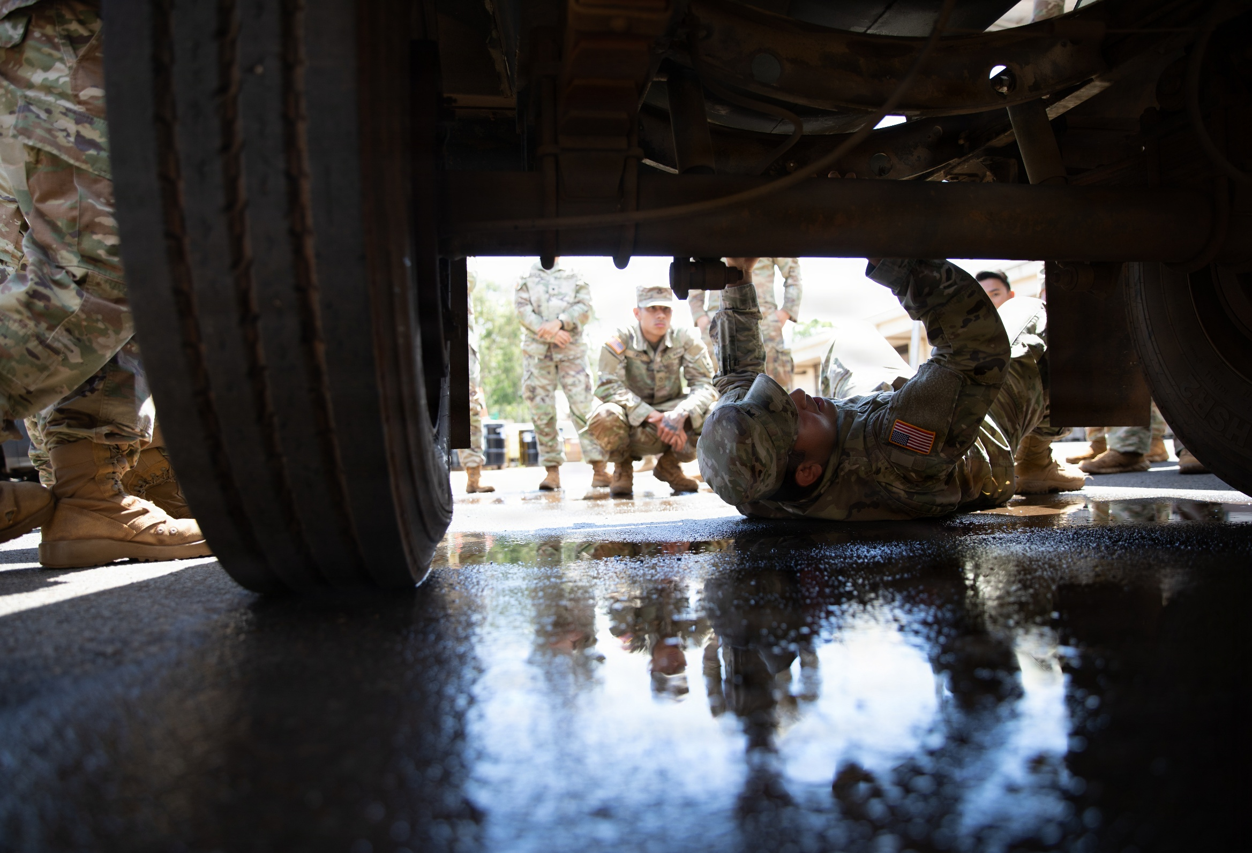
Command Information & Internal Communication
Command information could be presented as:
A newsletter
A flyer
A briefing
A bulletin board
An internal slideshow or collage
Public Affairs Preparedness / UPAR Training

Slide 19

Social Media
Unit Unofficial Accounts only
  closed or private groups
  labeled unofficial
State PAO Official Accounts
  TAG, DAG, CSEL
  HIARNG, HIANG
Public Affairs Preparedness / UPAR Training

Slide 20
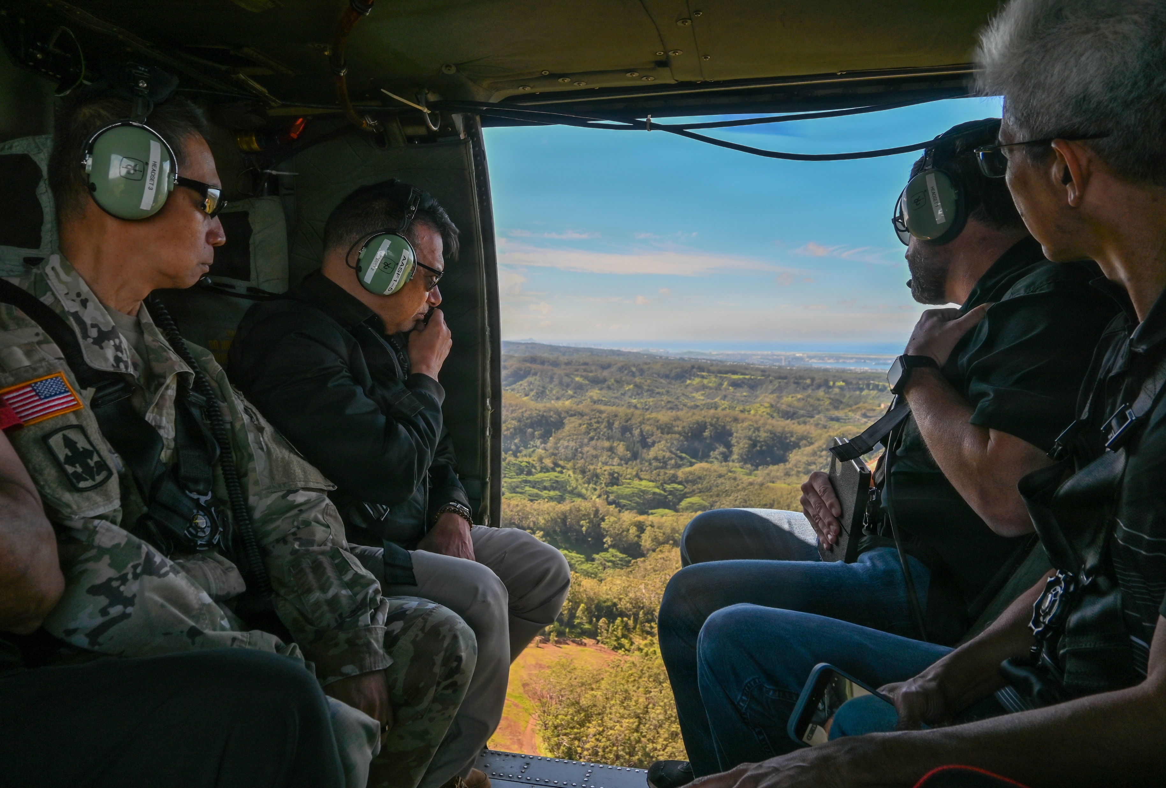
PA LIAISON
In the beginning
Policy
UPAR Responsibilities
Public Affairs Preparedness
Public Affairs Liaison
Take Photos, Write Captions, & Get Published
Record Basic Video
Understanding Media & Social Media
Where do PA products go?
Final Notes
Public Affairs Liaison / UPAR Training

Slide 21
PA Liaison
A person that allows different organizations or groups to work together and provide information to each other.
Position of responsibility
To the Commander
To higher PA elements
Share the most current PA information from higher PA element - State PAO, 117th MPAD
Public Affairs Liaison / UPAR Training

Slide 22

PA Liaison
Provide counsel to the Commander and higher PA
“Pulling and Pushing” of information
UPARs immediately notify PAO of any issues that might gain national or international media attention (accidents/investigations)
Public Affairs Liaison / UPAR Training
Notes:
Establish communication with 117th MPAD, as they will approve all products and be the release authority during exercises or some training events.
The State PAO will be your full-time higher PA element.
The State PAO oversees and provides all UPAR training and serve as PA SMEs. During State Active Duty Missions there may be a Task Force PAO, but you can always contact the State PAO.

Slide 23
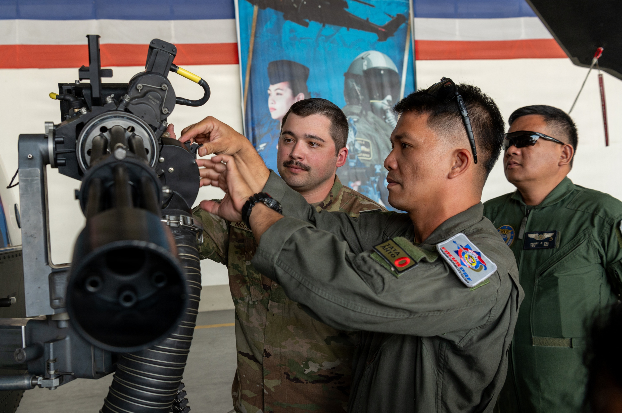
TAKE PHOTOS, WRITE CAPTIONS, & GET PUBLISHED
In the beginning
Policy
UPAR Responsibilities
Public Affairs Preparedness
Public Affairs Liaison
Take Photos, Write Captions, & Get Published
Record Basic Video
Understanding Media & Social Media
Where do PA products go?
Final Notes
The primary function that the State PAO would like every UPAR to do is to take a good photo, write a caption for it and then get it to the next PA echelon.
Take Photos, Write Captions, & Get Published / UPAR Training

Slide 24
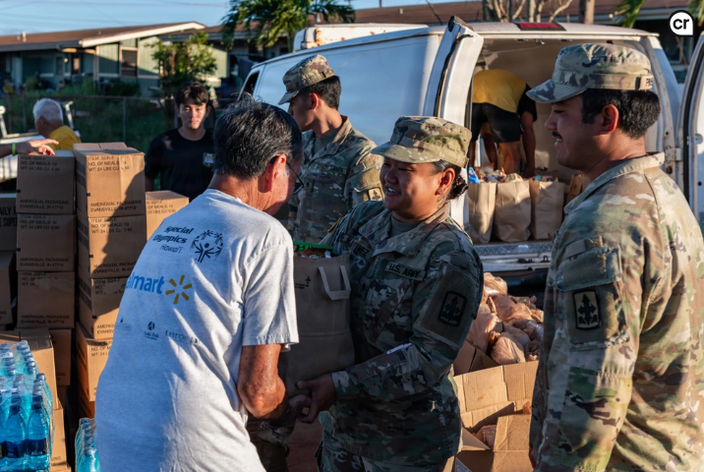
TAKE PHOTOS
Take Photos, Write Captions, & Get Published / UPAR Training

Slide 25
What to take photos of
State emergency activation
Unusual or noteworthy training programs
Change to your unit's equipment, force structure, or mission
Visits by dignitaries or well-known personalities
Public service projects or charitable works
Drug demand reduction programs
Major awards, honors, or individual achievements
Open house or ceremonies
Interesting new equipment or aircraft
training for Overseas deployments
Cost saving solutions
Events that have an impact on the local environment
Annual training for your unit
Officer and Noncommissioned Officer academy graduations
Presentation of awards and decorations to your unit
Construction or significant remodeling/repair of facilities
Changes to recruiting/retention benefits
Take Photos, Write Captions, & Get Published / UPAR Training

Slide 26
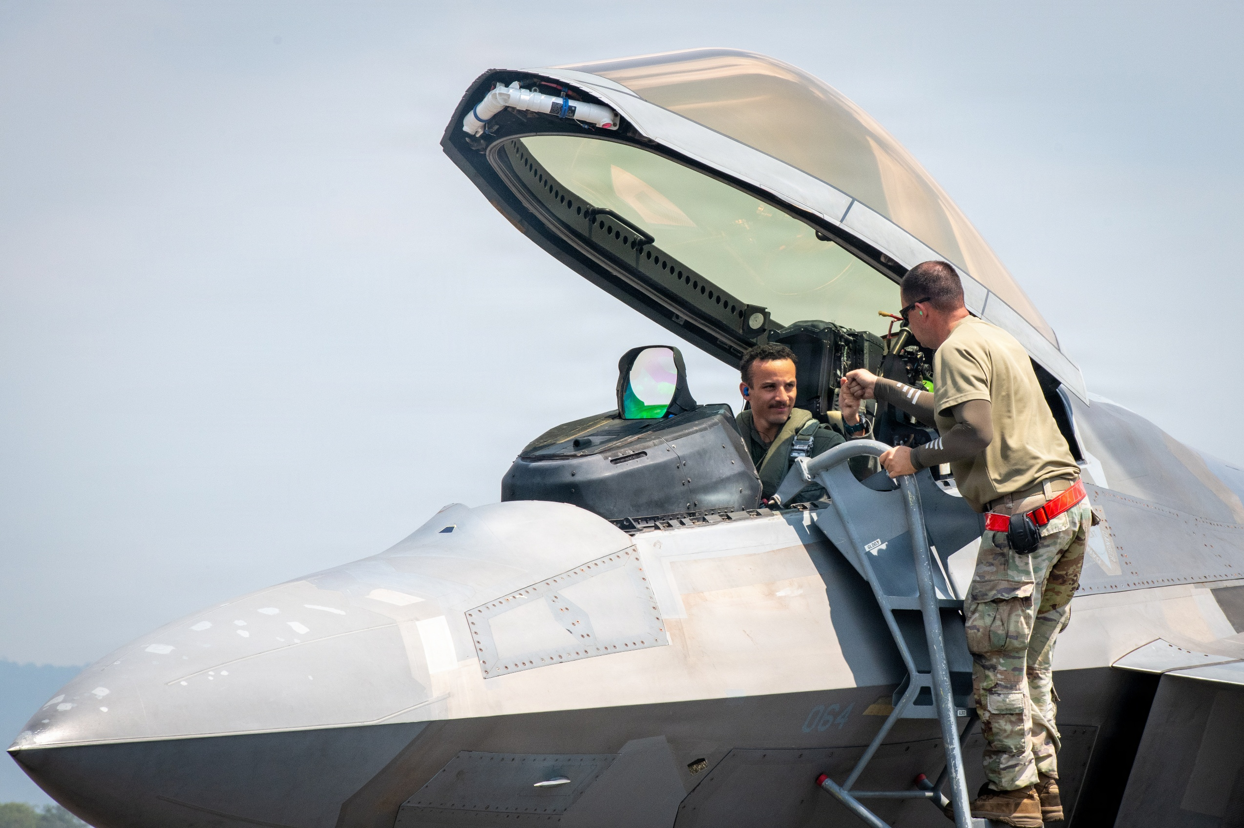
Photos
“Faces and Patches”
Less “Shaka” photos
Catch subject doing something, not looking at camera
Less pics at desks
Action: begin shooting before the subject starts moving through the scene.
Take Photos, Write Captions, & Get Published / UPAR Training

Slide 27
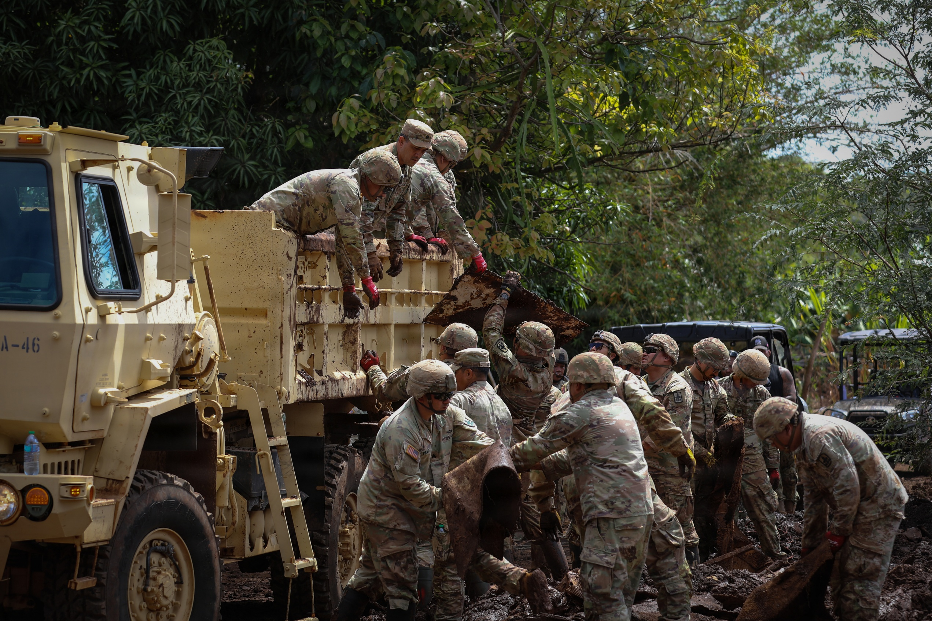
Photos – Things to Look For
What is in the background?
Is everyone in proper uniform? (No Badges)
Proper PPE
No hands in pockets
Not to standard- injured, belly hanging out, non-reg hair, pens, tilted hat
If eyes closed; mouth open
Avoid backs of heads
Take Photos, Write Captions, & Get Published / UPAR Training

Slide 28
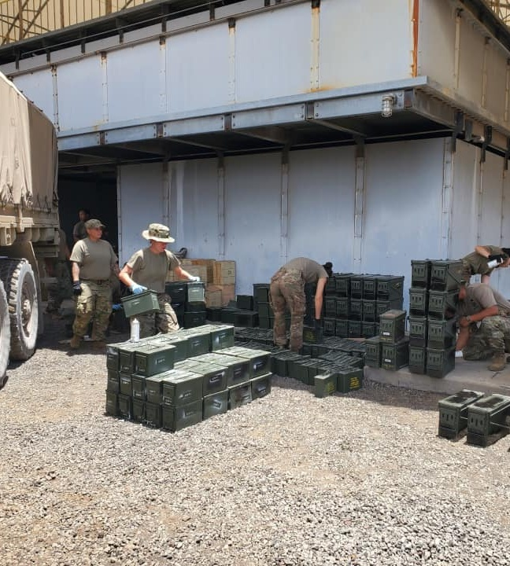
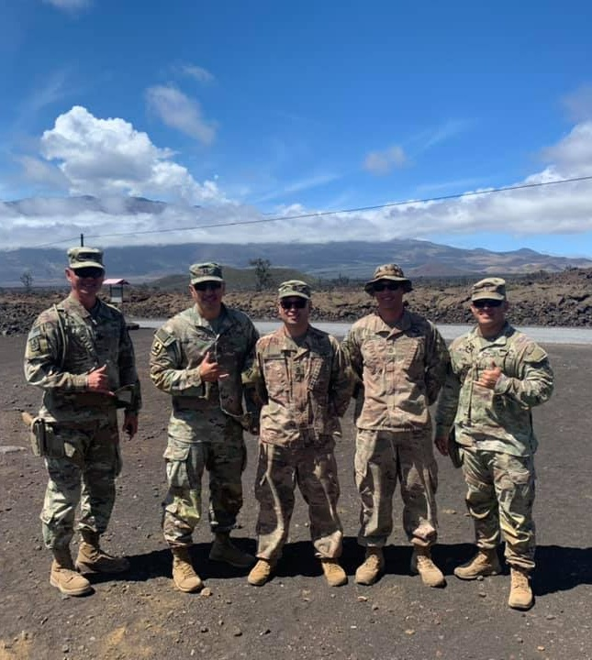
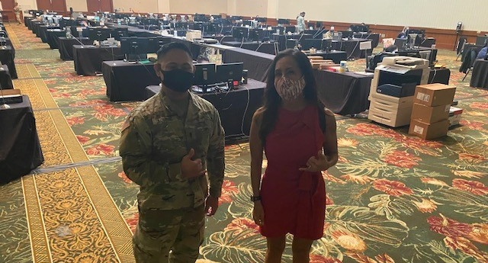
More to Look For
Backlit subjects
Shadows on face
“Photo bombers”
No faces, but butts and backs
Cigarettes/ vapes, phones in hands
Muzzle awareness
OSHA violations- safety
Product endorsement
Middle fingers (it happens!)
Take Photos, Write Captions, & Get Published / UPAR Training

Slide 29

Taking Pictures with Your Smart Phone
Get close to the action, but do not interfere, restrict movement, or compromise safety
  Do a practice run
Focus on your subject tap the screen
Don’t stop shooting
  Burst mode
  Review your photos after event
Prepare ahead of time battery life & storage space (Be at rehearsals)
Take Photos, Write Captions, & Get Published / UPAR Training

Slide 30
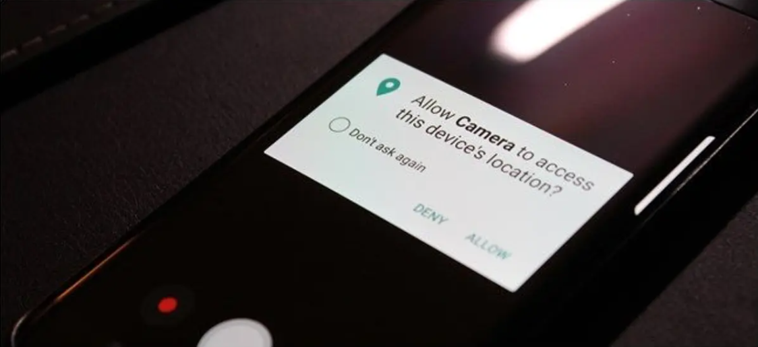
Smartphone Tips
Turn off GEO tagging on your phone
High dynamic range- setting to help with low light
Turn off the camera sound
Helpful hint: airplane mode
Take Photos, Write Captions, & Get Published / UPAR Training
Notes:
HDR settings: (High Dynamic Range), HDR photo is created by balancing the shadows and highlights of an image so that neither is being favored or ignored

Slide 31
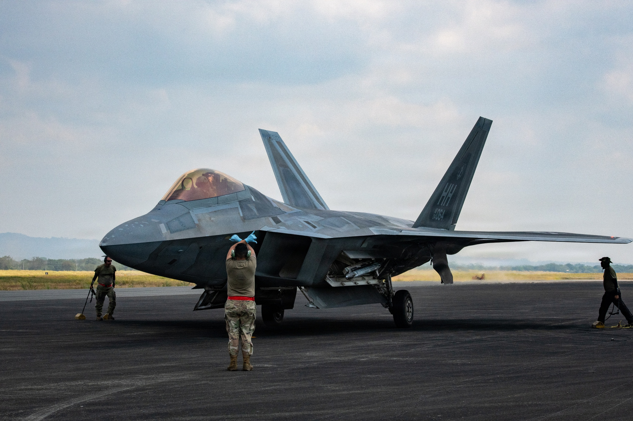
Enable Gridlines on Your Smart Phone
IOS
Setting
Camera
Under composition
  Switch on grid
Android
Camera
Setting
Switch on grid lines
Take Photos, Write Captions, & Get Published / Basic UPAR Training

Slide 32


Rule of Thirds
Place your subject in the cross hairs for a more “balanced” photo
If your subject is moving, leave empty room to move in and out of the frame.
Take Photos, Write Captions, & Get Published / UPAR Training

Slide 33

Photos – Using Angles
Eye level
Top view
High angle
Framed view / Hidden view
Low angle
Off-center
Action
Static shot
Focal Point
Take Photos, Write Captions, & Get Published / UPAR Training

Slide 34
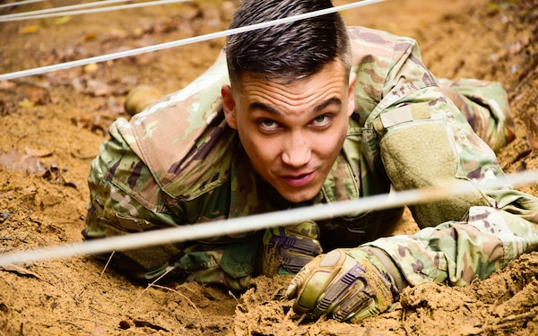
Eye Level
Take Photos, Write Captions, & Get Published / Basic UPAR Training
Notes:
Eye Level: camera / smartphone is placed at the same height as the eyes of the subject in your frame

Slide 35
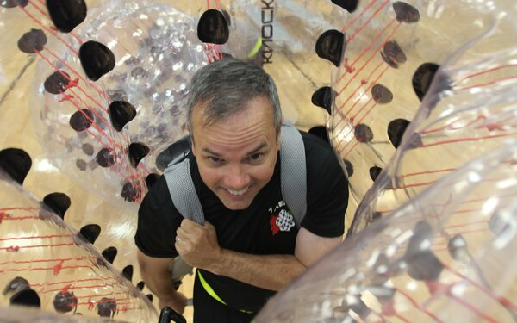
Top View
Take Photos, Write Captions, & Get Published / UPAR Training
Notes:
Top Angle: where the smartphone looks down on the subject

Slide 36
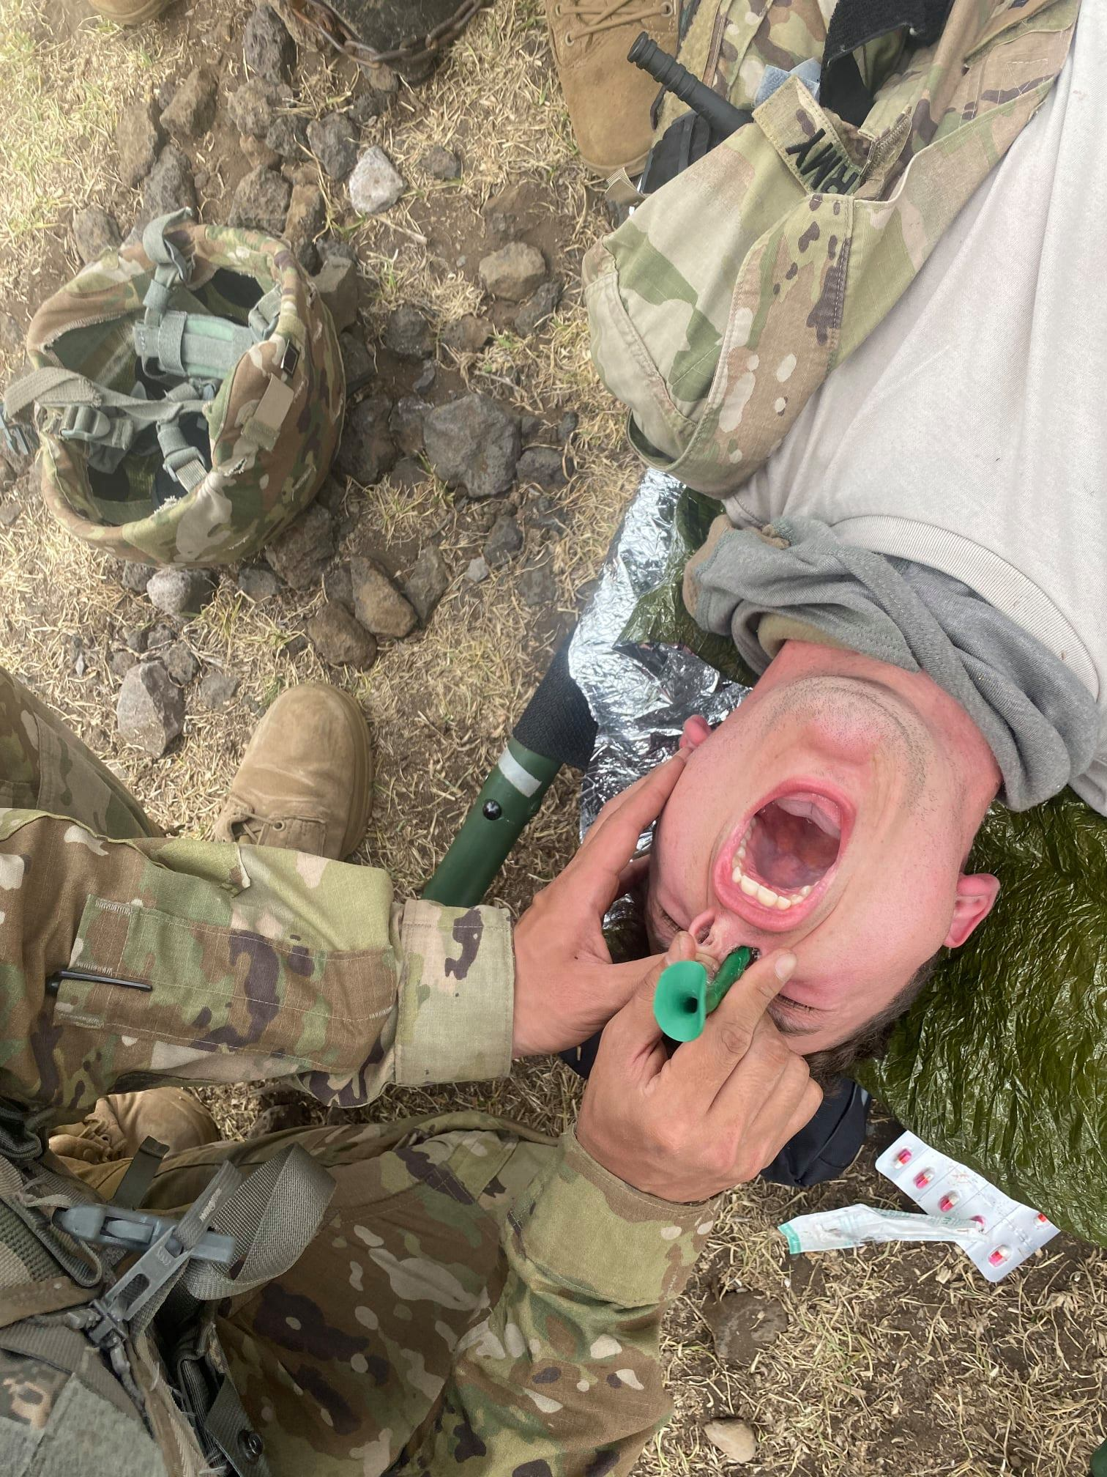
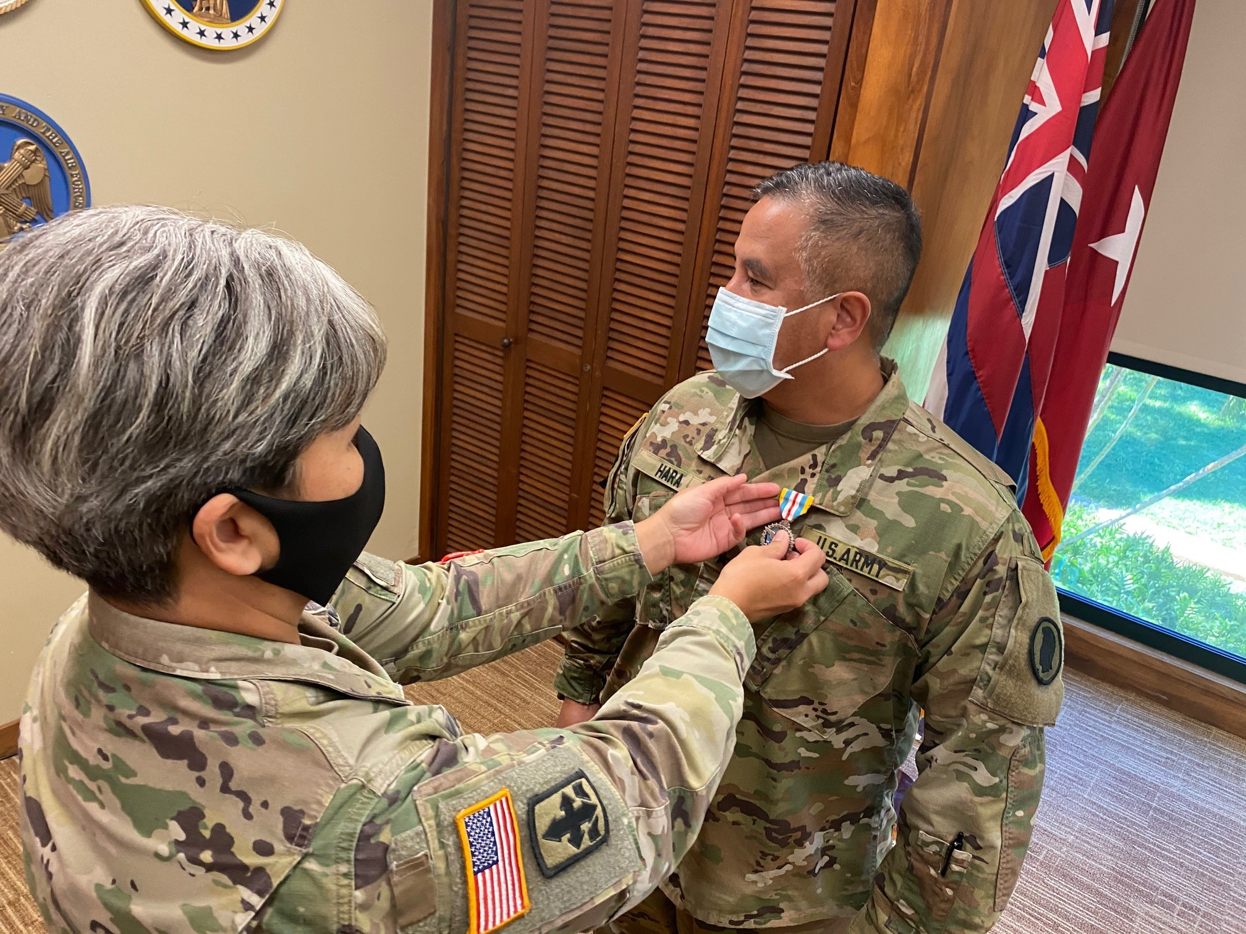
High Angle
Take Photos, Write Captions, & Get Published / UPAR Training
Notes:
A high-angle shot: placing the smartphone high about your head angled down on your subject. Similar to a top angle

Slide 37
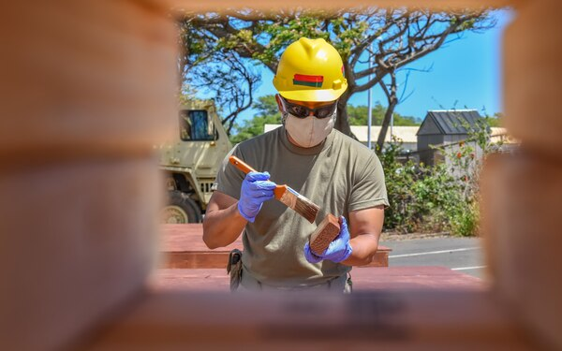
Framed/Hidden View
Take Photos, Write Captions, & Get Published / UPAR Training
Notes:
Framed / Hidden View: can be set and framed in any shot size you like, just as long as there is only one character featured within the frame

Slide 38
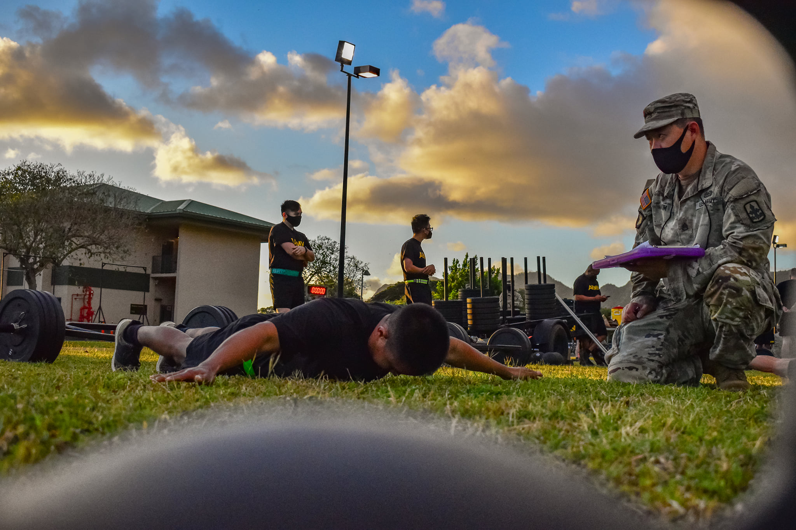
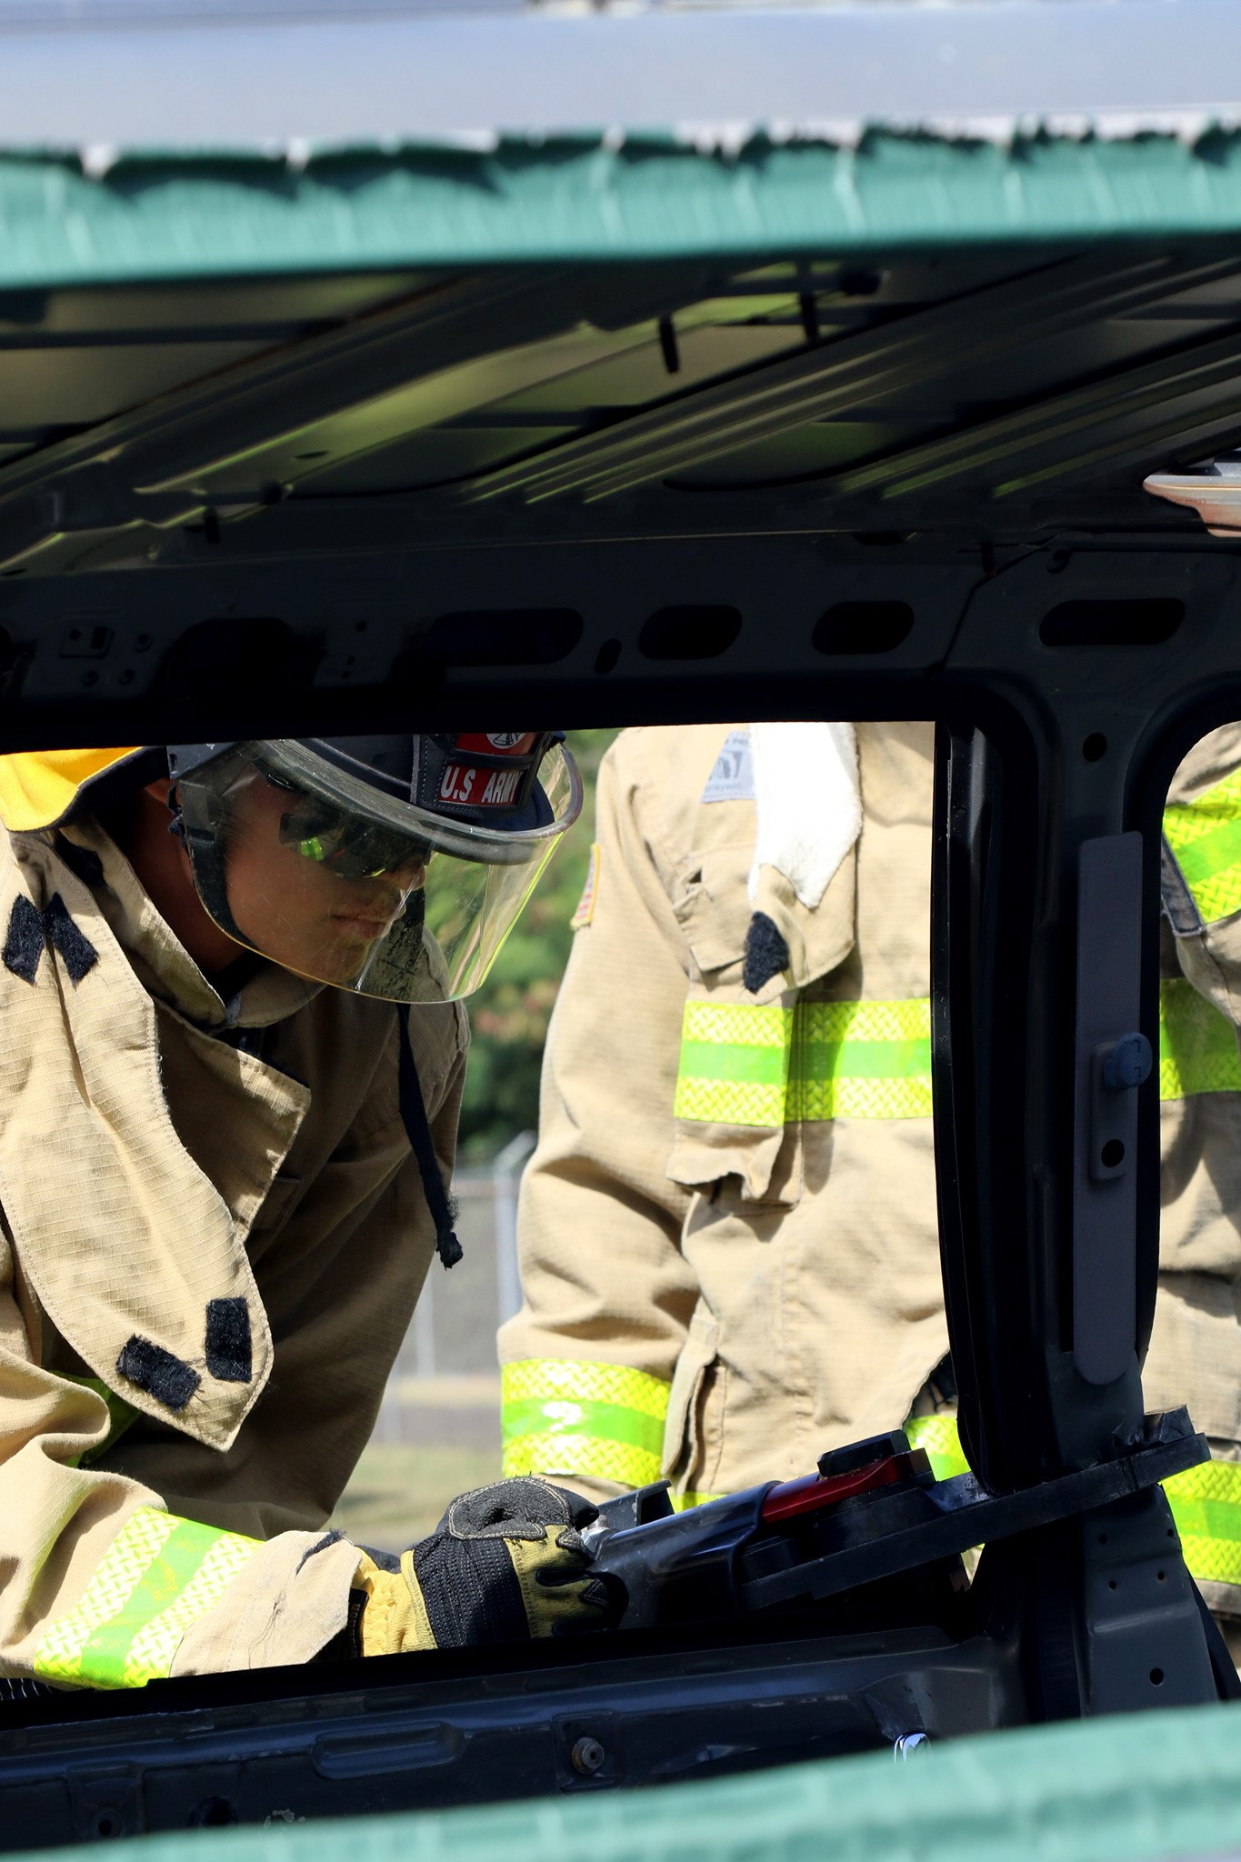
Framed/Hidden View
Take Photos, Write Captions, & Get Published / UPAR Training
Notes:
Framed / Hidden View: can be set and framed in any shot size you like, just as long as there is only one character featured within the frame

Slide 39
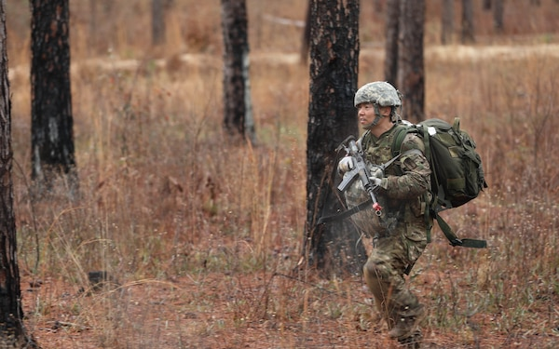
Off-Center
Take Photos, Write Captions, & Get Published / UPAR Training
Notes:
Space in front of the subject

Slide 40
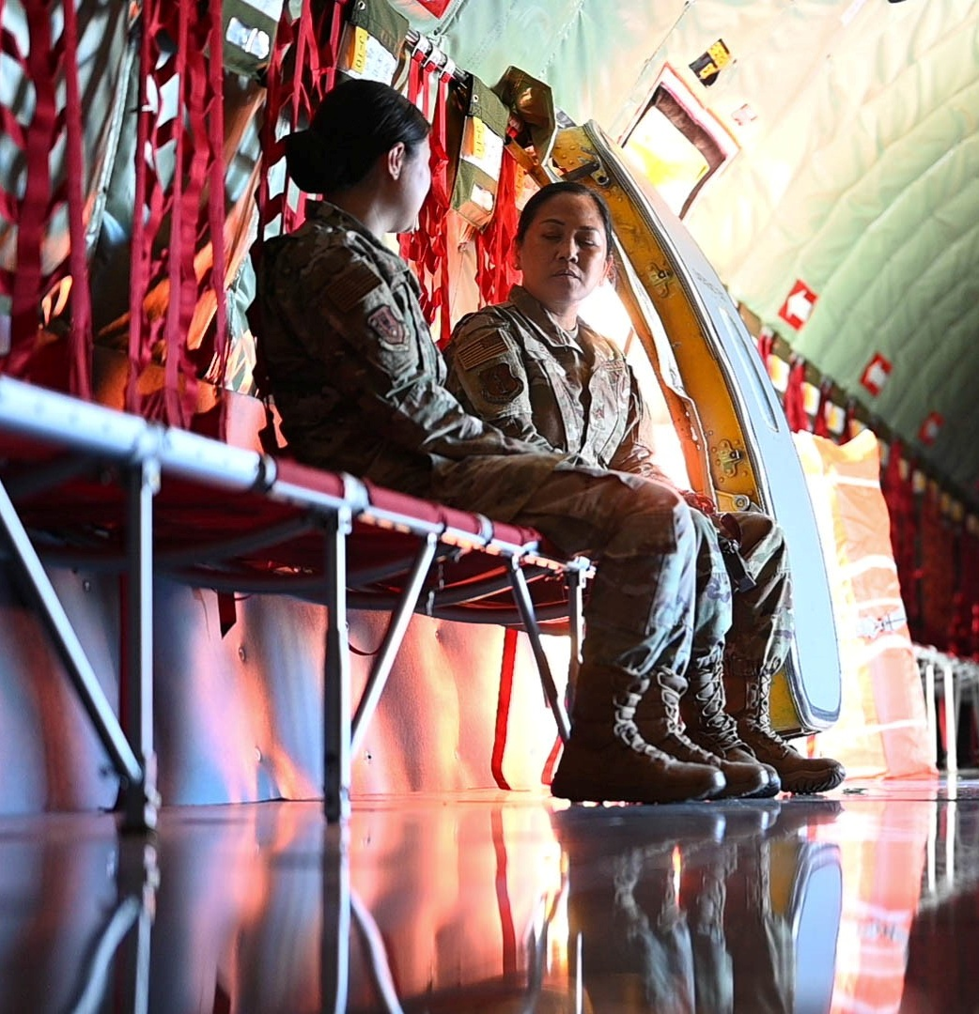
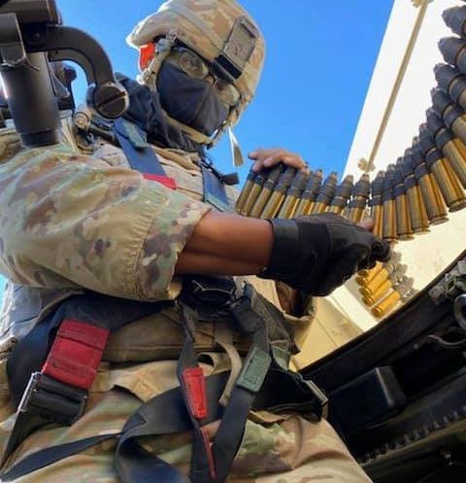
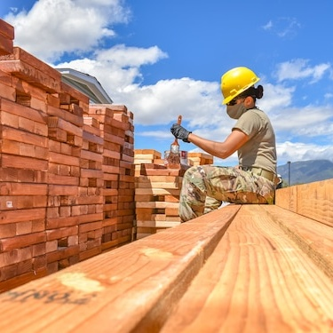
Low Angle
Take Photos, Write Captions, & Get Published / UPAR Training
Notes:
Low Angle: conveys a number of emotions or feelings about the subject in the frame, it gives them power
You can get low, or you can just hold the camera low

Slide 41
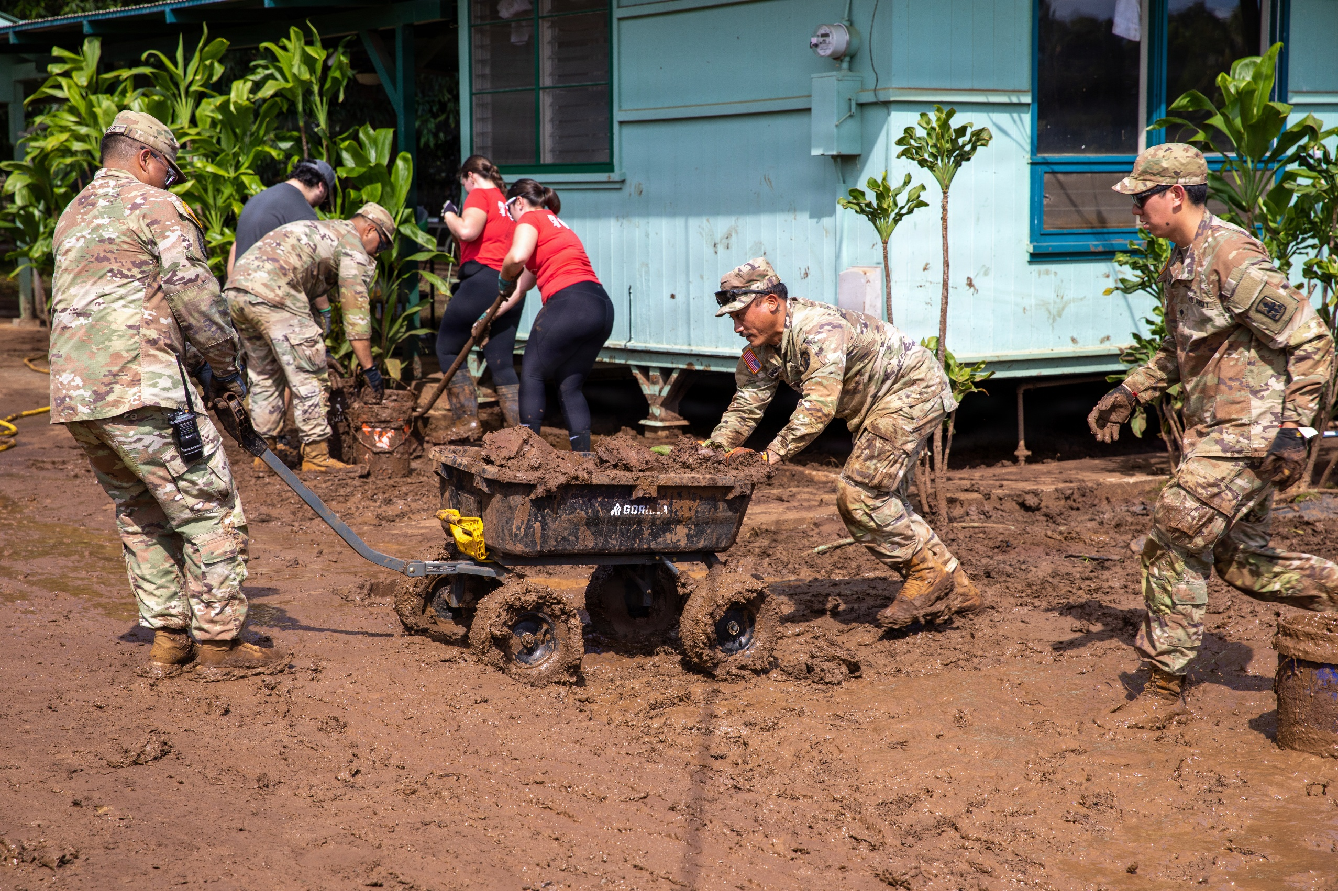
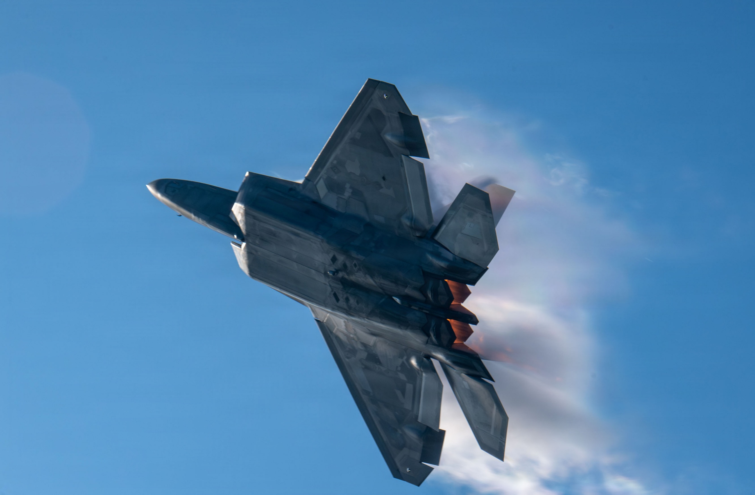
Action
Take Photos, Write Captions, & Get Published / UPAR Training

Slide 42
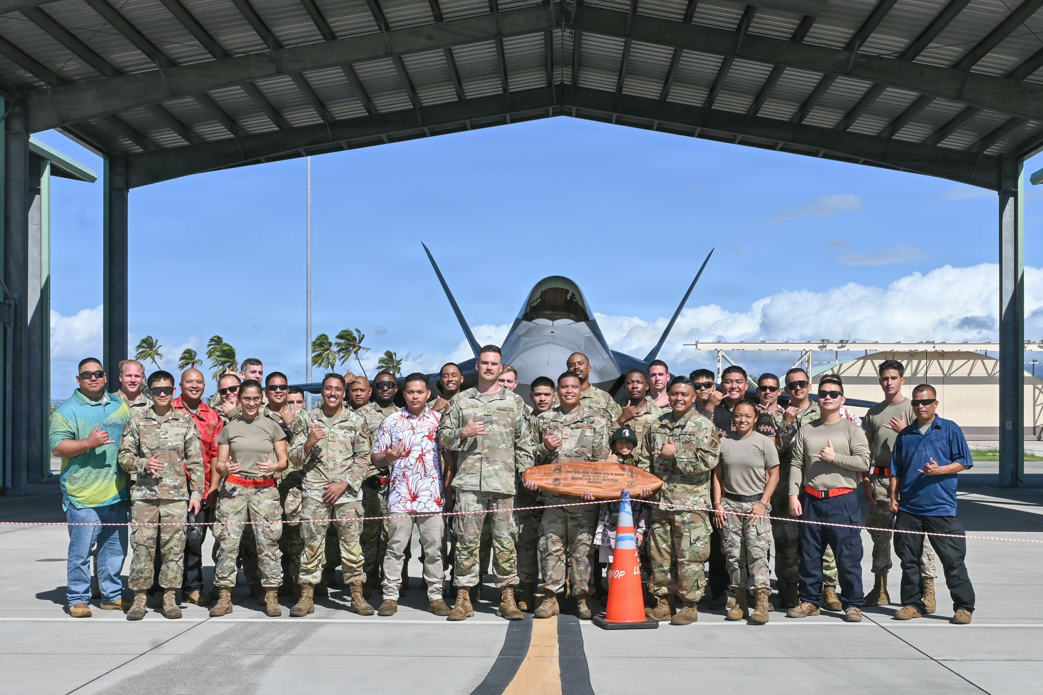
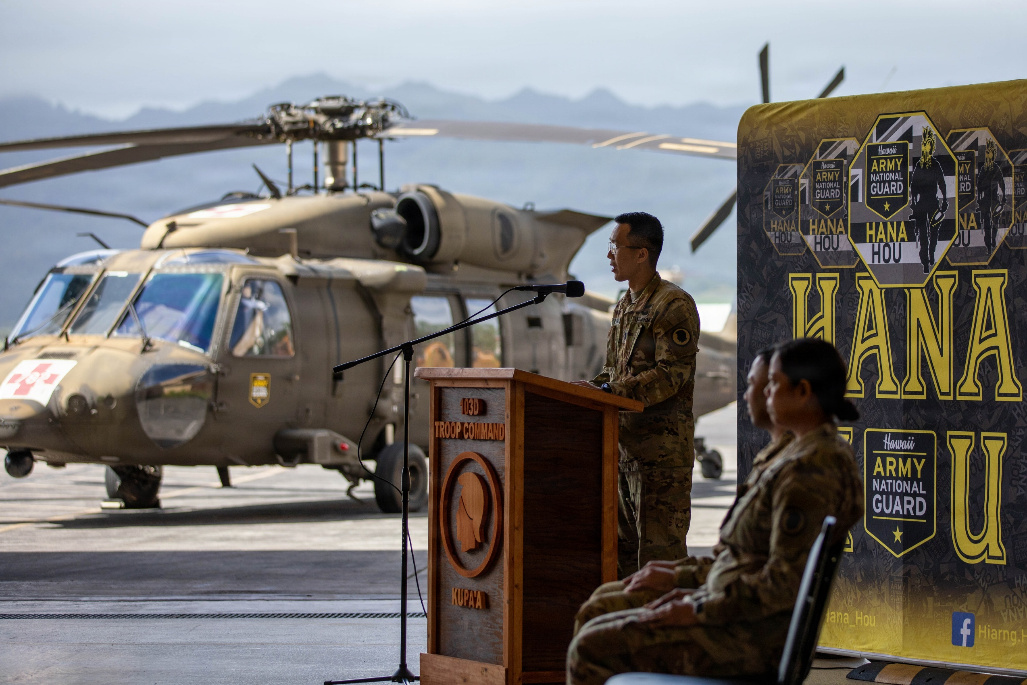
Static Shots
Take Photos, Write Captions, & Get Published / UPAR Training

Slide 43
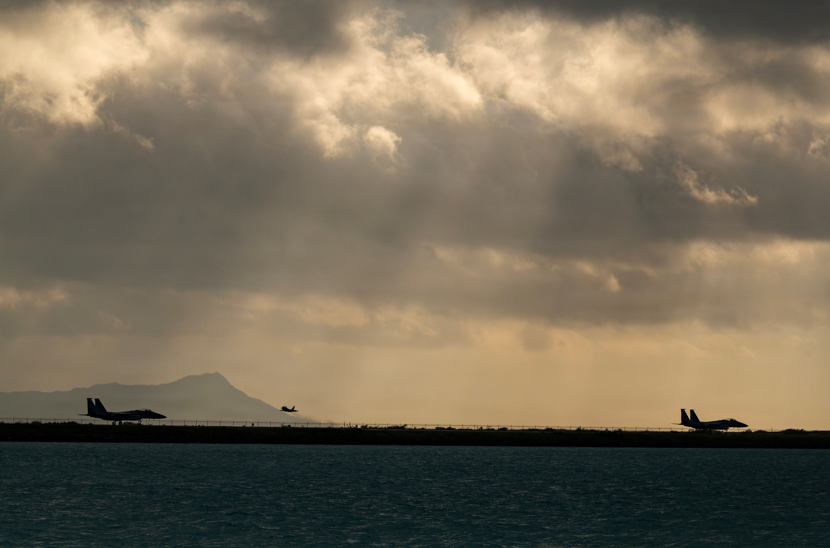
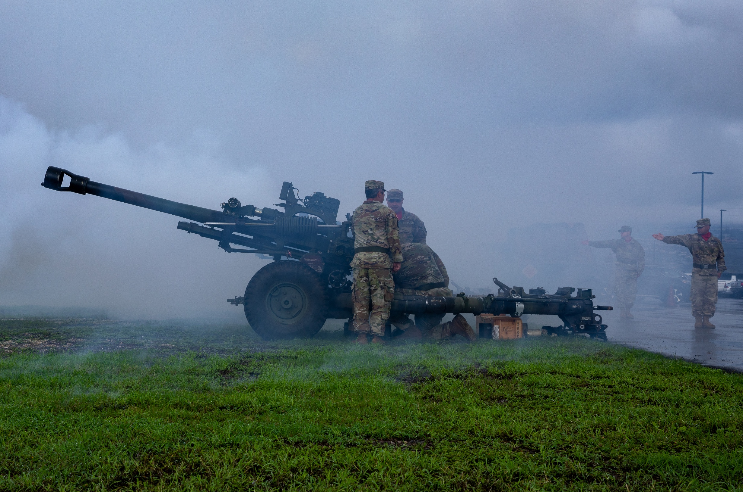
Cool Stuff
Take Photos, Write Captions, & Get Published / UPAR Training

Slide 44
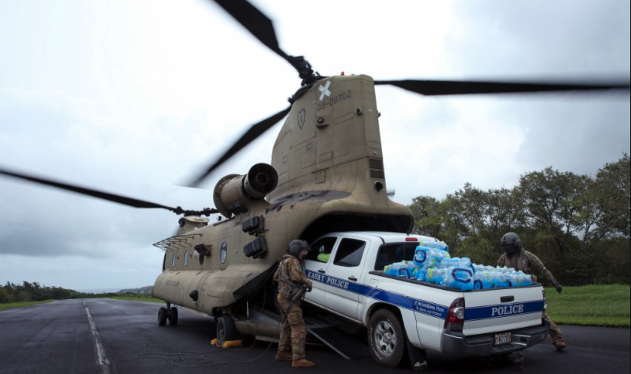
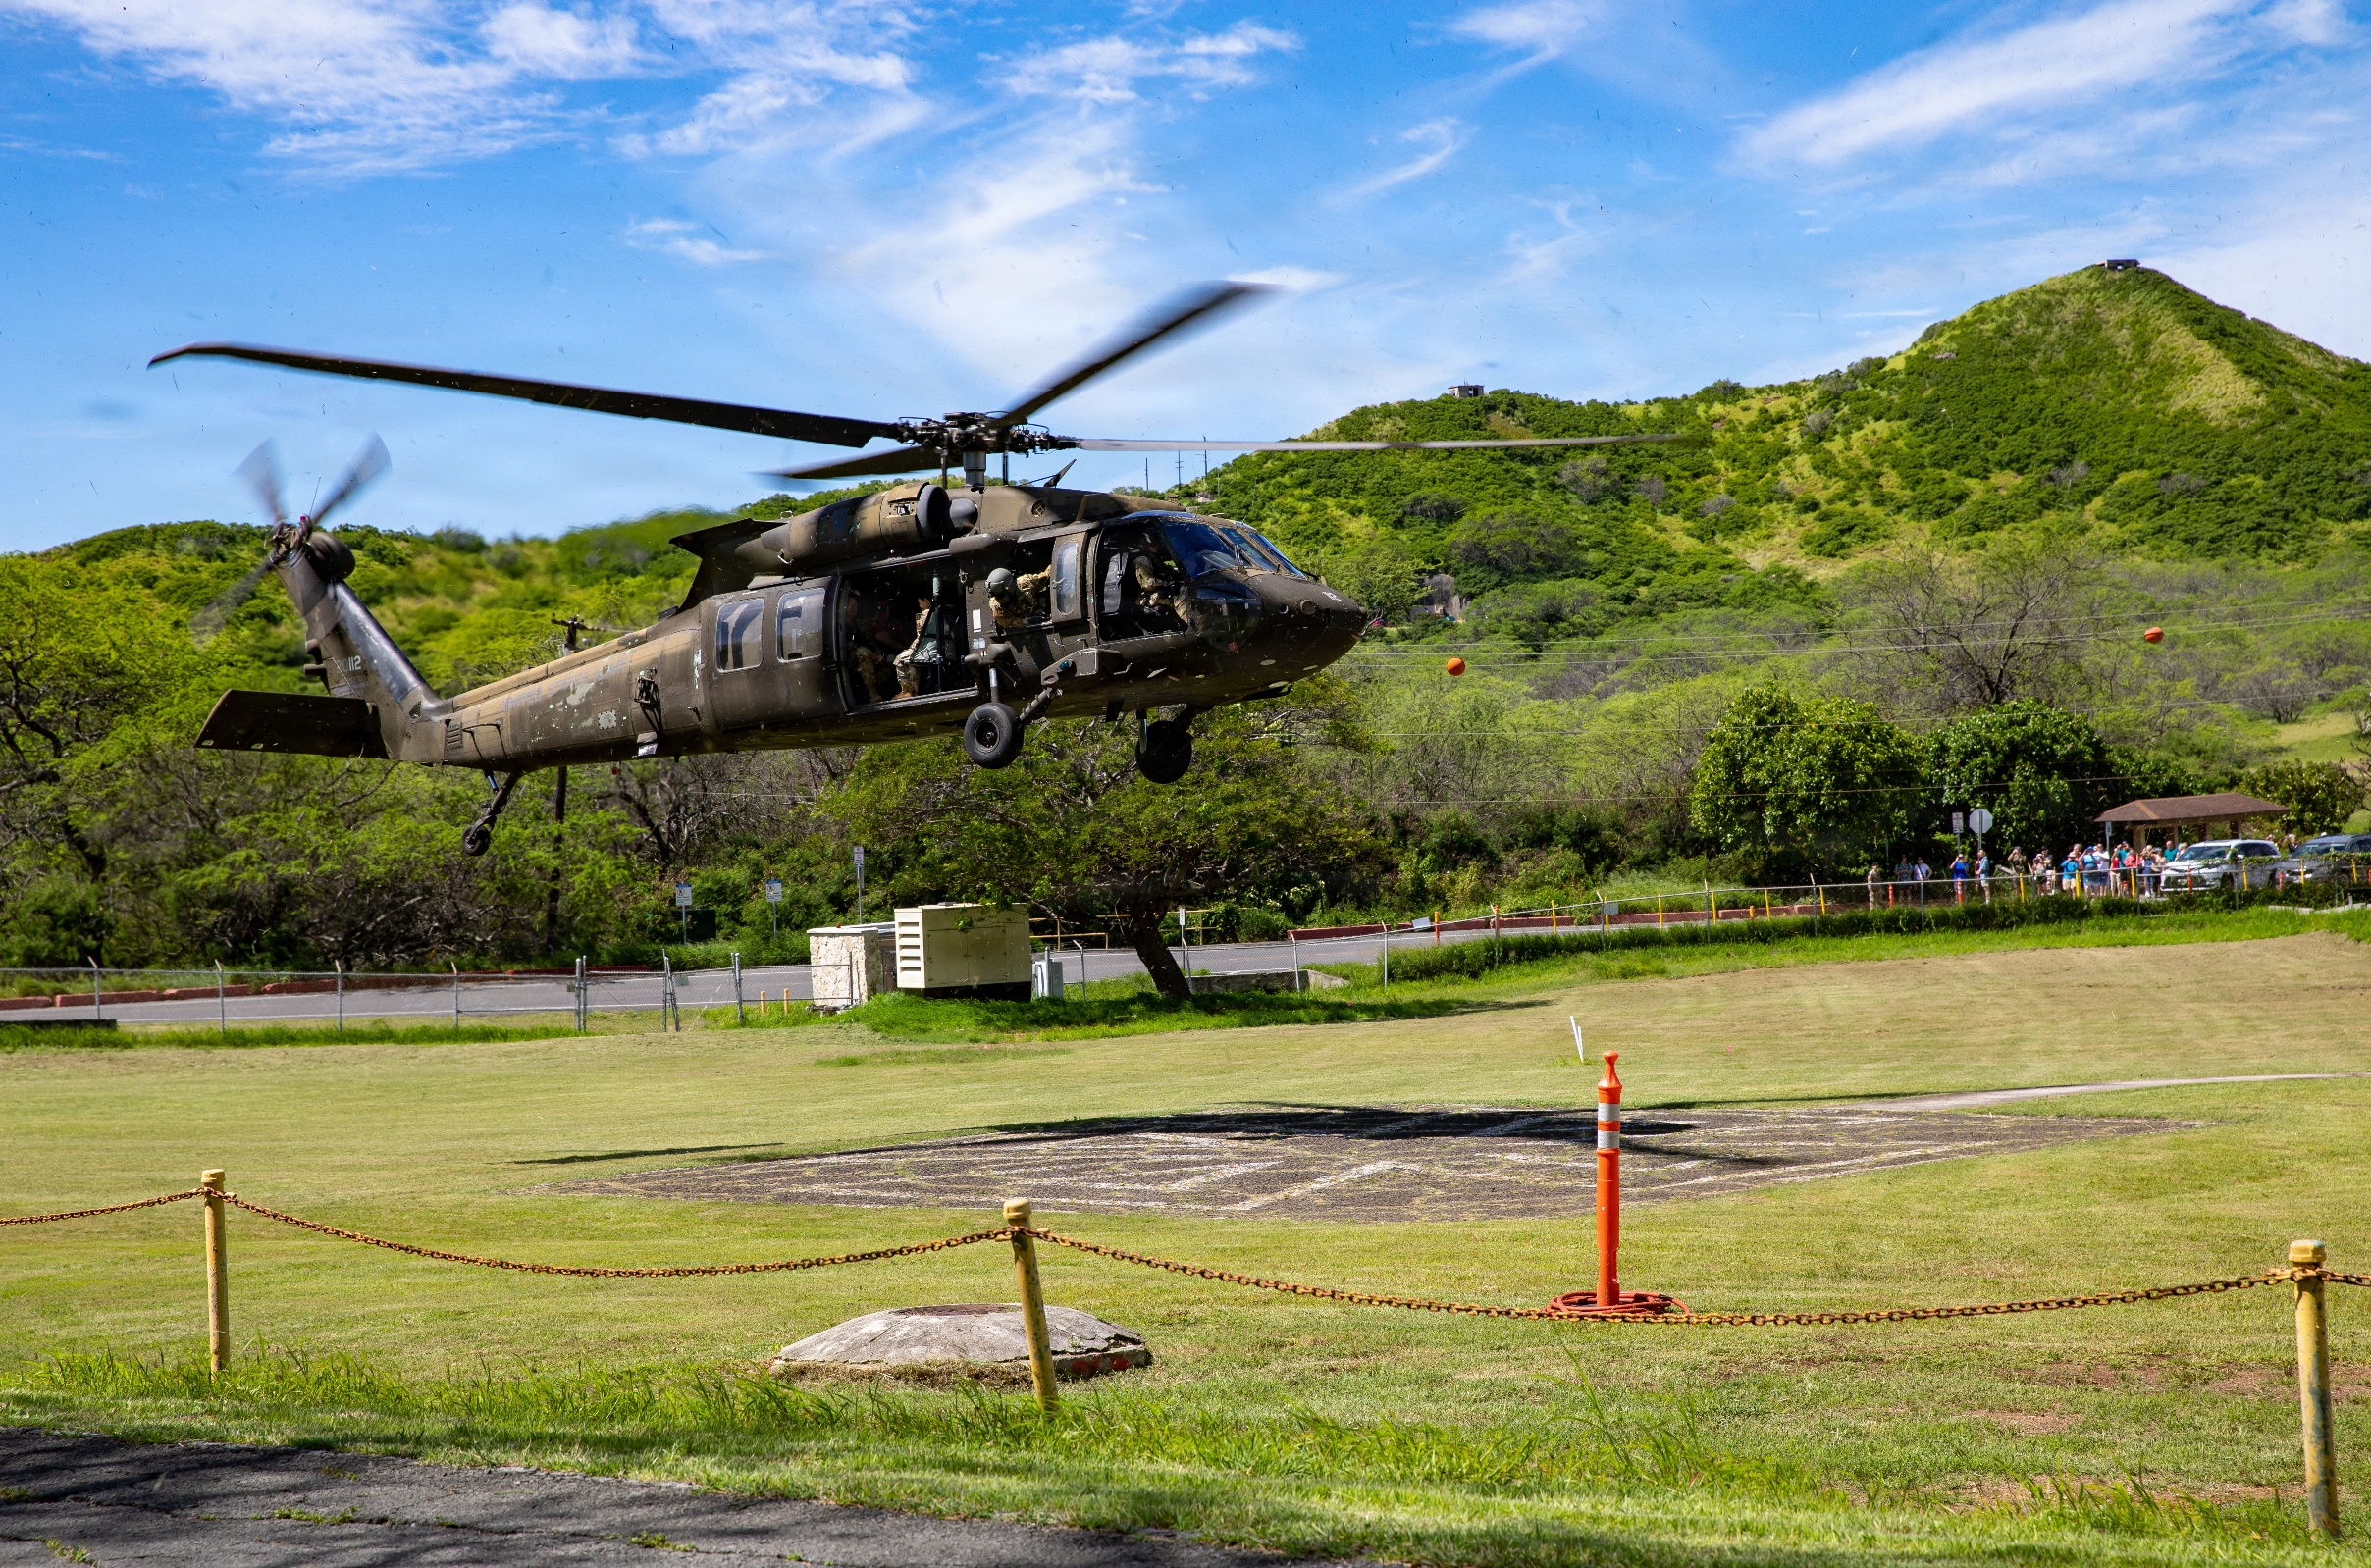
“Good” Helicopter Shots
Take Photos, Write Captions, & Get Published / UPAR Training

Slide 45
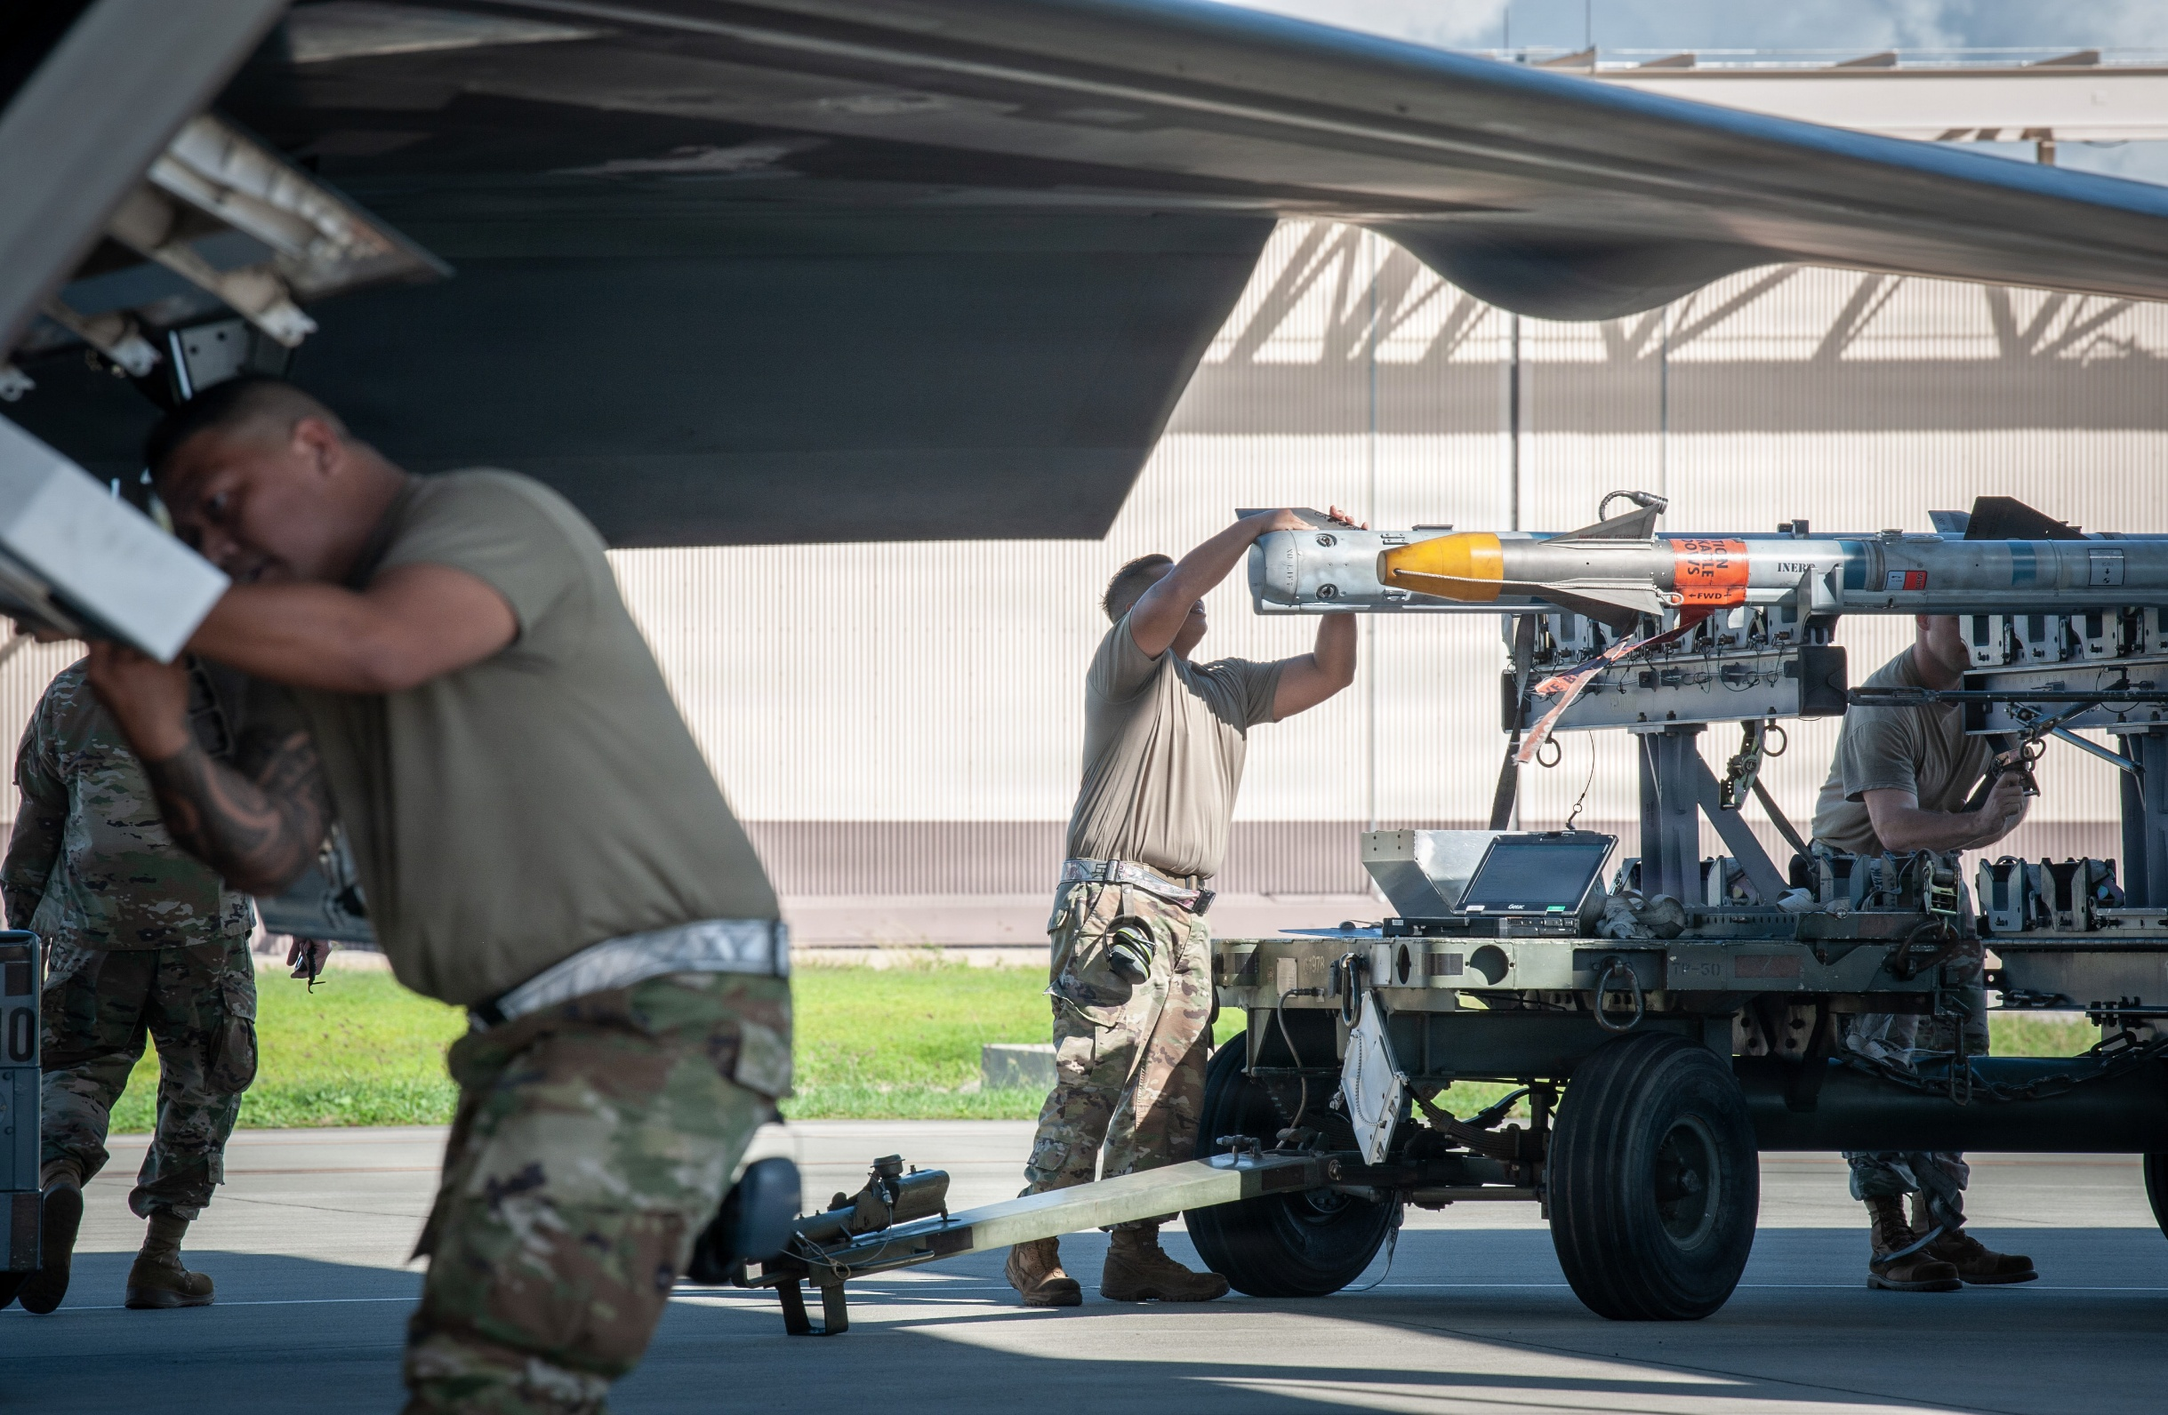
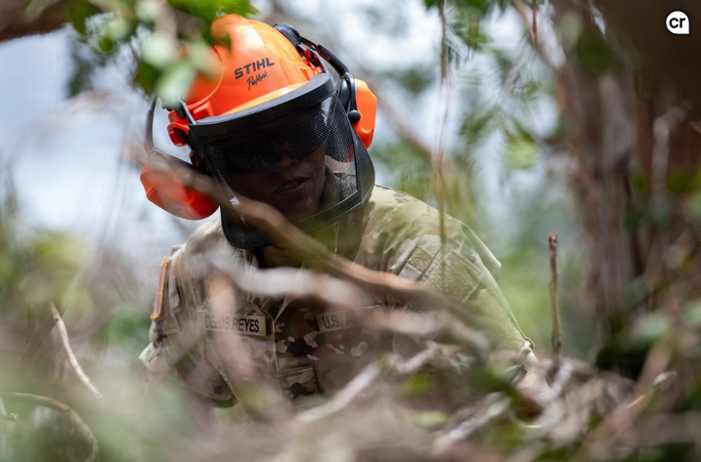
Focal Point
Take Photos, Write Captions, & Get Published / UPAR Training

Slide 46
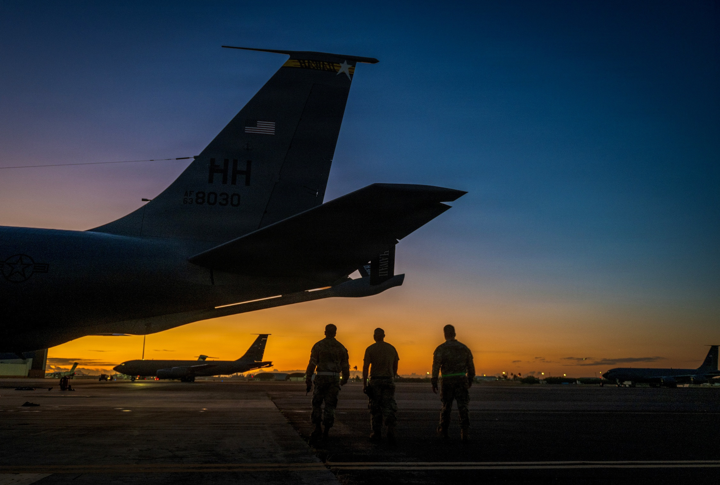
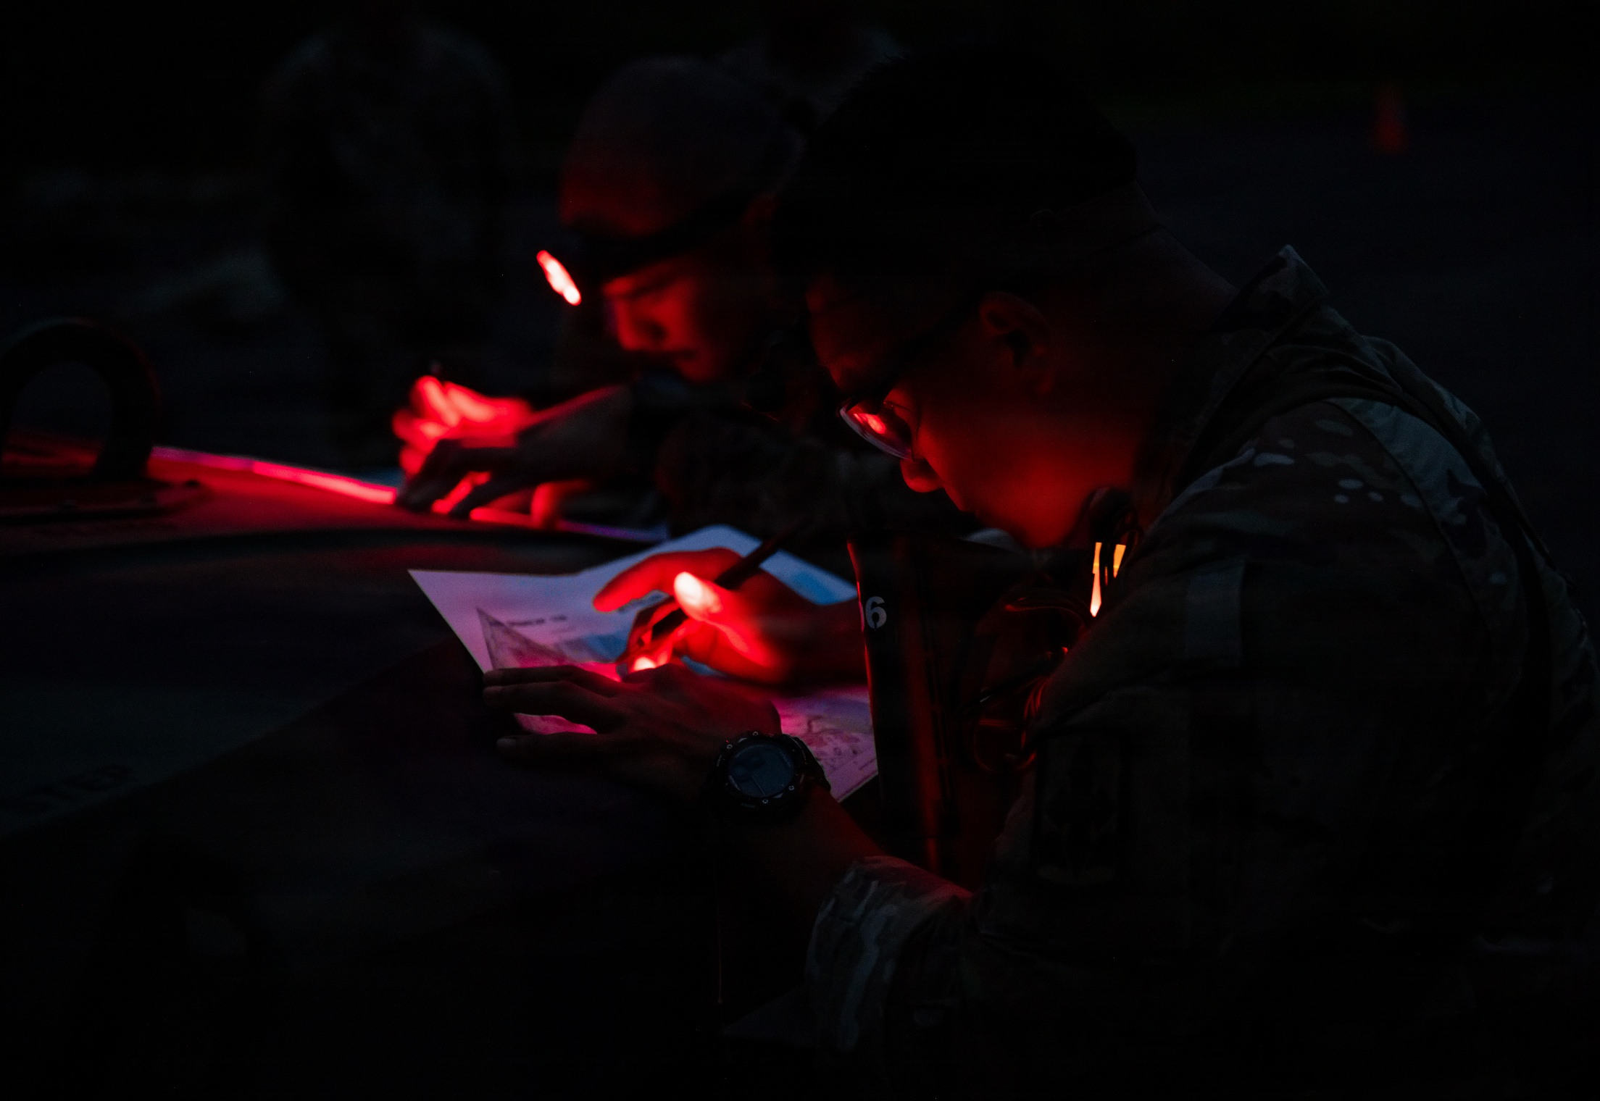
Lighting
Take Photos, Write Captions, & Get Published / UPAR Training

Slide 47
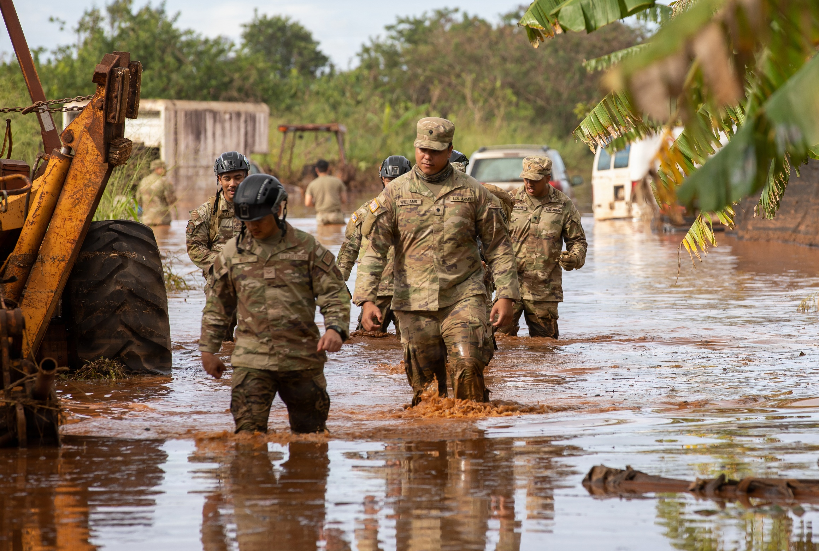
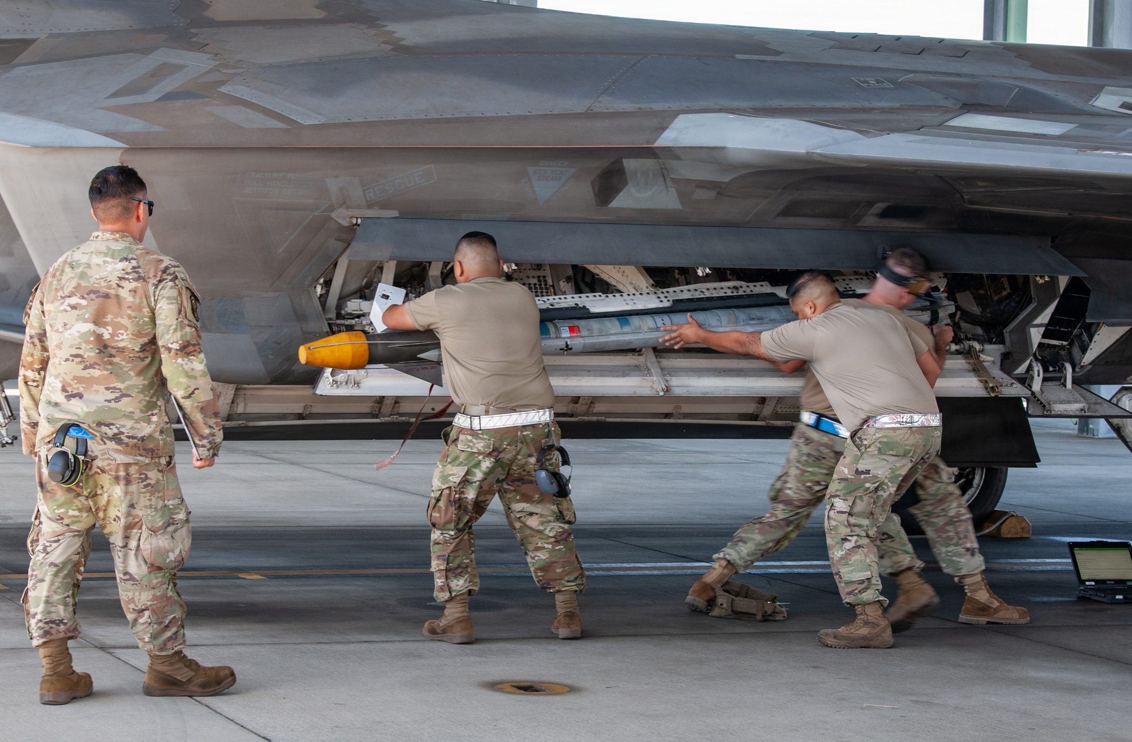
People in Motion
Take Photos, Write Captions, & Get Published / UPAR Training

Slide 48
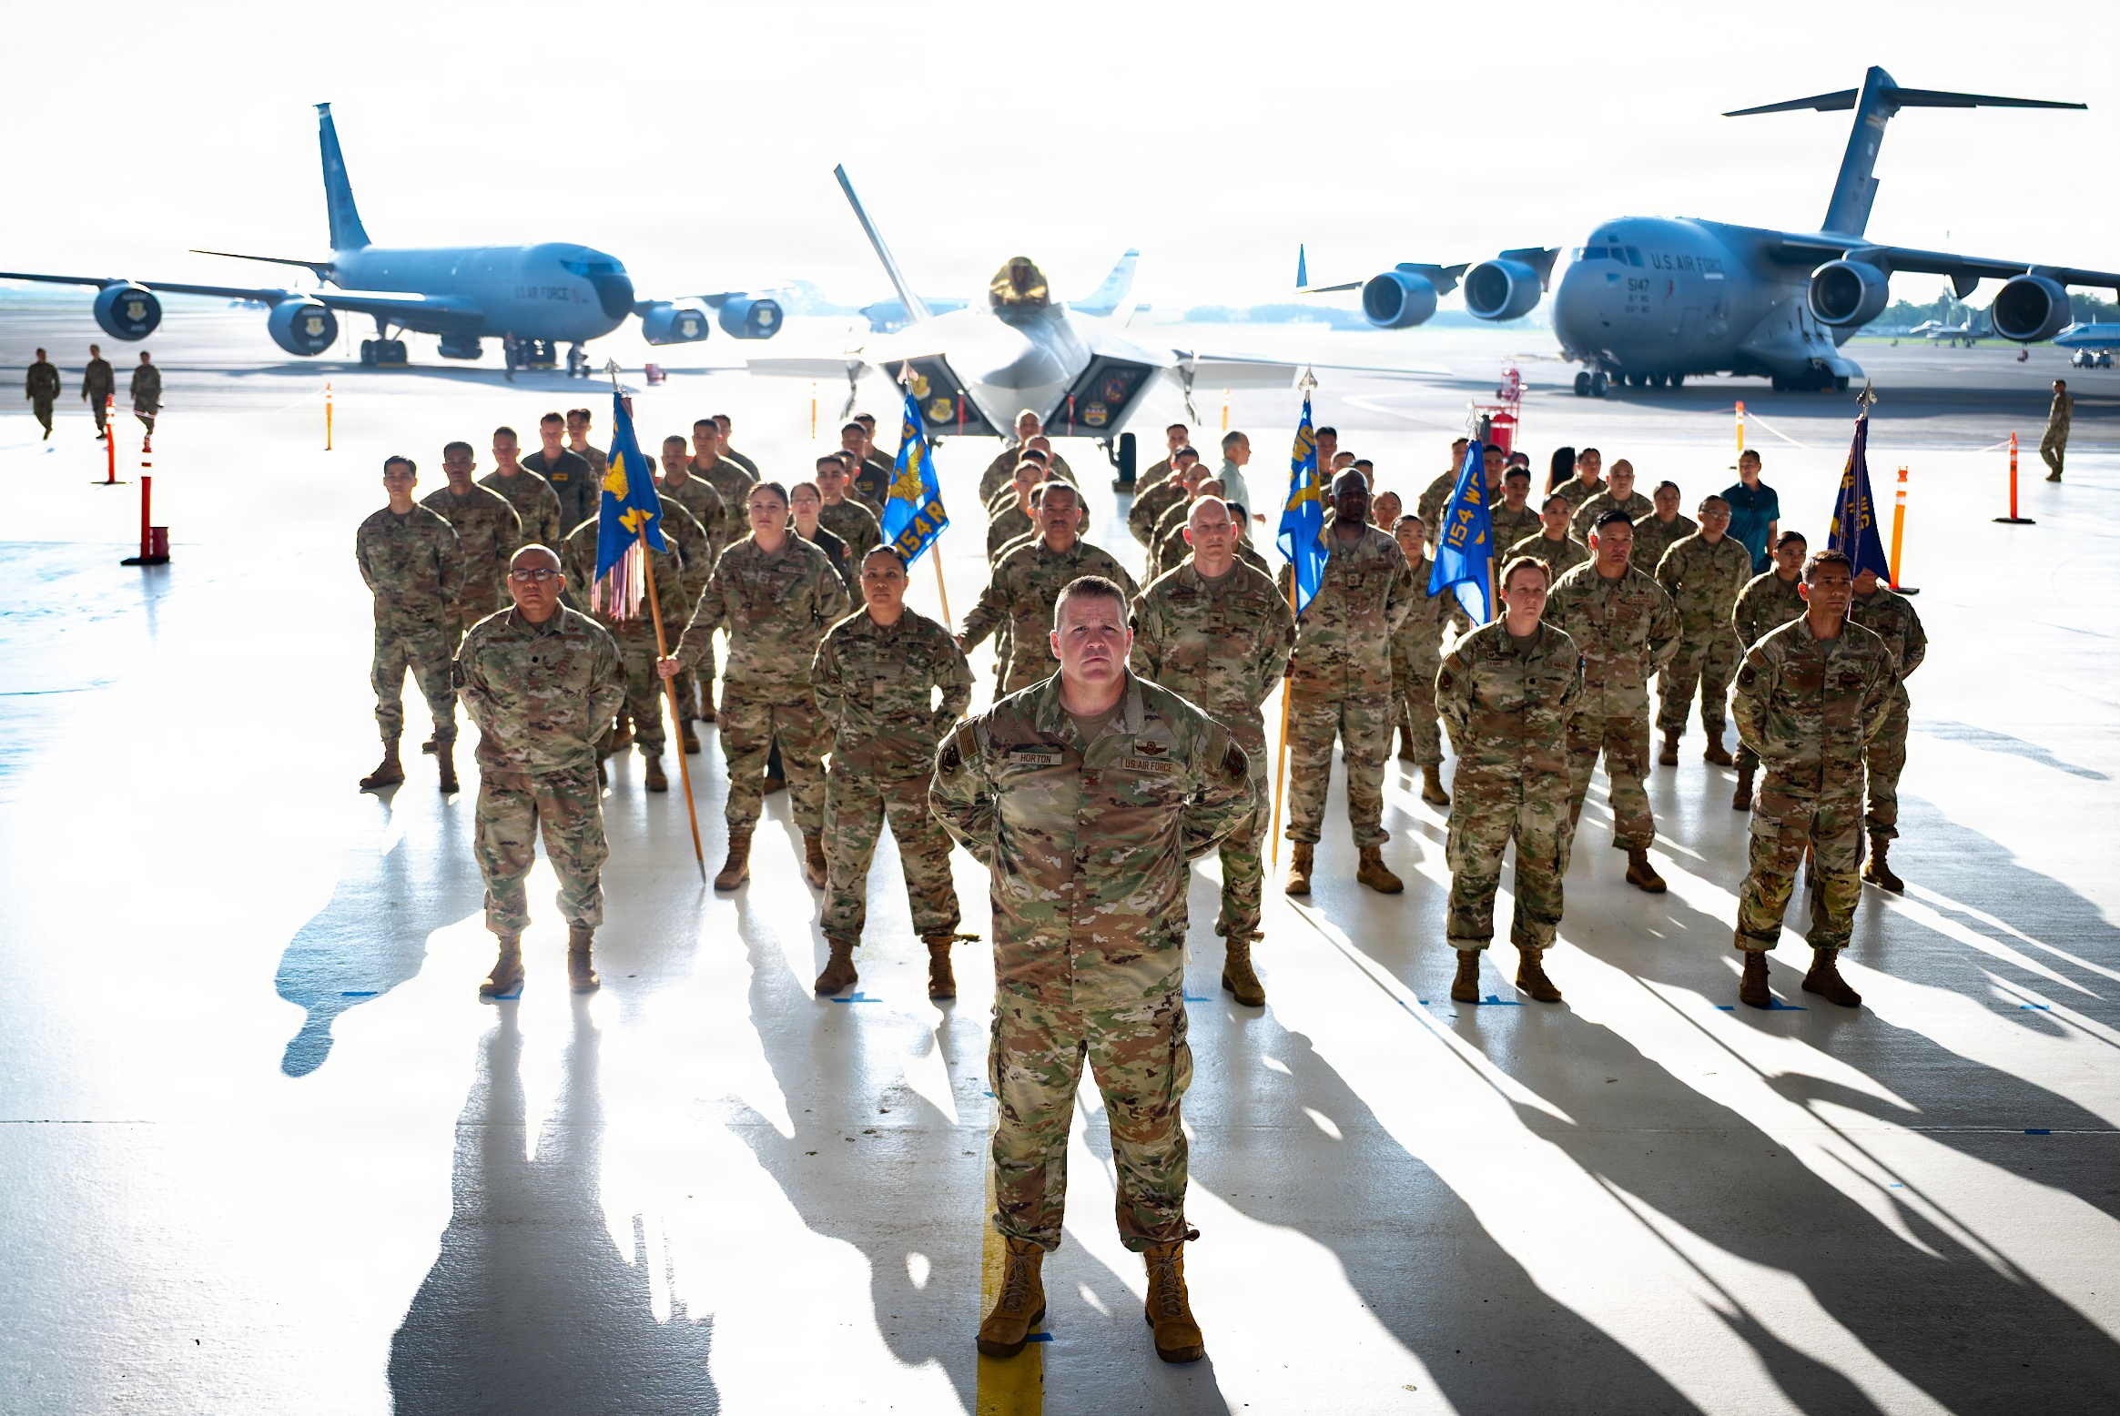
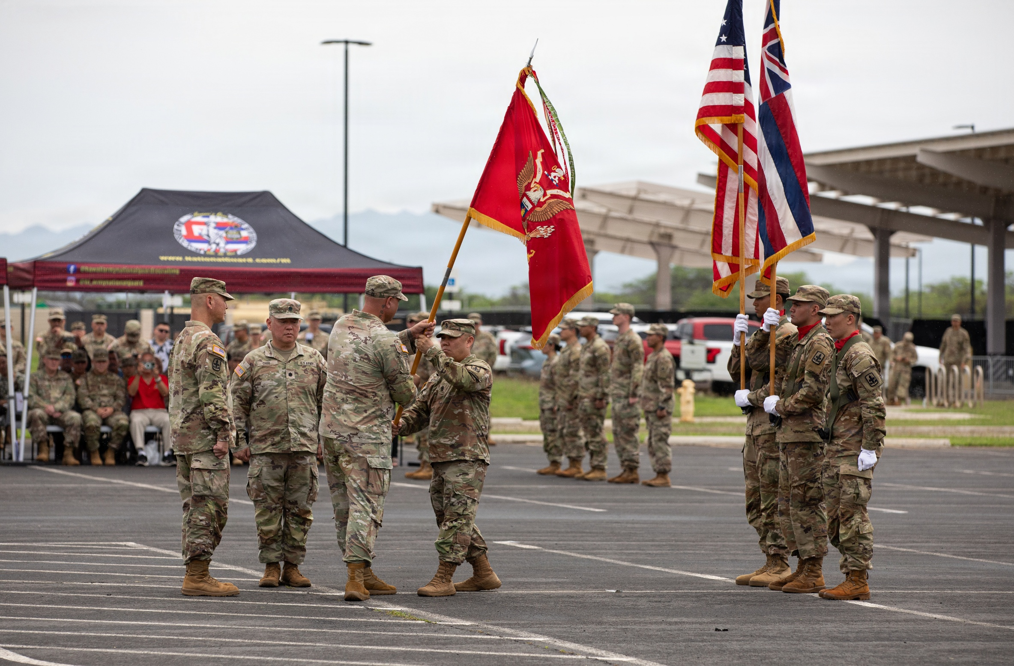
Ceremonies
Take Photos, Write Captions, & Get Published / UPAR Training
Notes:
Rehearsals, you move around action, expected “money shots” that should be captured, easy to get up close, you know where action will be
Other- equipment, formations, PT, office, field….more challenging, shoot plenty, review later, find the good nuggets, action and posed shots will be

Slide 49
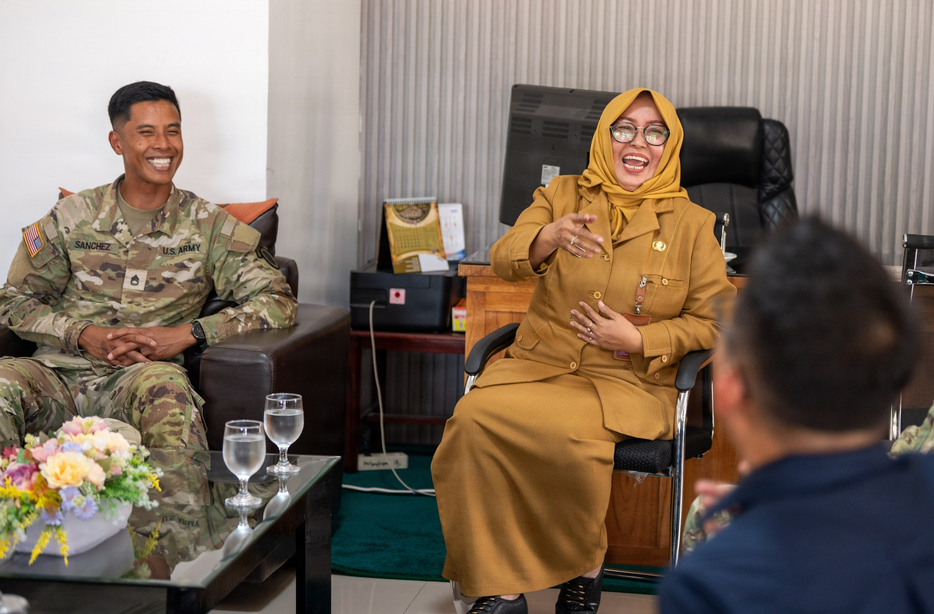
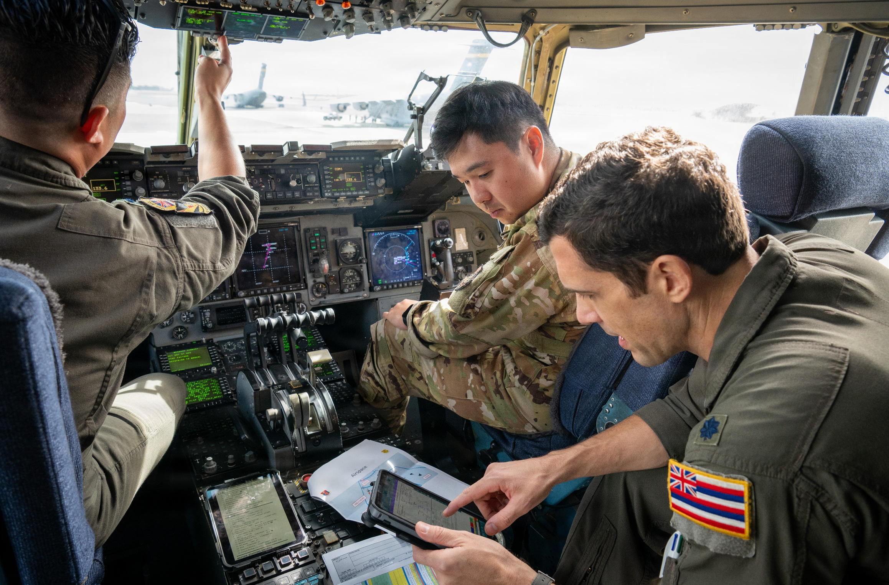
Candid
Take Photos, Write Captions, & Get Published / Basic UPAR Training
Notes:
Hands in pockets, proper PPE, eyes open, body language is positive, don’t make subjects look bad
Candid vs posed
Focus on the face- without any context or background scenery, a face can express a lot.
It’s also constantly changing from emotion to emotion, giving you an endless source of interesting shots
A prime spot to look for candid photos is in a group or pair of people

Slide 50
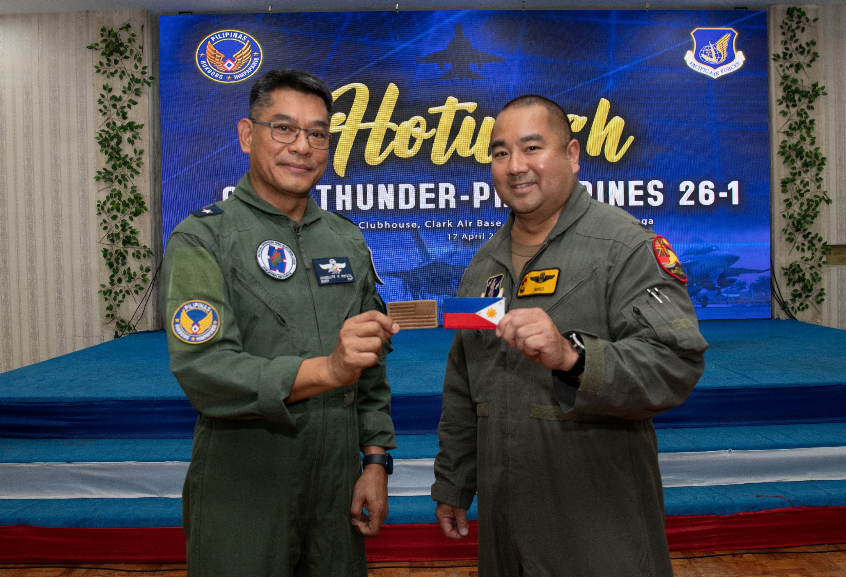
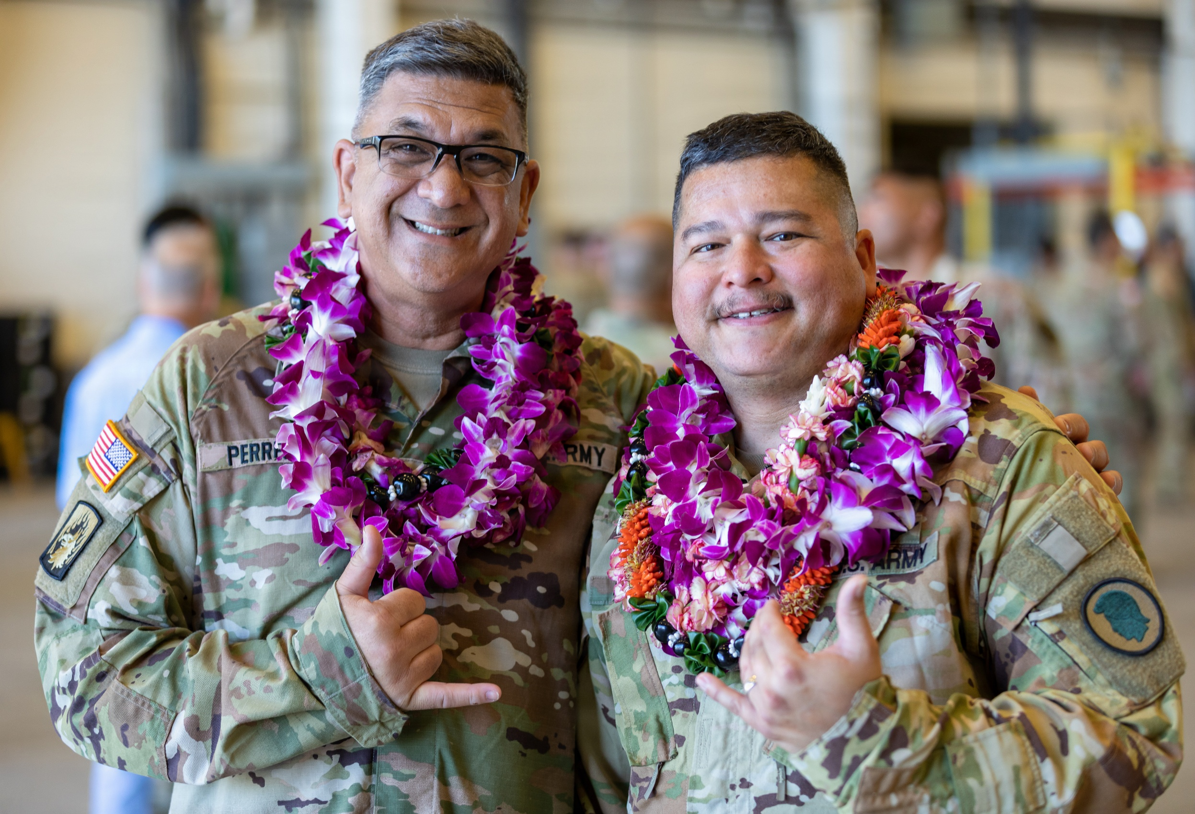
Posed
Take Photos, Write Captions, & Get Published / Basic UPAR Training
Notes:
Posed Award or promotion ceremony.
Get Close and Watch Your Subjects Without Being Noticed
Turn off the Flash to Stay Discreet
Move Around Your Subjects for Better Composition
Shoot in Burst Mode to Capture Every Moment

Slide 51


What NOT to Do
Take Photos, Write Captions, & Get Published / UPAR Training
Notes:
Promotion on left- she has a puppet on her hand while taking the oath of office. Big no go! And she was a PAO.
Dude on right is all kinds of wrong. I don’t know what status he is, I don’t know if he knew either.

Slide 52



What NOT to Do
Take Photos, Write Captions, & Get Published / UPAR Training
Notes:
PPE- masks not covering nose
Background- OPSEC, maps or lists or statuses of equipment
Tonguing a POW sign
Jumping out of airplane with a fish, then taking a pic of it. Dumb.
People like flipping the camera off at the end of a course. Please don’t do this.

Slide 53




A Series of Photos Can Tell a Story
Establishing shot
Long shot
Medium shot
Close-up
Extreme close-up
Vary angles and distance
Take Photos, Write Captions, & Get Published / UPAR Training
Notes:
Establishing Shot: lets the audience know the setting for the scene they're about to watch
Long Shot: a view of a scene
Medium Shot: is a shot that frames the subject from just above their head down to about midway on their torso.
Close-up: faces
Extreme Close-up: hands on an instrument or turning a wrench

Slide 54
Practical Exercise
Get up for a moment and grab a buddy
Take a few pictures of…
Take Photos, Write Captions, & Get Published / UPAR Training

Slide 55
Break!

Slide 56




What have UPARs done?
Take Photos, Write Captions, & Get Published / UPAR Training

Slide 57



What have UPARs done?
Take Photos, Write Captions, & Get Published / UPAR Training

Slide 58

WRITE CAPTIONS
Take Photos, Write Captions, & Get Published / UPAR Training

Slide 59
Captions
Tell the story behind the photograph
Short and clear
1-3 Sentences
Influence picture meaning
Complements the pic by relating to non-visual senses
Explain technical information
Photo credit (byline)
Take Photos, Write Captions, & Get Published / UPAR Training
Notes:
An explanation of what is going on in a photograph and why it is important to the audience.
If possible include command messages

Slide 60

Elements of a Basic Caption
WHO is in the photo? Full ID (Rank, name, unit and MOS) if less than three people
WHAT is in the photo? WHAT is the action taking place?
WHERE is the action taking place? (geographic location)
WHEN is the action taking place? (date, training event)
WHY is the action taking place? WHY does it matter?
Take Photos, Write Captions, & Get Published / UPAR Training

Slide 61

Caption
U.S. Army Sgt. 1st Class Bryan Hinkle, a flight paramedic, and Sgt. Curtis Wright, a HH-60 Black Hawk helicopter repairer and crew chief assigned to Detachment 1, Golf Company, 3rd Battalion, 126th Aviation Regiment, Hawaiʻi Army National Guard, prepare a simulated patient for litter transport from a HH-60 Black Hawk helicopter by medical technicians from the 908th and 911th Aeromedical Staging Squadrons during Exercise Nexus Forge at Schofield Barracks, Hawaiʻi, Feb. 6, 2025. Nexus Forge allows participants to experience the full depth of tactical combat casualty care and deployment process, ensuring wartime combat readiness. (U.S. Army National Guard photo by Staff Sgt. Lianne M. Hirano)
Take Photos, Write Captions, & Get Published / UPAR Training

Slide 62

Caption
U.S. Air Force Senior Master Sgt. Wilda Morita, 154th Maintenance Operations Squadron senior enlisted leader, waves from the backseat of a 173rd Fighter Wing F-15 Eagle April 15, 2025, at Joint Base Pearl Harbor-Hickam, Hawaiʻi. During Exercise Sentry Aloha, Morita experienced an incentive flight, accommodated by visiting F-15 personnel, to gain firsthand insight into the challenges fighter pilots face, whose missions are supported by her critical work in the Maintenance Operations Flight. (U.S. Air National Guard photo by Senior Master Sgt. Mysti Bicoy)
Take Photos, Write Captions, & Get Published / UPAR Training

Slide 63

Caption
Rotary wing aviators from the Hawai‘i Army National Guard and the Armed Forces of the Philippines held a key leader engagement on ‘Oahu during the first week of March 2025. The engagement included 103rd Troop Command Commander Col. Phoebe Inigo, State Army Aviation Officer Lt. Col. Deanna Manriquez, Philippine Air Force 205th Tactical Helicopter Wing Commander Brig. Gen. Alvin Hate and select members of their respective staffs. (U.S. Army National Guard photo by Master Sgt. Andrew Jackson)
Take Photos, Write Captions, & Get Published / UPAR Training

Slide 64

Practical Exercise
Write a caption for this picture:
breaching exercise – demolitions, different explosive charge assembly and breaching methods
Spc. Sean McKee, a combat engineer
A Co., 227th BEB, 29th IBCT
unravels detonation cord
Schofield Barracks
March 2, 2025
trained alongside Reserve Soldiers
Take Photos, Write Captions, & Get Published / UPAR Training

Slide 65
Practical Exercise - Caption
U.S. Army Spc. Sean McKee, a combat engineer assigned to Alpha Company, 227th Brigade Engineer Battalion, 29th Infantry Brigade Combat Team, Hawaiʻi Army National Guard (HIARNG), unravels detonation cord during a breaching exercise on Schofield Barracks, Hawaiʻi, March 2, 2025. HIARNG’s engineers trained alongside U.S. Army Reserve Soldiers on demolitions and different explosive charge assembly and breaching methods to enhance the unit’s readiness and warfighting capabilities while showcasing their lethality to distinguished leaders observing the training. (U.S. Army National Guard photo by Staff Sgt. John Schoebel)
Take Photos, Write Captions, & Get Published / UPAR Training

Slide 66
Convention of Writing English
Proper Nouns
Word usage: their/they’re/there, your/you’re, its/it’s
Proper punctuation
Numbers: spell out 1-9, use numerals for the rest
Avoid passive voice (describing action)
  Active: U.S. Soldiers destroy confiscated ordnance.
  Passive: Confiscated ordnance is destroyed by U.S. Soldiers
Does not need to be 100% if sending to PAO. For unit-level release, keep it simple and as perfect as possible.
Take Photos, Write Captions, & Get Published / UPAR Training

Slide 67
Captions and AI
AI has improved over the years, still not perfect
Feed it key details
Ask for multiple versions, adjust tone, edit
  It can be obvious when AI is used
Double check the facts
Good way to get ideas
Take Photos, Write Captions, & Get Published / UPAR Training

Slide 68
Captions – Review
Tell the story behind the photograph
Allows the photo to be used by higher PA Element
Could be used to support a story or stand alone
IDs group shots
With a caption, photo can be used
For every shot you think is good, a caption is needed
Captioned photos help (Commander, Unit, PA)
Don’t forget your byline (“Who are you?”)
Take Photos, Write Captions, & Get Published / UPAR Training

Slide 69
Captions – Disaster
5 Ws: who, what, where, when and why
- Task Force Maui, debris clearance, upcountry, today, Hurricane support
First 48hrs after the disaster: SPEED
First week after the disaster: variety and community support
Take Photos, Write Captions, & Get Published / UPAR Training

Slide 70
Break!

Slide 71

Get Published
Take Photos, Write Captions, & Get Published / UPAR Training

Slide 72
Approved & Published
The job is not done until your photos and captions are sent to higher PA elements
Consider who has the Release Authority
AT or exercise: higher PA element
Deployment: Bde PAO, then DIV or higher
Take Photos, Write Captions, & Get Published / UPAR Training

Slide 73

Approved & Published
Submit 3-5 of your best photos with captions (at least two sentences) to State PAO once a quarter
https://dod.hawaii.gov/hiarng/upar-social-media-submission/
Take Photos, Write Captions, & Get Published / UPAR Training

Slide 74

SHOOTING VIDEO & “B-ROLL”
In the beginning
Policy
UPAR Responsibilities
Public Affairs Preparedness
Public Affairs Liaison
Take Photos, Write Captions, & Get Publishing
Record Basic Video
Understanding Media & Social Media
Where do PA products go?
Final Notes
Record Basic Video / UPAR Training

Slide 75
What is "B-roll"
What other organizations use to make a video news story, the raw footage
If media cannot attend, they rely on HING shooting B-roll of an event
It’s advantageous to HING for use to shoot B-roll and submit to media for possible usage
Record Basic Video / UPAR Training

Slide 76

What is "B-roll"
U.S. Soldiers from Alpha Company, 227th Brigade Engineer Battalion, 29th Infantry Brigade Combat Team, Hawaiʻi Army National Guard (HIARNG) and the Headquarters and Headquarters Company, 411th Engineer Battalion, 303rd Maneuver Enhancement Brigade, 9th Mission Support Command, U.S. Army Reserve conduct intercomponent demolition training on Schofield Barracks, Hawaiʻi, March 2, 2025. HIARNG’s engineers trained alongside U.S. Army Reserve Soldiers on demolitions and different explosive charge assembly methods to enhance the unit’s readiness and warfighting capabilities while showcasing their lethality to distinguished leaders observing the training. (U.S. Army National Guard video by Sgt. Sean Walker)
https://www.dvidshub.net/video/954069/b-roll-hawaii-army-national-guards-combat-engineers-showcase-warfighting-capabilities-with-demolition-training
Record Basic Video / UPAR Training

Slide 77

Shooting Video and "B-roll"
Video
can be used as stand-alone
ready for publishing
B-roll
a series of videos used by specialist or media
raw footage that can be edited for a news story
Both: 15 seconds or less
Shoot using horizontal and vertical mode
keep as still as possible
Watch your lighting (backlit is the enemy of good video)
Try not to zoom, move your feet
Record Basic Video / UPAR Training

Slide 78

Shooting Video and “B-roll”
Vary angles and depth for B-roll
Watch out for “video bombing”
Is the subject worth shooting with video?
When shooting, don’t talk
Review it before sending
Record Basic Video / UPAR Training

Slide 79
Practical Exercise
Get up for a moment and find a buddy
Take a few videos of…
Record Basic Video / UPAR Training

Slide 80


B-roll “package” should include:
Multiple clips
Establishing shot, long shots, medium shots, close-ups
Cut-aways (interruption of a continuously filmed action by inserting a view of something else)
Establishing Shot
Long Shot
Medium Shot
Close-up
Record Basic Video / UPAR Training

Slide 81
What have UPARs done?
Hurricane Lala: EMS Rescue
Operation Hoopauahi: Saddle Road Fire
Hurricane Lala: Debris Removal
Take Photos, Write Captions, & Get Published / UPAR Training

Slide 82
UNDERSTANDING MEDIA & SOCIAL MEDIA
In the beginning
Policy
UPAR Responsibilities
Public Affairs Preparedness
Public Affairs Liaison
Take Photos, Write Captions, & Get Publishing
Understanding Media & Social Media
Where do PA products go?
Final Notes
Understanding Media & Social Media / UPAR Training

Slide 83
Different Types of Media
Media is looking for:
TV | want a great video; provided during visit, or b-roll already up on DVIDS​
Radio | want natural sounding sound bites and a good interview
Print | want one or two great pictures of action that matches the story​
Digital | “Click bait” quality video or headlines
Understanding Media & Social Media / UPAR Training

Slide 84
Traditional Media Key Facts
Reporters are important, Bill of Rights - freedom of the press
Reporters have bosses, work in a competitive marketplace
Accurate and fast
Reporters are eager to learn new things
Timing is everything: first newscast at 1600
Sell ads and keep eyeballs ​
Get story and get out​
Lifespan of a story​​
Understanding Media & Social Media / UPAR Training

Slide 85
Traditional Media
Traditional Platforms
Traditional TV Media
30% TV​
10% Radio​
3% Newspaper​
57% Digital Devices (laptop, phone…)
18-29 less than 30% get news from outlets​
30-49 30%​
50-64 35-45% (CNN to FOX)​
65+ (ABC, NBC, CBS, FOX= about 50%)
Understanding Media & Social Media / UPAR Training

Slide 86
Traditional Media Players
Civil Beat- gov. accountability, watchdog​
MidWeek- largest circulation, most read, nearly 270k on Oʻahu​
Hawaiʻi Public Radio- high ratings, trusted, reaching more of state​
Top TV Stations:​
KGMB (Hawaii News Now)​
KHON​
KITV
Understanding Media & Social Media / UPAR Training

Slide 87
Where the PA steps in
Privacy Act and personal identifiable information
HIPAA
Deaths, incidents and accidents
Criminal matters and investigations
Let PAO handle these matters
  PAO has specific training
If unit or UPAR does speak to media after an incident: notify PAO immediately
Understanding Media & Social Media / UPAR Training

Slide 88
Social Media
Facebook
Instagram
X (formerly Twitter)
Youtube
LinkedIn
Understanding Media & Social Media / UPAR Training

Slide 89
Where do you get your News?
Social media users get their news on:
Local accounts
Stolen Stuff Hawaii - 209k​
Big Island Thieves - 109k​
MauiNow.com - 225k​
Maui 24/7 - 242k ​
What’s Happening on Kauaʻi - 158k
HungryHungryHawaiian/HHHNewz - 285k​
808Viral - 456k​
MyKailua - FB 108k, IG 96k​
Lexbreezyhawaii - 99k​
SonofOahu - 103k
59% X​
52% TikTok​
48% Facebook​
40% Instagram
Understanding Media & Social Media / UPAR Training

Slide 90
Social media has:
accelerated the news cycle/ shorten attention spans
increased public engagement through comments
changed stories by providing feedback and dialogue
Increased the spread of mis/dis/mal-information
Increased pressure to respond quickly potentially compromising:
  accuracy
  credibility
Understanding Media & Social Media / UPAR Training

Slide 91

WHERE DO PA PRODUCTS GO?
In the beginning
Policy
UPAR Responsibilities
Public Affairs Preparedness
Public Affairs Liaison
Take Photos, Write Captions, & Get Publishing
Record Basic Video
Where do PA products go?
Final Notes
Where do PA products go? / UPAR Training

Slide 92
Were do PA Products go?
Level 1 | Unit Level | Examples: Unit newsletter
Level 2 | State PAO | Examples: HIARNG, HIANG, TAG, DAG, CSEL social media, HIDOD PowerPoints, Pupukahi newsletters, DVIDS or news releases
Level 3 | Local or National Media | Examples: Any media outlet (TV, online, newspaper), DOW, NGB, PACOM, Big Army or Big Air Force, USARPAC, PACAF
Where do PA products go? / UPAR Training

Slide 93



L2: Your Photo Can Go Anywhere
Pupukahi
HIDOD Social Media
DVIDS
HIDOD PowerPoint(s)
News Releases
Where do PA products go? / UPAR Training

Slide 94
L2: Social Media – Approved Accounts
Hawaii National Guard Leadership
  www.facebook.com/taghawaii
  www.instagram.com/tagofhawaii
  https://twitter.com/HawaiiTAG
  www.linkedin.com/company/hidod
  https://www.youtube.com/@HI_DOD_PA
  www.facebook.com/daghawaii/
  www.facebook.com/cselhawaii
Hawaii Army National Guard
  www.facebook.com/HIARNG
  www.instagram.com/hawaiiarmynationalguard
  www.linkedin.com/company/hiarng
Hawaii Air National Guard
  www.facebook.com/hawaiiairguard
  www.instagram.com/hawaiiairnationalguard/
  www.linkedin.com/company/hiang
  https://x.com/HiAirGuard
  https://www.youtube.com/user/HIairguard
Where do PA products go? / UPAR Training

Slide 95
L2: Posted on DVIDS, Potential L3
Where do PA products go? / UPAR Training

Slide 96


L3: Your Photo Can Go Anywhere
National Social Media
  Big Army, Big Air, NGB
Newspaper
TV
Where do PA products go? / UPAR Training

Slide 97
Who are the higher PA elements?
State PAO
117th MPAD
154th Wing PAO
Joint Staff PAO
Joint Task Force PAO
Where do PA products go? / UPAR Training

Slide 98
ALL PAU!
Wait!
Final Notes
In the beginning
Policy
UPAR Responsibilities
Public Affairs Planning
Public Affairs Liaison
Take Photos, Write Captions, & Get Publishing
Record Basic Video
Where do PA products go?
Final Notes
Final Notes / UPAR Training
Notes:
Have hand out ready and printed
Be sure to have pens for the class to use.

Slide 99
You Are a UPAR
Public Affairs Preparedness – meet with Commander to set goals and create a plan
Public Affairs Liaison – POC for all things public affairs
Take Photos, Write Captions and Get Published - #1 job
Record Basic Video – film short clips
Understanding Media and Social Media– comprehend the framework of media and social media
Final Notes / UPAR Training

Slide 100
Final Word
Remember, if we don’t tell our story, someone else will!
The Army Public Affairs Program (AR 360-1)
  https://armypubs.army.mil/epubs/DR_pubs/DR_a/ARN30105-AR_360-1-000-WEB-1.pdf
Communication Strategy and Public affairs Operations
  https://armypubs.army.mil/epubs/DR_pubs/DR_a/ARN34864-FM_3-61-000-WEB-1.pdf
Army Social Media Handbook
  https://www.army.mil/socialmedia/
Final Notes / UPAR Training

Slide 101

UPAR Resources
Handbook
Slideshow
Submit photos & captions
Helpful links
DVIDS
Social media links
Examples
Additional duty appointment sample
https://dod.hawaii.gov/hawaii-national-guard-unit-public-affairs-representative-program/
Final Notes / UPAR Training

Slide 102
Contact
State PAO
Office: (808) 441-7000
dod.pao.all@hawaii.gov
Cell: (808) 475-5909
Rachel.s.blaire.civ@army.mil Rachel.s.blaire@hawaii.gov
Final Notes / UPAR Training

Slide 103

AAR
Final Notes / UPAR Training

