Slide 1
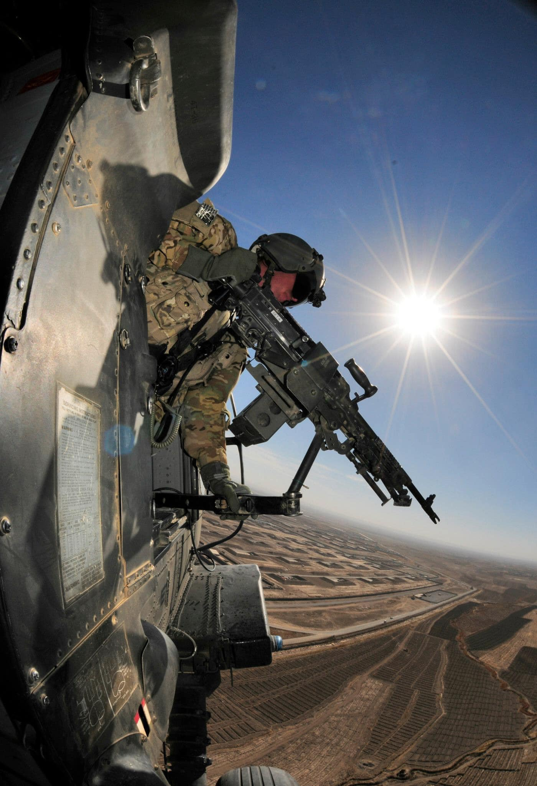


Hawaii National Guard
Basic UPAR Training

Slide 2
Agenda
In the Beginning…
Policy
UPAR Responsibilities
  Public Affairs Planning
  Public Affairs Liaison
  Take Photos, Write Captions, & Get Published
  Record Basic Video
Final Notes
Introduction / Basic UPAR Training

Slide 3
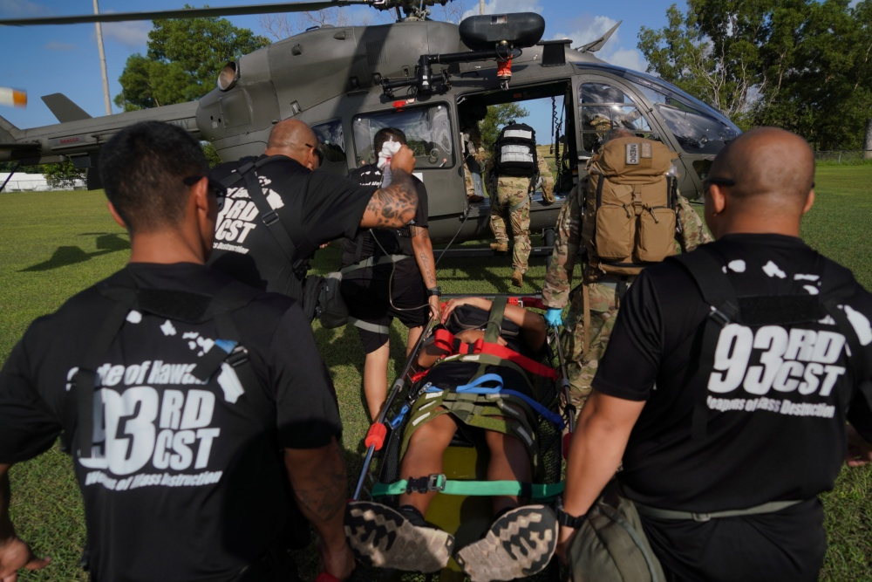
In the Beginning…
Introductions
  Rank, first & last name, unit, favorite snack
Mahalo!
Building a foundation (for you and your unit’s PA program)
The HING UPAR Handbook
Introduction / Basic UPAR Training
Notes:
- tell all of us your rank, first and last name, unit, favorite snack.
Thank you all for being here
learn the basics of how to be a UPAR. advanced UPAR class offered. UPAR It nests with the slides
The highest PA element is the State Public Affairs Office, if they can get 3-5 pics from UPARs a quarter, help share the HIARNG story

Slide 4

Why UPAR?
Support HING Public Affairs program
We need your help in telling your units, and “Hawaiʻi National Guard story”
  HIARNG 23 PAO positions
  HIANG 12 PAO positions
  Over 5,500 guardsman
History of HING
UPARs need two important things from the commander and the unit:
  Time
  Support
Introduction / Basic UPAR Training
Notes:
There are over 5,500 stories to tell.
PA Specialists cannot cover everything.
Commanders will need to provide you UPARs two things….
Time: for a UPAR to plan and carry out tasks, to meet with the UPAR to plan and initiate the unit’s PA Plan.
Support: The unit’s staff need to know the UPAR and that command supports the UPAR's efforts. Involve the UPAR in unit meetings, access to info

Slide 5

Policy
In the beginning
Policy
UPAR Responsibilities
Public Affairs Planning
Public Affairs Liaison
Take Photos, Write Captions, & Get Published
Record Basic Video
Final Notes
Policy / Basic UPAR Training

Slide 6
DOD Policy
Free-flow of general / military information, without censorship or propaganda
Information will not be classified or withheld to protect Government from criticism or embarrassment
Information will be withheld only when:
  adversely affect national security
  threatens safety or privacy of the Armed Forces
  directed by law or regulation
DoD’s obligation: provide public with information, may require detailed public affairs planning
Propaganda has NO place in DOD public affairs
Policy / Basic UPAR Training

Slide 7
DOD Policy
Standalone or portions of classified and unclassified information have potential to compromise security
Information for public release is cleared via security and policy review (conducted by PAO)
Effective communication is required
Increase public awareness of the mission, goals, policies and programs
Foster community relations and build good will
Release of accurate information must be done with speed, efficiency and through variety of mediums (different audiences)
Accountable to taxpayers and rely on their support
Policy / Basic UPAR Training

Slide 8

OPSEC
Operations Security
Exact # of troops, exact times of departure, radio frequencies, which vehicles are mission ready, what route a unit will take…
Adhere to SAPP (Security, Accuracy, Propriety and Policy)
Practice security at the source
Be aware of OPSEC and responsible for safeguarding sensitive information
OPSEC applies to:
  media interviews
  sharing info/imagery with family & friends, including email & social media platforms
Unauthorized disclosure of information can degrade operational effectiveness
Policy / Basic UPAR Training

Slide 9
SAPP
Security, Accuracy, Propriety and Policy
Security
Is there an OPSEC concern? Protect your team
Accuracy
Is the information correct and true? Don’t spread misinformation
Propriety
Is it in good taste? Be professional and respect privacy rights
Policy
Do not violate DOD policy; if you don’t know, Ask
Goes hand-in-hand with operations and personnel security
Monitor information environment and balance release to print media, TV, social media, etc.
Policy / Basic UPAR Training

Slide 10
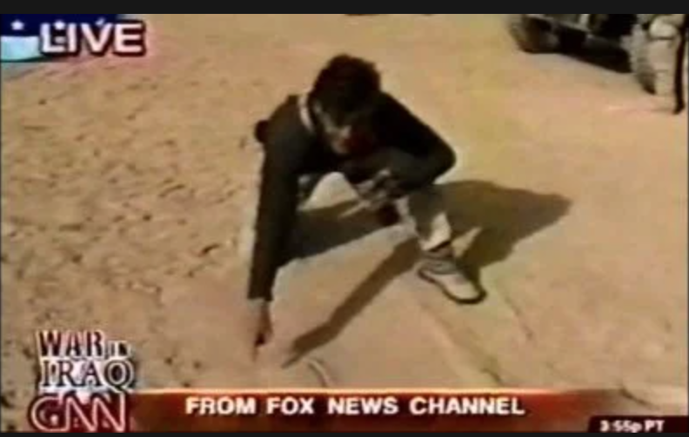
What Not To Do
For example:
2003, Geraldo Rivera traveling with 101st Airborne Division in Iraq as a war correspondent for Fox News and made major tactical error
Rivera drew map during a live broadcast, pinpointing exact location and revealing time and details of upcoming operation
Policy / Basic UPAR Training

Slide 11
Misc. & Things to Consider
Photos of children from events must have parental permission
Copyright and Fair Use of your products
If you are a service member, working with government equipment and/or on government time - it belongs to the government
FOIA (Freedom of Information Act)
Allows members of the public to request a record, unless the record is exempt by law
Every large unit has a FOIA Rep, UPARs may assist in gathering info, but never lead FOIA responses
Do not forward bad or inappropriate photos, please delete them
Policy / Basic UPAR Training

Slide 12
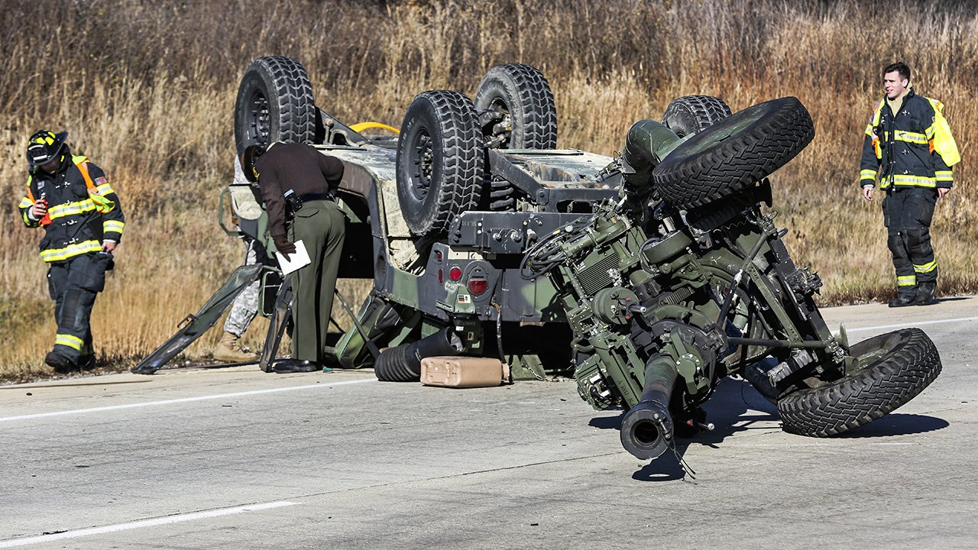
Where the PA steps in
Privacy act and personal identifiable information
HIPAA
Deaths, incidents and accidents
Criminal matters and investigations
Let PAO handle these matters
PAO has specific training
If unit or UPAR does speak to media after an incident: notify PAO immediately
Policy / Basic UPAR Training

Slide 13
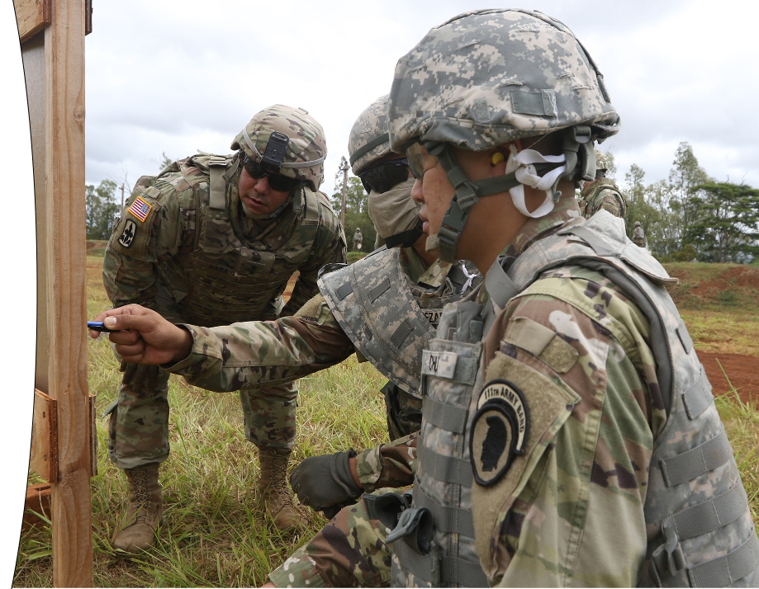
UPAR RESPONSIBILITIES
In the beginning
Policy
UPAR Responsibilities
Public Affairs Planning
Public Affairs Liaison
Take Photos, Write Captions, & Get Published
Record Basic Video
Final Notes
UPAR Responsibilities / Basic UPAR Training

Slide 14
UPAR Responsibilities
Create a Public Affairs Plan – meet Commander to set goals and create plan
Public Affairs Liaison – POC for all things public affairs
Take Photos, Write Captions and Get Published - #1 job
Record Basic Video – film short clips
Media Escort and Preparation – prepare your unit and assist the media
Media Relations – understand the media and prepare for interviews
Command Information – communicating to members of the command
Writing the Story - news story vs feature story
UPAR Responsibilities / Basic UPAR Training

Slide 15
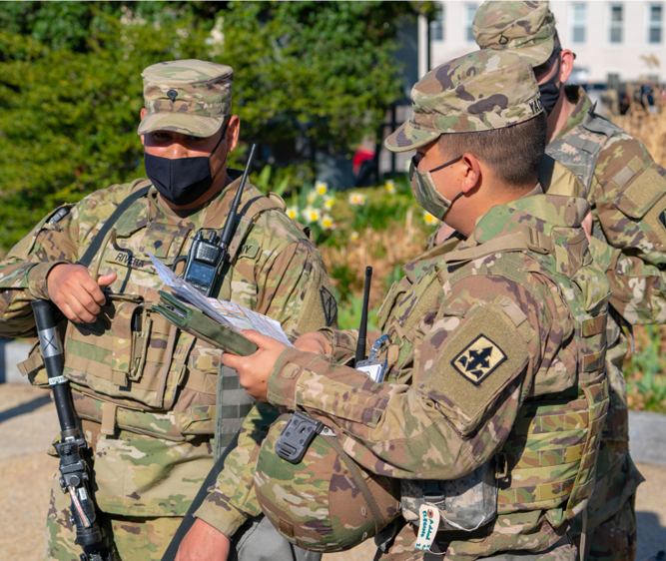
PA PLANNING
In the beginning
Policy
UPAR Responsibilities
Public Affairs Planning
Public Affairs Liaison
Take Photos, Write Captions, & Get Published
Record Basic Video
Final Notes
Public Affairs Planning / Basic UPAR Training

Slide 16
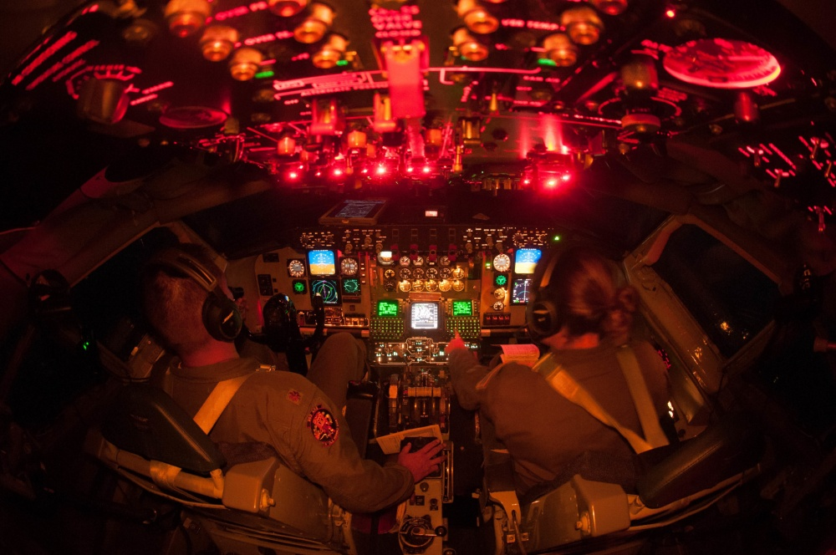
PA Planning
Talk to unit Commander
Get info from YTB and training schedules
Make a plan together
Pitch ideas
Choose events, coordinate with POC
Prepare, have a schedule
Annual Training = Goldmine
Look at social media to get ideas
PA plans are fluid
Public Affairs Planning / Basic UPAR Training

Slide 17
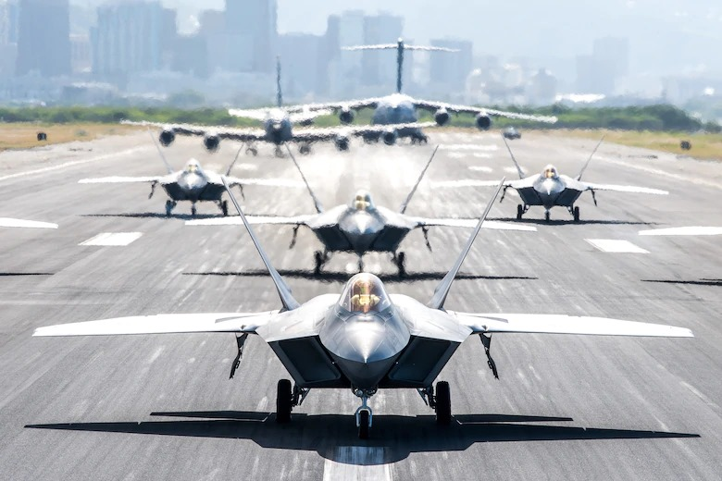
Release Authority
Approving of content- Release Authority
  Unit level = Commander for unit
  This step protects you
Levels of Public Affairs
Level 1 | Unit level Example: unit newsletter
Level 2 | Example: TAG, DAG, HING, CSEL social media, HIDOD PowerPoint, Pupukahi, DVIDS or media releases
Level 3 | Example: Any media outlet (TV, online, newspaper), DOW, NGB, INDOPACOM, Big Army or Big Air Force, USARPAC, PACAF
Public Affairs Planning / Basic UPAR Training

Slide 18
PA Plan Sample
OCT 2026
Dec Newsletter - Start designing layout and looking at past socials for story ideas
DEC 2026
Quarterly Photos - Weapons qualifications Take photos, get best scores and new shooters. Write caption. Send to PAO
Dec Newsletter - Do final draft. Get commander approval. Distribute newsletter
NOV 2026
Dec Newsletter - Draft content and pics. Get Commander to write a column
Coordinate with higher PA, about new equipment, Reach out to contact with story idea and details (5 W’s)
Annual Training
Quarterly Photos - New equipment Take photos. Write caption. Send to PAO
Public Affairs Planning / Basic UPAR Training

Slide 19
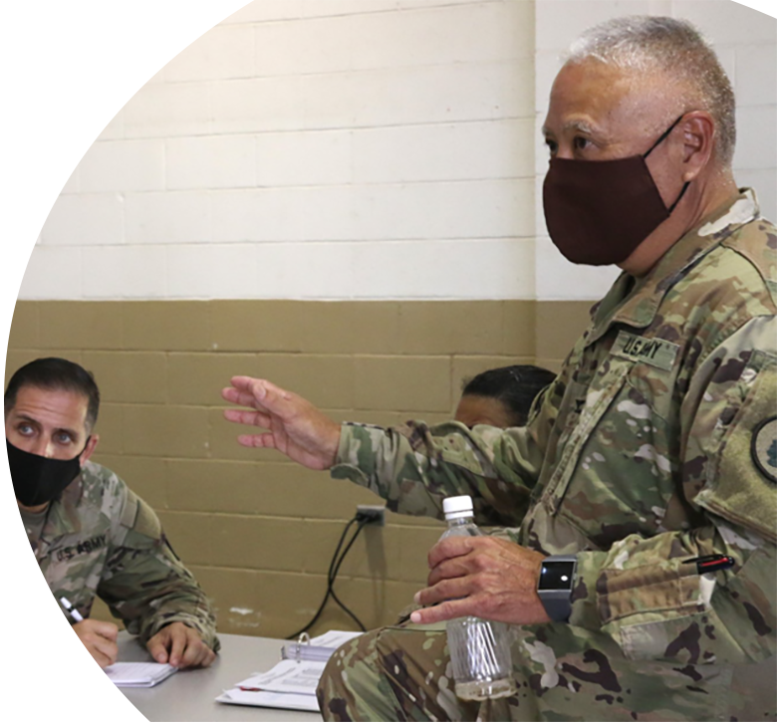
What should come out of a PA Plan?
Commander’s intent / objectives
Commander’s priorities, command messages
What will be covered by UPAR during drills and AT
Release authority given
When to request PAO
Expectations, content evaluation
Public Affairs Planning / Basic UPAR Training

Slide 20
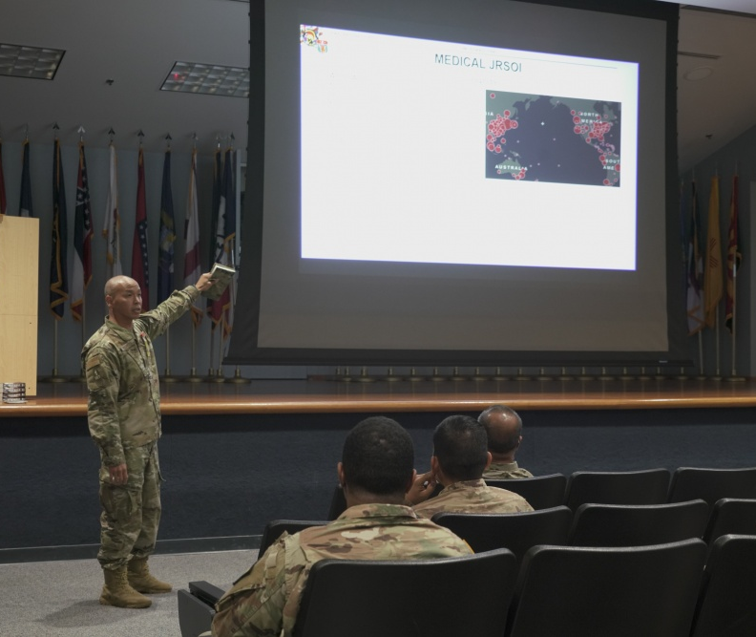
PA LIAISON
In the beginning
Policy
UPAR Responsibilities
Public Affairs Planning
Public Affairs Liaison
Take Photos, Write Captions, & Get Published
Record Basic Video
Final Notes
Public Affairs Liaison / Basic UPAR Training

Slide 21
PA Liaison
A person that allows different organizations or groups to work together and provide information to each other.
Position of responsibility
To the Commander
To higher PA elements
Can share the most current PA information from higher PA element - State PAO, 117th MPAD
Could be unit spokesperson for media engagements
Public Affairs Liaison / Basic UPAR Training

Slide 22
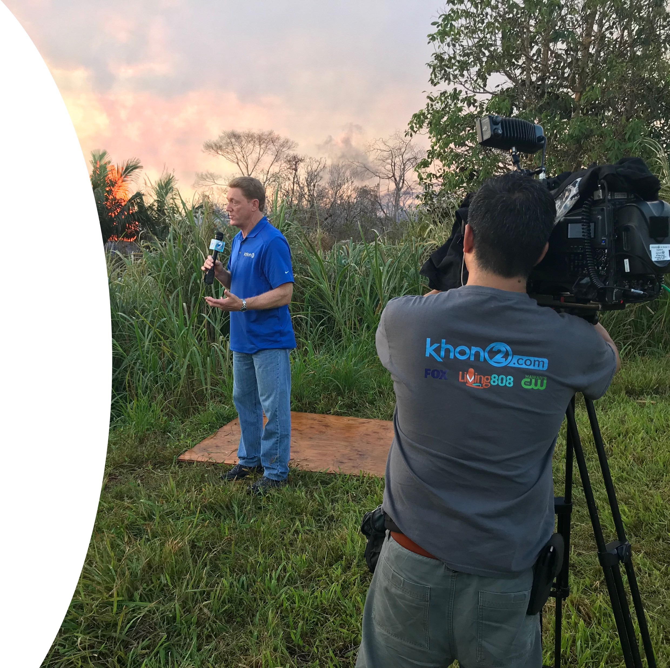
PA Liaison
Provide counsel to the Commander and higher PA
This does not happen automatically
Be self-aware and respectful
Understand higher PA elements
“Pulling and Pushing” of information
UPARs will immediately notify PAO of any issues that might gain national or international media attention (accidents/investigations)
Public Affairs Liaison / Basic UPAR Training
Notes:
Establish communication with 117th MPAD, as they will approve all products and be the release authority during exercises or some training events.
The State PAO will be your full-time higher PA element.
The State PAO oversees and provides all UPAR training and serve as PA SMEs. During State Active Duty Missions there may be a Task Force PAO, but you can always contact the State PAO.

Slide 23
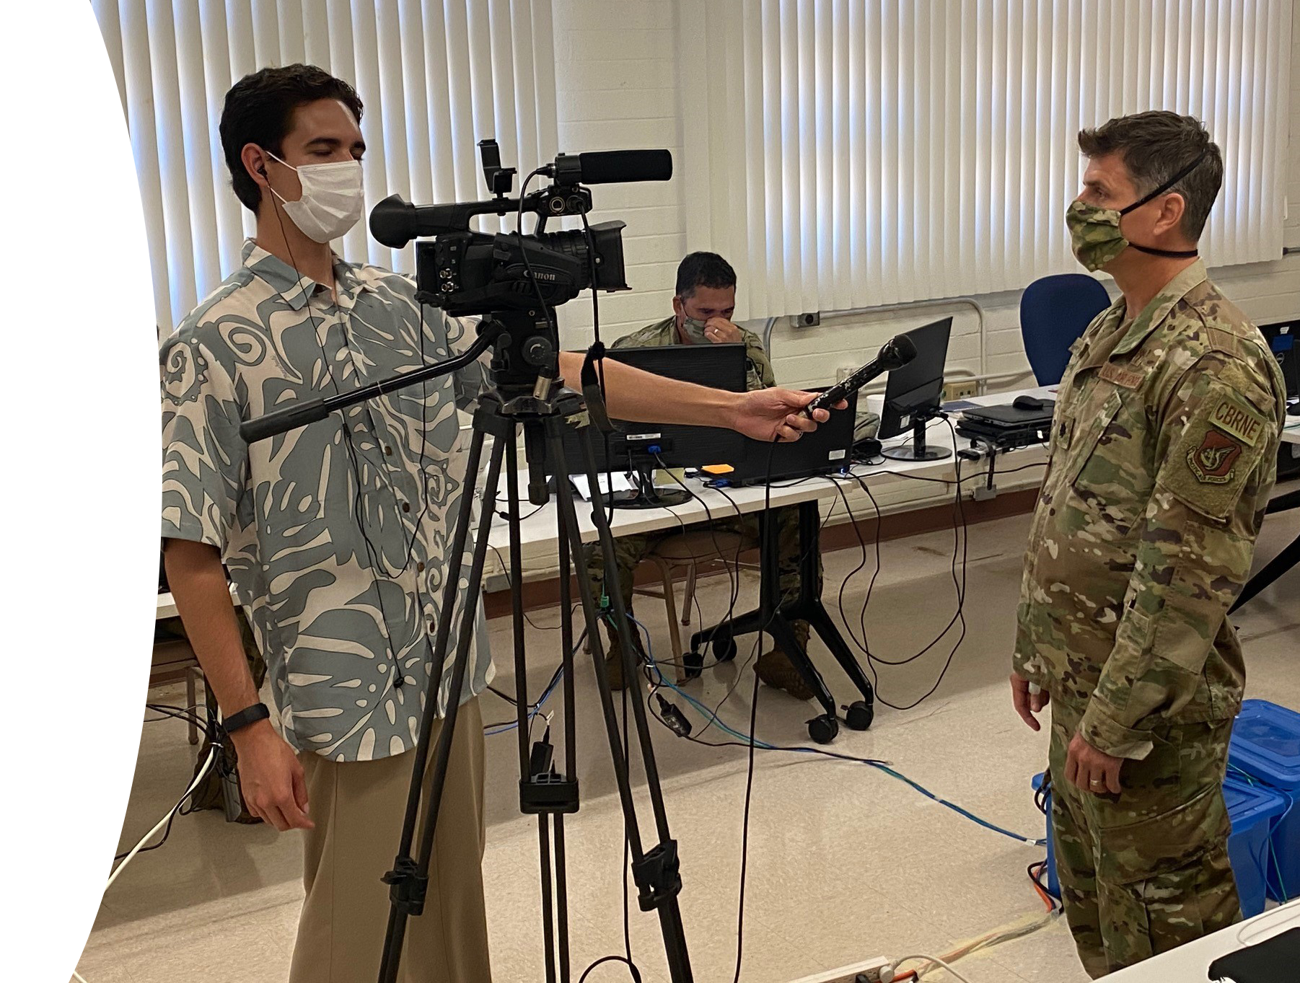
PA Liaison
Not PA trained, just helping commander
With approval from higher PA, Coordinate unit level media escort
First person who media meets when visiting
Public Affairs Liaison / Basic UPAR Training

Slide 24
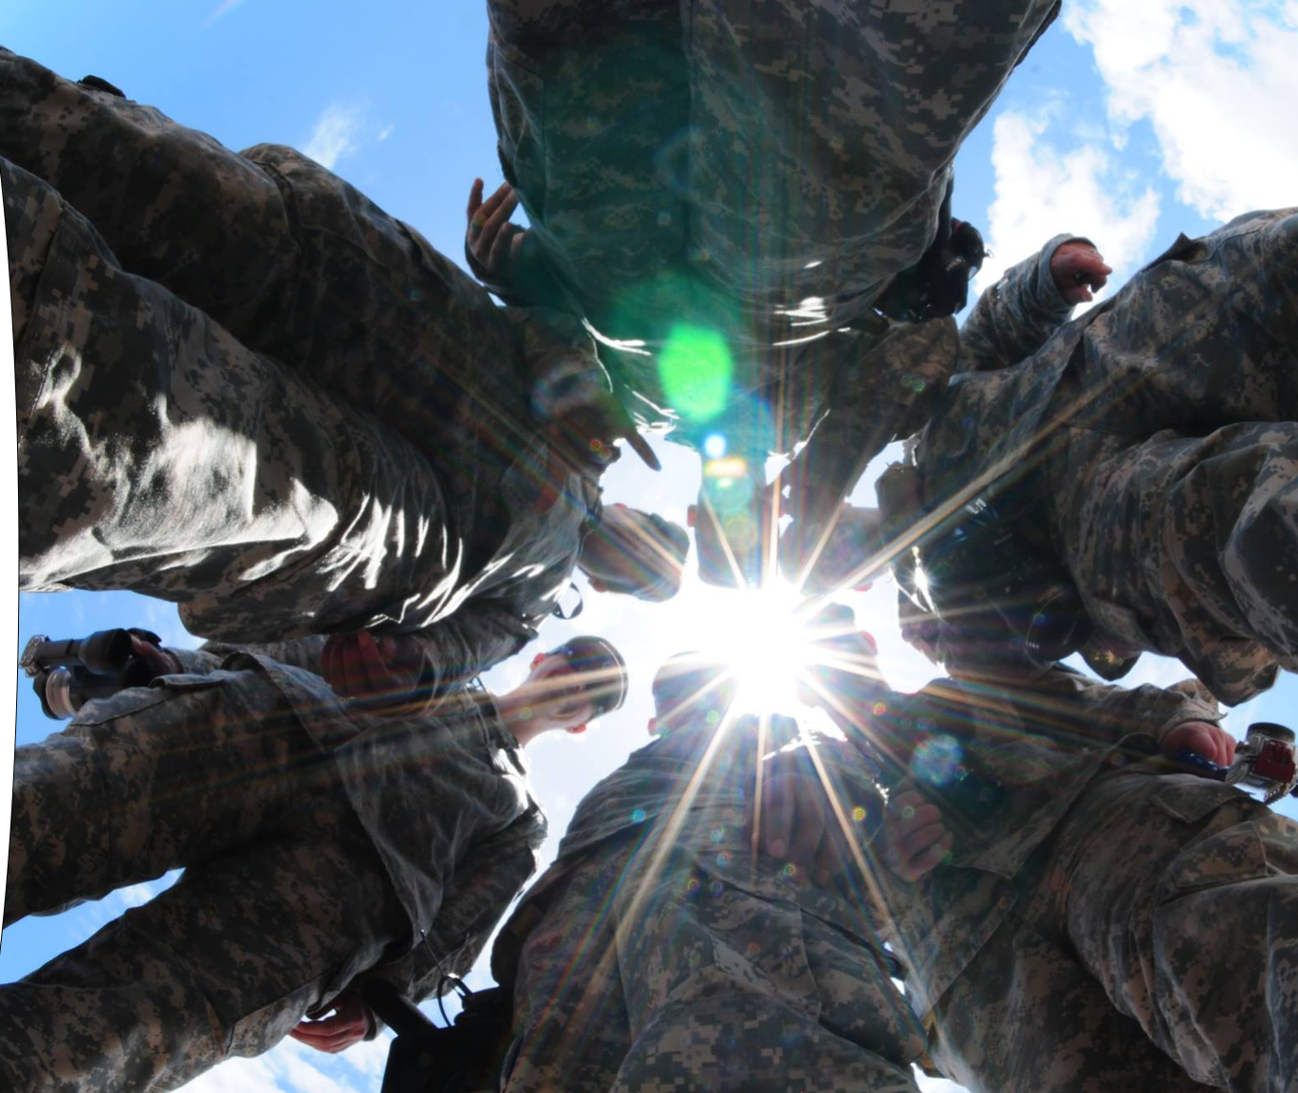
TAKE PHOTOS, WRITE CAPTIONS, & GET PUBLISHED
In the beginning
Policy
UPAR Responsibilities
Public Affairs Planning
Public Affairs Liaison
Take Photos, Write Captions, & Get Published
Record Basic Video
Final Notes
The primary function that the State PAO would like every UPAR to do is to take a good photo, write a caption for it and then get it to the next PA echelon.
Take Photos, Write Captions, & Get Published / Basic UPAR Training

Slide 25
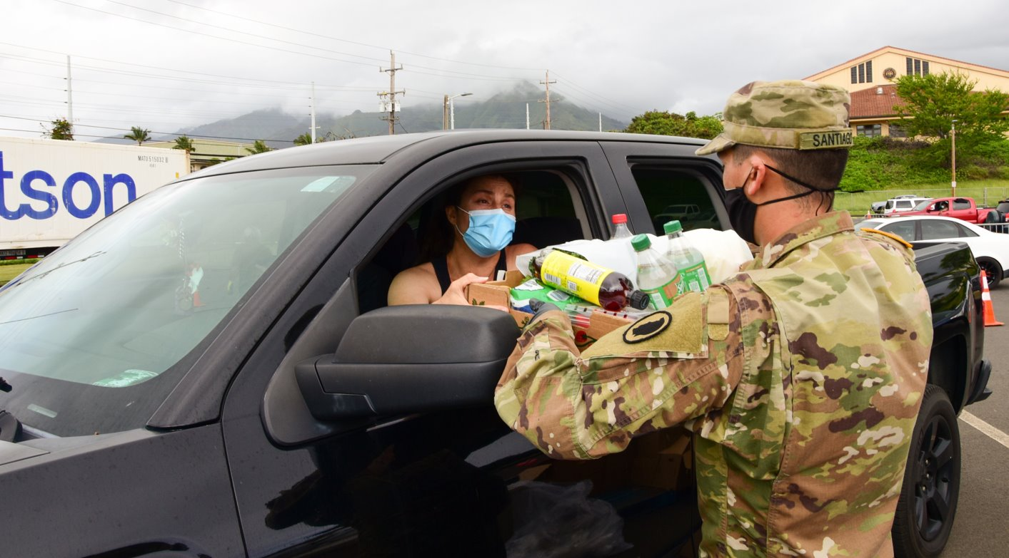
TAKE PHOTOS
Take Photos, Write Captions, & Get Published / Basic UPAR Training

Slide 26
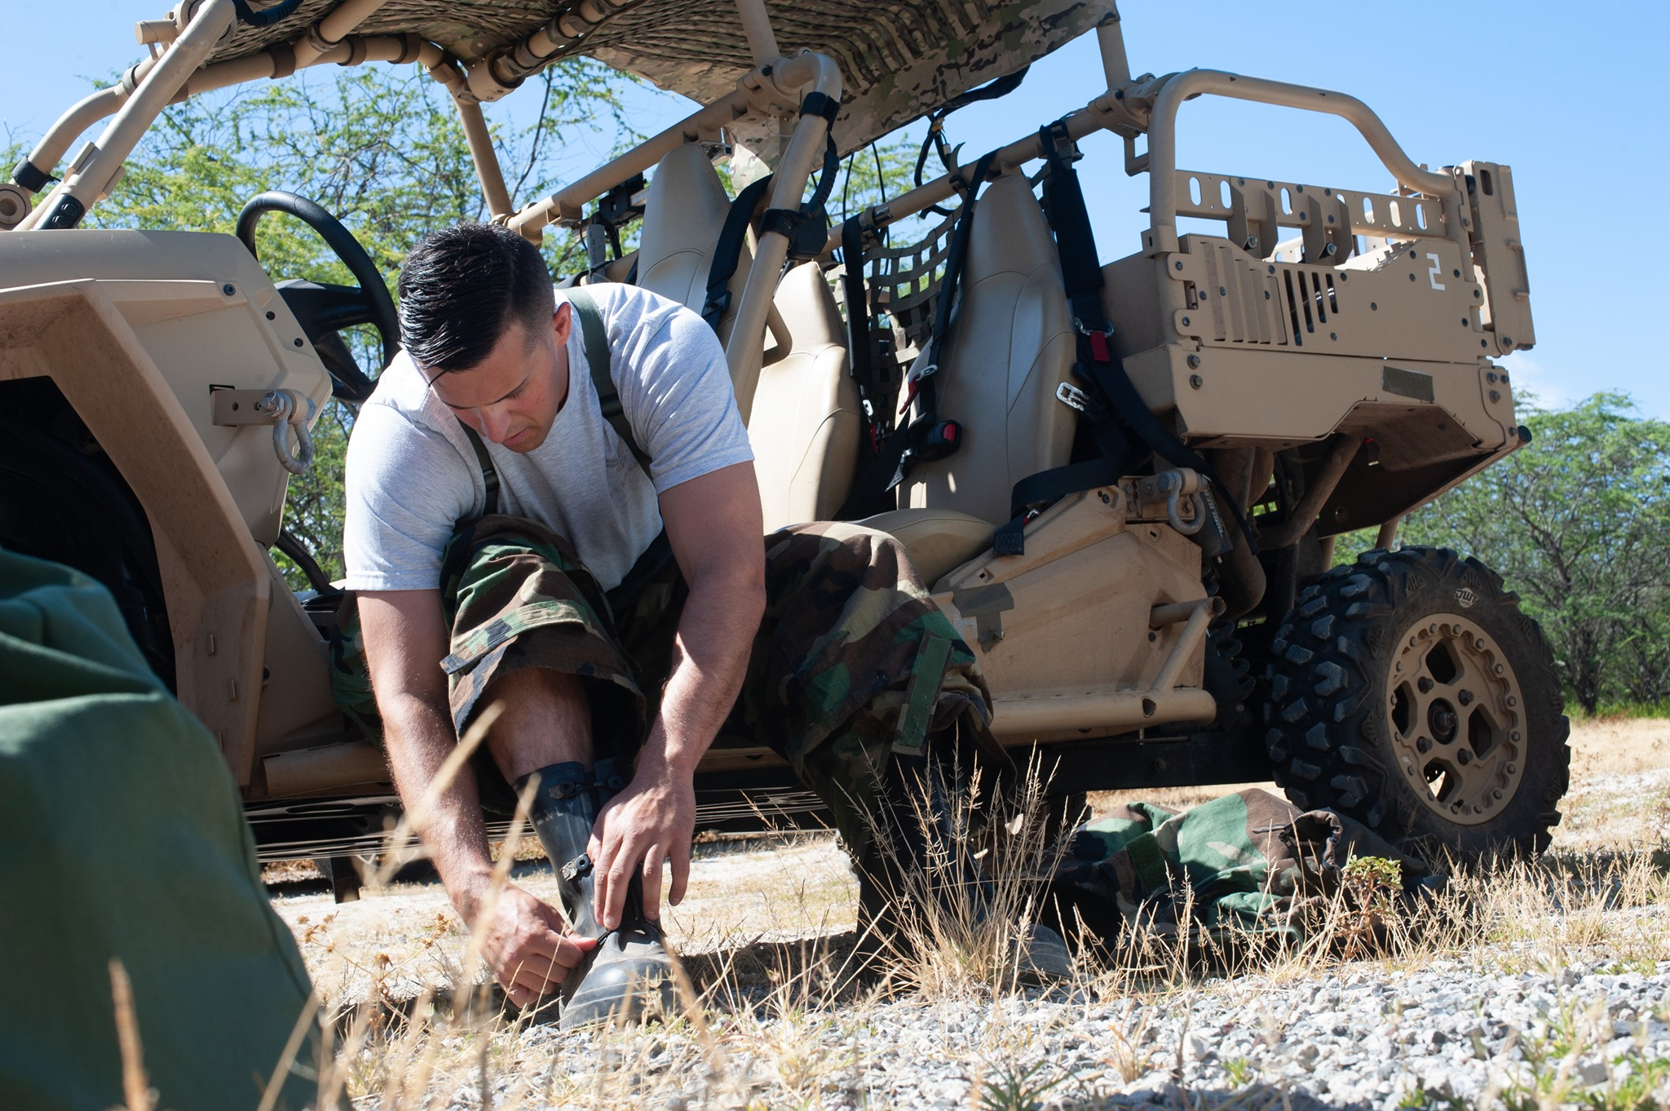
Photos
“Faces and Patches”
Less “Shaka” photos
Catch subject doing something, not looking at camera
Less pics at desks
Action begin shooting before the subject starts moving through the scene.
Take Photos, Write Captions, & Get Published / Basic UPAR Training

Slide 27
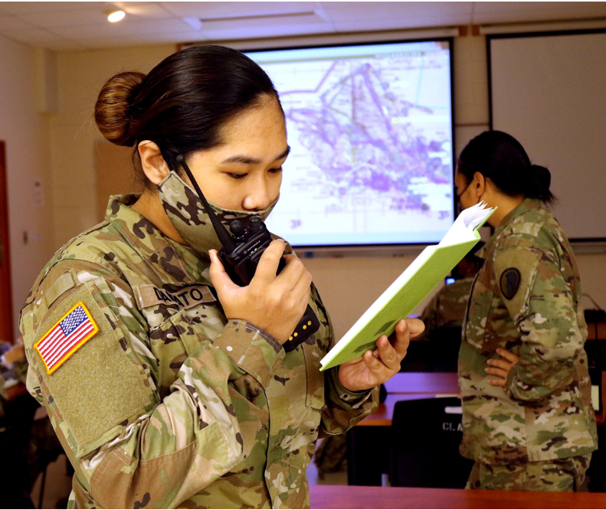
Photos – Things to Look For
What is in the background?
Is everyone in proper uniform? No Badges
Proper PPE
Hands in pockets
Not to standard- injured, belly hanging out, non-reg hair, pens, tilted hat
Eyes closed; mouth open
Take Photos, Write Captions, & Get Published / Basic UPAR Training

Slide 28
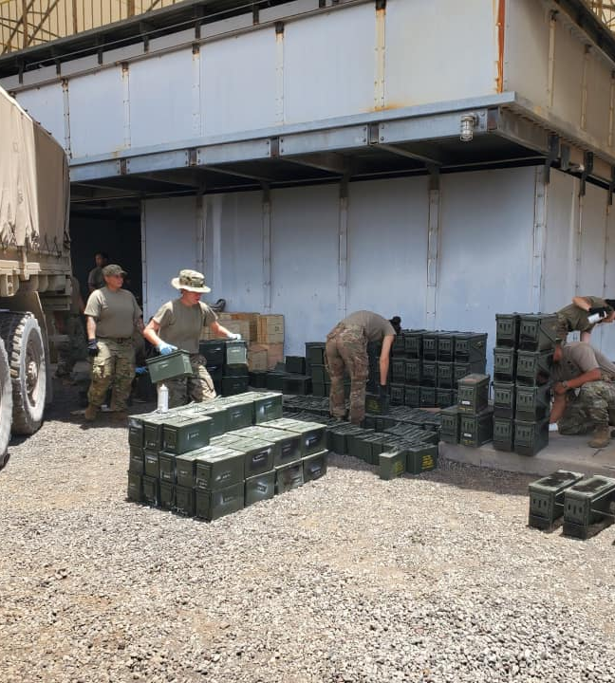
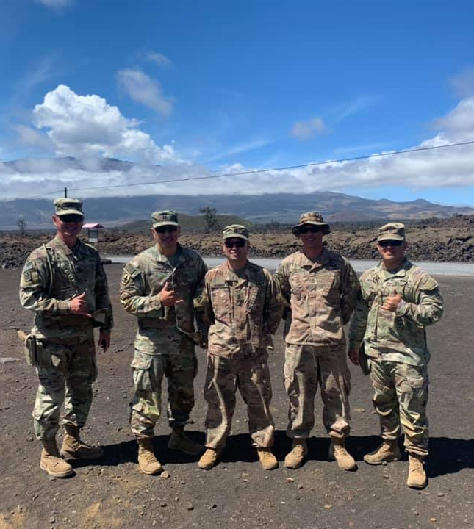
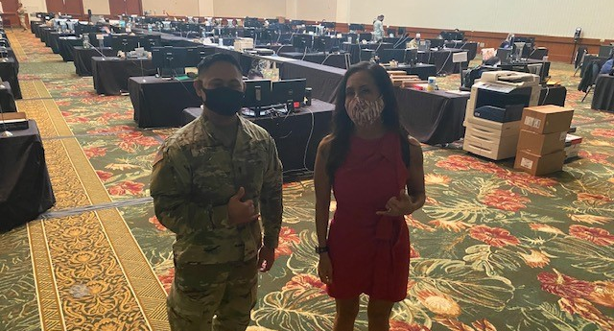
More to Look For
Backlit subjects
Shadows on face
“Photo bombers”
No faces, but butts and backs
Cigarettes/ vapes, phones in hands
Muzzle awareness
OSHA violations- safety
Product endorsement
Middle fingers (it happens!)
Take Photos, Write Captions, & Get Published / Basic UPAR Training

Slide 29

Taking Pictures with Your Smart Phone
Get close to the action, but do not interfere, restrict movement, or compromise safety
  Do a practice run
Focus on your subject tap the screen
Don’t stop shooting
  Burst mode
  Review your photos after event
Prepare ahead of time battery life & storage space (Be at rehearsals)
Take Photos, Write Captions, & Get Published / Basic UPAR Training

Slide 30
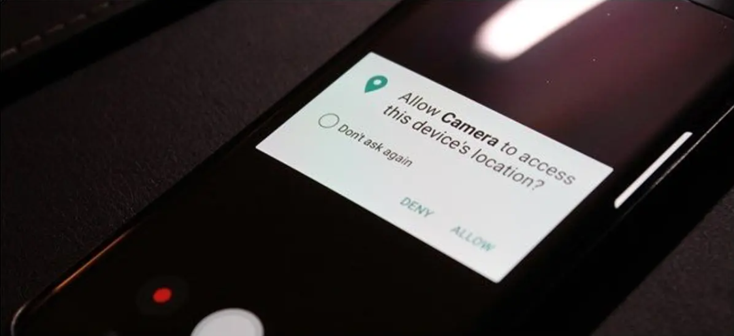
Smartphone Tips
Turn off GEO tagging on your phone
High dynamic range- setting to help with low light
Turn off the camera sound
Helpful hint: airplane mode
Take Photos, Write Captions, & Get Published / Basic UPAR Training
Notes:
HDR settings: (High Dynamic Range), HDR photo is created by balancing the shadows and highlights of an image so that neither is being favored or ignored

Slide 31

Enable Gridlines on Your Smart Phone
IOS
Setting
Camera
Under composition
  Switch on grid
Android
Camera
Setting
Switch on grid lines
Take Photos, Write Captions, & Get Published / Basic UPAR Training

Slide 32


Rule of Thirds
Place your subject in the cross hairs for a more “balanced” photo
If your subject is moving, leave empty room to move in and out of the frame.
Take Photos, Write Captions, & Get Published / Basic UPAR Training

Slide 33

Photos – Using Angles
Eye level
Top view
High angle
Framed view / Hidden view
Low angle
Off-center
Action
Static shot
Focal Point
Take Photos, Write Captions, & Get Published / Basic UPAR Training

Slide 34
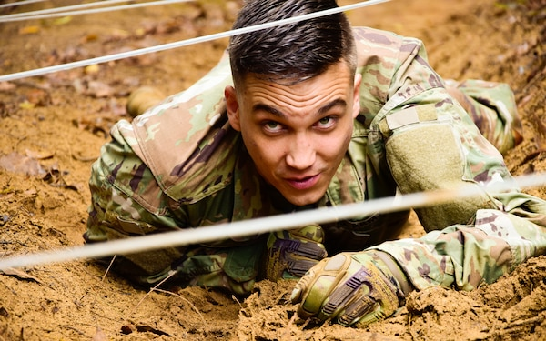
Eye Level
Take Photos, Write Captions, & Get Published / Basic UPAR Training
Notes:
Eye Level: camera / smartphone is placed at the same height as the eyes of the subject in your frame

Slide 35
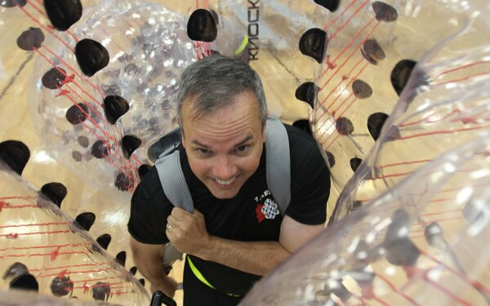
Top View
Take Photos, Write Captions, & Get Published / Basic UPAR Training
Notes:
Top Angle: where the smartphone looks down on the subject

Slide 36
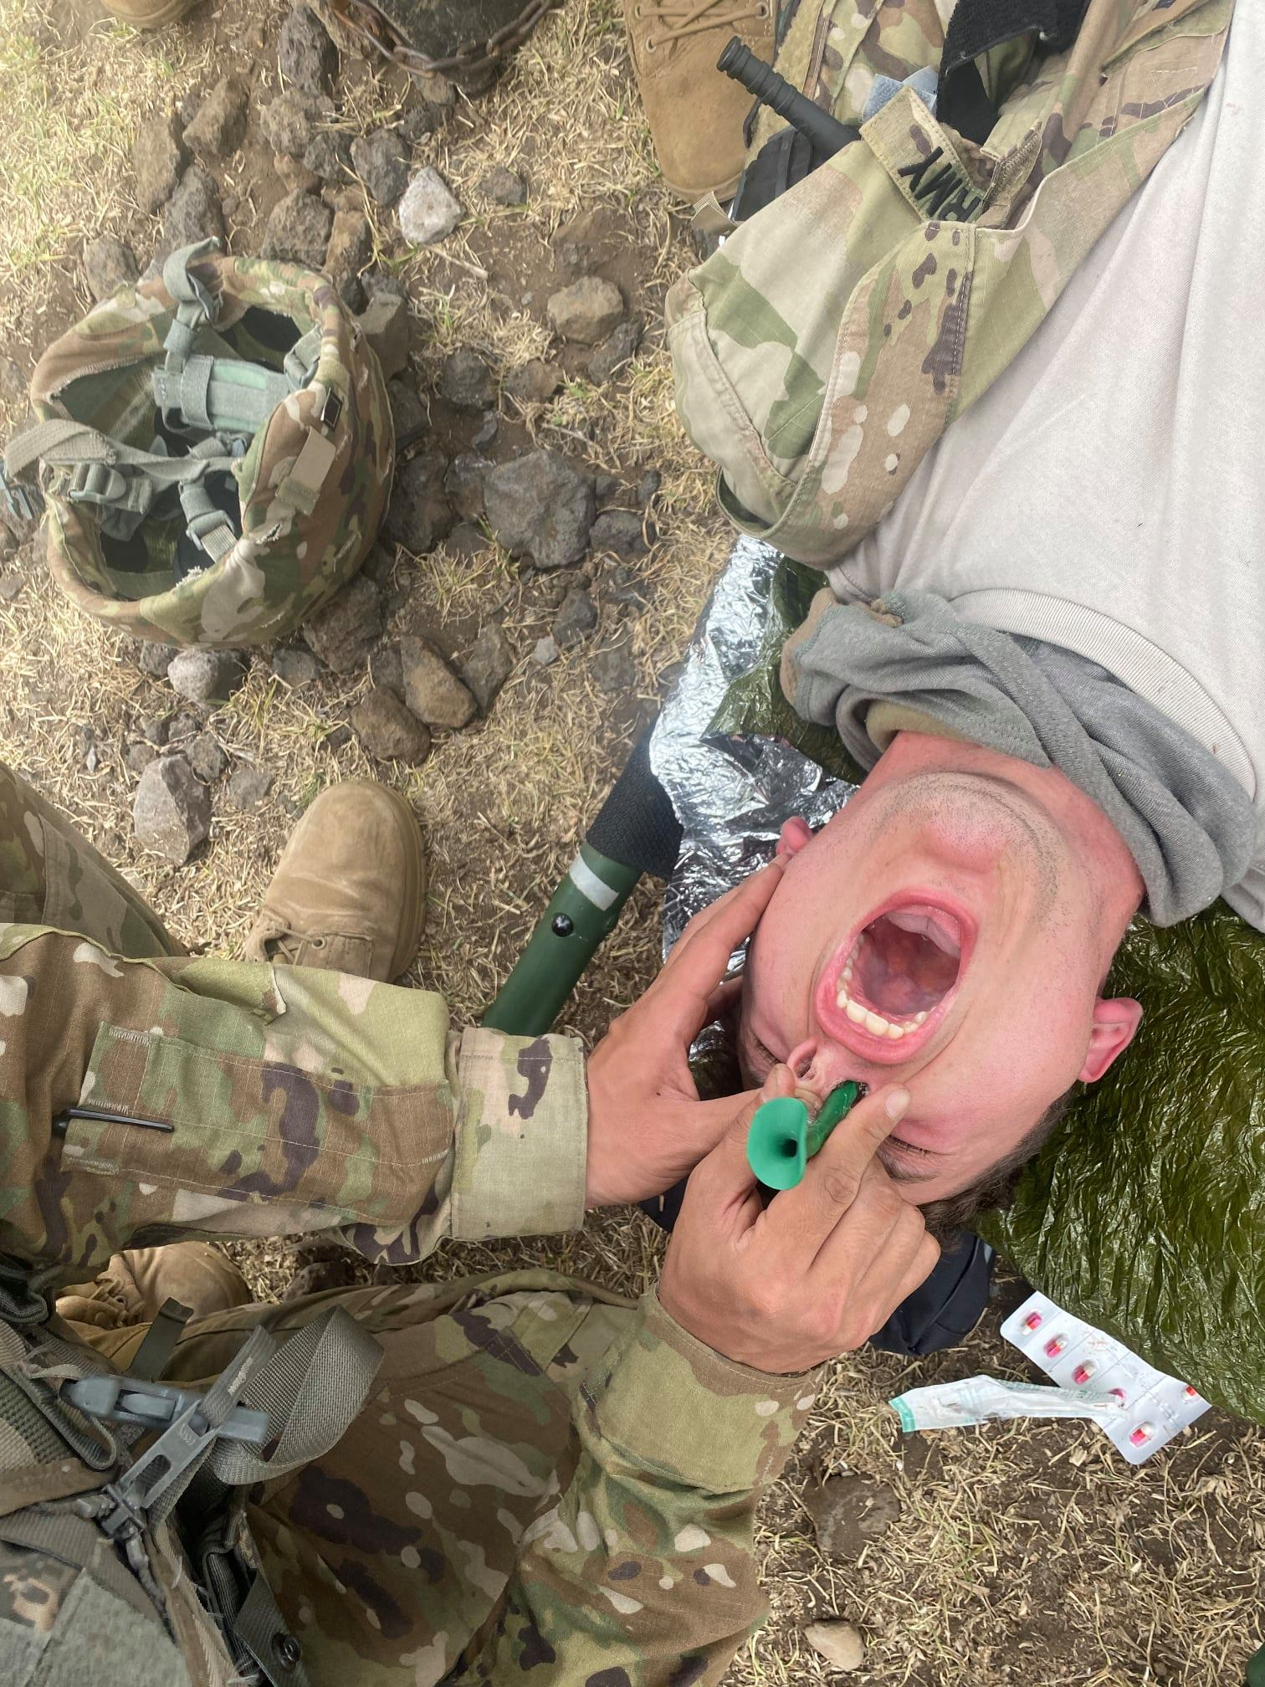
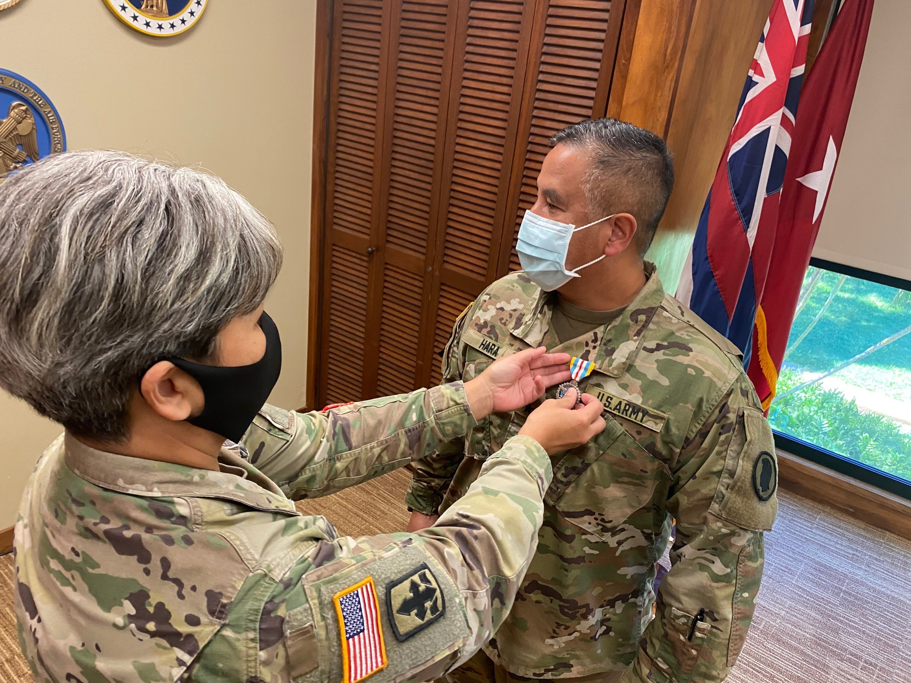
High Angle
Take Photos, Write Captions, & Get Published / Basic UPAR Training
Notes:
A high-angle shot: placing the smartphone high about your head angled down on your subject. Similar to a top angle

Slide 37
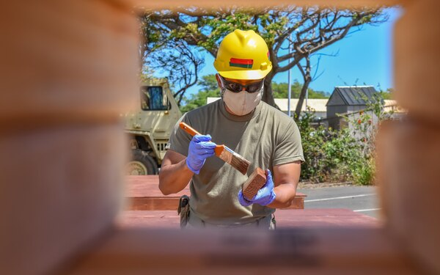
Framed/Hidden View
Take Photos, Write Captions, & Get Published / Basic UPAR Training
Notes:
Framed / Hidden View: can be set and framed in any shot size you like, just as long as there is only one character featured within the frame

Slide 38
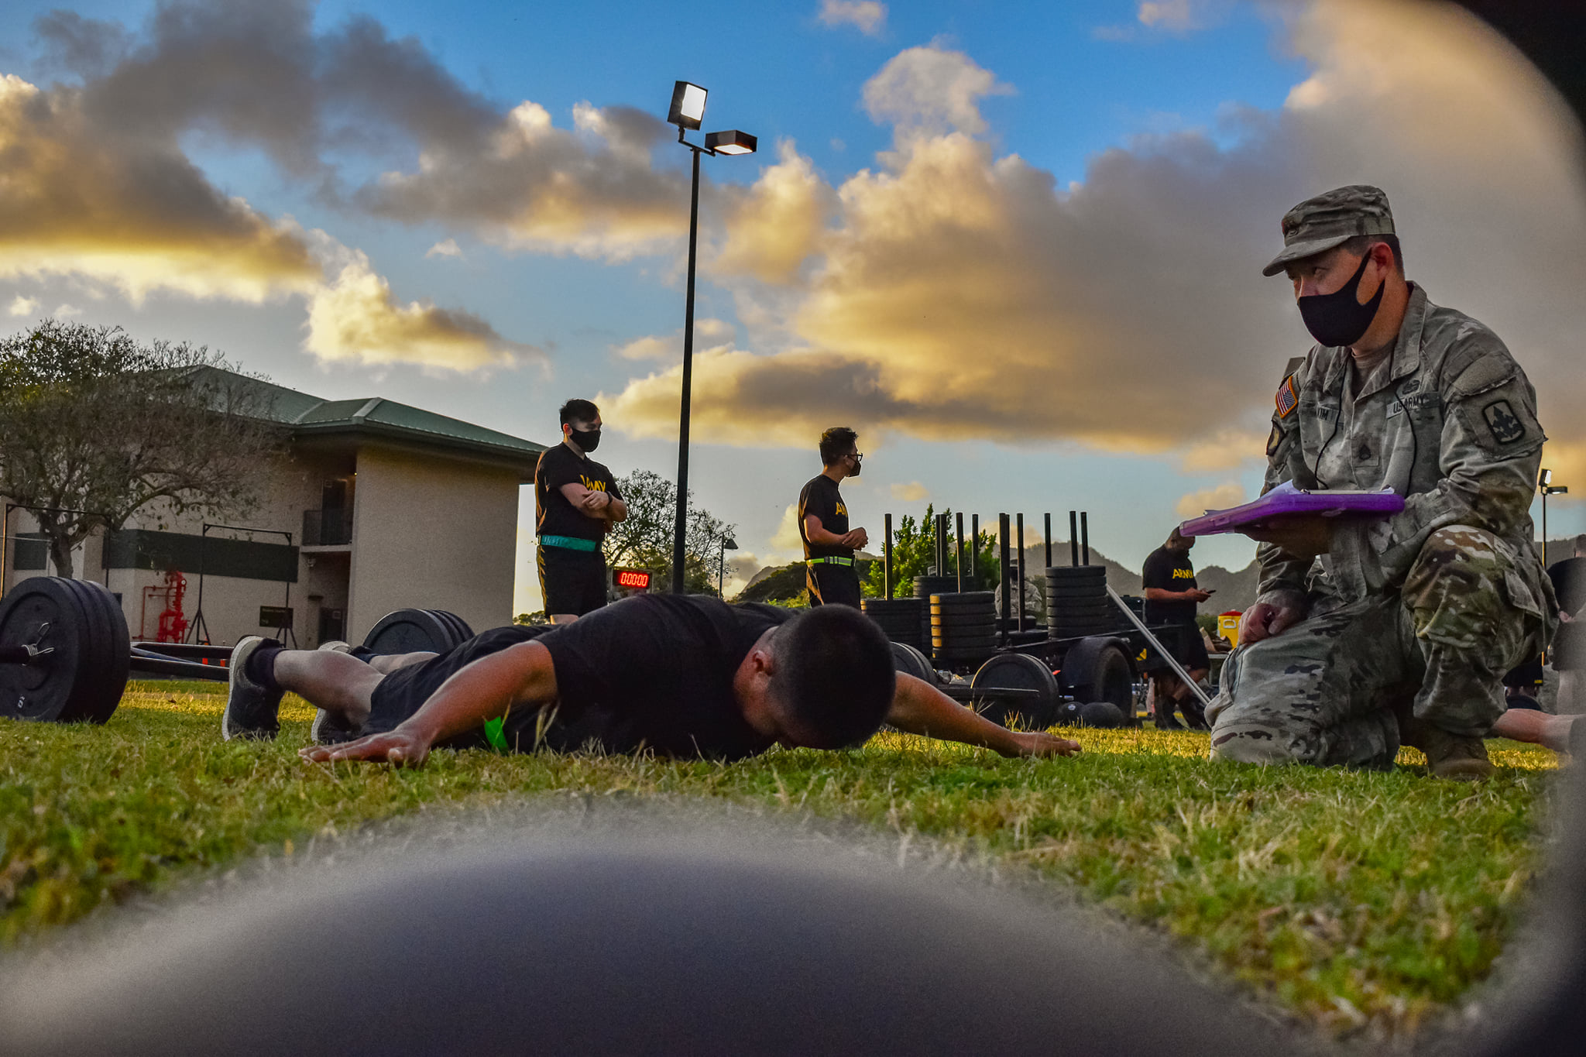
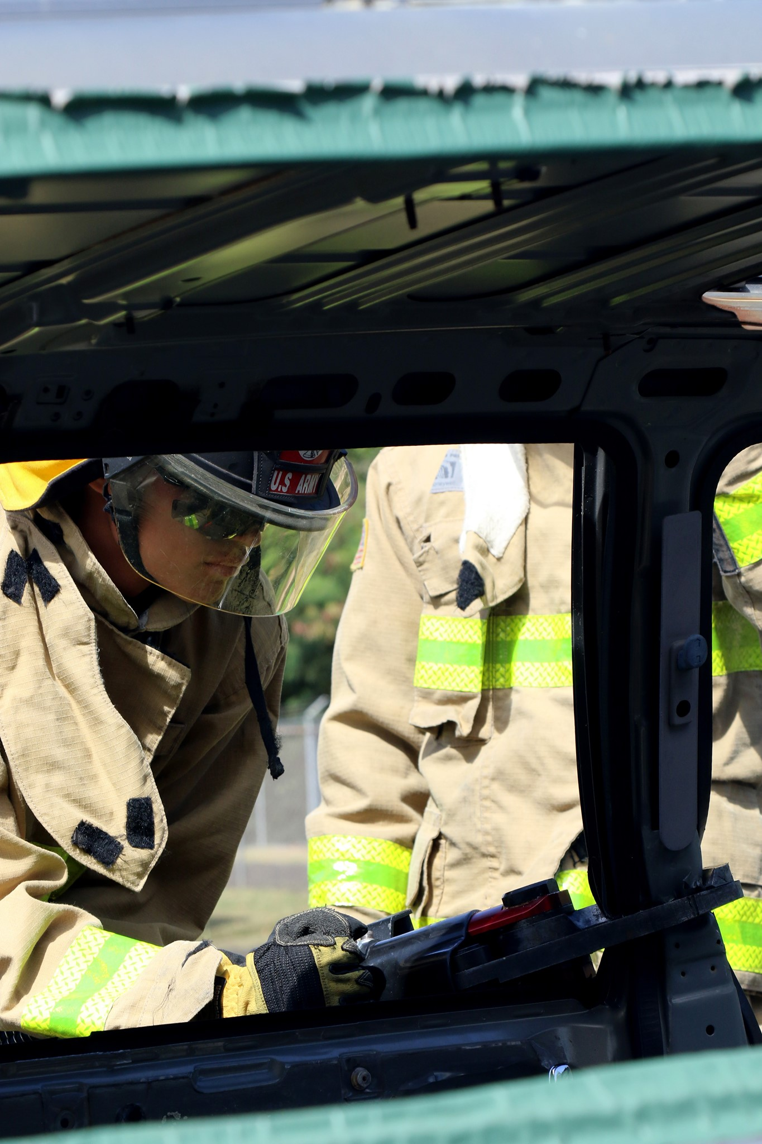
Framed/Hidden View
Take Photos, Write Captions, & Get Published / Basic UPAR Training
Notes:
Framed / Hidden View: can be set and framed in any shot size you like, just as long as there is only one character featured within the frame

Slide 39
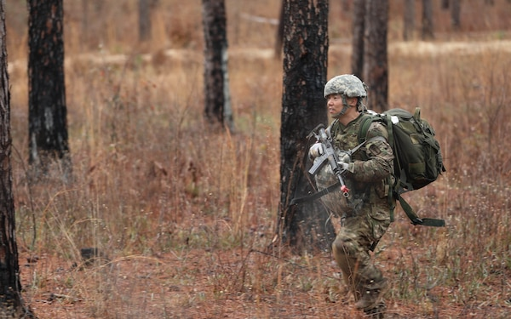
Off-Center
Take Photos, Write Captions, & Get Published / Basic UPAR Training
Notes:
Space in front of the subject

Slide 40
Off-Center
Take Photos, Write Captions, & Get Published / Basic UPAR Training
Notes:
Space in front of the subject

Slide 41
Off-Center Cropped
Take Photos, Write Captions, & Get Published / Basic UPAR Training
Notes:
Do not crop an off-center picture. It takes away interest in picture and looks odd

Slide 42
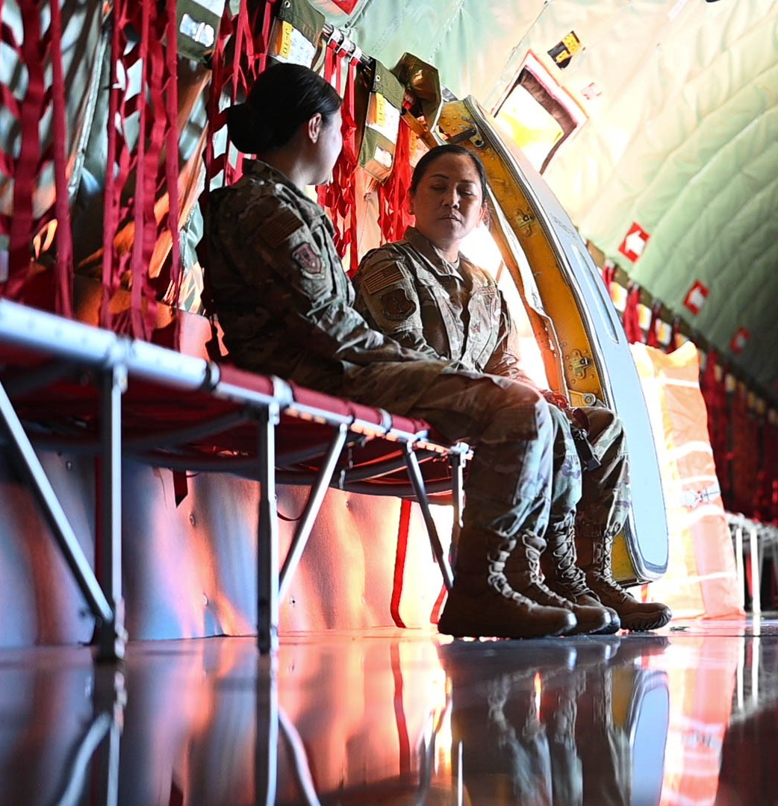
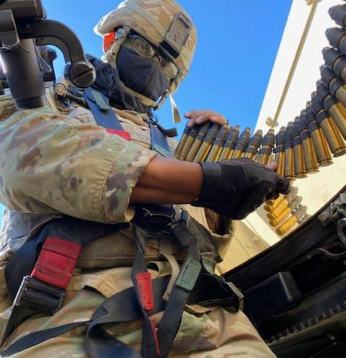

Low Angle
Take Photos, Write Captions, & Get Published / Basic UPAR Training
Notes:
Low Angle: conveys a number of emotions or feelings about the subject in the frame, it gives them power
You can get low, or you can just hold the camera low

Slide 43
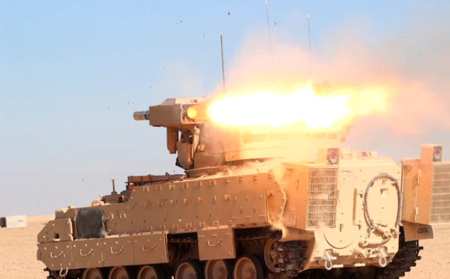
Action
Take Photos, Write Captions, & Get Published / Basic UPAR Training

Slide 44
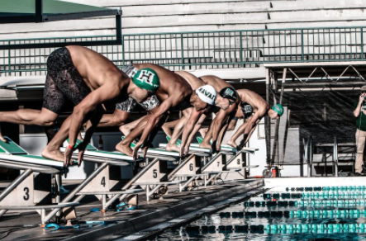
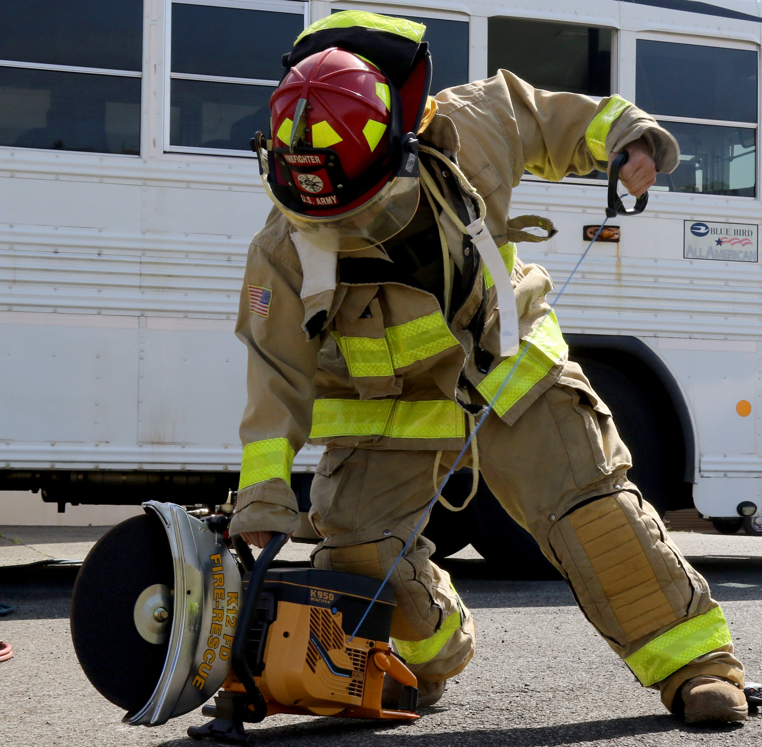
Action
Take Photos, Write Captions, & Get Published / Basic UPAR Training

Slide 45
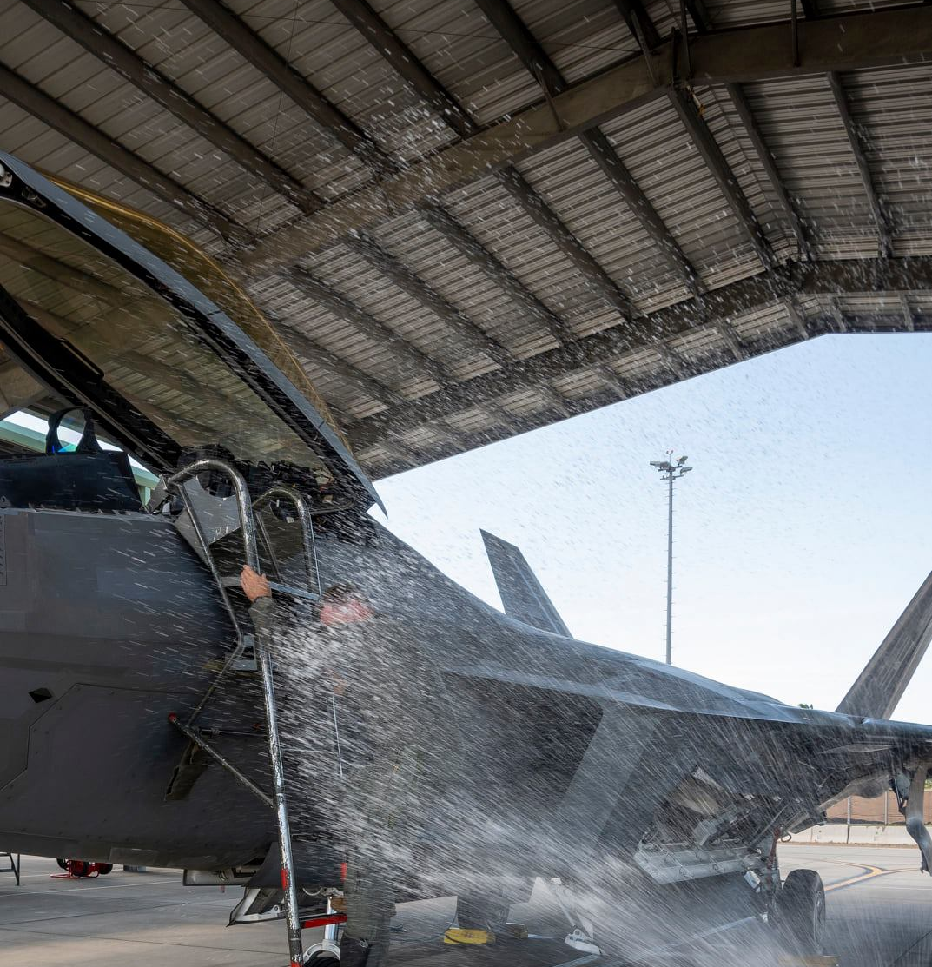
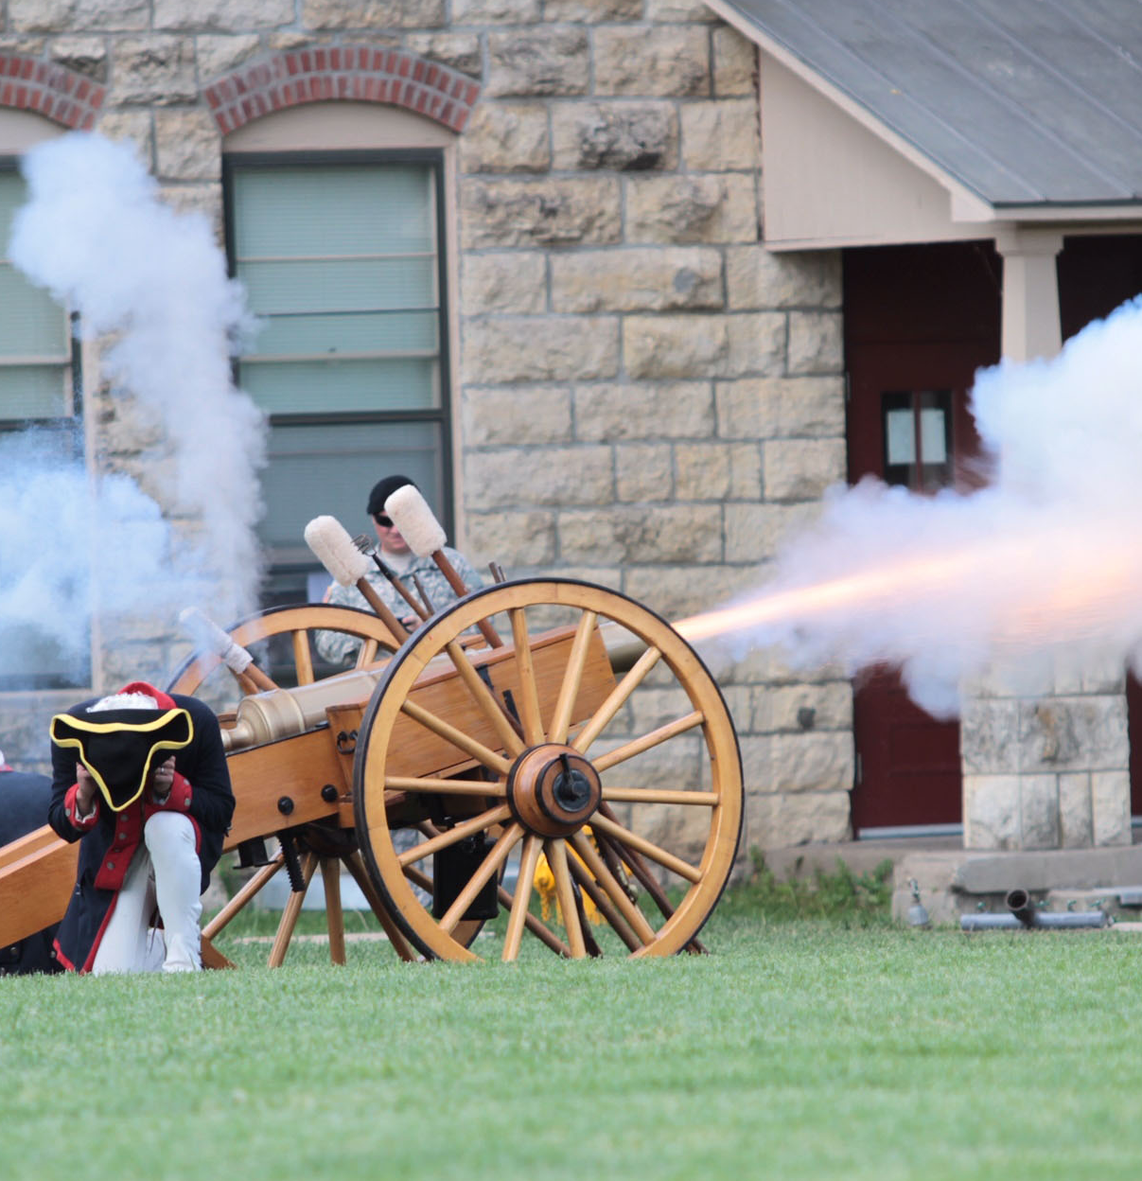
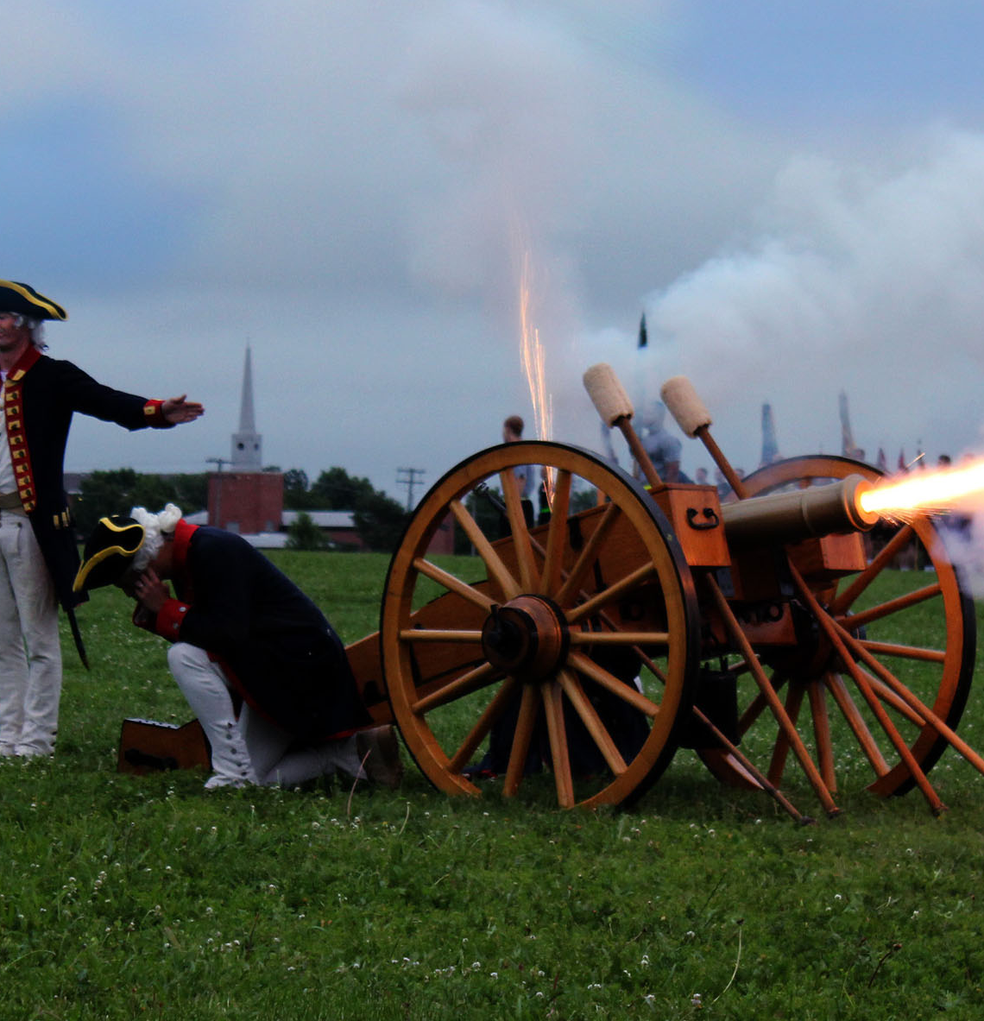
Action
Take Photos, Write Captions, & Get Published / Basic UPAR Training

Slide 46
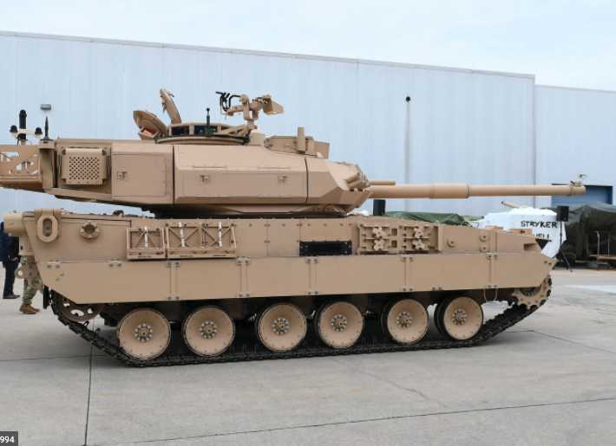
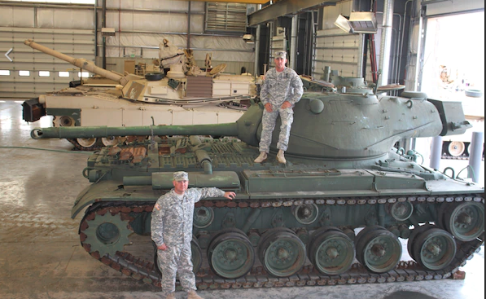
Static Shots
Take Photos, Write Captions, & Get Published / Basic UPAR Training

Slide 47
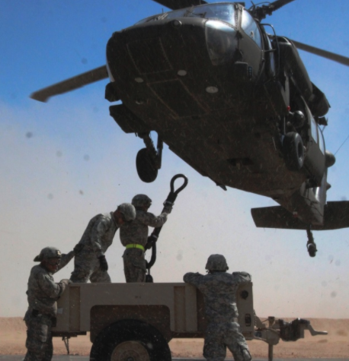
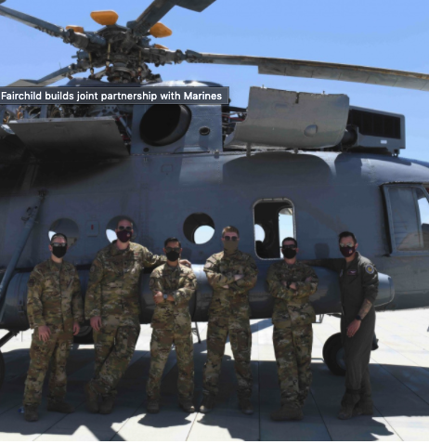
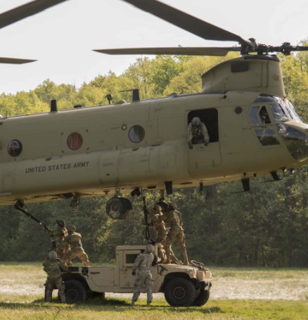
Helicopters and Other Cool Stuff
Take Photos, Write Captions, & Get Published / Basic UPAR Training

Slide 48
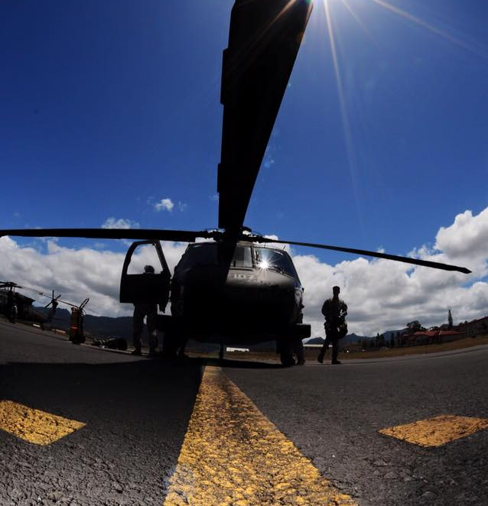
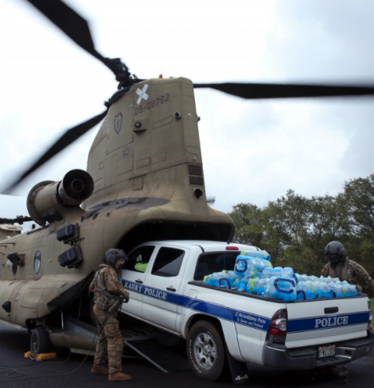
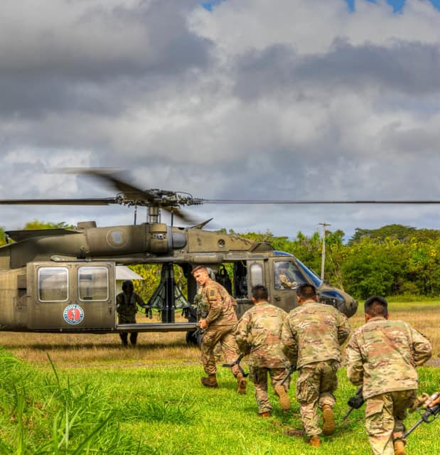
“Good” Helicopter Shots
Take Photos, Write Captions, & Get Published / Basic UPAR Training

Slide 49
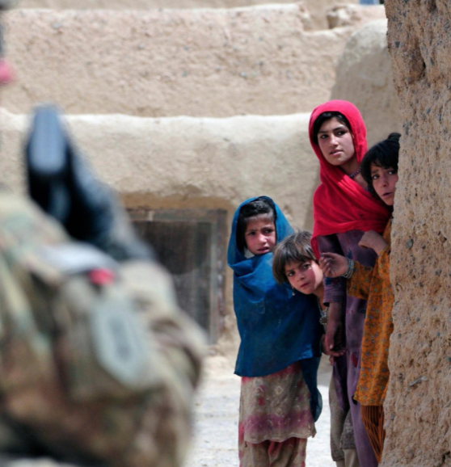
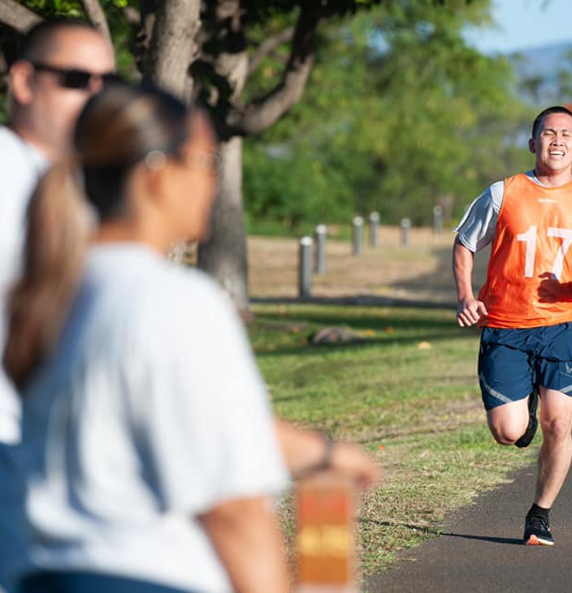
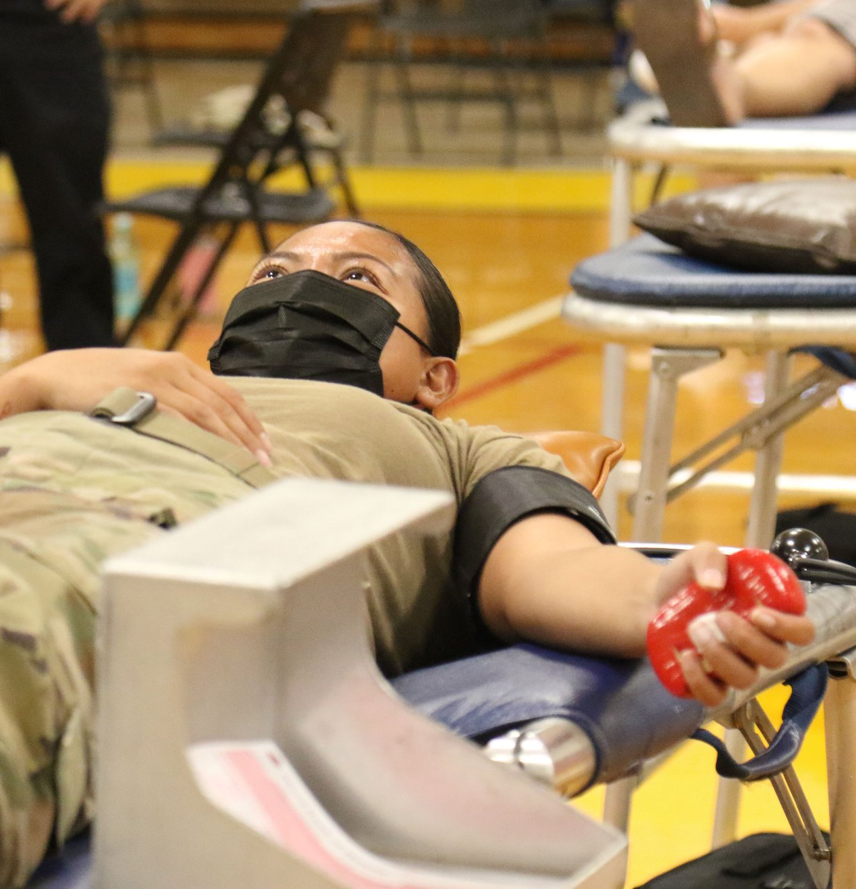
Focal Point
Take Photos, Write Captions, & Get Published / Basic UPAR Training

Slide 50
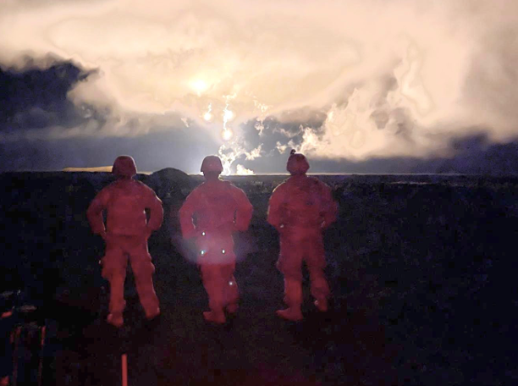
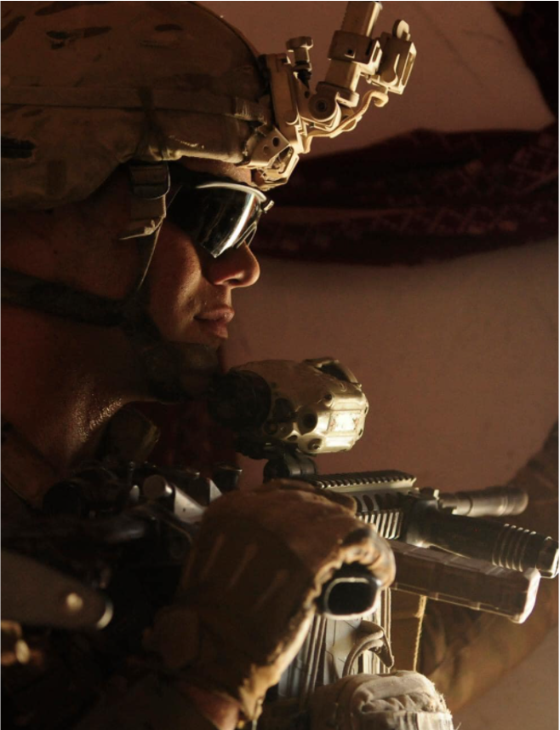

Lighting
Take Photos, Write Captions, & Get Published / Basic UPAR Training

Slide 51
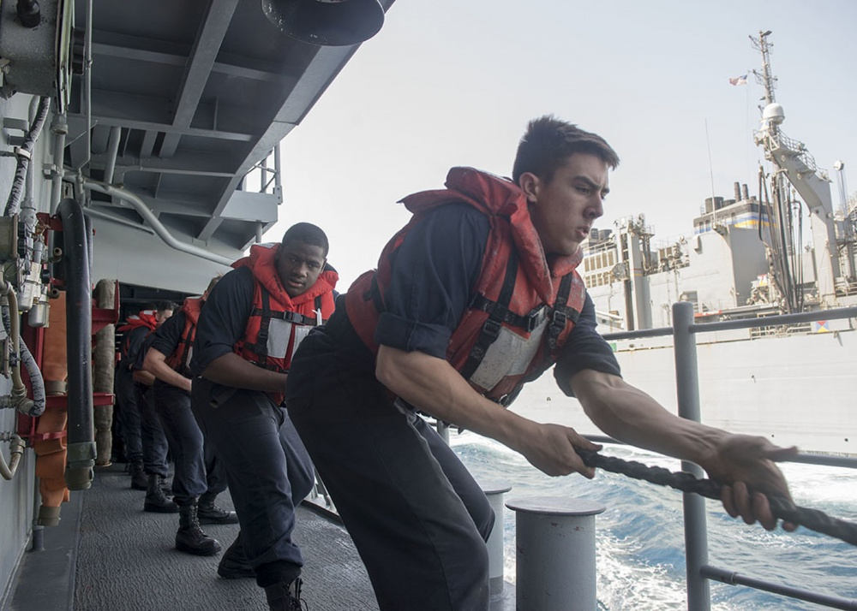

People in Motion
Take Photos, Write Captions, & Get Published / Basic UPAR Training

Slide 52



Ceremonies
Take Photos, Write Captions, & Get Published / Basic UPAR Training
Notes:
Rehearsals, you move around action, expected “money shots” that should be captured, easy to get up close, you know where action will be
Other- equipment, formations, PT, office, field….more challenging, shoot plenty, review later, find the good nuggets, action and posed shots will be

Slide 53

Key Moments to Capture
Reenlistment
Oath of office
Promotion
Pinning of rank
Change of Command
Incoming and outgoing
Take Photos, Write Captions, & Get Published / Basic UPAR Training
Notes:
Remember that there are people behind you- ceremonies
Don’t photo-bomb other photogs or videographer- ceremonies

Slide 54


Candid
Take Photos, Write Captions, & Get Published / Basic UPAR Training
Notes:
Hands in pockets, proper PPE, eyes open, body language is positive, don’t make subjects look bad
Candid vs posed
Focus on the face- without any context or background scenery, a face can express a lot.
It’s also constantly changing from emotion to emotion, giving you an endless source of interesting shots
A prime spot to look for candid photos is in a group or pair of people

Slide 55


Posed
Take Photos, Write Captions, & Get Published / Basic UPAR Training
Notes:
Posed Award or promotion ceremony.
Get Close and Watch Your Subjects Without Being Noticed
Turn off the Flash to Stay Discreet
Move Around Your Subjects for Better Composition
Shoot in Burst Mode to Capture Every Moment

Slide 56


(Good) Posed
Take Photos, Write Captions, & Get Published / Basic UPAR Training
Notes:
Even you need to take a posed shot, look for interesting backgrounds, use low or high angle to take the shot. Be creative.

Slide 57

(Good) Posed
Take Photos, Write Captions, & Get Published / Basic UPAR Training
Notes:
Find something interesting in the background, it does not need to be in focus, but it should add context to the shot.

Slide 58


What NOT to Do
Take Photos, Write Captions, & Get Published / Basic UPAR Training
Notes:
Promotion on left- she has a puppet on her hand while taking the oath of office. Big no go! And she was a PAO.
Dude on right is all kinds of wrong. I don’t know what status he is, I don’t know if he knew either.

Slide 59



What NOT to Do
Take Photos, Write Captions, & Get Published / Basic UPAR Training
Notes:
PPE- masks not covering nose
Background- OPSEC, maps or lists or statuses of equipment
Tonguing a POW sign
Jumping out of airplane with a fish, then taking a pic of it. Dumb.
People like flipping the camera off at the end of a course. Please don’t do this.

Slide 60




A Series of Photos Can Tell a Story
Establishing shot
Long shot
Medium shot
Close-up
Extreme close-up
Vary angles and distance
Take Photos, Write Captions, & Get Published / Basic UPAR Training
Notes:
Establishing Shot: lets the audience know the setting for the scene they're about to watch
Long Shot: a view of a scene
Medium Shot: is a shot that frames the subject from just above their head down to about midway on their torso.
Close-up: faces
Extreme Close-up: hands on an instrument or turning a wrench

Slide 61
Practical Exercise
Get up for a moment and grab a buddy
Now l want everyone to take about five minutes take a few pictures of…
Take Photos, Write Captions, & Get Published / Basic UPAR Training

Slide 62
Break!

Slide 63

WRITE CAPTIONS
Take Photos, Write Captions, & Get Published / Basic UPAR Training

Slide 64
Captions
Tell the story behind the photograph
Short and clear
1-3 Sentences
Influence picture meaning
Complements the pic by relating to non-visual senses
Explain technical information
Take Photos, Write Captions, & Get Published / Basic UPAR Training
Notes:
An explanation of what is going on in a photograph and why it is important to the audience.
If possible include command messages

Slide 65
Element of a Basic Caption
Who?
What?
When?
Where?
Why?
Photo credit (byline)
Take Photos, Write Captions, & Get Published / Basic UPAR Training

Slide 66

The Five W’s
WHO is in the photo? Full ID (Rank, name, unit and MOS) if less than three people
WHAT is in the photo? WHAT is the action taking place?
WHEN is the action taking place? (date, training event)
WHERE is the action taking place? (geographic location)
WHY is the action taking place? WHY does it matter?
If possible, explain the HOW?
Take Photos, Write Captions, & Get Published / Basic UPAR Training

Slide 67

Caption
U.S. Army Sgt. 1st Class Bryan T. Hinkle, a flight paramedic, and Sgt. Curtis Wright, a HH-60 Black Hawk helicopter repairer and crew chief assigned to Detachment 1, Golf Company, 3rd Battalion, 126th Aviation Regiment, Hawaiʻi Army National Guard, prepare a simulated patient for litter transport from a HH-60 Black Hawk helicopter by medical technicians from the 908th and 911th Aeromedical Staging Squadrons during Exercise Nexus Forge at Schofield Barracks, Hawaiʻi, Feb. 6, 2025. Nexus Forge allows participants to experience the full depth of tactical combat casualty care and deployment process, ensuring wartime combat readiness. (U.S. Army National Guard photo by Staff Sgt. Lianne M. Hirano)
Take Photos, Write Captions, & Get Published / Basic UPAR Training

Slide 68

Caption
U.S. Air Force Senior Master Sgt. Wilda Morita, 154th Maintenance Operations Squadron senior enlisted leader, waves from the backseat of a 173rd Fighter Wing F-15 Eagle April 15, 2025, at Joint Base Pearl Harbor-Hickam, Hawaiʻi. During Exercise Sentry Aloha, Morita experienced an incentive flight, accommodated by visiting F-15 personnel, to gain firsthand insight into the challenges fighter pilots face, whose missions are supported by her critical work in the Maintenance Operations Flight. (U.S. Air National Guard photo by Senior Master Sgt. Mysti Bicoy)
Take Photos, Write Captions, & Get Published / Basic UPAR Training

Slide 69

Caption
Rotary Wing aviators from the Hawai‘i Army National Guard (HIARNG) and the Armed Forces of the Philippines (AFP) held a key leader engagement on ‘Oahu during the first week of March 2025. The engagement included 103rd Troop Command Commander Col. Phoebe Inigo, State Army Aviation Officer Lt. Col. Deanna Manriquez, Philippine Air Force 205th Tactical Helicopter Wing Commander Brig. Gen. Alvin Hate and select members of their respective staffs. (U.S. Army National Guard photo by Master Sgt. Andrew Jackson)
Take Photos, Write Captions, & Get Published / Basic UPAR Training

Slide 70

Practical Exercise
Write a caption for this picture:
breaching exercise – demolitions, different explosive charge assembly and breaching methods
Spc. Sean McKee, a combat engineer
A Co., 227th BEB, 29th IBCT
unravels detonation cord
Schofield Barracks
March 2, 2025
trained alongside Reserve Soldiers
Take Photos, Write Captions, & Get Published / Basic UPAR Training

Slide 71
Practical Exercise - Caption
U.S. Army Spc. Sean McKee, a combat engineer assigned to Alpha Company, 227th Brigade Engineer Battalion, 29th Infantry Brigade Combat Team, Hawaiʻi Army National Guard (HIARNG), unravels detonation cord during a breaching exercise on Schofield Barracks, Hawaiʻi, March 2, 2025. HIARNG’s engineers trained alongside U.S. Army Reserve Soldiers on demolitions and different explosive charge assembly and breaching methods to enhance the unit’s readiness and warfighting capabilities while showcasing their lethality to distinguished leaders observing the training. (U.S. Army National Guard photo by Staff Sgt. John Schoebel)
Take Photos, Write Captions, & Get Published / Basic UPAR Training

Slide 72
Convention of Writing English
Proper Nouns
Word usage: their/they’re/there, your/you’re, its/it’s
Proper punctuation
Numbers: spell out 1-9, use numerals for the rest
Avoid passive voice (describing action)
  Active: U.S. Soldiers destroy confiscated ordnance.
  Passive: Confiscated ordnance is destroyed by U.S. Soldiers
Does not need to be 100% if sending to PAO. For unit-level release, keep it simple and as perfect as possible.
Take Photos, Write Captions, & Get Published / Basic UPAR Training

Slide 73

Constructing an Extended Caption
1st: Who, What, Where, When
Present Tense
Describe image in moment captured
2nd: Why
Past Tense
Significant background info
Quote
Command message
  The Hawaii Army National Guard is a community-based organization.
Why does the audience care?
Take Photos, Write Captions, & Get Published / Basic UPAR Training

Slide 74

Extended Captions
SAMPLE EXTENDED CAPTIONS
4W’s Sergeant First Class David Earle, an Officer Candidate with the Charlie company 29th Infantry Brigade Combat Team, Hawaii Army National Guard, participates in the stress shoot portion of the 2021 State Best Warrior Competition at Puuloa Rile Range, Ewa Beach, Hawaii April 1, 2021.
Why “The stress shoot pushes Soldiers to zero and qualify with their assigned weapon while placed under physical and mental stress,” said Earle. More than 30 Soldiers of the Hawaii Army National Guard participated in the 2021 Best Warrior Competition March 31-April 3, 2021.
Byline Photo by Spc. Ronald Bankole, 117th Mobile Public Affairs Detachment, Hawaii Army National Guard
Take Photos, Write Captions, & Get Published / Basic UPAR Training

Slide 75

Extended Captions
SAMPLE EXTENDED CAPTIONS
4W’s As part of Sexual Assault Awareness & Prevention Month, “Chalk Dah Walk” was held for the first time at Hawai‘i Army National Guard’s (HIARNG) Diamond Head Armory, Bldg. 300 on April 22. The event featured participants drawing and writing messages of hope and encouragement in chalk for sexual assault survivors on the sidewalk.
Why “Events like this are a way for us to let our survivors know that during times when it can feel very lonely, we have people that are here to support them and care about them,” says Edgar Campbell, HIARNG Sexual Assault Response Coordinator. “It’s our way of communicating to people that we don’t always get a chance to talk to.”
Byline Photo by SPC Ruben Duldulao, 117th Mobile Public Affairs Detachment, Hawaii Army National Guard
Take Photos, Write Captions, & Get Published / Basic UPAR Training

Slide 76

Practical Exercise
Write a caption for this picture
  Spc. Joshua Mendiola, healthcare specialist, B Company, 1109th TASMG, 103rd TC
  HIARNG Best Warrior Competition 2025
  Waimanalo
  April 4, 2025
  BWC identifies the most skilled and proficient Soldiers, NCOs and officers
  Hawaii’s winners will advance to the Region 7 competition against AZ, CA, CO, Guam, NV, NM and UT
Write a caption for this picture:
Take Photos, Write Captions, & Get Published / Basic UPAR Training

Slide 77

Practical Exercise - caption
U.S. Army Spc. Joshua Mendiola, a healthcare specialist assigned to Bravo Company, 1109th Theater Aviation Sustainment Maintenance Group 103d Troop Command, Hawaii Army National Guard (HIARNG), takes a tactical halt during the HIARNG Best Warrior Competition (BWC) 2025 in Waimanalo, Hawaii, April 4, 2025. The state-level BWC is an annual event held throughout the country by Army National Guard organizations to identify the most skilled and proficient Soldiers, noncommissioned officers and officers within their organization. Hawaii’s winners in the Soldier and noncommissioned officer categories will advance to the Region 7 competition against Arizona, California, Colorado, Guam, Nevada, New Mexico and Utah National Guards. (U.S. Army National Guard photo by Staff Sgt. John Schoebel)
Take Photos, Write Captions, & Get Published / Basic UPAR Training

Slide 78

DOD Key Themes
Take Photos, Write Captions, & Get Published / Basic UPAR Training

Slide 79

Captions and AI
AI has improved over the years, still not perfect (not replacing humans)
Feed it key details
Ask for multiple versions, adjust tone, edit
  It can be obvious when AI is used
Double check the facts
Good way to get ideas
Take Photos, Write Captions, & Get Published / Basic UPAR Training

Slide 80
Captions – Review
Tell the story behind the photograph
Allows the photo to be used by higher PA Element
Could be used to support a story or stand alone
IDs group shots
With a caption, photo can be used
For every shot you think is good, a caption is needed
Captioned photos help (Cdr, Unit, PA)
Don’t forget your byline (“Who are you?”)
Take Photos, Write Captions, & Get Published / Basic UPAR Training

Slide 81
Break!

Slide 82

Get Published
Take Photos, Write Captions, & Get Published / Basic UPAR Training

Slide 83
Approved & Published
The job is not done until your photos and captions are sent to higher PA elements
Consider who has the Release Authority
AT or exercise: higher PA element
Deployment: Bde PAO, then DIV or higher
Take Photos, Write Captions, & Get Published / Basic UPAR Training

Slide 84
Approved & Published
PAO can help get your photos to L3
Submit 3-5 of your best photos with captions (at least two sentences) to State PAO once a quarter
https://dod.hawaii.gov/hiarng/upar-social-media-submission/
Levels of Public Affairs
Level 1 | Unit level Example: unit newsletter
Level 2 | Example: TAG, DAG, CSEL, HING social media, HIDOD PowerPoints, Pupukahi, DVIDS or media releases
Level 3 | Example: Any media outlet (TV, online, newspaper), DOD, NGB, INDOPACOM, Big Army or Big Air Force, USARPAC
Take Photos, Write Captions, & Get Published / Basic UPAR Training

Slide 85




L2: Your Photo Can Go Anywhere
Pupukahi
HIDOD Social Media
DVIDS
HIDOD PowerPoints
Media releases
Take Photos, Write Captions, & Get Published / Basic UPAR Training

Slide 86
L3: Social Media – Approved Accounts
Hawaii Army National Guard
  www.facebook.com/HIARNG
  www.instagram.com/hawaiiarmynationalguard
  www.linkedin.com/company/hiarng
Hawaii Army Recruiting and Retention Battalion
  www.facebook.com/HawaiiNationalGuard
  www.instagram.com/hi_armynationalguard
117th Mobile Public Affairs Detachment
  www.facebook.com/117MPAD/
  www.instagram.com/117mpad/
Hawaii Air National Guard
  www.facebook.com/hawaiiairguard
  www.instagram.com/hawaiiairnationalguard/
  www.linkedin.com/company/hiang
Hawaii Air Recruiting and Retention
  www.facebook.com/HIANGRecruitingandRetention
  www.instagram.com/hawaiiairguardrecruiting/
Hawaii National Guard Leadership
  www.facebook.com/taghawaii
  www.instagram.com/tagofhawaii
  https://twitter.com/HawaiiTAG
  www.linkedin.com/company/hidod
  www.facebook.com/daghawaii/
  www.facebook.com/cselhawaii
Take Photos, Write Captions, & Get Published / Basic UPAR Training

Slide 87

L2: Posted on DVIDS, Potential L3
Take Photos, Write Captions, & Get Published / Basic UPAR Training

Slide 88


L3: Your Photo Can Go Anywhere
National Social Media
  Big Army, Big Air, NGB
Newspaper
TV
Take Photos, Write Captions, & Get Published / Basic UPAR Training

Slide 89
Who are the higher PA elements?
State PAO
117th MPAD
154th Wing PAO
Joint Staff PAO
JTF PAO…
  The goal is to get to Level 2
  Did it get used? You can follow up with State PAO
Take Photos, Write Captions, & Get Published / Basic UPAR Training

Slide 90

SHOOTING VIDEO & “B-ROLL”
In the beginning
Policy
UPAR Responsibilities
Public Affairs Planning
Public Affairs Liaison
Take Photos, Write Captions, & Get Publishing
Record Basic Video
Final Notes
Record Basic Video / Basic UPAR Training

Slide 91
What is "B-roll"
What other organizations use to make a video news story, the raw footage
If media cannot attend, they rely on HING shooting B-roll of an event
It is advantageous to HING for use to shoot B-roll and submit to media for possible usage
Record Basic Video / Basic UPAR Training

Slide 92
What is "B-roll"
U.S. Soldiers from Alpha Company, 227th Brigade Engineer Battalion, 29th Infantry Brigade Combat Team, Hawaiʻi Army National Guard (HIARNG) and the Headquarters and Headquarters Company, 411th Engineer Battalion, 303rd Maneuver Enhancement Brigade, 9th Mission Support Command, U.S. Army Reserve conduct intercomponent demolition training on Schofield Barracks, Hawaiʻi, March 2, 2025. HIARNG’s engineers trained alongside U.S. Army Reserve Soldiers on demolitions and different explosive charge assembly methods to enhance the unit’s readiness and warfighting capabilities while showcasing their lethality to distinguished leaders observing the training. (U.S. Army National Guard video by Sgt. Sean Walker)
https://www.dvidshub.net/video/954069/b-roll-hawaii-army-national-guards-combat-engineers-showcase-warfighting-capabilities-with-demolition-training
Record Basic Video / Basic UPAR Training

Slide 93
Shooting Video and "B-roll"
Video
can be used as stand-alone
ready for publishing
B-roll
a series of videos used by specialist or media
raw footage that can be edited for a news story
Both: 15 seconds or less
Shoot using horizontal mode
keep as still as possible
Watch your lighting (backlit is the enemy of good video)
Try not to zoom, move your feet
Record Basic Video / Basic UPAR Training

Slide 94

Shooting Video and “B-roll”
Vary angles and depth for B-roll
Watch out for “video bombing”
Is the subject worth shooting with video?
When shooting, don’t talk
Review it before sending
Record Basic Video / Basic UPAR Training

Slide 95
Practical Exercise
Get up for a moment and find a buddy
Now l want everyone to take about five minutes take a few Videos of…
Record Basic Video / Basic UPAR Training

Slide 96
B-roll “package” should include:
Multiple clips
Establishing shot, long shots, medium shots, close-ups
Cut-aways (interruption of a continuously filmed action by inserting a view of something else)
Establishing Shot
Long Shot
Medium Shot
Close-up
Record Basic Video / Basic UPAR Training

Slide 97
ALL PAU!
Wait!
Final Notes
In the beginning
Policy
UPAR Responsibilities
Public Affairs Planning
Public Affairs Liaison
Take Photos, Write Captions, & Get Publishing
Record Basic Video
Final Notes
Final Notes/ Basic UPAR Training
Notes:
Have hand out ready and printed
Be sure to have pens for the class to use.

Slide 98
You Are Almost a UPAR
Create a Public Affairs Plan – meet commander, set goals & create plan
Public Affairs Liaison – POC for all things public affairs
Take Photos, Write Captions and Get Published - #1 job
Record Basic Video – film short clips
Intermediate UPAR Class
5. Media escort and preparation - prepare your unit and assist the media
6. Media relations – understand media and prepare for interviews
7. Command information – communicating to members of the command
8. Writing the story - news story vs feature story
Final Notes/ Basic UPAR Training

Slide 99
Final Word
Remember, if we don’t tell our story, someone else will!
The Army Public Affairs Program (AR 360-1)
  https://armypubs.army.mil/epubs/DR_pubs/DR_a/ARN30105-AR_360-1-000-WEB-1.pdf
Communication Strategy and Public affairs Operations
  https://armypubs.army.mil/epubs/DR_pubs/DR_a/ARN34864-FM_3-61-000-WEB-1.pdf
Army Social Media Handbook
  https://www.army.mil/socialmedia/
Final Notes/ Basic UPAR Training

Slide 100

UPAR Resources
Handbook
Slideshow
Submit photos & captions
Helpful links
DVIDS
Social media links
Examples
Additional duty appointment sample
https://dod.hawaii.gov/hawaii-national-guard-unit-public-affairs-representative-program/
Final Notes/ Basic UPAR Training

Slide 101

Contact
State PAO: (808) 441-7000
Email: Rachel.s.blaire.civ@army.mil, Rachel.s.blaire@hawaii.gov or
dod.pao.all@hawaii.gov
Final Notes/ Basic UPAR Training

Slide 102

AAR
Final Notes/ Basic UPAR Training

