Slide 1
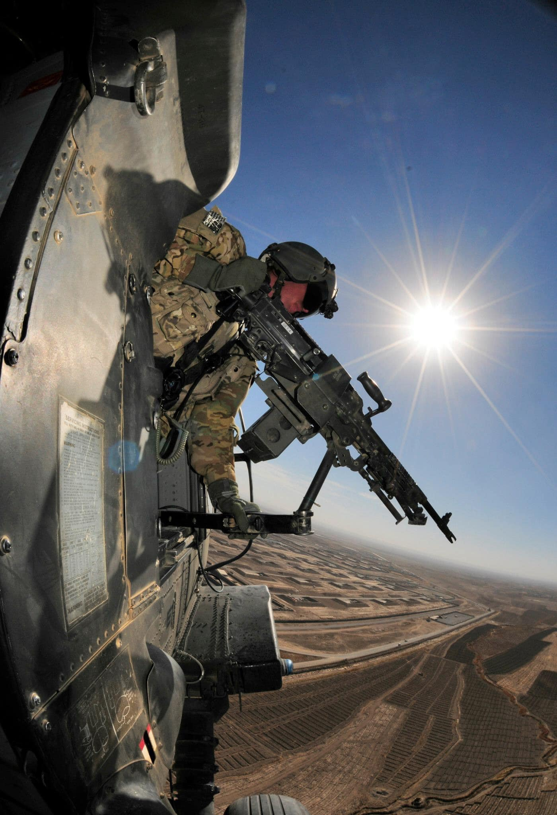


Hawaii National Guard
Basic UPAR Training

Slide 2
Agenda
In the beginning…
Policy
UPAR Responsibilities
Public Affairs Planning
Public Affairs Liaison
Take Photos, Write Captions, & Get Published
Record Basic Video
AAR
Page 1
Introduction / Basic UPAR Training

Slide 3
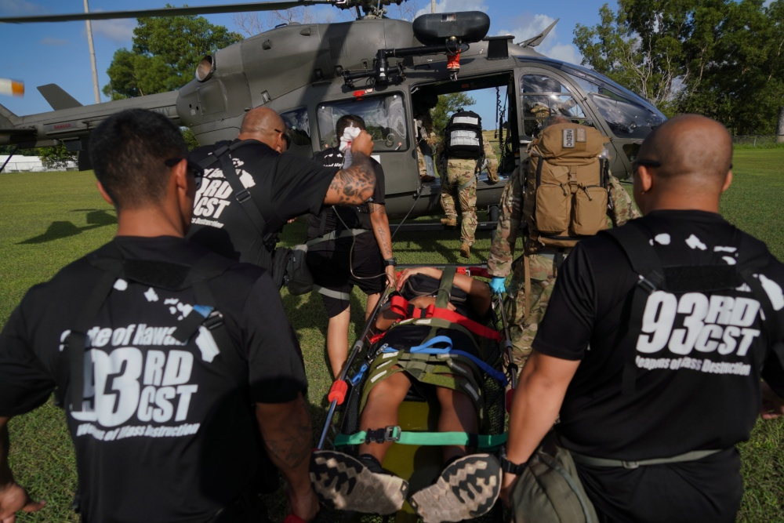
In the Beginning…
Introductions
  Rank, first and last name, unit, favorite snack
UPAR
Mahalo!
Building a foundation (for you and your unit’s PA program)
The HING UPAR Handbook
Page 2
Introduction / Basic UPAR Training
Notes:
- tell all of us your rank, first and last name, unit, favorite snack.
Thank you all for being here
learn the basics of how to be a UPAR. advanced UPAR class offered. UPAR It nests with the slides
The highest PA element is the State Public Affairs Office, if they can get 3-5 pics from UPARs a quarter, help share the HIARNG story

Slide 4

Why UPAR?
Support HING Public Affairs program
We need your help in telling your units, and “Hawaii National Guard story”
  HIARNG 23 PAO positions
  HIANG 12 PAO positions
  Over 5,500 guardsman
History of HING
UPARS need two important things from the commander and the unit:
  Time
  Support
Page 3
Introduction / Basic UPAR Training
Notes:
There are over 5,500 stories to tell.
PA Specialists cannot cover everything.
Commanders will need to provide you UPARs two things….
Time: for a UPAR to plan and carry out tasks, to meet with the UPAR to plan and initiate the unit’s PA Plan.
Support: The unit’s staff need to know the UPAR and that command supports the UPAR's efforts. Involve the UPAR in unit meetings, access to info

Slide 5

Policy
In the beginning
Policy
UPAR Responsibilities
Public Affairs Planning
Public Affairs Liaison
Take Photos, Write Captions, & Get Published
Record Basic Video
AAR
Page 4
Policy / Basic UPAR Training

Slide 6
DOD Policy
Free-flow of general and military information will be made available without censorship or propaganda
Information will not be classified or withheld to protect the Government from criticism or embarrassment
Information will be withheld only when disclosure would:
  adversely affect national security
  threaten safety or privacy of the Armed Forces
  otherwise directed by law or regulation
DoD’s obligation to provide the public with information on major programs may require detailed public affairs planning and coordination within the DoD and other agencies
Propaganda has NO place in DoD public affairs
Page 5
Policy / Basic UPAR Training

Slide 7
DOD Policy
Standalone or combined portions of classified and unclassified information have the potential to compromise classified information or disclose operations security
Information intended for public release is first cleared via security and policy review, usually conducted by Public Affairs
Effective communication is required at the core of all government organizations
Disseminate the information to the intended audience
Increase public awareness to the organization’s mission, goals, policies, and programs
Helps foster community relations and builds good will
Release of accurate information must be done with speed, efficiency, and through a variety of mediums
We are accountable to taxpayers and rely on their support
Page 6
Policy / Basic UPAR Training

Slide 8

OPSEC
Operations Security
Exact # of troops, Exact times of departure, radio frequencies, which vehicles are mission ready, what route a unit will take…
Adhere to SAPP (Security, Accuracy, Propriety and Policy)
All DoD employees must practice security at the source
All personnel must be aware of OPSEC and be responsible for safeguarding sensitive information
OPSEC applies to:
  media interviews
  sharing information/imagery with family and friends, including email and social media platforms
Prevents unauthorized disclosure of information that could degrade operational effectiveness
Page 7
Policy / Basic UPAR Training

Slide 9
SAPP
Security, Accuracy, Propriety and Policy
Security
Is there an OPSEC concern? Protect your team
Accuracy
Is the information correct and true? Don’t spread misinformation
Propriety
Is it in good taste? Be professional and respect privacy rights
Policy
Do not violate DoD policy; if you don’t know, Ask
Goes hand-in-hand with operations and personnel security
Monitor the information environment and balance release to print media, television, social media, etc.
Page 8
Policy / Basic UPAR Training

Slide 10
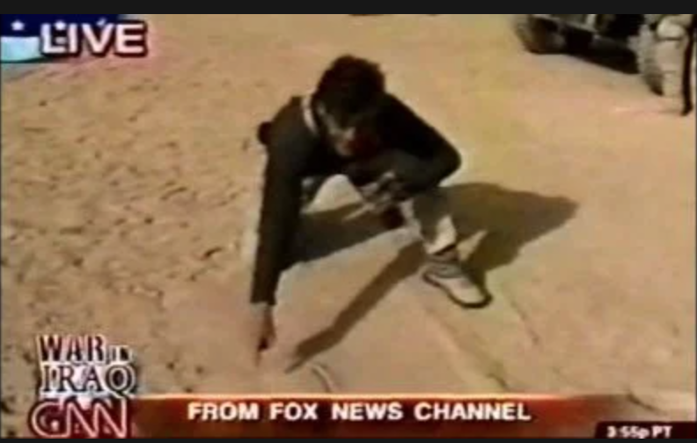
What Not To Do
For example:
In 2003, Geraldo Rivera was traveling with the 101st Airborne Division in Iraq as a war correspondent for Fox News and made a major tactical error
Rivera drew a map in the sand during a live broadcast, pinpointing his exact location and revealing the time and details of an upcoming operation
What could a PAO or UPAR have done to prevent this?
Page 9
Policy / Basic UPAR Training

Slide 11
Misc. & Things to Consider
Parental Permissions
Photos of children during family day or community day events must have parental permission prior to releasing
Photo/video release form can be obtained from PAO office
Copyright and Fair Use of your products
If you are a service member, working with government equipment, and/or on government time, you cannot copyright your work - it belongs to the government
FOIA (Freedom of Information Act)
Allows members of the public who follow the rules established by proper authority in the DOD to request a record without it being withheld unless the record is exempt
Every large unit has a FOIA Rep, UPARs may assist in gathering info, but never lead FOIA responses
Do not forward bad or inappropriate photos, please delete them
Page 10
Policy / Basic UPAR Training

Slide 12
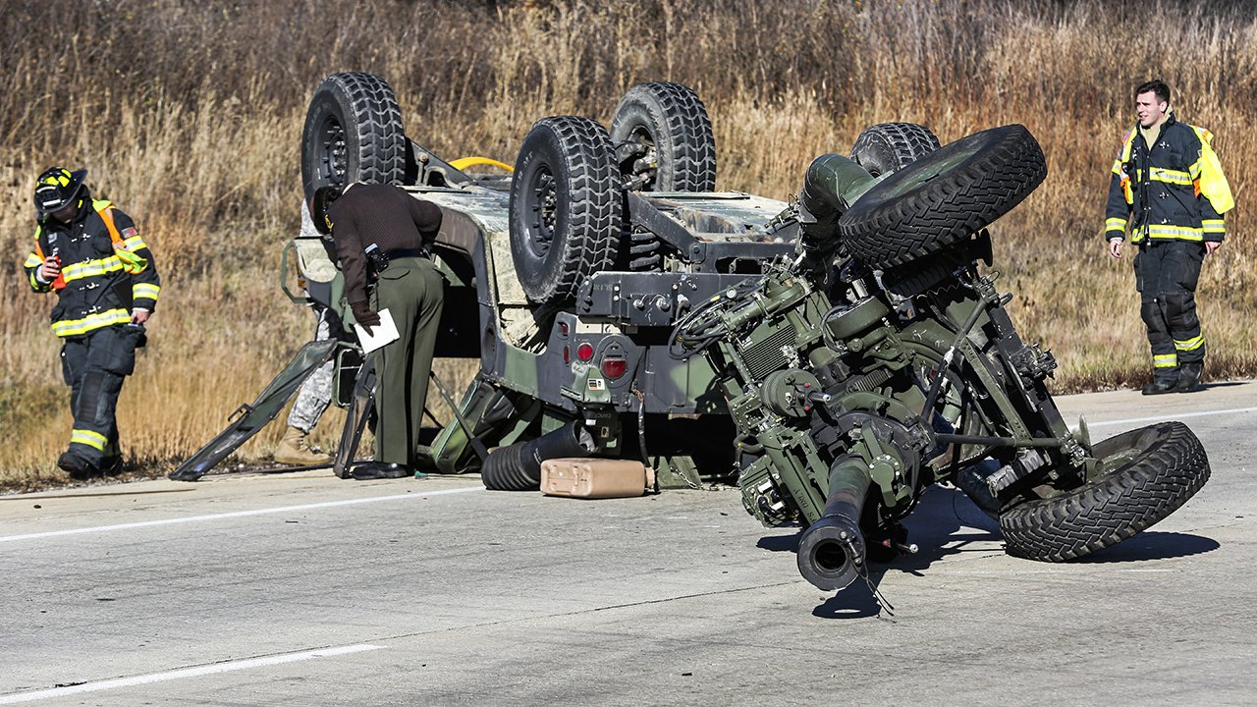
Where the PA steps in
Privacy Act and PII
HIPAA
Deaths, Incidents and Accidents
Criminal Matters and Investigations
Let PAO handle these matters
PAO has specific training
If unit or UPAR does speak to media after an incident: Notify Public Affairs immediately
Page 11
Policy / Basic UPAR Training

Slide 13
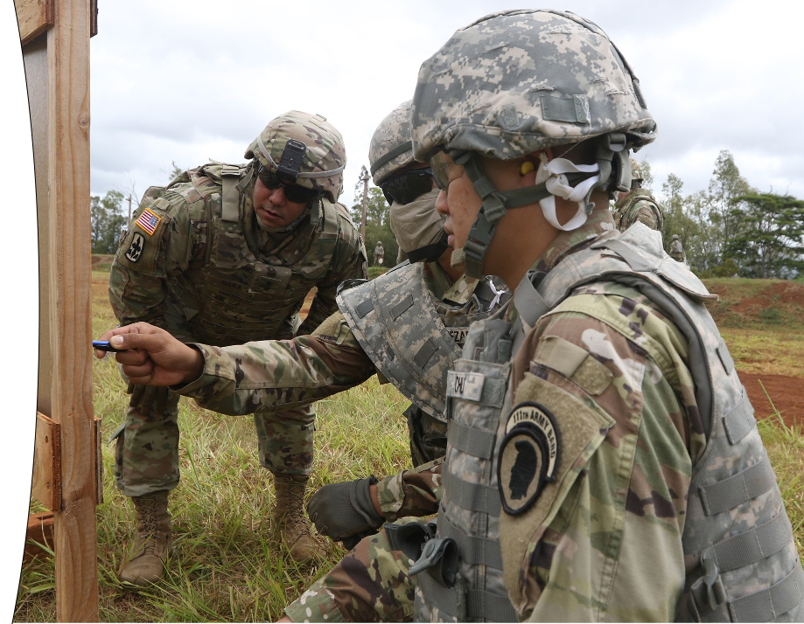
UPAR RESPONSIBILITIES
In the beginning
Policy
UPAR Responsibilities
Public Affairs Planning
Public Affairs Liaison
Take Photos, Write Captions, & Get Published
Record Basic Video
AAR
Page 12
UPAR Responsibilities / Basic UPAR Training

Slide 14
UPAR Responsibilities
Create a Public Affairs Plan – meet with Commander to set goals and create a plan
Public Affairs Liaison – being the POC for all things public affairs
Take Photos, Write Captions and Get Published - #1 job
Record Basic Video – film short clips
Media Escort and Preparation – prepare your unit and assist the media
Media Relations – understand the media and prepare for interviews
Command Information – communicating to members of the command
Writing the Story - news story vs feature story
Page 13
UPAR Responsibilities / Basic UPAR Training

Slide 15
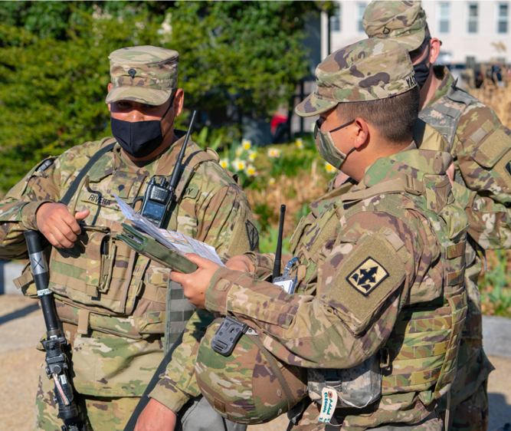
PA PLANNING
In the beginning
Policy
UPAR Responsibilities
Public Affairs Planning
Public Affairs Liaison
Take Photos, Write Captions, & Get Published
Record Basic Video
AAR
Page 14
Public Affairs Planning / Basic UPAR Training

Slide 16
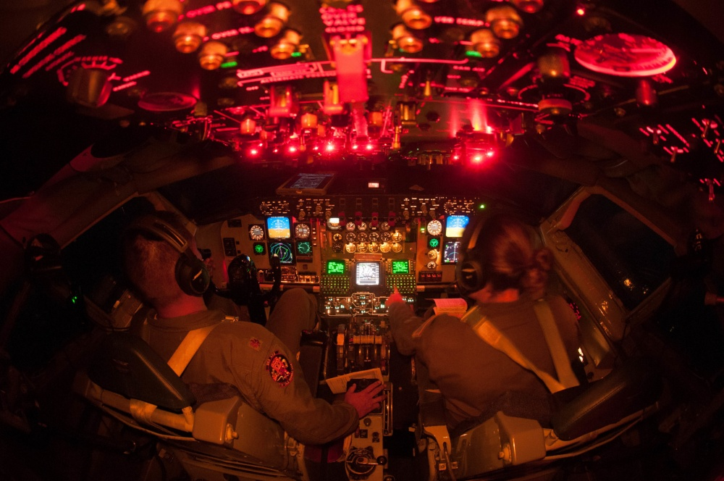
PA Planning
Talk to unit Commander
Get info from YTB and Tng Schedules
Make a plan together
Pitch ideas
Choose events, coordinate with POC
Prepare, have a schedule
Annual Training = Goldmine
Look at other units’ social media to get ideas
PA Plans are fluid, keep adding to it
Page 15
Public Affairs Planning / Basic UPAR Training

Slide 17
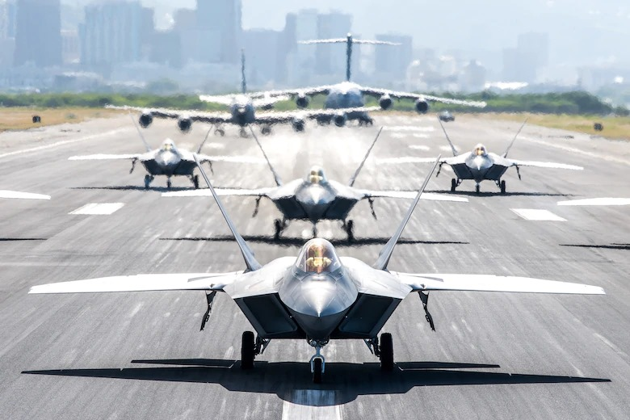
Release Authority
Approving of photos- Release Authority
  Unit level = Commander for unit newsletters
  This step protects you
Levels of Public Affairs
Level 1 | Unit level Example: unit newsletter
Level 2 | MSC’s Example: HIARNG, Recruiting, MRD, 29th IBCT, 103rd TC, 298th MFTR social media
Level 3 | Example: TAG, DAG, CSEL social media, HIDOD PowerPoints, Pupupukahi, DVIDS or media releases
Level 4 | Example: Any media outlet (TV, online, newspaper), DOD, NGB, INDOPACOM, Big Army or Big Air Force, USARPAC
Page 16
Public Affairs Planning / Basic UPAR Training

Slide 18
PA Plan Sample
OCT 2023
Social Media Post - Weapons qualifications Take photos, get best scores and new shooters. Write caption. Send to higher PA elements
Dec Newsletter - Start designing layout and looking at past socials for story ideas
DEC 2023
Social Media Post - Mandatory Classes Take photos. Write caption. Send to higher PA elements
Dec Newsletter - Do final draft. Get commander approval. Distribute newsletter
Holiday party - Take photo. Write a story. Send to higher PA elements
NOV 2023
Social Media Post – New PT test Take photos, interview, most improved. Write caption. Send to higher PA elements
Dec Newsletter - Draft content and pics. Get Commander to write a column
Coordinate with higher PA, about new equipment, Reach out to contact with story idea and details (5 W’s)
Holiday party contact committee to get event details
Annual Training
Social Media Post - New equipment Take photos. Write caption. Send to higher PA elements
Social Media Post - Soldier’s first AT Take photos. Write caption. Send to higher PA elements
Page 17
Public Affairs Planning / Basic UPAR Training

Slide 19
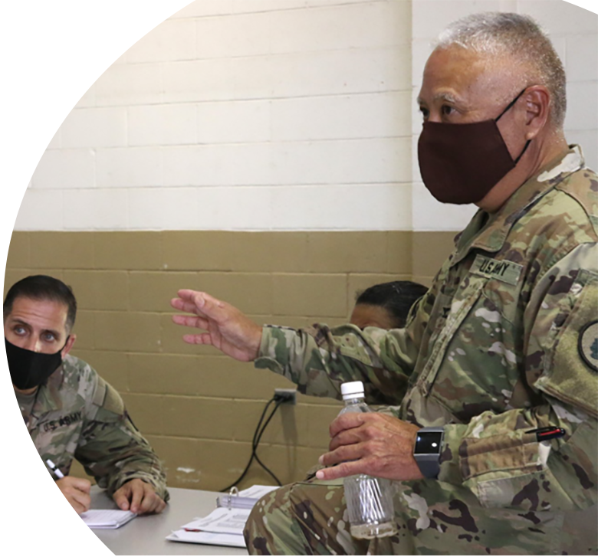
What Should Come Out of a PA Plan?
Commander’s intent / objectives
Commander’s priorities, command messages
What will be covered by UPAR during drills and Annual Training
Release authority given
When to request PAO
Expectations, content evaluation
Page 18
Public Affairs Planning / Basic UPAR Training

Slide 20
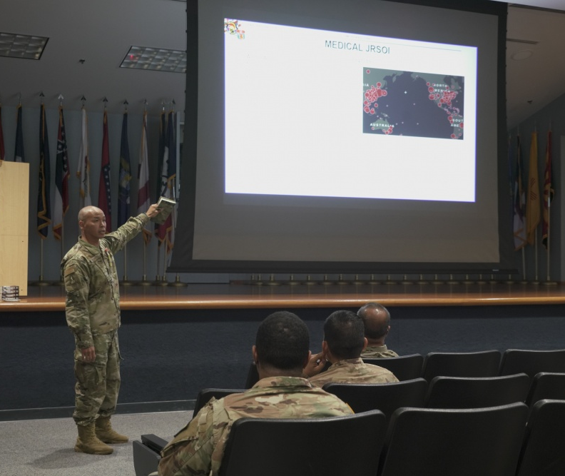
PA LIAISON
In the beginning
Policy
UPAR Responsibilities
Public Affairs Planning
Public Affairs Liaison
Take Photos, Write Captions, & Get Published
Record Basic Video
AAR
Page 19
Public Affairs Liaison / Basic UPAR Training

Slide 21
PA Liaison
A person that allows different organizations or groups to work together and provide information to each other.
Position of responsibility
To the Commander
To Higher PA elements
Can share the most current PA information from higher PA element- State PAO, 117th MPAD, 29th IBCT PAO
Could be unit spokesperson for media engagements
Page 20
Public Affairs Liaison / Basic UPAR Training

Slide 22
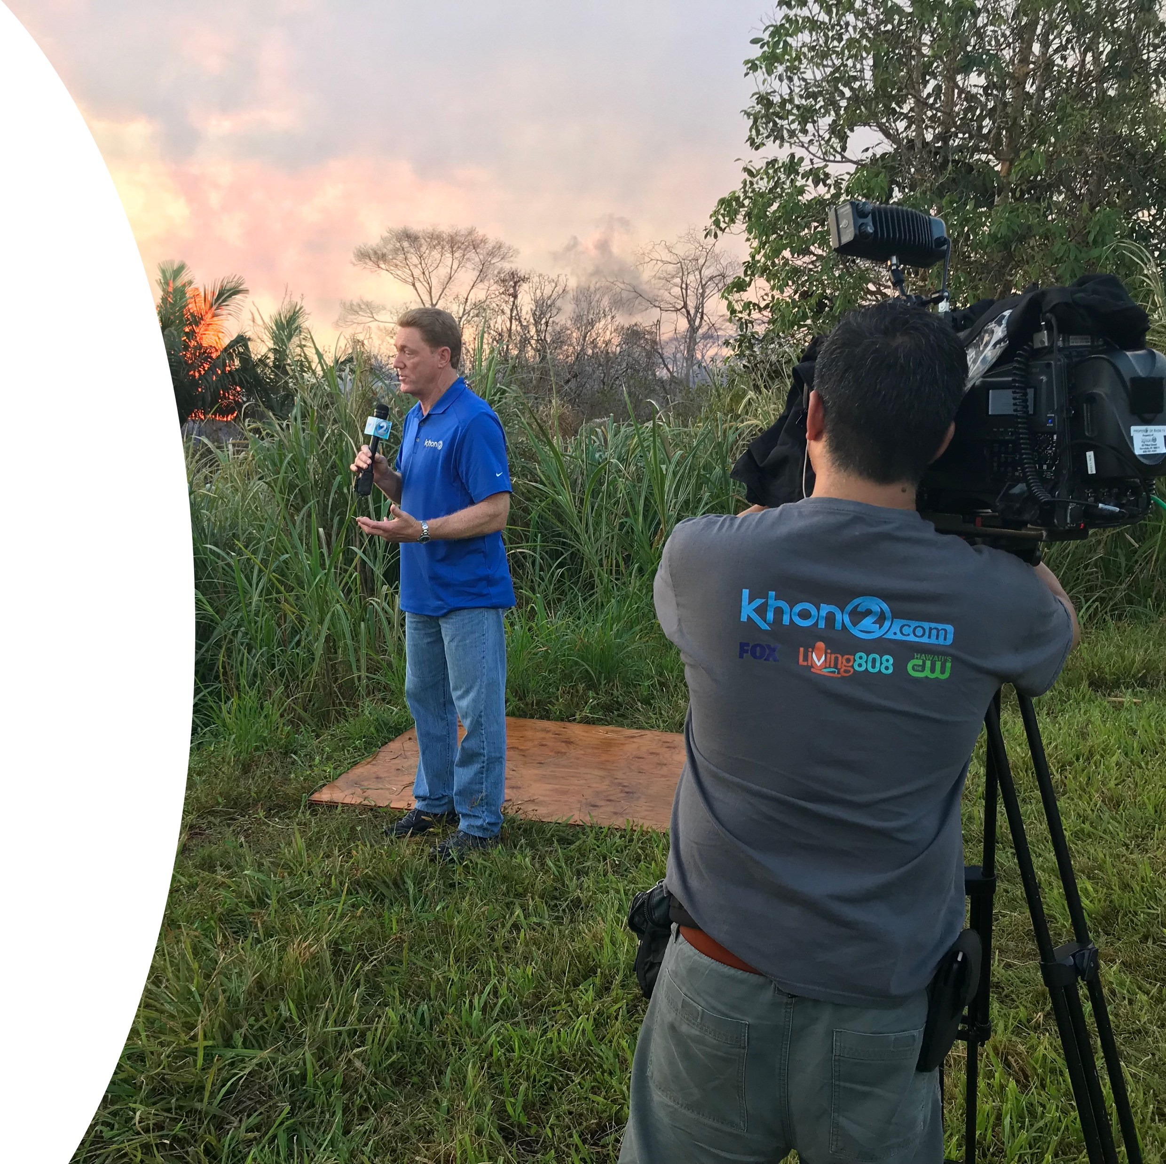
PA Liaison
Provide counsel to the Commander and Higher PA
This does not happen automatically
Be self-aware and respectful
Understand what higher PA element is
“Pulling and Pushing” of information
UPARs will immediately notify PAO of any issues that might gain national or international media attention (accidents/investigations)
Page 21
Public Affairs Liaison / Basic UPAR Training
Notes:
Establish communication with 29th IBCT PAO or 117th MPAD, as they will approve all products and be the release authority during exercises or some training events.
The State PAO will be your full-time higher PA element.
The State PAO oversees and provides all UPAR training and serve as PA SMEs. During State Active Duty Missions there may be a Task Force PAO, but you can always contact the State PAO.

Slide 23
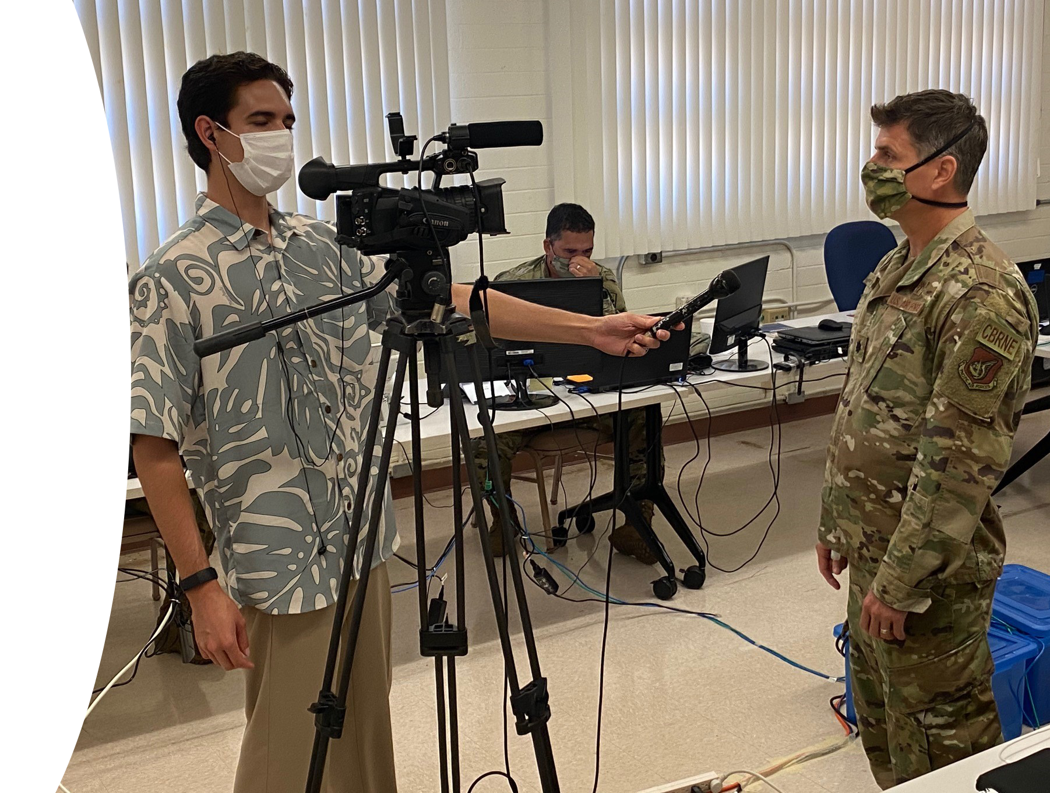
PA Liaison
Not PA trained, just helping commander
With approval from higher PA, Coordinate unit level media escort
First person who media meets when visiting
Page 22
Public Affairs Liaison / Basic UPAR Training

Slide 24
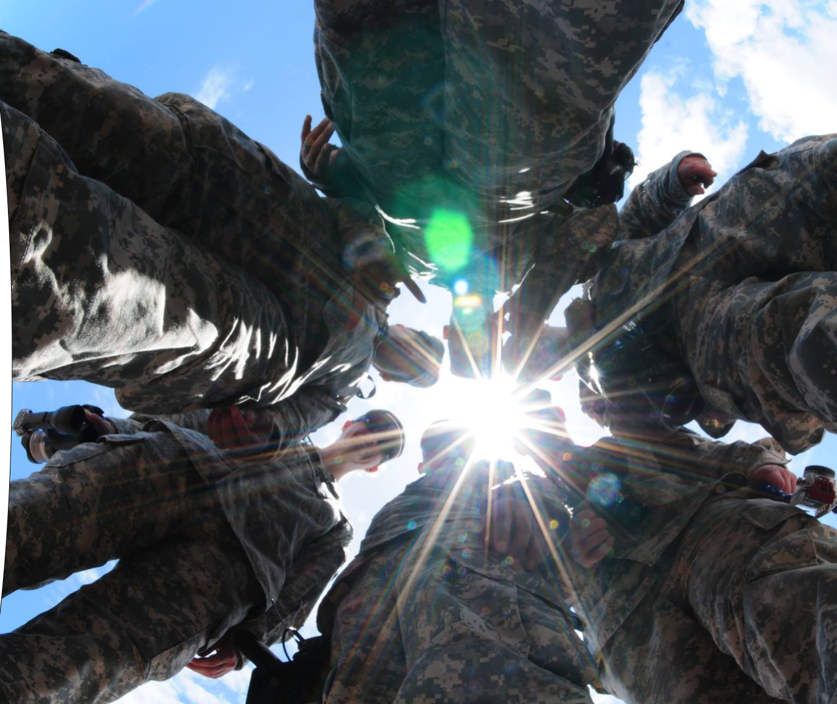
TAKE PHOTOS, WRITE CAPTIONS, & GET PUBLISHED
In the beginning
Policy
UPAR Responsibilities
Public Affairs Planning
Public Affairs Liaison
Take Photos, Write Captions, & Get Published
Record Basic Video
AAR
The primary function that the State PAO would like every UPAR to do is to take a good photo, write a caption for it and then get it to the next PA echelon.
Page 23
Take Photos, Write Captions, & Get Published / Basic UPAR Training

Slide 25
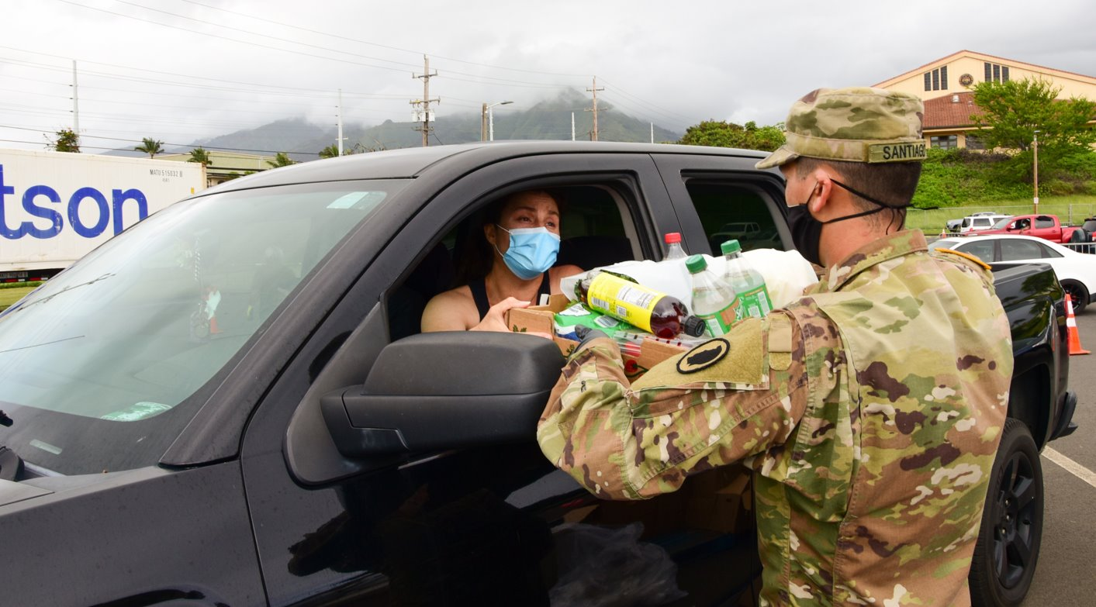
TAKE PHOTOS
Page 24
Take Photos, Write Captions, & Get Published / Basic UPAR Training

Slide 26
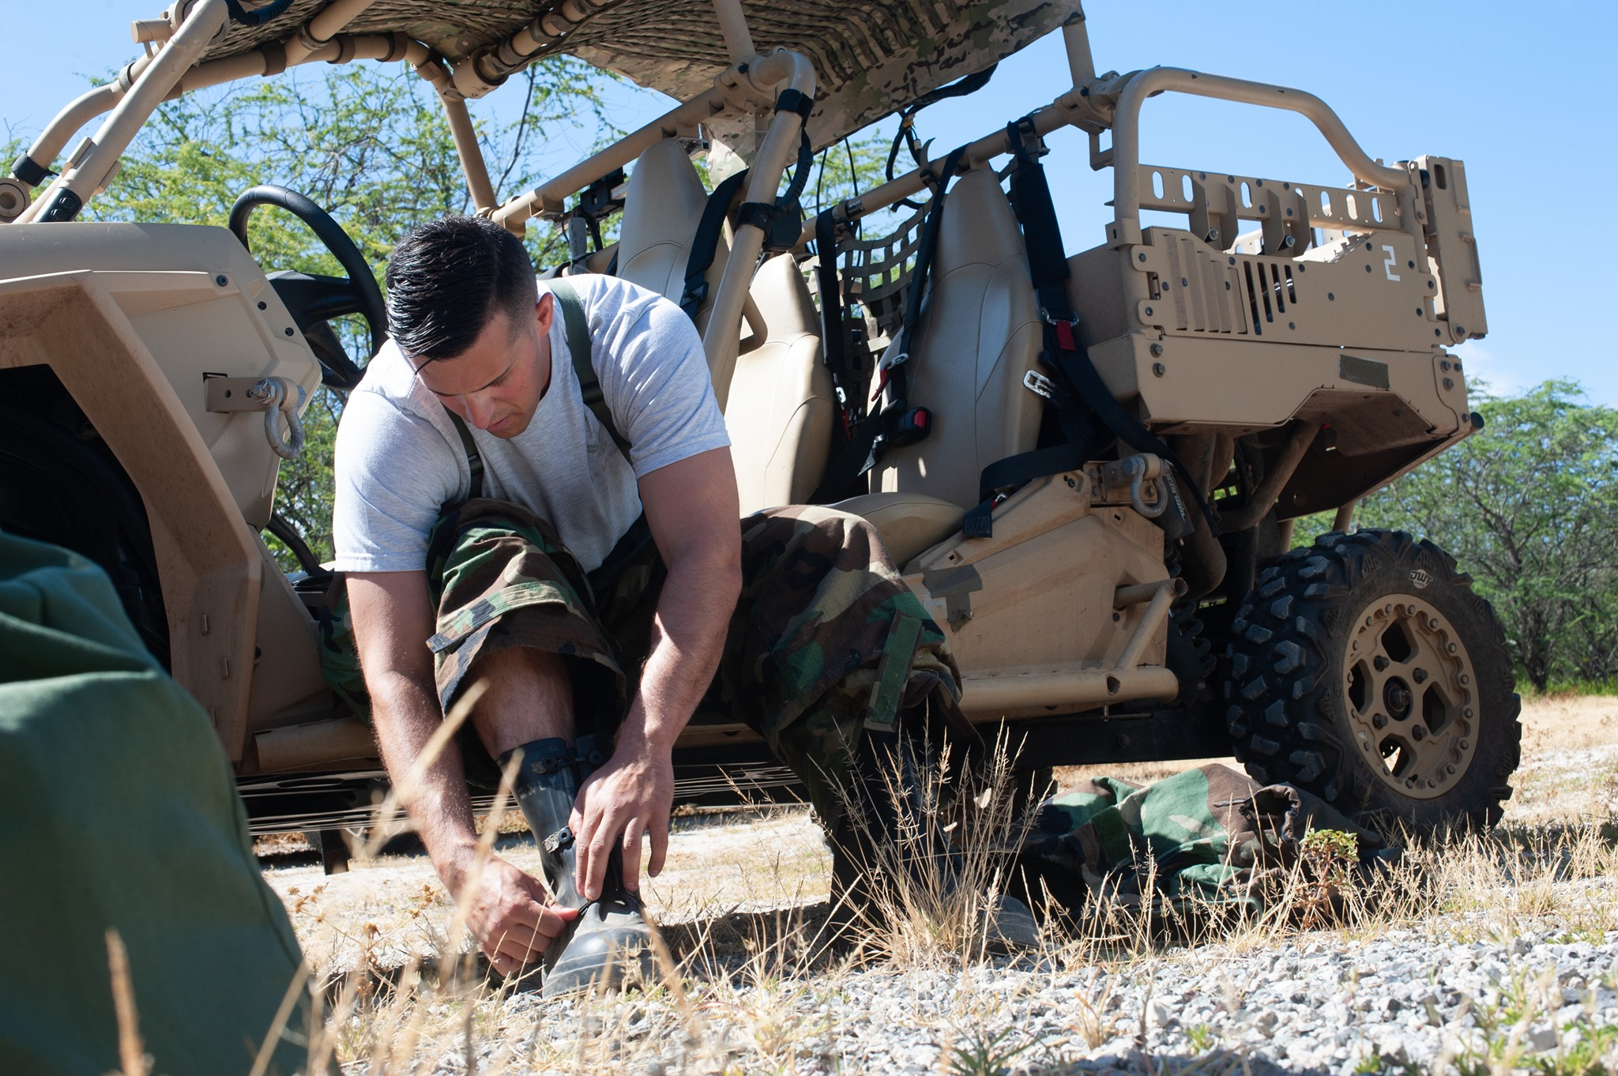
Photos
Action Begin shooting before the subject starts moving through the scene.
“Faces and Patches”
Less “Shaka” photos
Catch subject doing something, not looking at camera
Less pics at desks
Page 25
Take Photos, Write Captions, & Get Published / Basic UPAR Training

Slide 27
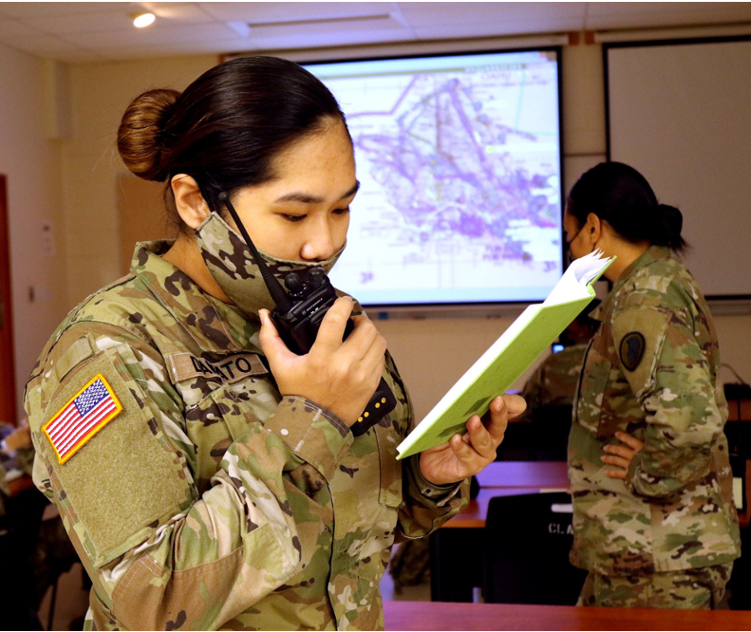
Photos – Things to Look For
What is in the background?
Is everyone in proper uniform? No Badges.
Proper PPE
Hands in pockets
Not to standard- injured, belly hanging out, non-reg hair, pens, tilted hat
Eyes closed; mouth open
Page 26
Take Photos, Write Captions, & Get Published / Basic UPAR Training

Slide 28
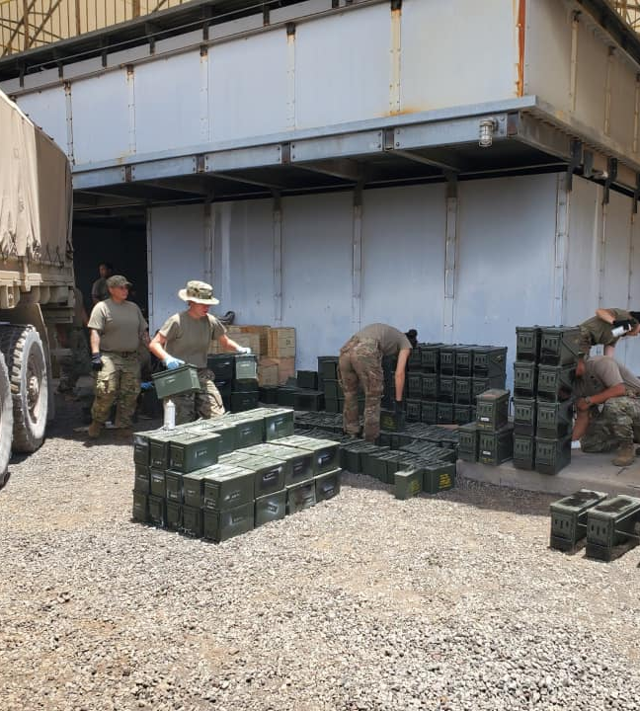
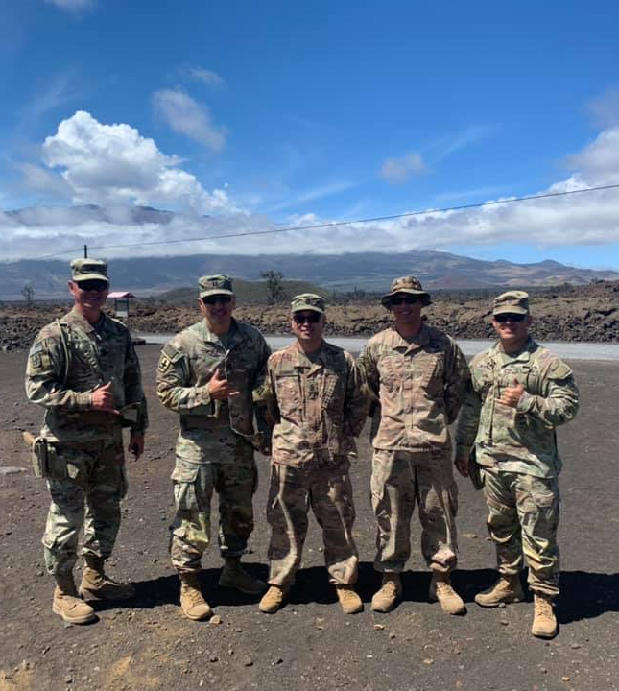
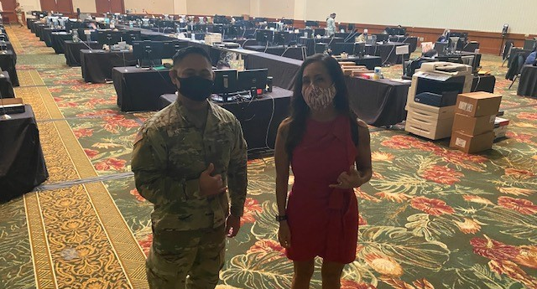
More to Look For
Backlit subjects
Shadows on face
“Photo bombers”
No faces, but butts and backs
Cigarettes/ vapes, phones in hands
Muzzle awareness
OSHA violations- safety
Product endorsement
Middle fingers (it happens!)
Page 27
Take Photos, Write Captions, & Get Published / Basic UPAR Training

Slide 29

Taking Pictures with Your Smart Phone
Get close to the action, but do not interfere, restrict movement, or compromise safety
  Do a practice run
Focus on your subject tap the screen
Don’t stop shooting
  Burst mode
  Review your photos after the event
Prepare ahead of time battery life & storage space (Be at rehearsals)
Page 28
Take Photos, Write Captions, & Get Published / Basic UPAR Training

Slide 30
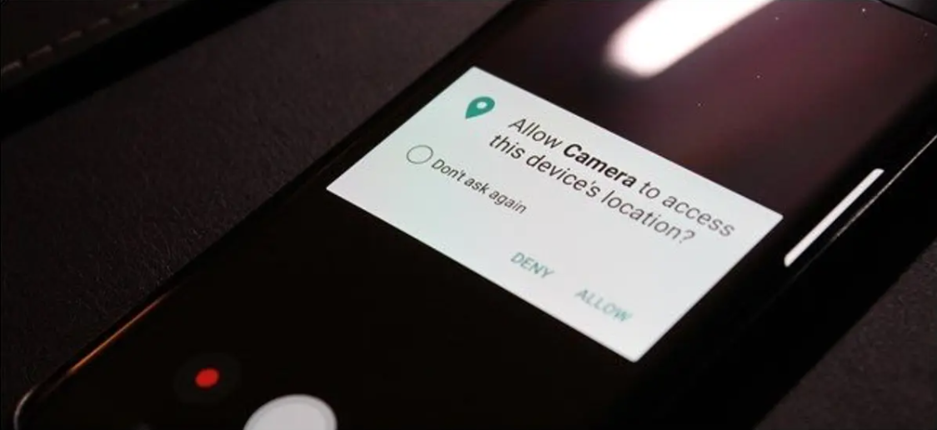
Smartphone Tips
Turn off GEO Tagging on your phone
High Dynamic Range- setting to help with low light
Turn off the camera sound
Helpful hint: airplane mode
Page 29
Take Photos, Write Captions, & Get Published / Basic UPAR Training
Notes:
HDR settings: (High Dynamic Range), HDR photo is created by balancing the shadows and highlights of an image so that neither is being favored or ignored

Slide 31


Rule of Thirds
Place your subject in the cross hairs for a more “balanced” photo
If your subject is moving, leave empty room to move in and out of the frame.
Page 30
Take Photos, Write Captions, & Get Published / Basic UPAR Training

Slide 32

Enable Gridline on Your Smart Phone
IOS
Setting
Camera
Under composition
  Switch on grid
Android
Camera
Setting
Switch on grid lines
Page 31
Take Photos, Write Captions, & Get Published / Basic UPAR Training

Slide 33

Photos – Using Angles
Eye level
Top view
High angle
Framed view / Hidden view
Low angle
Off-center
Action
Static shot
Focal Point
Candid
Posed
Page 32
Take Photos, Write Captions, & Get Published / Basic UPAR Training

Slide 34
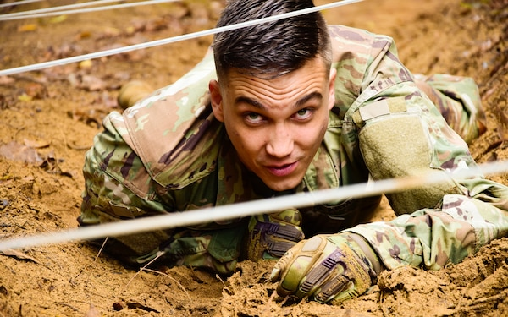
Eye Level
Page 33
Take Photos, Write Captions, & Get Published / Basic UPAR Training
Notes:
Eye Level: camera / smartphone is placed at the same height as the eyes of the subject in your frame

Slide 35
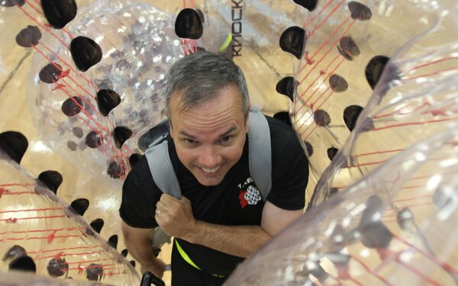
Top View
Page 34
Take Photos, Write Captions, & Get Published / Basic UPAR Training
Notes:
Top Angle: where the smartphone looks down on the subject

Slide 36
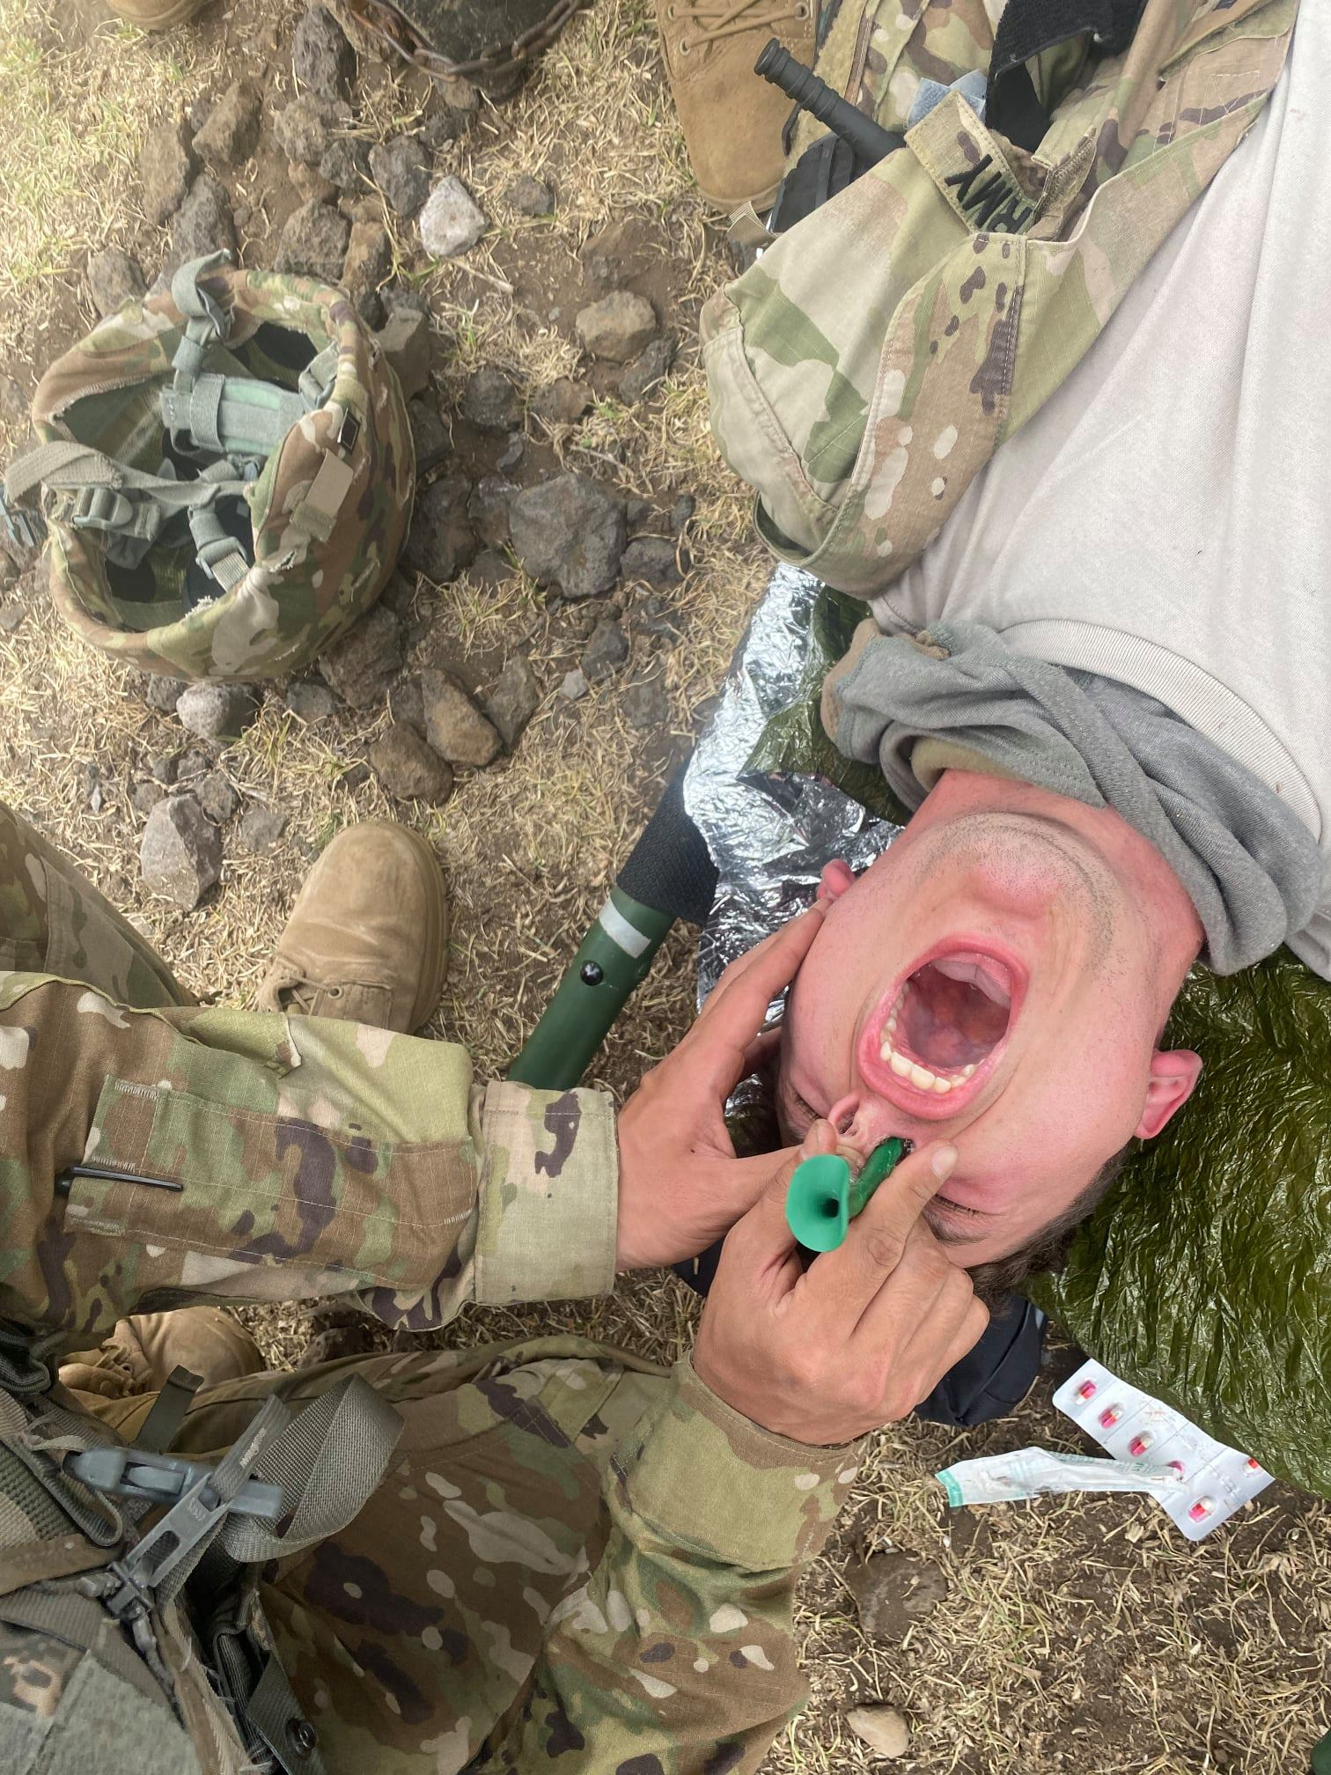
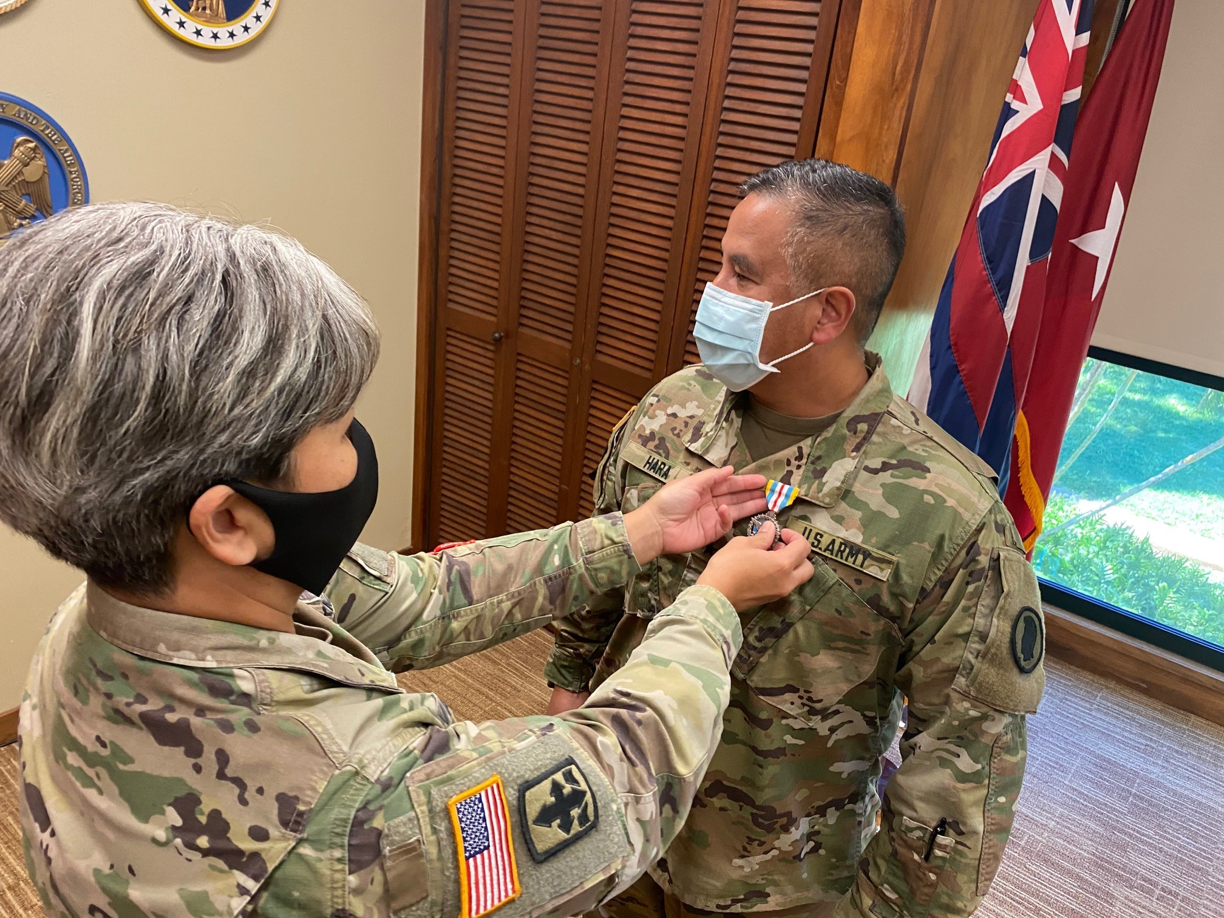
High Angle
Page 35
Take Photos, Write Captions, & Get Published / Basic UPAR Training
Notes:
A high-angle shot: placing the smartphone high about your head angled down on your subject. Similar to a top angle

Slide 37
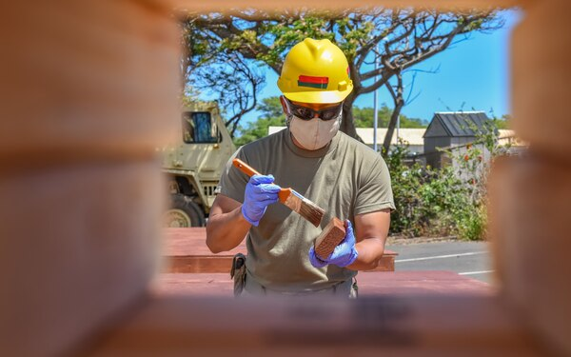
Framed/Hidden View
Page 36
Take Photos, Write Captions, & Get Published / Basic UPAR Training
Notes:
Framed / Hidden View: can be set and framed in any shot size you like, just as long as there is only one character featured within the frame

Slide 38
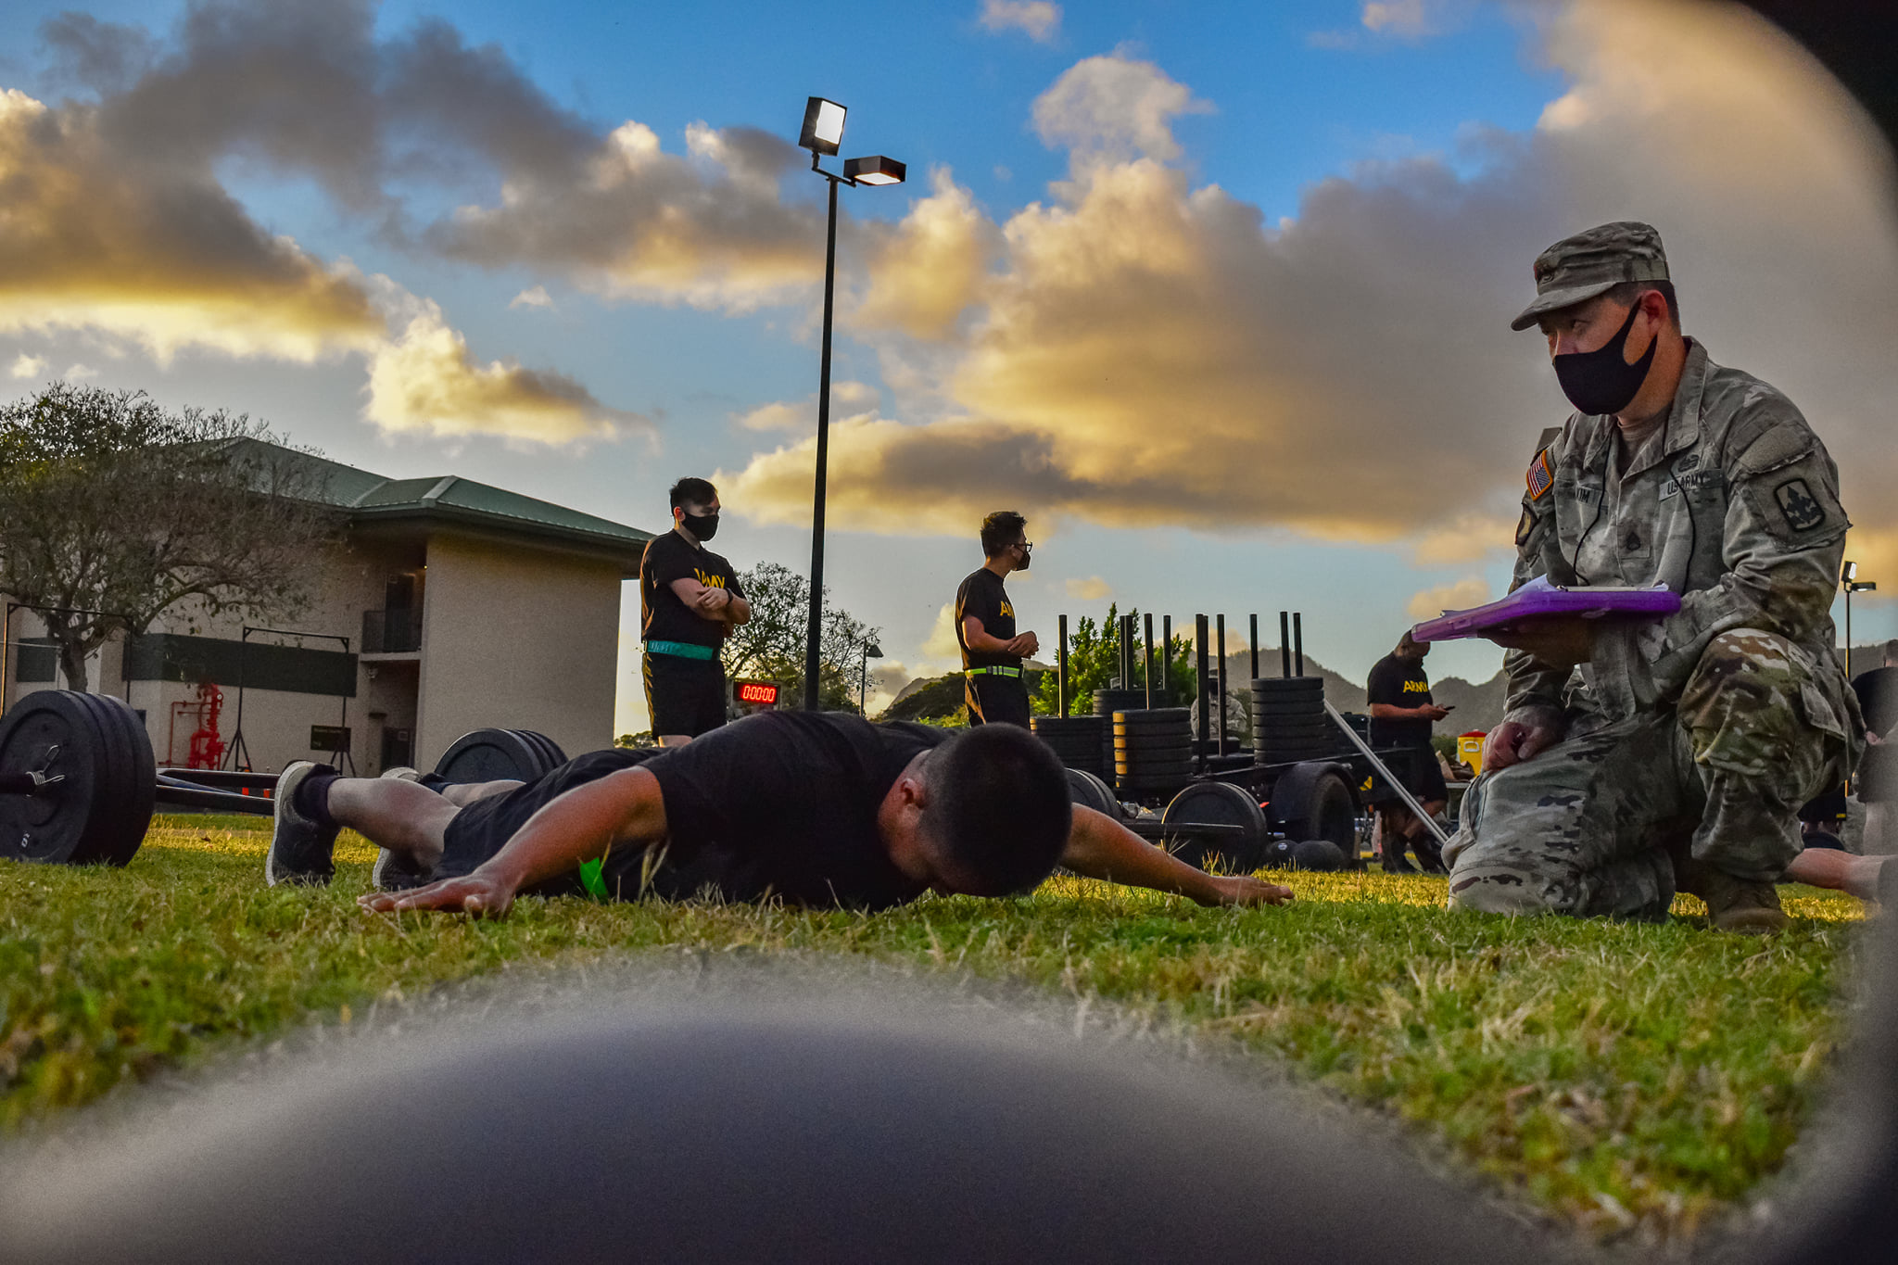
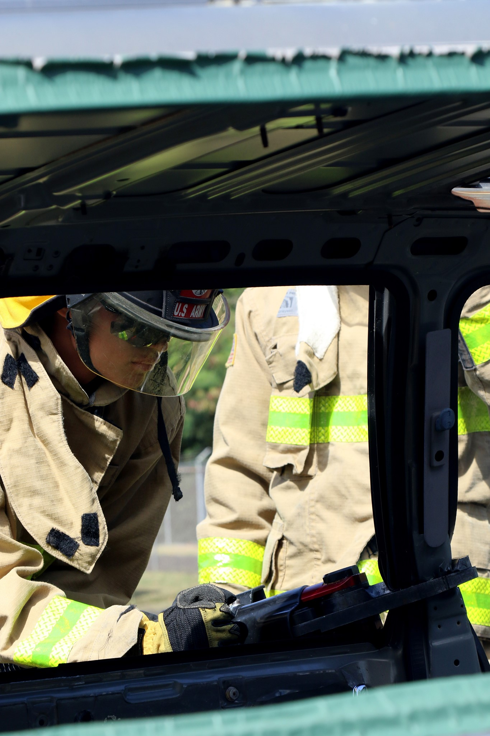
Framed/Hidden View
Page 37
Take Photos, Write Captions, & Get Published / Basic UPAR Training
Notes:
Framed / Hidden View: can be set and framed in any shot size you like, just as long as there is only one character featured within the frame

Slide 39
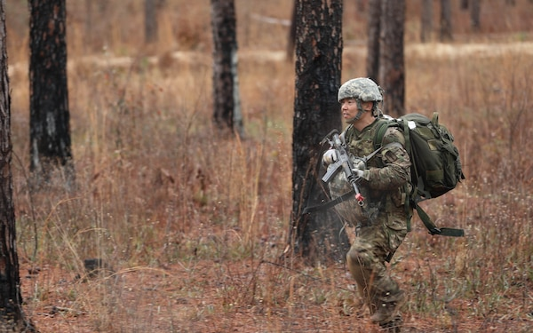
Off-Center
Page 38
Take Photos, Write Captions, & Get Published / Basic UPAR Training
Notes:
Space in front of the subject

Slide 40
Off-Center
Page 39
Take Photos, Write Captions, & Get Published / Basic UPAR Training
Notes:
Space in front of the subject

Slide 41
Off-Center Cropped
Page 40
Take Photos, Write Captions, & Get Published / Basic UPAR Training
Notes:
Do not crop an off-center picture. It takes away interest in picture and looks odd

Slide 42
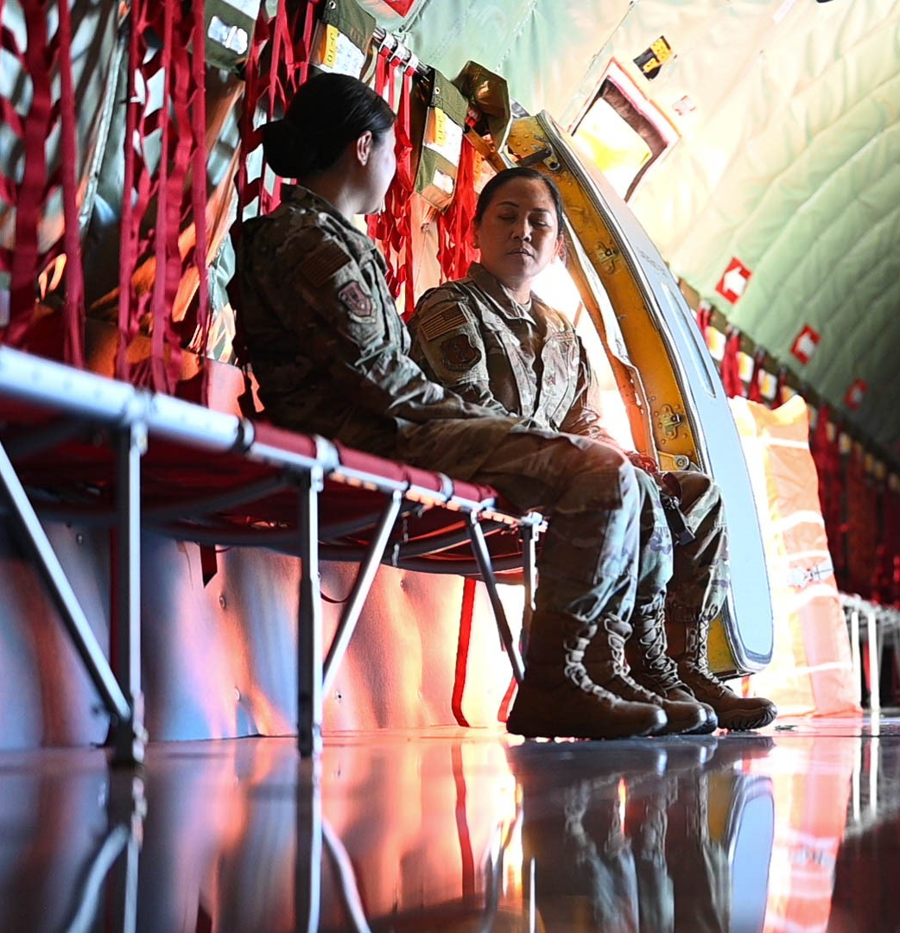
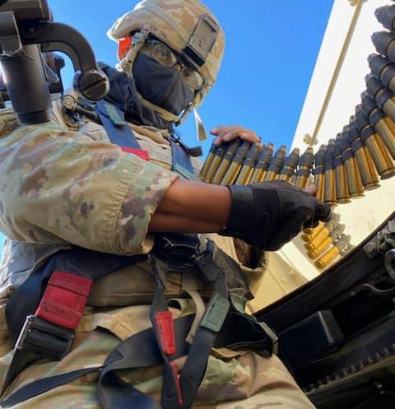

Low Angle
Page 41
Take Photos, Write Captions, & Get Published / Basic UPAR Training
Notes:
Low Angle: conveys a number of emotions or feelings about the subject in the frame, it gives them power
You can get low, or you can just hold the camera low

Slide 43
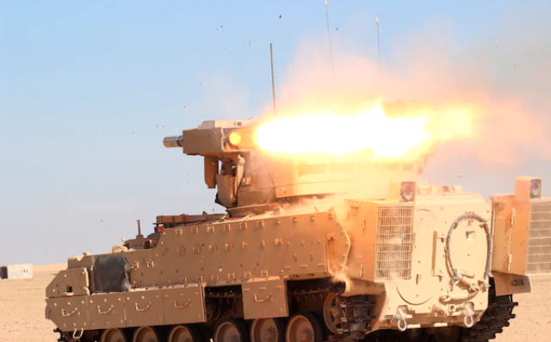
Action
Page 42
Take Photos, Write Captions, & Get Published / Basic UPAR Training

Slide 44
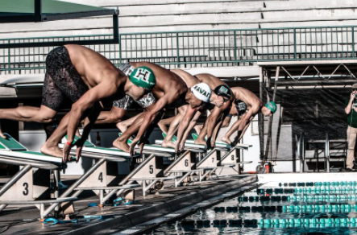
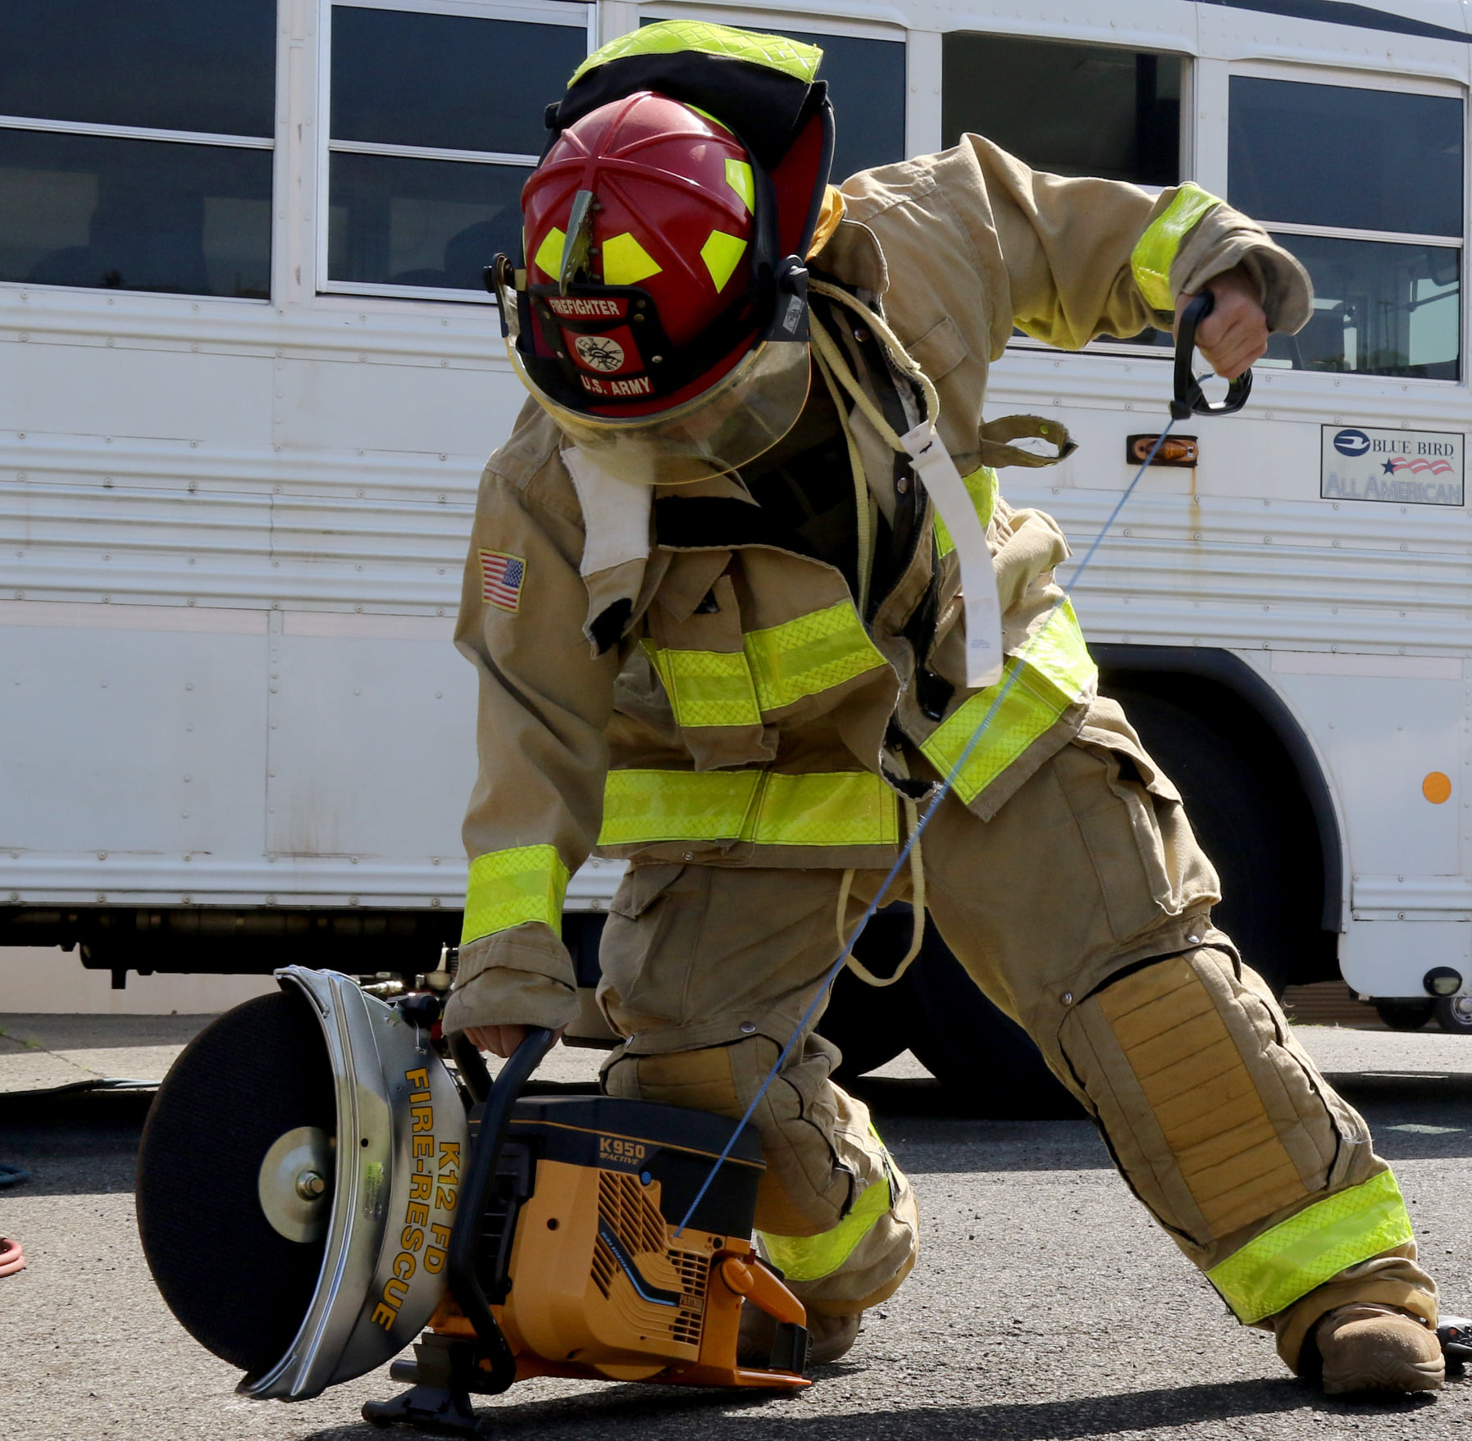
Action
Page 43
Take Photos, Write Captions, & Get Published / Basic UPAR Training

Slide 45
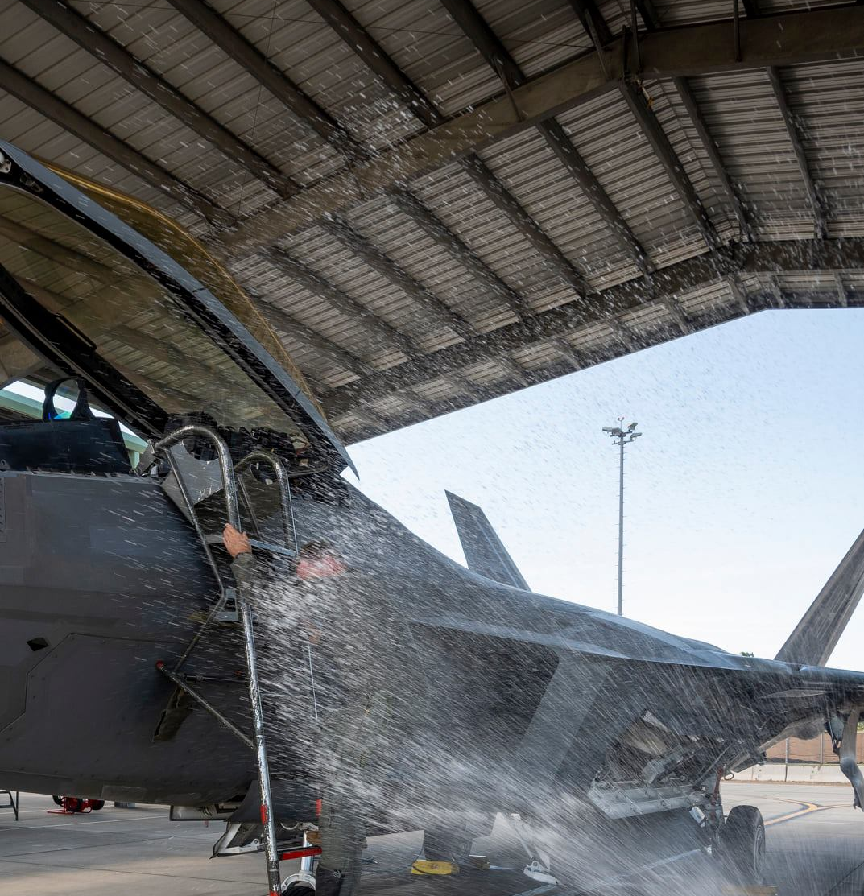
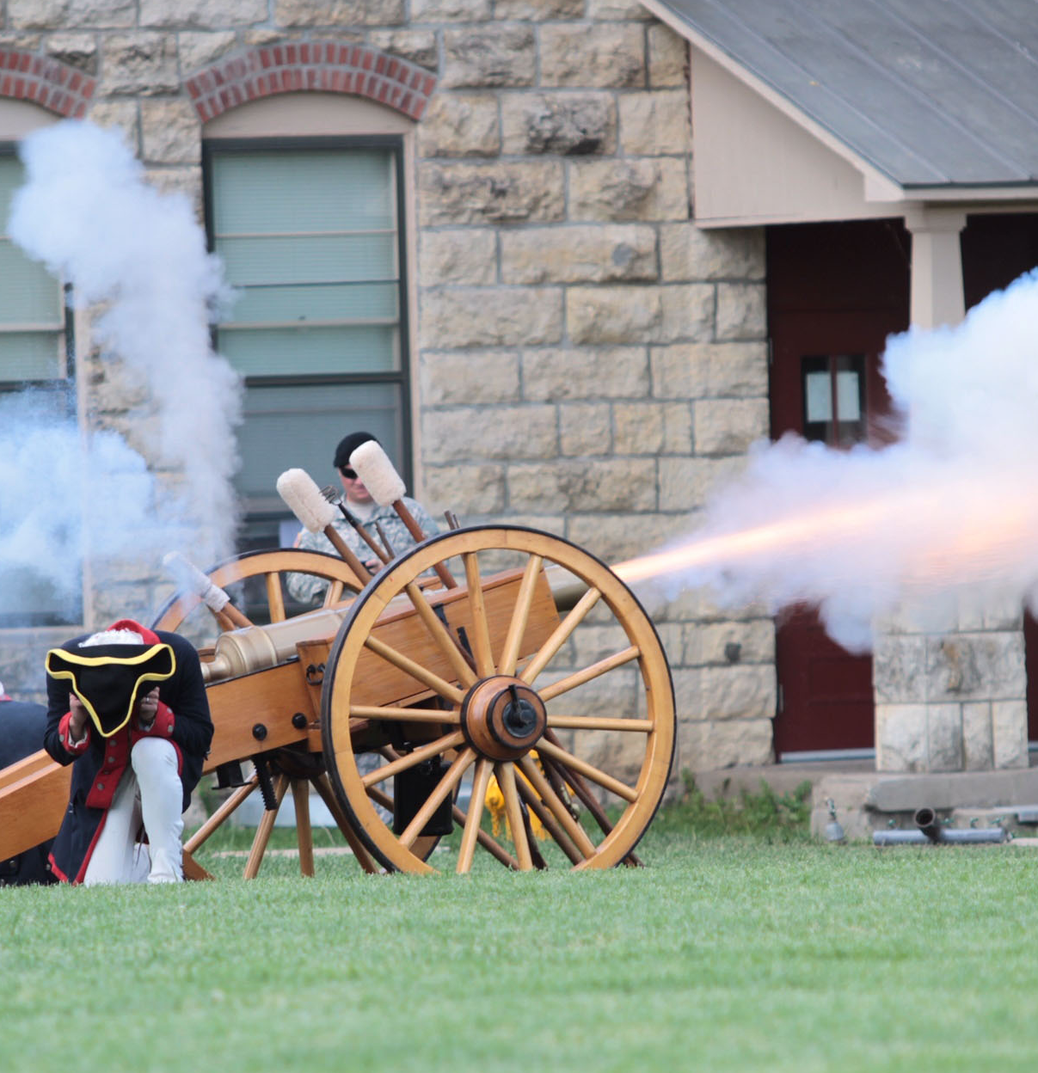
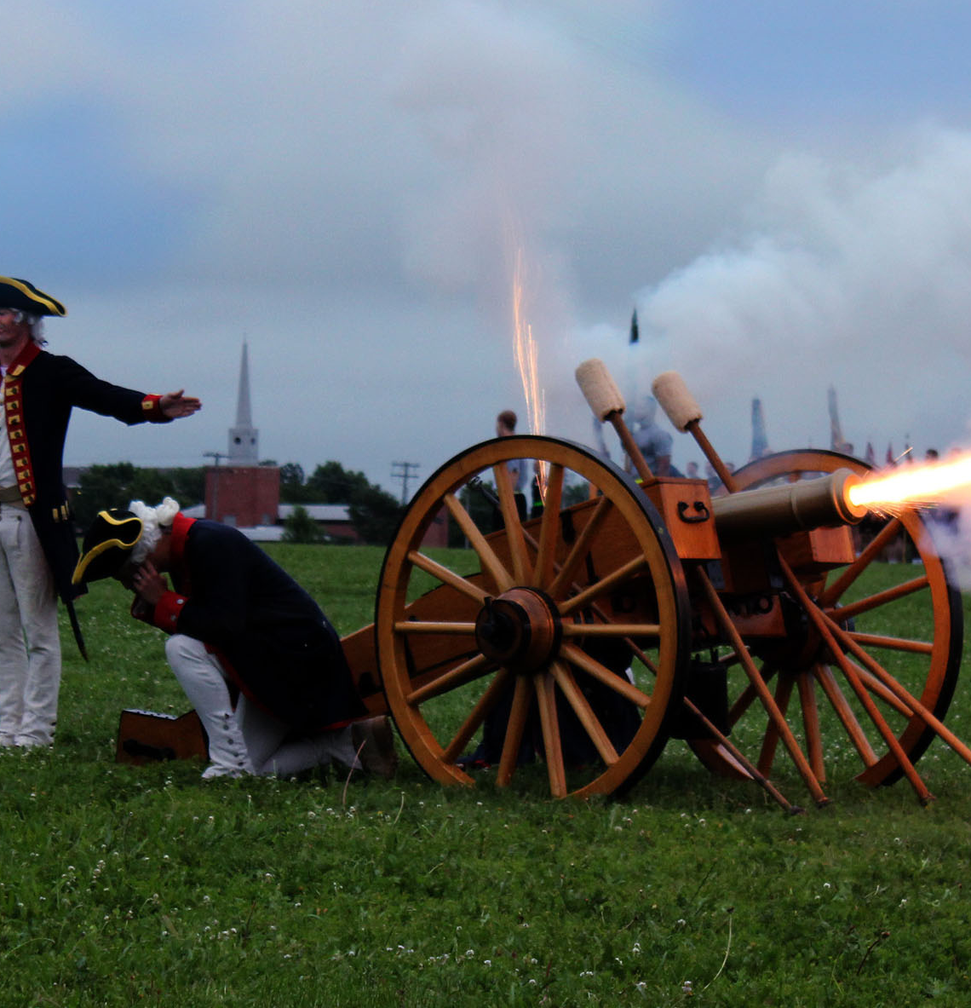
Action
Page 44
Take Photos, Write Captions, & Get Published / Basic UPAR Training

Slide 46
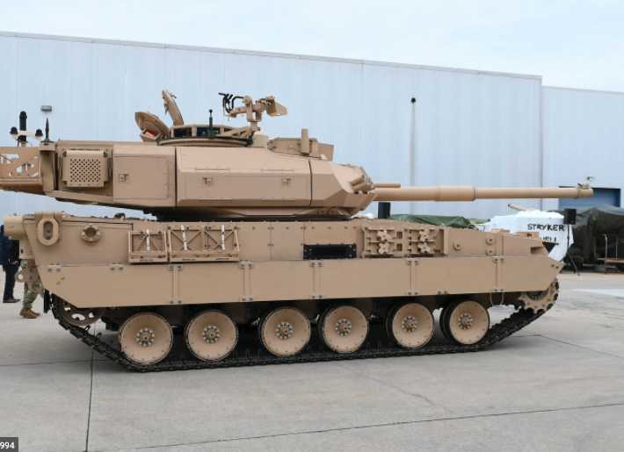
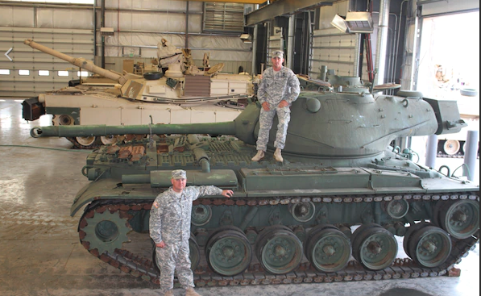
Static Shots
Page 45
Take Photos, Write Captions, & Get Published / Basic UPAR Training

Slide 47
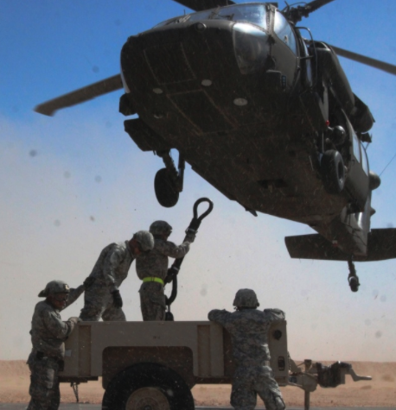
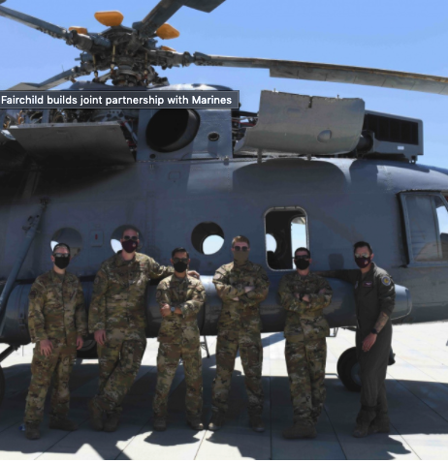
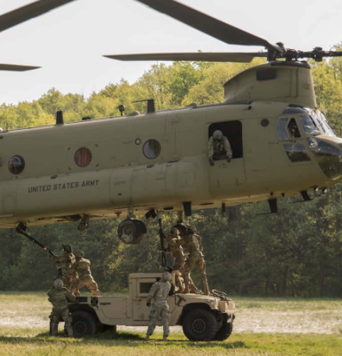
Helicopters and Other Cool Stuff
Page 46
Take Photos, Write Captions, & Get Published / Basic UPAR Training

Slide 48
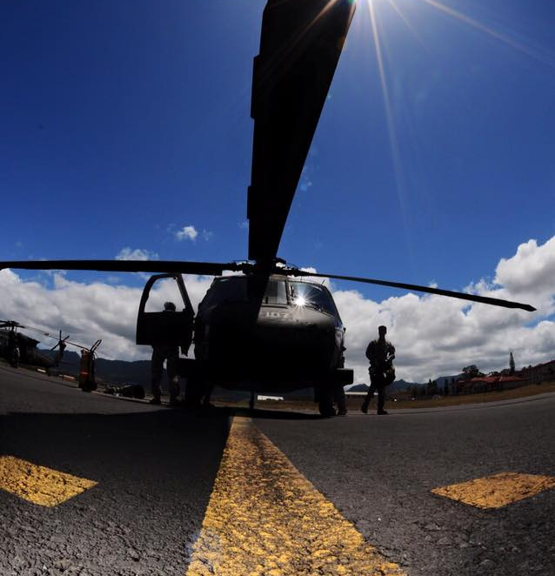
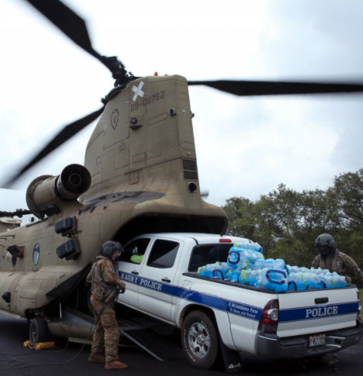
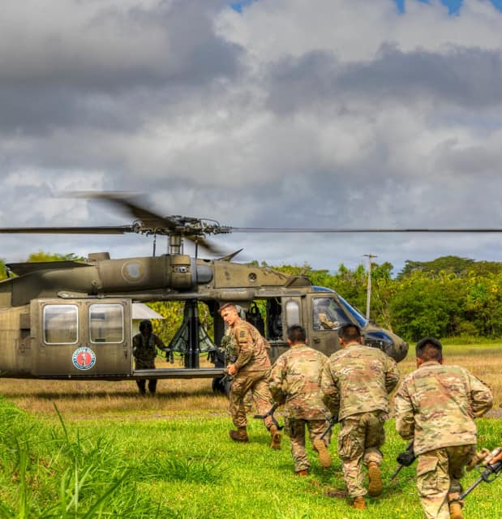
“Good” Helicopter Shots
Page 47
Take Photos, Write Captions, & Get Published / Basic UPAR Training

Slide 49
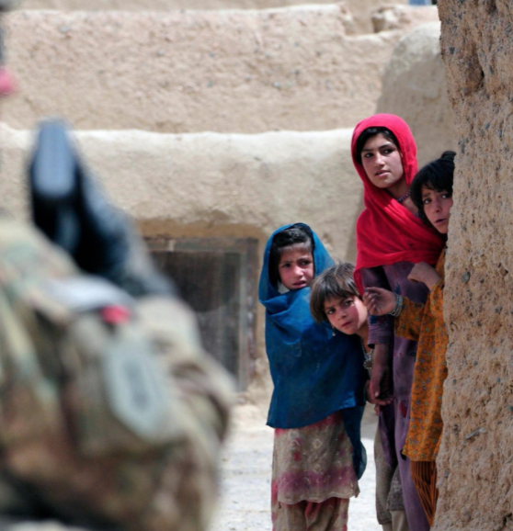
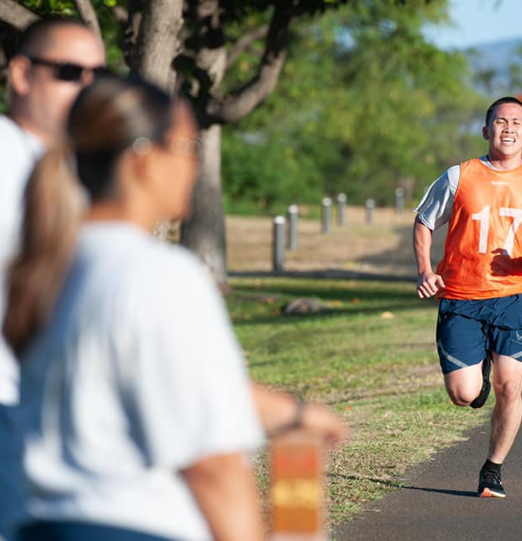
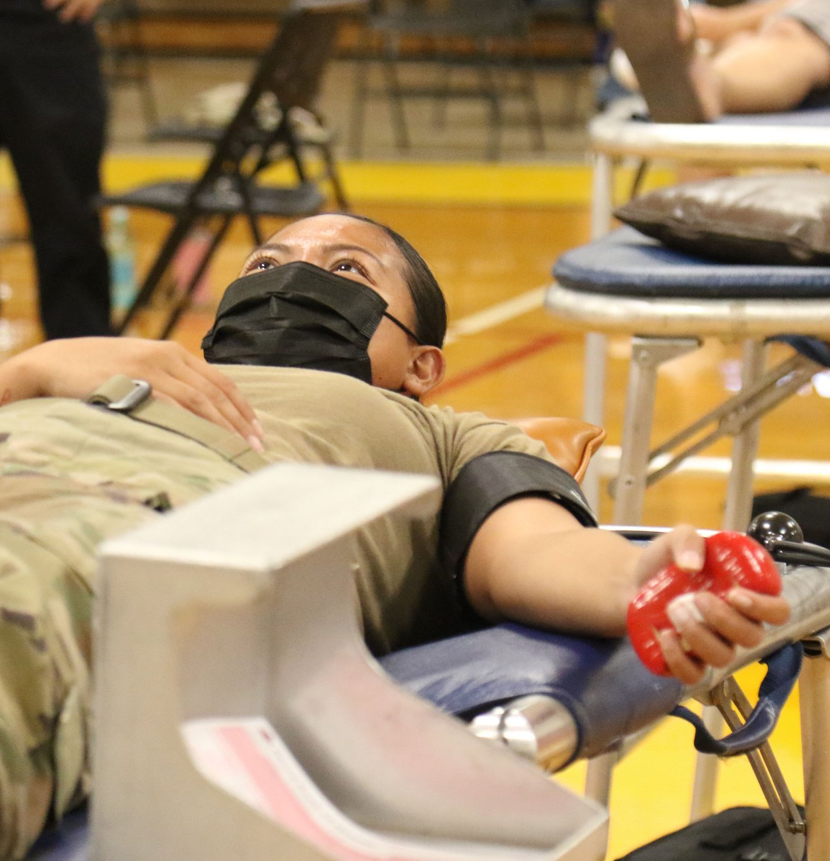
Focal Point
Page 48
Take Photos, Write Captions, & Get Published / Basic UPAR Training

Slide 50
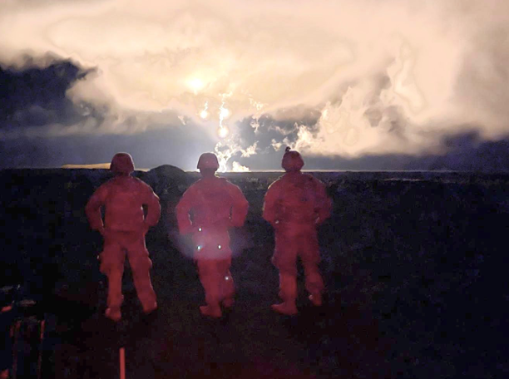
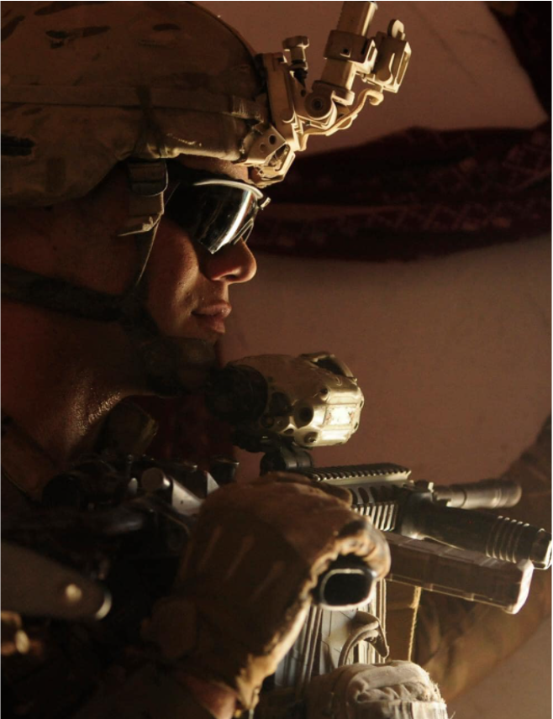

Lighting
Page 49
Take Photos, Write Captions, & Get Published / Basic UPAR Training

Slide 51

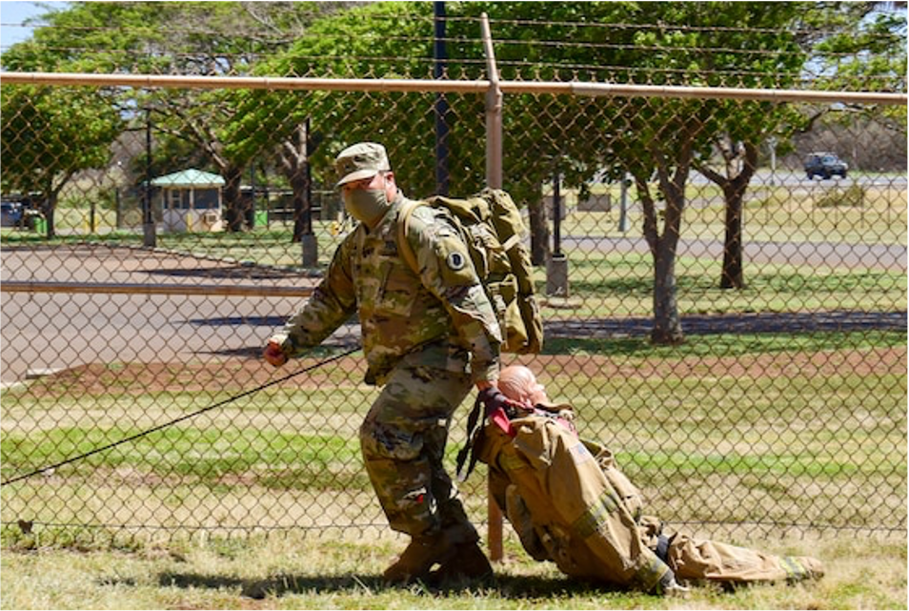
People in Motion
Page 50
Take Photos, Write Captions, & Get Published / Basic UPAR Training

Slide 52



Ceremonies
Page 51
Take Photos, Write Captions, & Get Published / Basic UPAR Training
Notes:
Rehearsals, you move around action, expected “money shots” that should be captured, easy to get up close, you know where action will be
Other- equipment, formations, PT, office, field….more challenging, shoot plenty, review later, find the good nuggets, action and posed shots will be

Slide 53

Key Moments to Capture
Reenlistment
Oath of office
Promotion
Pinning of rank
Change of Command
Incoming and outgoing
Page 52
Take Photos, Write Captions, & Get Published / Basic UPAR Training
Notes:
Remember that there are people behind you- ceremonies
Don’t photo-bomb other photogs or videographer- ceremonies

Slide 54


Candid
Page 53
Take Photos, Write Captions, & Get Published / Basic UPAR Training
Notes:
Hands in pockets, proper PPE, eyes open, body language is positive, don’t make subjects look bad
Candid vs posed
Focus on the face- without any context or background scenery, a face can express a lot.
It’s also constantly changing from emotion to emotion, giving you an endless source of interesting shots
A prime spot to look for candid photos is in a group or pair of people

Slide 55


Posed
Page 54
Take Photos, Write Captions, & Get Published / Basic UPAR Training
Notes:
Posed Award or promotion ceremony.
Get Close and Watch Your Subjects Without Being Noticed
Turn off the Flash to Stay Discreet
Move Around Your Subjects for Better Composition
Shoot in Burst Mode to Capture Every Moment

Slide 56


(Good) Posed
Page 55
Take Photos, Write Captions, & Get Published / Basic UPAR Training
Notes:
Even you need to take a posed shot, look for interesting backgrounds, use low or high angle to take the shot. Be creative.

Slide 57

(Good) Posed
Page 56
Take Photos, Write Captions, & Get Published / Basic UPAR Training
Notes:
Find something interesting in the background, it does not need to be in focus, but it should add context to the shot.

Slide 58


What NOT to Do
Page 57
Take Photos, Write Captions, & Get Published / Basic UPAR Training
Notes:
Promotion on left- she has a puppet on her hand while taking the oath of office. Big no go! And she was a PAO.
Dude on right is all kinds of wrong. I don’t know what status he is, I don’t know if he knew either.

Slide 59



What NOT to Do
Page 58
Take Photos, Write Captions, & Get Published / Basic UPAR Training
Notes:
PPE- masks not covering nose
Background- OPSEC, maps or lists or statuses of equipment
Tonguing a POW sign
Jumping out of airplane with a fish, then taking a pic of it. Dumb.
People like flipping the camera off at the end of a course. Please don’t do this.

Slide 60




A Series of Photos Can Tell a Story
Establishing Shot
Long Shot
Medium Shot
Close-up
Extreme Close-up
Vary the angle and the distance
Page 59
Take Photos, Write Captions, & Get Published / Basic UPAR Training
Notes:
Establishing Shot: lets the audience know the setting for the scene they're about to watch
Long Shot: a view of a scene
Medium Shot: is a shot that frames the subject from just above their head down to about midway on their torso.
Close-up: faces
Extreme Close-up: hands on an instrument or turning a wrench

Slide 61
Practical Exercise
Get up for a moment and stretch
Now l want everyone to take about five minutes take a few pictures of…
Page 60
Take Photos, Write Captions, & Get Published / Basic UPAR Training

Slide 62
Break!
Page 61

Slide 63

WRITE CAPTIONS
Page 62
Take Photos, Write Captions, & Get Published / Basic UPAR Training

Slide 64
Captions
Tell the story behind the photograph
Be short and clear
1-3 Sentences
Influence picture meaning
Complements the pic by relating to non-visual senses
Explain technical information
Page 63
Take Photos, Write Captions, & Get Published / Basic UPAR Training
Notes:
An explanation of what is going on in a photograph and why it is important to the audience.
If possible include command messages

Slide 65
Element of a Basic Caption
Who?
  Full ID (Rank, Name, Unit and MOS) If less than three people in photo
What?
When?
Where?
Why?
Photo credit (byline)
Page 64
Take Photos, Write Captions, & Get Published / Basic UPAR Training

Slide 66

The Five W’s
WHO is in the photo? WHO is the subject of the photo?
WHAT is in the photo? WHAT is the action taking place?
WHEN is the action taking place? (date, training event)
WHERE is the action taking place? (geographic location)
WHY is the action taking place? WHY does it matter?
If possible, explain the HOW?
Page 65
Take Photos, Write Captions, & Get Published / Basic UPAR Training

Slide 67

Caption
Members of the Armed forces of the Philippines, 525th Engineers, demonstrate patient packaging during a subject matter expert exchange in support of Balikatan 2017 at Fort Magsaysay in Santa Rosa, Nueva Ecija, May 7, 2017. These skills ensure that first responders and military members can secure and remove victims during a real-life crisis. Balikatan is an annual U.S.-Philippine bilateral military exercise focused on a variety of missions, including humanitarian assistance, disaster relief, and counterterrorism. (U.S. Air Force Photo by Tech. Sgt. Andrew L. Jackson)
Page 66
Take Photos, Write Captions, & Get Published / Basic UPAR Training

Slide 68

Practical Exercise
Write a caption for this picture:
Airman 1st Class Jolene Chun on left
MAR 21
Smith is in Task Force Oahu
Sgt. John K. Smith is on the right
Daily temperature screening
Smith is on State Active Duty
It was sunny day
To prevent spread of COVID-19
Kalaeloa, Oahu
Page 67
Take Photos, Write Captions, & Get Published / Basic UPAR Training

Slide 69

Practical Exercise
Write a caption for this picture
  (make up names, the beginning of COVID-19 operations on neighbor islands)
Page 68
Take Photos, Write Captions, & Get Published / Basic UPAR Training

Slide 70
Convention of Writing English
Proper Nouns
Word usage: their/they’re/there, your/you’re, its/it’s
Proper punctuation
Numbers: spell out 1-9, use numerals for the rest
Avoid passive voice (describing action)
  Active: U.S. Soldiers destroy confiscated ordnance.
  Passive: Confiscated ordnance is destroyed by U.S. Soldiers
Does not need to be perfect if sending to PAO. If it is for unit-level release, keep it simple and as perfect as possible.
Page 69
Take Photos, Write Captions, & Get Published / Basic UPAR Training

Slide 71

DOD Key Themes
Page 69
Take Photos, Write Captions, & Get Published / Basic UPAR Training

Slide 72

Constructing an Extended Caption
1st: Who, What, Where, When
Present Tense
Describe image in moment captured
2nd: Why
Past Tense
Significant background info
Quote
Command message
  The Hawaii Army National Guard is a community-based organization.
  Over 800 Hawaii National Guardsmen are on State Active Duty orders in support of COVID-19.
Why does the audience care?
Page 70
Take Photos, Write Captions, & Get Published / Basic UPAR Training

Slide 73

Extended Captions
SAMPLE EXTENDED CAPTIONS
4W’s Sergeant First Class David Earle, an Officer Candidate with the Charlie company 29th Infantry Brigade Combat Team, Hawaii Army National Guard, participates in the stress shoot portion of the 2021 State Best Warrior Competition at Puuloa Rile Range, Ewa Beach, Hawaii April 1, 2021.
Why “The stress shoot pushes Soldiers to zero and qualify with their assigned weapon while placed under physical and mental stress,” said Earle. More than 30 Soldiers of the Hawaii Army National Guard participated in the 2021 Best Warrior Competition March 31-April 3, 2021.
Byline Photo by Spc. Ronald Bankole, 117th Mobile Public Affairs Detachment, Hawaii Army National Guard
Page 71
Take Photos, Write Captions, & Get Published / Basic UPAR Training

Slide 74

Practical Exercise
Write an extended caption for this picture
(make up names, COVID-19 response, temperature screening)
Page 72
Take Photos, Write Captions, & Get Published / Basic UPAR Training

Slide 75

Practical Exercise
Write an extended caption for this picture
(make up names and date, Joint Exercise First Strike)
Page 73
Take Photos, Write Captions, & Get Published / Basic UPAR Training

Slide 76

Captions and AI
AI has improved over the years, still not perfect (not replacing humans)
Feed it key details
Ask for multiple versions, adjust tone, edit
  It can be obvious when AI is used
Double check the facts
Good way to get ideas
Page 74
Take Photos, Write Captions, & Get Published / Basic UPAR Training

Slide 77
Captions – Review
Tell the story behind the photograph
Allows the photo to be used by higher PA Element
Could be used to support a story or stand alone
IDs group shots
With a caption, a photo can be used on social media or newsletter.
Remember that for every shot you think is good, a caption is needed.
Captioned photos help (Cdr, Unit, PA)
Don’t forget your byline (“Who are you?”)
Page 75
Take Photos, Write Captions, & Get Published / Basic UPAR Training

Slide 78
Break!
Page 76

Slide 79

Get Published
Page 77
Take Photos, Write Captions, & Get Published / Basic UPAR Training

Slide 80
Approved & Published
The job is not done until your photos and captions are sent to higher PA elements
Consider who has the Release Authority
AT or exercise: higher PA element
Deployment: Bde PAO, then DIV or higher
Page 78
Take Photos, Write Captions, & Get Published / Basic UPAR Training

Slide 81
Approved & Published
What is Level 2 vs Level 3?
Level 2: HIARNG, Recruiting, MRD, 29th IBCT, 103rd TC, 298th MFTR social media
Level 3: TAG, DAG, CSEL social media, HIDoD PowerPoints, Pupupukahi, DVIDS or media releases
Submit 3-5 of your best photos with captions (at least two sentences) to State PAO at least once a quarter (HIRANG Website)
PAO can help get your photos to L4
Page 79
Take Photos, Write Captions, & Get Published / Basic UPAR Training

Slide 82





L3: Your Photo Can Go Anywhere
HIDOD Newsletter
HIDOD Social Media
DVIDS
Page 80
Take Photos, Write Captions, & Get Published / Basic UPAR Training

Slide 83


L3: HIDOD Pupukahi Newsletter
Page 81
Take Photos, Write Captions, & Get Published / Basic UPAR Training

Slide 84


L3: TAG or HING Facebook
Page 82
Take Photos, Write Captions, & Get Published / Basic UPAR Training

Slide 85

L3: Posted on DVIDS, Potential L3 & 4
Page 83
Take Photos, Write Captions, & Get Published / Basic UPAR Training

Slide 86
L4: Your Photo Can Go Anywhere
National Social Media
  Big Army, Big Air, Big NG
Newspaper
TV
Page 84
Take Photos, Write Captions, & Get Published / Basic UPAR Training

Slide 87
Who are the higher PA elements?
State PAO
117th MPAD
29th IBCT Bde PAO
154th Wing PAO
Joint Staff PAO
JTF PAO…
  The goal is to get to Level 3
  It can take minutes to days for approval
  Did it get used? You can follow up with State PAO
Page 85
Take Photos, Write Captions, & Get Published / Basic UPAR Training

Slide 88

SHOOTING VIDEO & “B-ROLL”
In the beginning
Policy
UPAR Responsibilities
Public Affairs Planning
Public Affairs Liaison
Take Photos, Write Captions, & Get Publishing
Record Basic Video
AAR
Page 86
Record Basic Video / Basic UPAR Training

Slide 89
What is "B-roll"
B-roll is what other organizations can use to make a video news story, the raw footage
If media cannot attend, they rely on HING shooting B-roll of an event
It is advantageous to HING for use to shoot B-roll and then submit to media for possible usage.
Page 87
Record Basic Video / Basic UPAR Training

Slide 90
Shooting Video and "B-roll"
Video
can be used as a stand-alone
is ready for publishing
B-roll
a series of videos used by specialist or media
is raw footage that can be edited for a News story
Both: 15 seconds or less
Shoot video using landscape mode
Try to keep it as still as possible
Watch your lighting, (backlit video is the enemy of good video)
Try not to zoom, move your feet
Page 87
Record Basic Video / Basic UPAR Training

Slide 91

Shooting Video and “B-roll”
Vary angles and depth for B-roll
Watch out for “video bombing”
Is the subject worth shooting with video?
When shooting, don’t talk
Review it before sending
Send to State PAO if B-roll was requested
Page 89
Record Basic Video / Basic UPAR Training

Slide 92
B-roll “package” should include:
Multiple clips
Establishing shot, medium shots, close-ups
Cut-aways (the interruption of a continuously filmed action by inserting a view of something else)
Establishing Shot
Long Shot
Medium Shot
Close-up
Page 90
Take Photos, Write Captions, & Get Published / Basic UPAR Training

Slide 93
You Are Almost a UPAR
Create a Public Affairs Plan – meet with commander to set goals and create a plan
Public Affairs Liaison – being the POC for all things public affairs
Take Photos, Write Captions and Get Published - #1 job
Record Basic Video – film short clips
Intermediate UPAR Class
Media escort and preparation - prepare your unit and assist the media
Media relations – understand the media and prepare for interviews
Command information – communicating to members of the command
Writing the story - news story vs feature story
Page 91
Record Basic Video / Basic UPAR Training

Slide 94
Final Word
Remember, if we don’t tell our story, someone else will!
The Army Public Affairs Program (AR 360-1)
  https://armypubs.army.mil/epubs/DR_pubs/DR_a/ARN30105-AR_360-1-000-WEB-1.pdf
Communication Strategy and Public affairs Operations
  https://armypubs.army.mil/epubs/DR_pubs/DR_a/ARN34864-FM_3-61-000-WEB-1.pdf
Army Social Media Handbook
  https://www.army.mil/socialmedia/
Page 92

Slide 95

Contact
State PAO: (808) 441-7000
Email: Rachel.s.blaire.civ@army.mil or
dod.pao.all@hawaii.gov
Page 93
The AAR / Basic UPAR Training

Slide 96
ALL PAU!
Wait!
The AAR
In the beginning
Policy
UPAR Responsibilities
Public Affairs Planning
Public Affairs Liaison
Take Photos, Write Captions, & Get Publishing
Record Basic Video
AAR
Page 94
The AAR / Basic UPAR Training
Notes:
Have hand out ready and printed
Be sure to have pens for the class to use.

Slide 97

AAR
Page 95
The AAR / Basic UPAR Training

Slide 98
HIDOD Social Media Class
If you are an admin on your unit's social media page, please contact PAO Information Specialist Ruben Duldulao:
ruben.duldulao@hawaii.gov
(808) 441-7000
30 minute virtual class on social media
Page 96
The AAR / Basic UPAR Training

