Slide 1

Black History Month
2025
African Americans and Labor
From……………………………………………………………………
To………………………………………………………………………..
The Brotherhood of Sleeping Car Porters

Slide 2
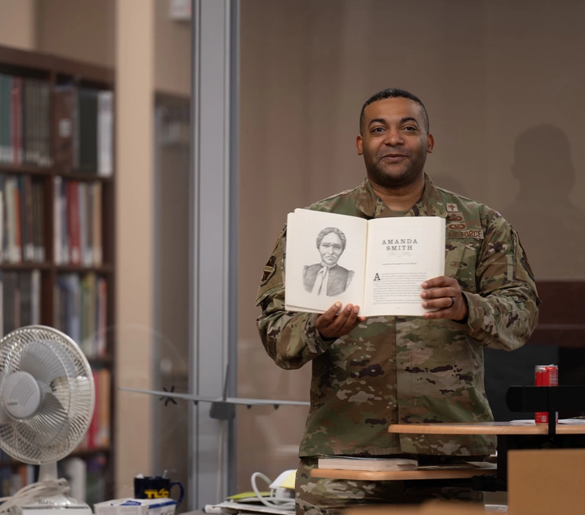
Black History Month
Black History Month, also known as African American History Month in the United States, is observed annually during February. President Gerald Ford announced the first nationally observed Black History Month in 1976.
Each year, the Department of Defense (DoD) joins the Nation in recognizing the important contributions, cultures, and achievements of African Americans throughout history.

Slide 3
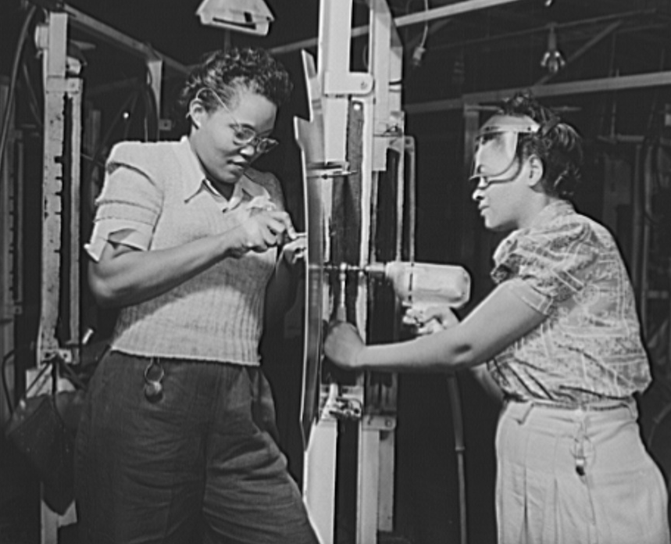
Theme
The Department of Defense’s Black History Month focus is on Excellence in Action, which builds on the Association for the Study of African American Life and History’s (ASALH) 2025 theme “African Americans and Labor.”
The ASALH press release states, “Like religion, social justice movements, and education, studying African Americans’ labor and labor struggles are important organizing foci for new interpretations and reinterpretations of the Black past, present, and future.”
Notes:
Information:
https://asalh.org/wp-content/uploads/2023/08/2025-Black-History-Theme-Executive-Summary-1.pdf

Slide 4
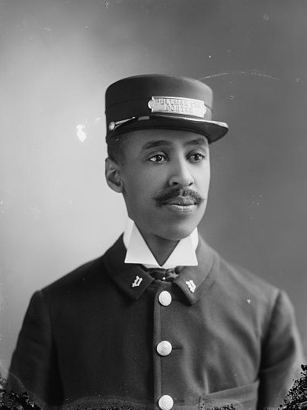
Presentation
This year marks the centennial of the Brotherhood of Sleeping Car Porters (BSCP), founded by labor leader and civil rights activist A. Philip Randolph, with essential support from figures like Rosina Corrothers Tucker.
The BSCP was the first Black-majority union to obtain a charter from the American Federation of Labor, empowering it to advocate for workplace equality, improved wages and conditions, and collective bargaining rights. This presentation highlights the BSCP, A. Philip Randolph, and Rosina Corrothers Tucker.

Slide 5
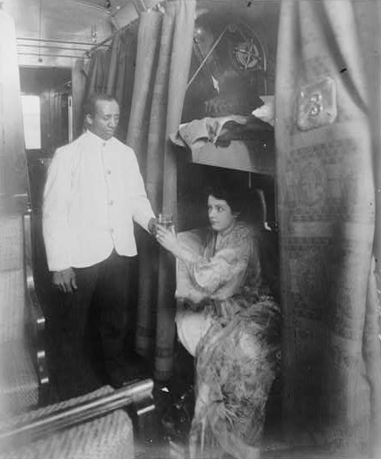
The Brotherhood of Sleeping Car Porters (1 of 3)
In 1867, the Pullman Palace Car Company was founded by George Pullman as the railroads expanded across America.
Pullman hired thousands of African Americans, including many former enslaved people, to serve as porters on his luxury train cars. These porters shined shoes, made beds, and catered to passengers.
Despite some benefits, these positions were marred by poor working conditions, grueling hours, low pay, and instances of being subjected to slurs and other mistreatment.
Notes:
Information:
https://www.history.com/topics/black-history/pullman-porters
https://guides.loc.gov/this-month-in-business-history/august/brotherhood-of-sleeping-car-porters

Slide 6
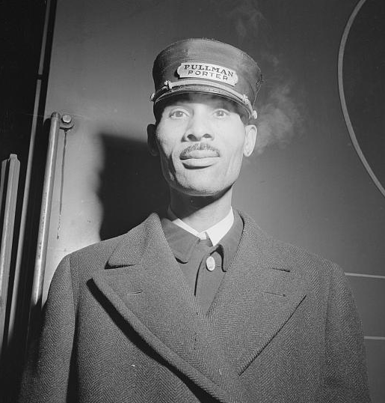
The Brotherhood of Sleeping Car Porters (2 of 3)
As the Pullman Company became the largest employer of Black men, civil rights and labor leader A. Philip Randolph met with Pullman porters to help them form a union.
White employees were organized with the American Railway Union, which prohibited Black men from joining. In 1925, Randolph formed and led the BSCP, which secured their first collective bargaining agreement in 1937. The BSCP secured higher wages, better conditions and benefits, and a decrease in monthly hours from as many as 400 to a 240-hour limit.
Notes:
Information:
https://www.history.com/topics/black-history/pullman-porters
https://guides.loc.gov/this-month-in-business-history/august/brotherhood-of-sleeping-car-porters

Slide 7
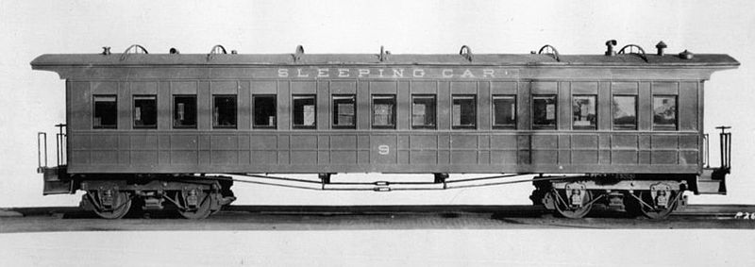
The Brotherhood of Sleeping Car Porters (3 of 3)
The BSCP contributed to the development of an African American middle class. Many porters saw different parts of the country for the first time, fueling the Great Migration and greater class consciousness.
The African American labor movement was entwined with the Civil Rights Movement, and many porters went on to work in the movement.
Notes:
Information:
https://www.history.com/topics/black-history/pullman-porters
https://guides.loc.gov/this-month-in-business-history/august/brotherhood-of-sleeping-car-porters

Slide 8
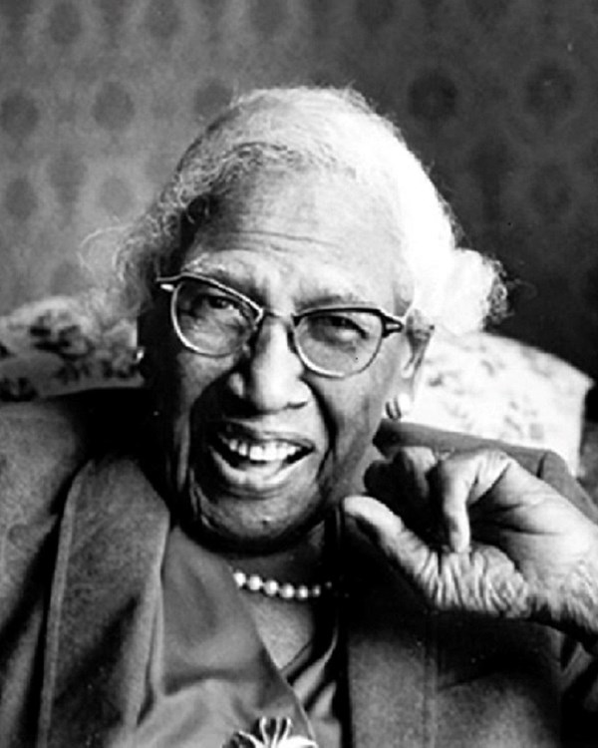
Rosina Corrothers Tucker (1 of 3)
Rosina Corrothers Tucker played a pivotal role as an activist and organizer, significantly contributing to the BSCP's success. Born in 1881, she married a Pullman porter in 1918 and began aiding the union after attending an organizing meeting with A. Philip Randolph in 1925.
Tucker was instrumental in establishing the Washington, DC chapter of the BSCP, focusing on fundraising and garnering support. The Pullman company closely monitored and punished workers for unionizing, making the role of women like Tucker indispensable as surrogates.
Notes:
Information:
https://www.nps.gov/people/rosina-corrothers-tucker.htm
https://blog.dol.gov/2024/01/17/8-black-women-labor-leaders-you-should-know
https://www.npca.org/articles/3707-the-women-behind-the-brotherhood

Slide 9
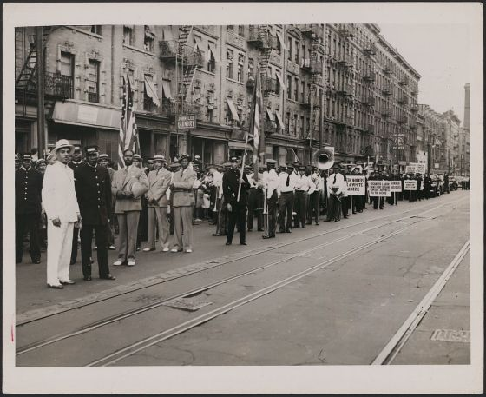
Rosina Corrothers Tucker (2 of 3)
In Washington, Tucker helped establish the Women’s Economic Council, later renamed the International Ladies Auxiliary Order, which led fundraising and organizing efforts for the BSCP.
The wives of porters and maids from the Pullman Company held annual conventions, canvassing campaigns, and ran local chapters. This allowed the union to get enough support to get recognized by the American Federation of Labor.
Notes:
Information:
https://www.nps.gov/people/rosina-corrothers-tucker.htm
https://blog.dol.gov/2024/01/17/8-black-women-labor-leaders-you-should-know
https://www.npca.org/articles/3707-the-women-behind-the-brotherhood

Slide 10
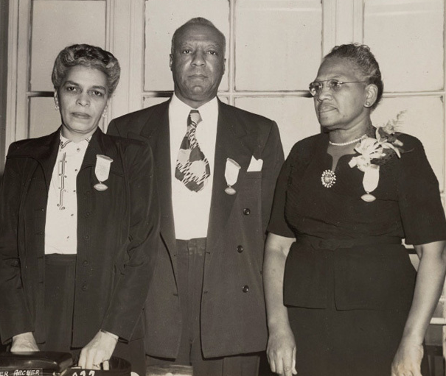
Rosina Corrothers Tucker (3 of 3)
Tucker’s activism extended beyond the BSCP. In the 1940s, she was crucial in planning a march on Washington to challenge segregation in the military and defense industries. She worked closely with workers in laundry trades and domestic service industries.
She also organized boycotts of businesses that didn’t employ Black people. Until her death in 1987 at the age of 105, she lobbied Congress for labor and education reforms and remained active in local politics.
Notes:
Information:
https://www.nps.gov/people/rosina-corrothers-tucker.htm
https://blog.dol.gov/2024/01/17/8-black-women-labor-leaders-you-should-know
https://www.npca.org/articles/3707-the-women-behind-the-brotherhood

Slide 11
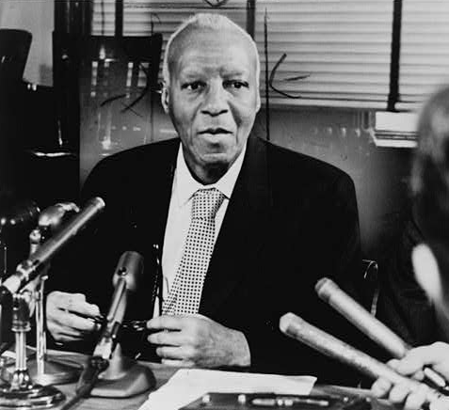
A. Philip Randolph (1 of 3)
Born in 1889, Asa Philip Randolph was a giant of the Civil Rights Movement and labor activist. After moving from Florida to New York City in 1911, Randolph started his career at an employment agency for Black workers.
After his work with BCSP to form the first predominantly Black labor union, Randolph used his platform to fight against discrimination in the Armed Forces. In 1940, he and other activists met with President Franklin D. Roosevelt and First Lady Eleanor Roosevelt to end segregation in the military.
Notes:
Information:
https://www.history.com/topics/black-history/a-philip-Randolph
https://home.nps.gov/hofr/learn/historyculture/a-philip-randolph.htm
https://www.nps.gov/people/a-philip-randolph.htm

Slide 12
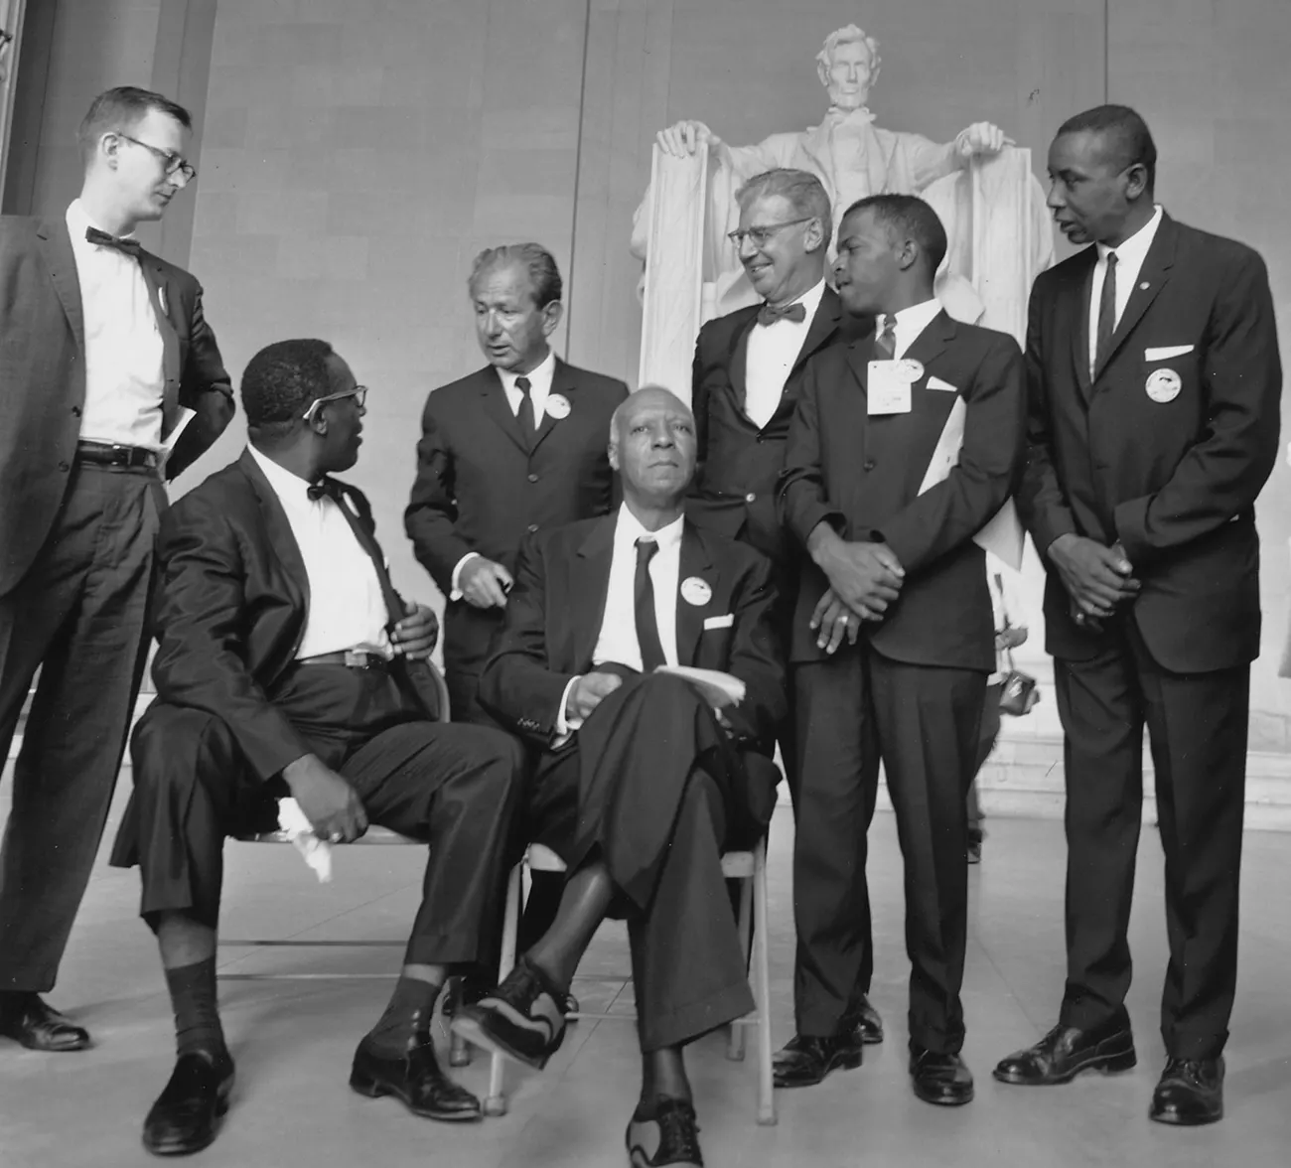
A. Philip Randolph (2 of 3)
In 1940, Randolph managed to secure only partial concessions from President Franklin D. Roosevelt, who remained steadfast against desegregation.
In response to this inequality, Randolph proposed a march on Washington. The threat of the march prompted Roosevelt to issue Executive Order No. 8802, which opened war industries to Black workers during World War II.
This same pressure led President Truman to fully desegregate the military in 1948. The vision of a march on Washington finally materialized in 1963 when Randolph partnered with Martin Luther King, Jr.
Notes:
Information:
https://www.history.com/topics/black-history/a-philip-Randolph
https://home.nps.gov/hofr/learn/historyculture/a-philip-randolph.htm
https://www.nps.gov/people/a-philip-randolph.htm

Slide 13
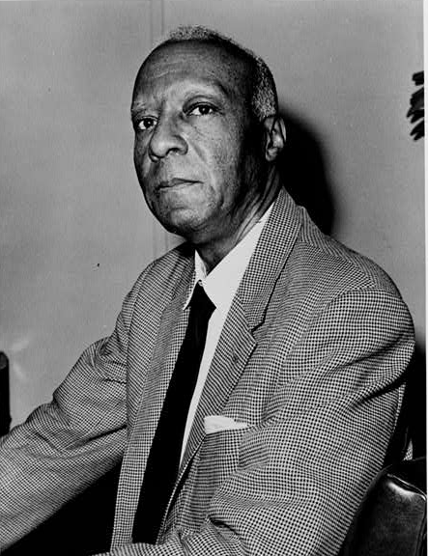
A. Philip Randolph (3 of 3)
Randolph played a crucial role as one of the key organizers and speakers at the 1963 March on Washington for Jobs and Freedom, an event that drew a crowd of 250,000 people rallying for civil rights.
The following year, the Civil Rights Act was passed. Randolph was awarded the Presidential Medal of Freedom and founded the A. Philip Randolph Institute to study and combat poverty.
Randolph devoted his life to improving labor relations and advocating for civil rights for African Americans. He retired as the president of the BSCP in 1968 and passed away in 1979 at the age of 90.
Notes:
Information:
https://www.history.com/topics/black-history/a-philip-Randolph
https://home.nps.gov/hofr/learn/historyculture/a-philip-randolph.htm
https://www.nps.gov/people/a-philip-randolph.htm

Slide 14
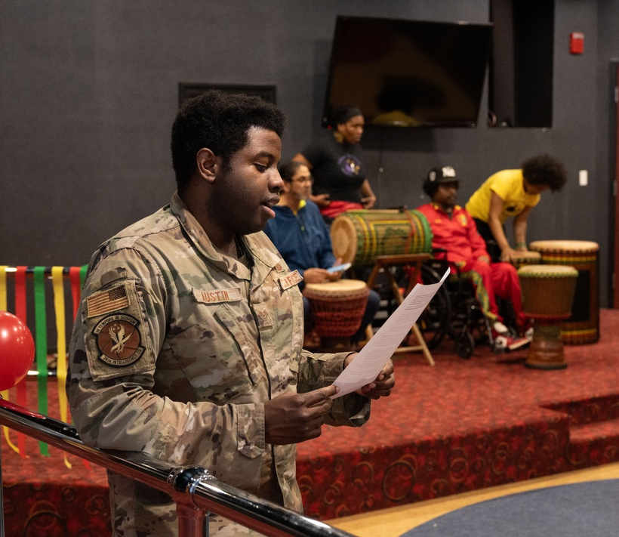
Conclusion
The labor movement, exemplified by the establishment of the BSCP and its founders, played a significant role in shaping the African American working, middle, and professional classes, while also fueling the Civil Rights Movement and changes within the U.S. Government and Military.
During Black History Month, the DoD honors the contributions of the BSCP, Rosina Corrothers Tucker, A. Philip Randolph, and the millions of Black workers contributing to the U.S. workforce today.

Slide 15

Prepared by the Defense Equal Opportunity Management Institute, Patrick Space Force Base, Florida February 2025
All photographs are public domain and are from various sources as cited.
The educational information within this presentation is designed to raise individuals’ general awareness on this topic. The information in this document is not to be construed as an official DEOMI, U.S. Military Services, or Department of Defense position.

