Slide 1
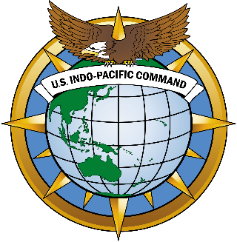
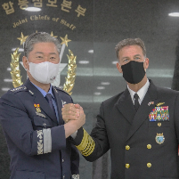
UNCLASSIFIED
United States Indo-Pacific Command
Ensuring a Free and Open Indo-Pacific
USINDOPACOM Strategy
UNCLASSIFIED

Slide 2
U.S. Indo-Pacific Command Organization
UNCLASSIFIED
President of the United States
Secretary of Defense
Chairman
Joint Chief of Staff
Commander
U.S. Indo-Pacific Command
Commander
U.S. Pacific Fleet
Commanding General
U.S. Army Pacific
Commander
U.S. Marine Corps Forces Pacific
Commander
U.S. Pacific
Air Forces
Commander
U.S. Pacific
Space Forces
Commander
U.S. Forces Korea
Commander
U.S. Forces Japan
Commander
U.S. Special Operations Command Pacific
Joint Interagency Task Force-West
Center for Excellence in Disaster Management and Humanitarian Assistance
Joint Intelligence Operations Center
UNCLASSIFIED
UNCLASSIFIED
Notes:
JIATF-West
Joint Interagency Task Force West (JIATF West) is the U.S. Pacific Command (USPACOM) Executive Agent for Department of Defense (DoD) support to law enforcement for counterdrug and drug-related activities. The JIATF West team is a composite of approximately 166 active duty, reserve, DOD civilian, contractor, and U.S. and foreign law enforcement agency personnel.
DKI APCSS
DKI APCSS addresses regional and global security issues, inviting military and civilian representatives of the United States and Asia-Pacific nations to its comprehensive program of executive education and workshops, both in Hawaii and throughout the Indo-Pacific region. The Center supports the U.S. Indo-Pacific Command’s objective of developing professional and personal ties among national security establishments throughout the region. With a non-warfighting mission, the Center focuses on a multilateral and multi-dimensional approach to defining and addressing regional security issues and concerns. The most beneficial result is building relationships of trust and confidence among future leaders and decision-makers within the region.
CFE-DM
CFE-DM is the principal agency to promote disaster preparedness and societal resiliency in the Asia-Pacific region. As part of its mandate, CFE facilitates education and training in disaster preparedness, consequence management and health security to develop domestic, foreign and international capability and capacity.
JIOC
Multi-agency coordinating and processing authority for consolidating all-domain intelligence (needs updated)

Slide 3

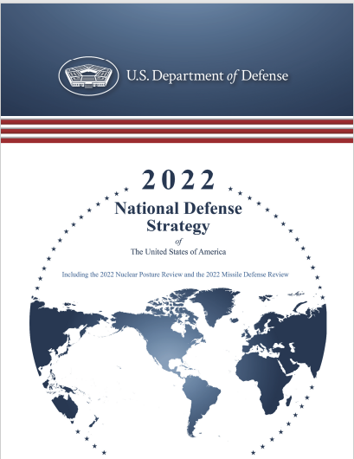



National Defense Strategy
UNCLASSIFIED
Security Environment
China is the most consequential, pacing challenge
Defense Priorities:
1. Defending the homeland
paced to the growing threat
posed by China.
2. Deterring strategic attacks
against the United States, allies,
and partners.
3. Deterring aggression
while being prepared to prevail in
conflict when necessary –
prioritizing the China challenge in
the Indo-Pacific, then the Russia
Challenge in Europe.
4. Building a resilient joint force and defense ecosystem
Russia poses acute threats.
DoD will remain capable of managing other persistent threats, including those from North Korea, Iran, and violent extremist organizations.
Transboundary challenges and competitor’s gray zone activities are transforming how DoD operates.
Approaches
DoD will advance U.S. goals through:
Alliances and
Partnerships
Integrated Deterrence
Enabled by combat-credible forces and ready to fight and win and backstopped by a safe, secure, effective nuclear deterrent.
Campaigning
A sequence of logically linked military initiatives, aimed at advancing strategy-aligned priorities.
Building Enduring Advantages
Modernize and innovate for new strategic demands.
Countries around the world have a vital interest in a free and open international system. Close collaboration between Allies and Partners is foundational for U.S. national security interests and our collective ability to address challenges to that system.
Force Planning
DoD will prioritize a future force
that is:
Lethal
Sustainable
Resilient
Survivable
Agile and Responsive
Deter conflict and prepare to win if deterrence fails.
UNCLASSIFIED

Slide 4
INDOPACOM Approach: Strategic Assessment and Operational Design
UNCLASSIFIED
Accelerate and Suffuse Information Operations synchronizes full spectrum military operations in all domains to build warfighting advantage and accelerate our ability to response immediately. Persistent forces, combined with our exercise and experimentation program, and synchronized with allies and partners is an effective means to deter potential invasion.
Build, Integrate, and Employ Advanced All-Doman Dynamic Combat Power capable of engaging in strategic competition and delivering integrated deterrence.
Strengthen Alliances and Partnerships, built on strength of our shared interests, is our greatest advantage. USINDOPACOM is strengthening all layers of our security network: allies, multilateral arrangements, partners, and friends. We execute security cooperation activities, training, and exercises to strengthen those relationships, build partner capacity, and enhance interoperability.
Improve Theater Posture to support all elements of the joint force, enables our ability to seamlessly operate with our allies and partners, and demonstrates U.S. commitment to a stable and peaceful security environment.
UNCLASSIFIED

Slide 5
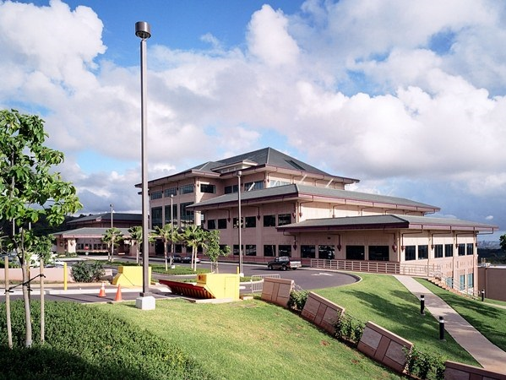
Discussion
5

