Slide 1
Uniformed Service Employment and Reemployment Rights Act of 1994 (USERRA)
CPT Beth D’Atri
808-672-1234
Beth.a.datri.mil@mail.mil
Ms. Jessica D’Amato
808-672-1229
Jessica.m.damato.civ@mail.mil

Slide 2
Administrative Notes
Keep your microphone on mute unless called upon
Raise your hand if you have a question/ comment or use the chat bar
If you cannot see the slides, you can download from the HRO Website or let us know so we can email to you

Slide 3
Agenda
What is USERRA?
USERRA: Absent – Uniformed Services Packet Overview
USERRA: Return-to-Duty Packet Overview

Slide 4
What is USERRA?
Effective 12 December 1994
USERRA protects the job rights of individuals who voluntarily leave employment positions to undertake military service. USERRA also prohibits employers from discriminating against past and present members of the uniformed services, and applicants to the uniformed service.
Limited to 5 cumulative years for Title 32 and Title 10. Exempted duty types below:
Exempted duty types include:
T10, USC, Sections 688, 10147, 12301(a), 12301(d), 12301(h) 12301(g), 12302, 12304, 12304(a), 12304(b), 12305 and 12406
T32, USC, Sections 502(a), 502(f)(2)(A) when ordered to full-time NG duty (other than training) by the President or the Secretary of Defense for the purpose of responding to a national emergency declared by the President and supported by federal funds, and 503
Notes:
The term “contingency operation” means a military operation that –
is designated by the Secretary of Defense as an operation in which members of the armed forces are or may become involved in military actions, operations, or hostilities against an enemy of the United States or against an opposing military force; or
results in the call or order to, or retention on, active duty of members of the uniformed services under section 688, 12301(a), 12302, 12304, 12305, or 12406 of title 10, United States Code, chapter 15 of title 10, United States Code, or any other provision of law during a war or during a national emergency declared by the President or Congress.

Slide 5
Absent-Uniformed Service
Benefits CAN be continued through military service but they are treated differently based on the type of orders the employee will be on. It is up to the employee to make elections that best suit their needs.
Next, we are going to go step-by-step through the checklist!
Note: The checklist is 4 pages, it is very important that you pay attention to each section and initial or put N/A if necessary.

Slide 6
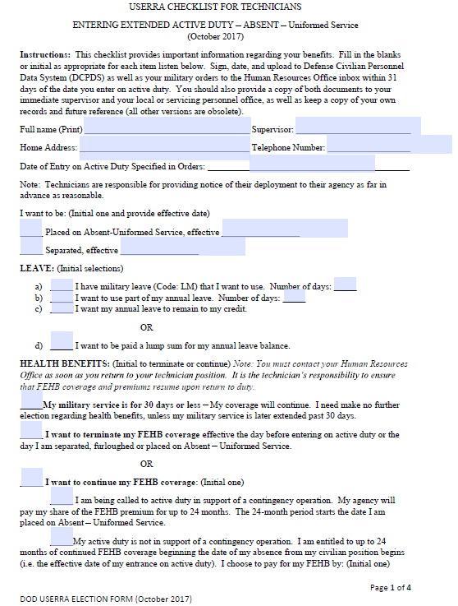
Setting the Effective Date
The Absent-US personnel action will be processed with an effective date the same as their military orders UNLESS the employee decides to use authorized available leave.
EXAMPLE:
Employee orders start January 1, normally the Absent-US would be effective January 1 but the employee has 40 hrs of regular comp time they want to use so the effective date for the Absent-US (KG) is January 6 (1-5 on Comp).

Slide 7
Leave
Once HRO processes the AUS, employees will be hard coded as Absent-US (KG), timekeepers can still code the following types of leave while the employee is on orders:
Military Leave (LM) under 5 U.S.C. 6323
Annual Leave (LA) under 5 U.S.C. 6304
Sick Leave (LS) (In accordance with regulation) 5 U.S.C. 6307
If paid leave is used while in Absent-US:
FEHB is retained, premiums deductions will still occur
FEGLI deductions will still occur
TSP and all other deductions will still occur
FERS (if applicable) deductions will also be deducted
All paid leave will not be considered/ included for calculations for MSD
Notes:
***Only authorized code while hard coded "KG" is LM, LA and LS with approval from HRO ***Mil leave depending on type of orders (AGR) cannot be utilized, however, if AGR goes on T10/contingency in support of an approved operation can be utilized

Slide 8
FEHB
Employees must elect to terminate or continue FEHB coverage during the military service period.
If FEHB is retained in a CONTINGENCY OPERATION:
Premiums paid by agency for up to 24 months
To receive FEHB coverage at no cost, must be:
1.) ENROLLED
2.) Reserve Component Member in a non-pay status
3.) Called to duty in support of contingency operation (10 USC Section 101(a) (13) )
4.) On active duty for more then 30 consecutive days
If FEHB is terminated:
Dates are determined by the employee based on individual circumstances
Termination is not a break in continuity of coverage for the purpose of eligibility to continue coverage as an annuitant
Employee has 31 day extension of coverage
Can Reinstate FEHB upon Return to Duty
FEHB Elections continue →

Slide 9
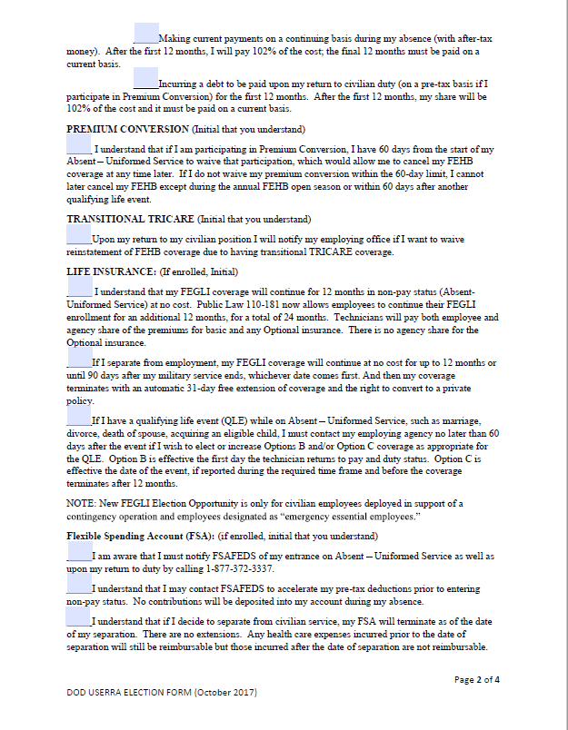
FEHB
If FEHB should continue based on a non-contingency operation, the employee has two options:
1.) Elect to pay the premium directly. Must be a minimum payment of the employee’s share of the premium for two pay periods. Please make your check or money order payable to DFAS-Cleveland. Include on the check your name, social security number, note that the payment is for FEHB premium and the pay period(s) for which the payment is being made.
2.) Elect to incur a debt, the repayment of the debt is deducted from your pay when you return to a pay status.
***first 12 months employee is responsible for their share of the premiums
***second 12 months, employee is responsible for their share, plus the governments hare plus 2% for admin costs/fee
***after 24 months, FEHB is terminated.

Slide 10
Premium Conversion
“Premium conversion” is a pre-tax arrangement in which the part of an employee’s salary that goes for Federal Employees Health Benefits (FEHB) program premiums becomes non-taxable.
This means that participants save on federal income tax and Social Security and Medicare taxes.
In most cases, they also save on state income tax and local income tax.
Conversion is automatic at enrollment unless waived and once you participate, your participation continues automatically unless you waive it.
Highly recommend all employees submit the Form HB-PC with your Absent-US checklist. It can be found here, (https://dod.hawaii.gov/hro/files/2012/12/Encl-3_Form-HB-PC.doc)
Notes:
For a small number of individuals it may make sense to waive premium conversion. There are two items to consider in making a decision to waive participation and they are:
Flexibility
Under IRS rules, you may reduce coverage (cancel, or change from Self and Family to Self Only) only during an Open Season or at the time of a qualifying life event.
Social Security
Paying your premiums with pre-tax money reduces your earnings reported to the Social Security Administration. When you begin to collect Social Security (normally this occurs at age 65), you may receive a slightly lower Social Security benefit. The extent of the impact will vary depending upon the retirement system you participate in, your salary compared with the Social Security wage base ($87,000 in 2003) and the number of years until you retire.
Recommend Premium Conversion is completed because it allows termination of FEHB ANYTIME outside of a QLE or open season. This prevents the employee forgetting to submit it within the 60 days of their AB-US and being stuck to pay 102% of premiums in their second 12 months of FEHB premiums.

Slide 11
Transitional Tricare
Contingency Operations may provide 180 days of Tricare once orders end

Slide 12
Federal Employees Group Life Insurance (FEGLI)
Continues at no cost to the employee for up to 12 months in Absent-US status when in a non-pay status (if paid leave is taken, a debt occurs)
Options:
Terminate at end of 12 months free coverage
Retain or Reduce Optional Coverage after end 12 months
**If retained, employees pays premium payments for both agency AND employee share

Slide 13
Flexible Spending Account (FSA)
It is the employees responsibility to contact FSAFEDS directly for any changes to FSA

Slide 14
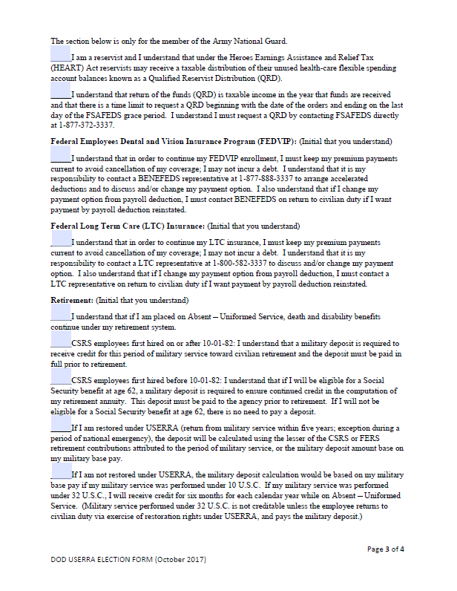
ARNG only
Contact FEDVIP directly
Contact FLTC directly
Military Deposit: If you are a Federal Employee Retirement System (FERS) or Civilian Service Retirement System (CSRS) employee, the period of Absent-US for military duty is creditable toward potential civilian retirement only if you make a service-credit deposit to cover this period of service. (We will cover this during the RTD portion of this brief)

Slide 15
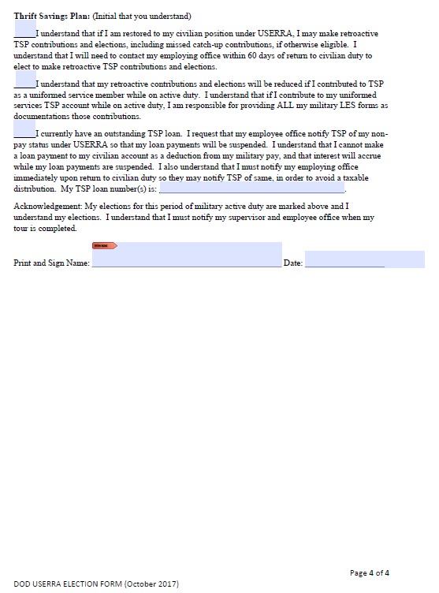
Thrift Savings Program (TSP)
If you choose not to submit an application to make Retroactive TSP Contributions you will not be eligible for any matching TSP contributions that you would have received if you had not been placed in an Absent-US status.

Slide 16
Questions
5 min break
Take a brief stretch and drop any questions in the chat bar.

Slide 17
Return-to Duty (RTD)
When returning to duty you have three options on when to come back to your civilian position:
1. Return the day after your orders end.
2. Return while on terminal leave, but not PDMRA leave. (attach approved DA form 31 to SF 52)
3. Return within 14 days after orders end, for orders that are longer than 90 days but less than 180 days
4. Return up to 90 days after your orders end, for orders longer than 180 days
Packets should be submitted NLT 14 days prior to your return to work, but earlier is better, it will give us time to process prior to your first pay period. If you extend your orders after you submitted your RTD Packet, make sure to contact us.

Slide 18
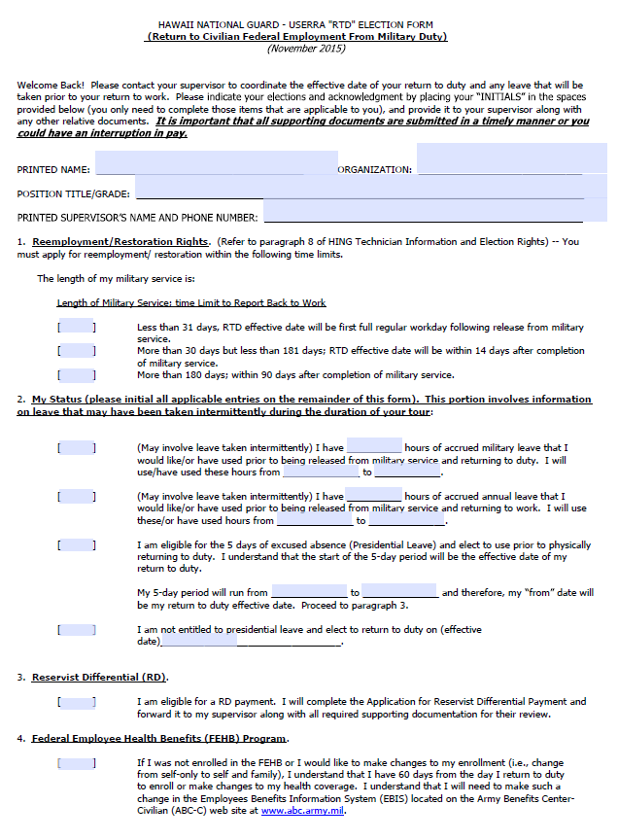
RTD
Submit this form with all of your orders, mods/amendments, DD214 for the service period
If you do not RTD within the listed time frame, you will be separated from your position without any reemployment rights.

Slide 19
Determining your RTD Date
You must annotate what will be your first day back at work

Slide 20
Reservist Differential
You will only receive this if you make less as a member of the military than you make as a civilian.
Federal employees who are in a leave without pay status due to a contingency operation will receive the difference in pay from their military pay to their civilian pay.
Your Military Pay includes Basic Pay, BAS, BAH, FSA-II, Hardship Location, Hostile Fire pay
You do not receive reservist differential if you use any type of leave during a pay period.
If an employee is entitled to reservist differential payment, upon returning to duty, the EMPLOYEE should provide any remaining military LESs and a copy of his/her DD 214 as soon as possible to the Employee Service Office.

Slide 21
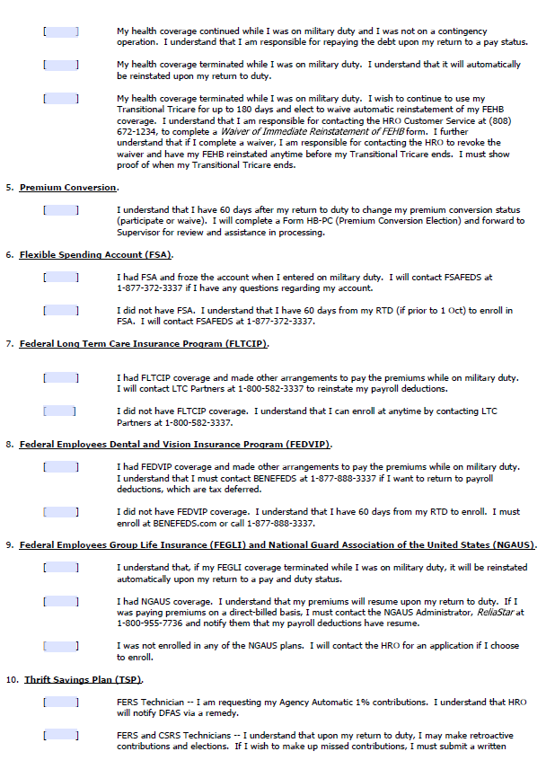
FEHB
Once you have Returned to Duty (RTD) you may enroll, cancel, or continue your (FEHB)
- If you choose to keep the FEHB election you had before you were placed in Absent-US you do not need to do anything but you can make changes to your existing FEHB
If you choose to enroll in FEHB you have three Qualifying Life Events (QLE’s) on which you may enroll.
Returning to Duty- QLE 1F- only if you cancelled FEHB when you were placed in Absent-US (AUS) . You may enroll up to 60 Days after you RTD. Supporting documentation is your SF 50 for RTD.
2. When your Tricare converts to TAMPUS- QLE 1M- you may enroll up to 30 days before or 60 days after you are eligible for TAMPUS. Supporting documentation is a Tricare Certificate of Eligibility or DoD Dependent ID Card with a status of T-180.
3. When your TAMPUS ends- QLE 1M- you may enroll up to 30 days before or 60 days after you are eligible for TAMPUS. Supporting documentation is your DoD Dependent ID Card with a status of T-180.

Slide 22
FEHB
You may choose to cancel your FEHB coverage because you are eligible for TAMPUS (QLE 1M). If you choose to cancel It must be completed through ABC-C. The cancellation becomes effective the last day in the pay period in which we receive it without a 31 day grace period.
- If you transfer to another Federal agency, your cancellation follows you to that agency.
If you separate from your employment, you will not be eligible for temporary continuation of coverage (TCC).
If you retire, you will not have an FEHB enrollment to continue into retirement.
If have a break in health benefit coverage by a federal health benefit program within 5 years from the date of retirement you may not be eligible for FEHB after your retirement .
You may not reenroll in FEHB until you loose your TAMP coverage or have another qualifying life event (QLE) that permits enrollment, or until the next FEHB Open Season.

Slide 23
RTD Packet cont’d
Initial each section for FSA, FLTCIP, FEDVIP, FEGLI, NGAUS or N/A if not applicable
If you would like to change your coverage on those benefits, the contact information has been provided to you.

Slide 24
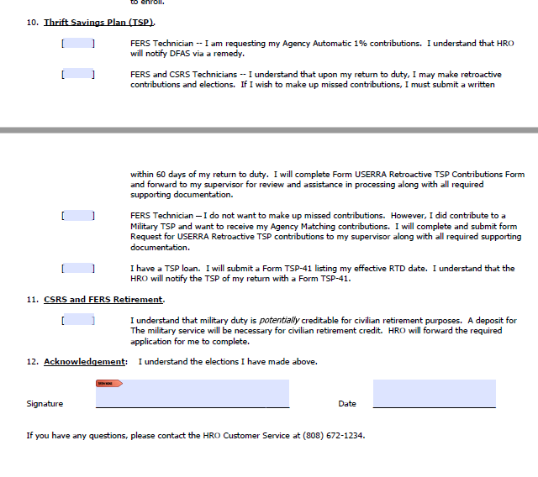
TSP
If you choose not to submit an application to make Retroactive TSP Contributions you will not be eligible for any matching TSP contributions that you would have received if you had not been placed in an Absent-US status.
DEADLINE- TSP ACTIONS MUST BE INITIATED WITHIN 60 DAYS OF YOUR RETURN TO A TECHNICIAN STATUS.
Three Types of TSP Contributions: 1.) Agency Automatic 1%
2.) TSP Employee Contributions
3.) TSP Agency Matching Contributions

Slide 25
Agency Automatic 1% (FERS Only)
This is a contribution this agency puts in your TSP account based on your salary whether you contribute or not. You are entitled to YOUR automatic 1% agency contribution upon your return to duty. This is calculated by TSP and may take several months to show up in your TSP account.
This is automatic and you do not need to fill out anything to receive the Agency Automatic 1%.

Slide 26
Make-up Employee Contributions
If you were placed in Absent-US (LWOP-US) you can make up contributions from the periods your were in Absent-US (LWOP-US) .
- Contributions will be based on the TSP-1 on file or one submitted with your paperwork. Please fill out and attach USERRA RETROACTIVE TSP CONTRIBUTIONS form, if applicable.
Make-up contributions will be deducted from your civilian LES. You can choose to spread your deductions out for up to 2 times the amount of pay periods you were gone. This means your TSP contributions will be combined on your LES.
*Can be found on our HRO Website:
https://dod.hawaii.gov/hro/files/2020/06/Retro-TSP-upon-RTD-Revised-June-2012.pdf

Slide 27
TSP cont’d
What Are Make-up Matching Contributions?
This is calculated by TSP based on your civilian salary. Full matching for the first 3% and half matching for the 4th and 5th percent of your civilian pay. Make-up Matching contributions will be allocated according to the most current disbursement or in the G fund only.
How do I receive Make-Up Matching Contributions?
You can only receive matching contributions if you make up your civilian employee contributions or if you contributed to TSP on your military side.
If you contributed to TSP on your military side all your military LESs or MMPA print out must be provided with your TSP makeup contribution paperwork.
You may receive matching contributions based on your military TSP contributions without making up employee contributions. This is free money and no money will be taken out of your LES.

Slide 28
Military Service Deposit
If you are a Federal Employee Retirement System (FERS) or Civilian Service Retirement System (CSRS) employee, the period of Absent-US for military duty is creditable toward potential civilian retirement only if you make a service-credit deposit to cover this period of service.
Step-by-Step directions for military service deposit are available on our website at: https://dod.hawaii.gov/hro/military-service-deposit-2/

Slide 29
References
NGB USERAA Guide Dated 12 February 2016
Chapter 43 Title 38 U.S.C.
5 CFR 353, 20 CFR Part 1002
Uniformed Employment and Reemployment Act of 1994

Slide 30
Additional Resources

Slide 31
Contact Us
Email the group mailbox:
ng.hi.hiarng.mbx.nghi-hro-benefits@mil.mil

Slide 32
Questions?

