Slide 1



OFFICIALS PROVIDE STORM UPDATE
Severe Weather Impacting Hawai‘i
Governor Josh Green
State of Hawaiʻi
March 20, 2026

Slide 2

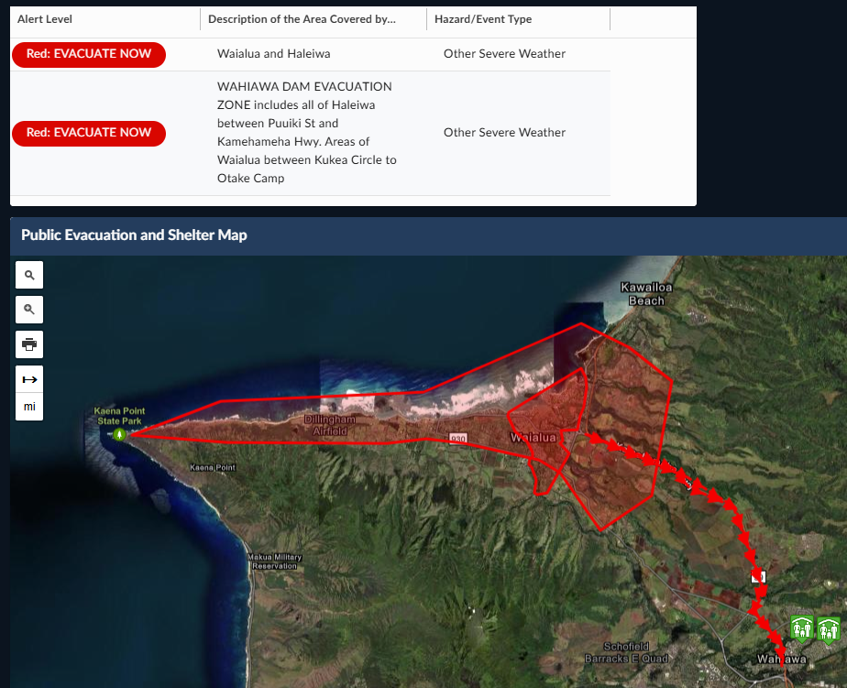
Severe Weather Update
O‘ahu Flood Warning in effect through 8 p.m. today. Statewide Flood Watch through Sunday 6 p.m.
Evacuation orders for Waialua and Hale‘iwa areas.
Evacuation warnings for parts of Lahaina, Kīhei, ʻIao Valley, Hana and East Moloka‘i.
Shelters and Assembly Areas available at ready.hawaii.gov

Slide 3
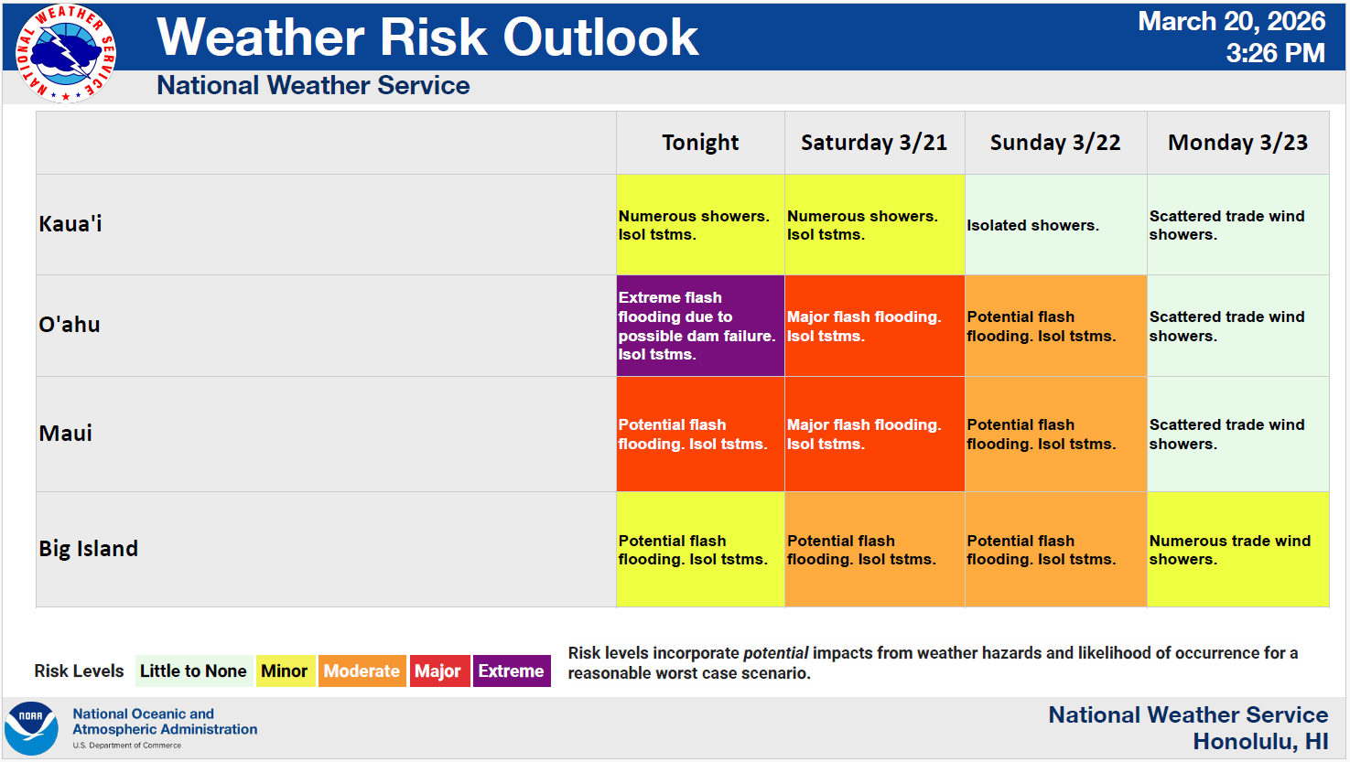

Slide 4
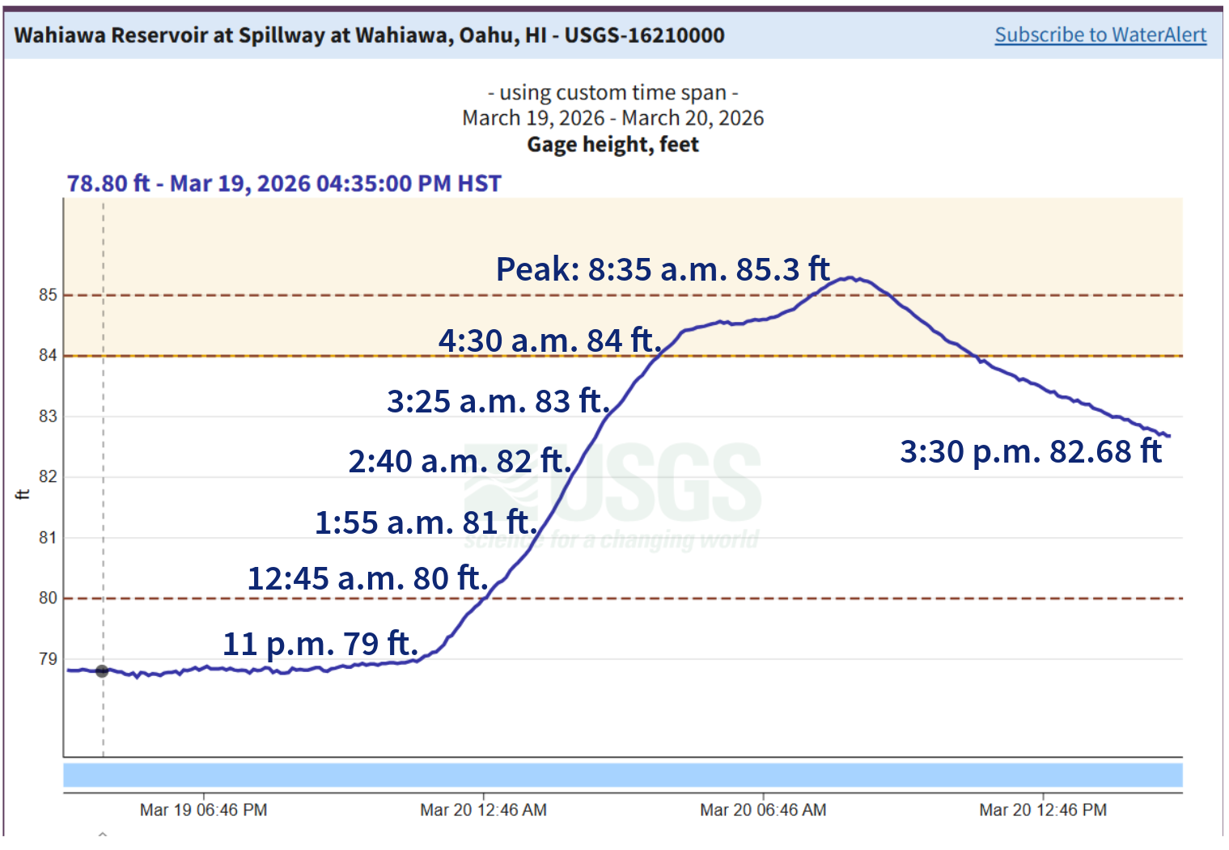
Wahiawā Dam Timeline

Slide 5
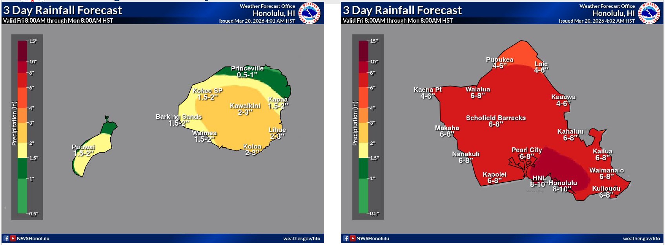
Rainfall Forecast Through Sunday Night

Slide 6
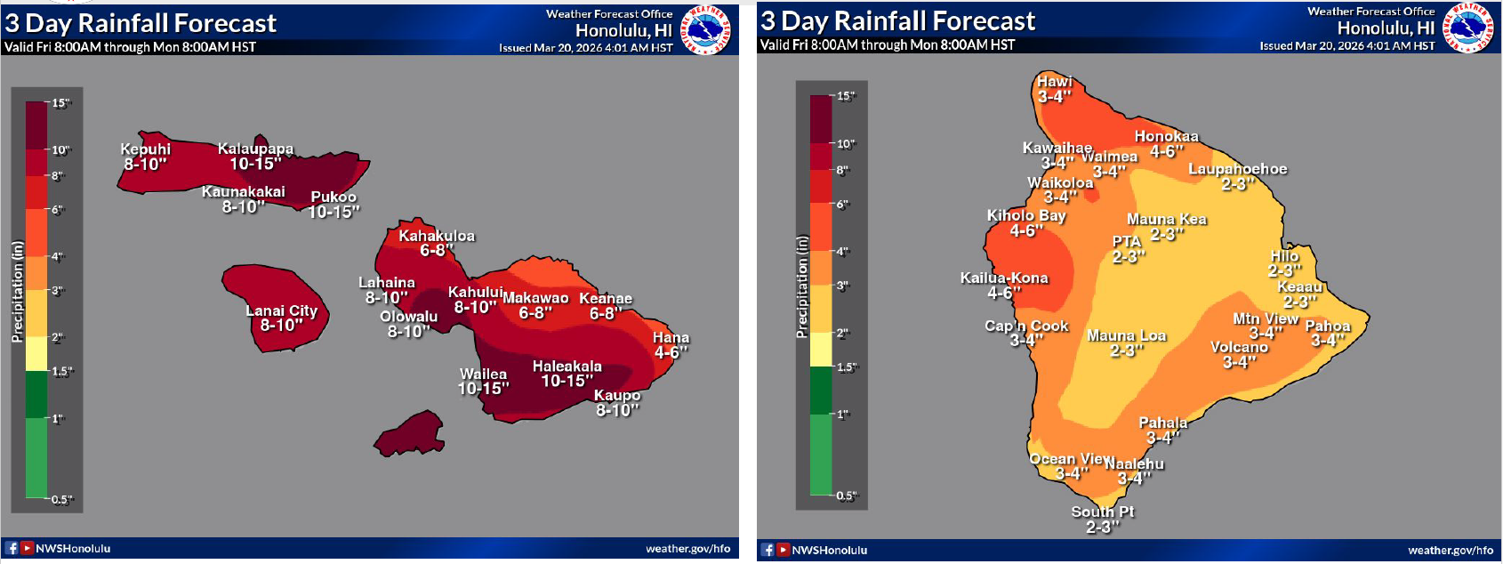
3-Day Rainfall Forecast Through Sunday Night

Slide 7
Shelter Information
Oʻahu
Ewa Beach:
Salvation Army Kroc Center
Nānākuli:
Nānākuli High and Intermediate School
Wahiawā:
George Fred Wright Wahiawā District Park
Maui
Kīhei:
South Maui Community Park Gym
Kīhei Community Center
Hāna:
Hāna High School Cafeteria
Lahaina:
Lahaina Civic Center
Wailuku:
Baldwin High School

Slide 8
Kamaʻāina Hotel Rates for Evacuees
Waikīkī Hotel Kamaʻāina Rates for Evacuees
Moana Surfrider, A Westin Resort & Spa
Outrigger Waikīkī Beachcomber Hotel
Outrigger Waikīkī Paradise Hotel
Outrigger Waikīkī Beach Resort
The Royal Hawaiian, A Luxury Collection Resort
Sheraton Princess Kaʻiulani Waikīkī Beach
Sheraton Waikīkī Beach Resort
Waikīkī Beach Marriott Resort & Spa
Rates starting at $191/night plus applicable taxes.
Call for availability. Details at ready.hawaii.gov.

Slide 9
Useful Links
Sign up for local emergency alerts: ready.hawaii.gov/alerts
National Weather Service Honolulu website: weather.gov/hfo
Road closures and travel disruptions: hidot.hawaii.gov
Donate to Hawaiʻi Community Foundation, Stronger Hawai‘i Fund: hawaiicommunityfoundation.org
Donate to American Red Cross and Salvation Army for local relief: ready.hawaii.gov

Slide 10
OFFICIALS PROVIDE STORM UPDATE, URGING PUBLIC PREPAREDNESS
Severe Weather Impacting Hawai‘i
Governor Josh Green
State of Hawaiʻi
March 20, 2026

