Slide 1
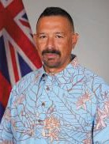
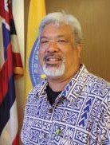
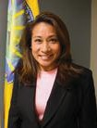
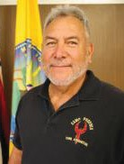
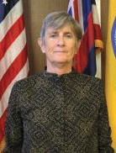
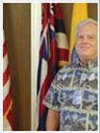
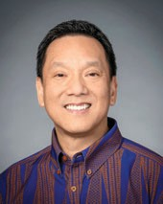
James DS. Barros Administrator 808-733-4300
james.barros@hawaii.gov
Don Aweau Executive Officer 808-733-4300
Ext. 521
donald.s.aweau@hawaii.gov
<īele mundson Communications Director ϴϬϴͲϳϯϯͲϰϯϬϬ
ǆt.ϱϮϬ
shirley.t.k.amundson@hawaii.gov
:ack Lee Operations Branch Chief
ϴϬϴͲϳϯϯͲϰϯϬϬ
ǆt. ϱϮϵ
jack.d.lee@hawaii.gov
:ackie Russell Logistics Branch Chief ϴϬϴͲϳϯϯͲϰϯϬϬ
ǆt. ϱϰϮ
jacquelyn.l.russell@hawaii.gov
Datthew tall
Resilience Branch Chief ϴϬϴͲϳϯϯͲϰϯϬ0
ǆt.ϴϭϲ
matthew.w.wall@hawaii.gov
ĂƌƌŝĐŬ ŚŝŶŐ
dmin Θ &inance Branch Chief
ϴϬϴͲϳϯϯͲϰϯϬϬ
ǆt.ϳϲϱ ĚĂƌƌŝĐŬ͘ũ͘ĐŚŝŶŐ@hawaii.gov

