Slide 1


SEVERE WEATHER & FLOODING EVENT
Unified Coordination Group (UCG) Meeting
03/15/2021
Current Operational Period
0600 HST, 03/15/2021 to 0559 HST, 03/16/2021

Slide 2

UCG Meeting Agenda
Opening Remarks | UCG
Update on Current Situation/Weather | Situation Unit / NWS
Review Incident Objectives | Planning SC
Operations Updates | Operations SC
Updates around the room | Attendees
Presentation of Meeting Schedule | Operations/Planning SC
Closing Remarks | UCG

Slide 3
Opening Remarks

Slide 4
Current Situation

Slide 5

Current Situation
County of Hawaii:
Closure at Highway 11 and Kahaopea Road to replace traffic signal downed by motor vehicle
County of Maui:
Landslide occurred on Honoapiilani Highway on Wailuku side of tunnel
Maui County closely monitoring water levels at Kaupakulua Dam. Water crested over spill way. Residents notified to be ready to evacuate.
City & County of Honolulu
Maakua Stream in Hauula clocked with debris on private property causing property flooding.
C&C issued emergency proc to lift rest restriction on disposal of household debris at transfer stations. Bulky waste pickups expanded on the North Shore.
Salvation Army assisting North Shore Christian Fellowship with the clean up of 3 households in Haleiwa & Wailua.
County of Kauai:
Kauai County’s new website page for March 2021 Flooding: http://www.kauai.gov/Government/Departments-Agencies/Emergency-Management-Agency-formerly-Civil-Defense/March-2021-Flooding
Kauai County issue guidance for North Shore community affected by Kuhio Closure. Residents asked to start separating putrescible waste so county can focus on initial removal once access is restored.
First Responders continue to have access to North Shore community by boat and Air 1 ops for emergency calls. Food supplies available at stores and food pantries in affected areas
Kuhio Hwy in vicinity of Hanalei Bridge (mile marker 1) remain closed. Work to clear debris is nearly done. Remaining work–installing barriers, rock fence & side barrier on downslope.
Temporary Flight Restriction submitted to FAA has been approved. Princeville to Kee Beach, 1500 ft. cap on ceiling. (1000 hours from 3/13 to 1000 hours on 3/20)
State of Hawaii:
Flash Flood Watch is extended for all islands until 6PM, 3/15. NWS reports wet pattern will continue as cold front stalls over eastern end of the state. A wet pattern will remain possible through the first half of the upcoming week. Home Clean up Hotline has been opened to support residents with flood damage. Call 211 or (808) 643-5555
NWS Extended High Surf Advisory Mon March 15, 2021 6PM
Salvation Army will hold event in Haleiwa (Waialua Community Association) & Hauula (Hauula Community Association) today 3/15 at 2pm – 6 pm, to provide disaster financial assistance (for those with damage to their residence), temporary housing assistance (for those displaced by flooding), food and hydration, and emotional and spiritual care.
DLNR -- Dam Safety:
County of Maui -- Kaupakalua Reservoir 38 water level is good and continues to drain. Owner of the dam is monitoring hourly and reporting to DLNR. Peahi – MA091 spiked up to 27’ but not still below the spillway and draining. Reservoir 61 at spillway but coming down.
Oahu and Kauai reservoirs water levels are ok, and not spilling. Wahiawa (Oahu) is flowing about ½ a foot through the spillway. No concerns at the moment.
4

Slide 6
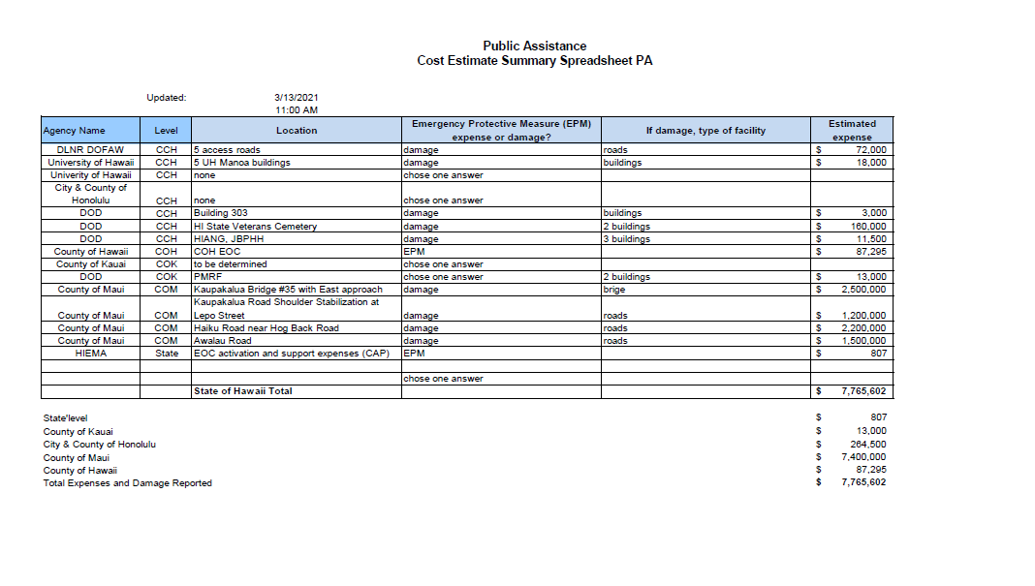
PA Damage Assessments (as of 3/13/21)
4

Slide 7
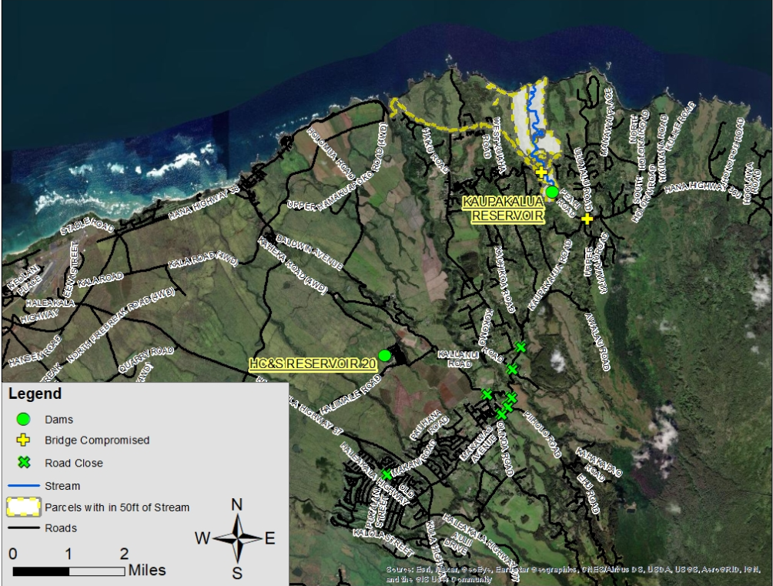
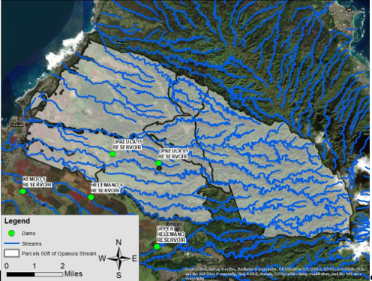
3/13/2021
County Impacts: Maui & Honolulu
County of Maui - Kaupakalua Reservoir. Areas highlighted in yellow are populated and within 50 feet of the stream center line. If dam were to be fully compromised, these areas would suffer highest degree of damage/impact/destruction.
City & County of Honolulu: Opaeula Reservoir
Areas highlighted in white are populated and within 50 feet of the stream center line. Earlier flooding from Opaeula stream caused an evacuation of Haleiwa Town.

Slide 8
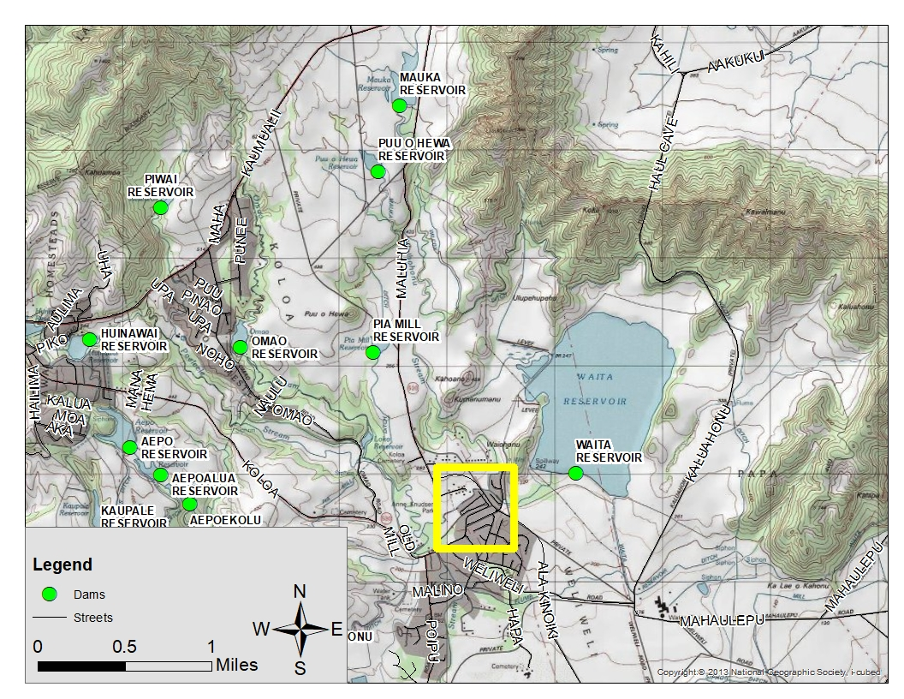
County Impacts: Kauai
Mauka Reservoir Dam. Yellow box is area of interest/observation.
Currently no issues with the dam, however there is water in the spill-way. Water in spill-way is a concern as this has caused flooding in the in the subdivision crossroad in the past. Dam Safety and KEMA are monitoring closely.
3
Notes:
As of 10PM, 3/9: Parks and Rec reports damage to the multi-use path in the vicinity of Coco Palms. Parking lot damage and beachfront erosion along Wailua. (see steve’s email sent at 10:24 pm)

Slide 9
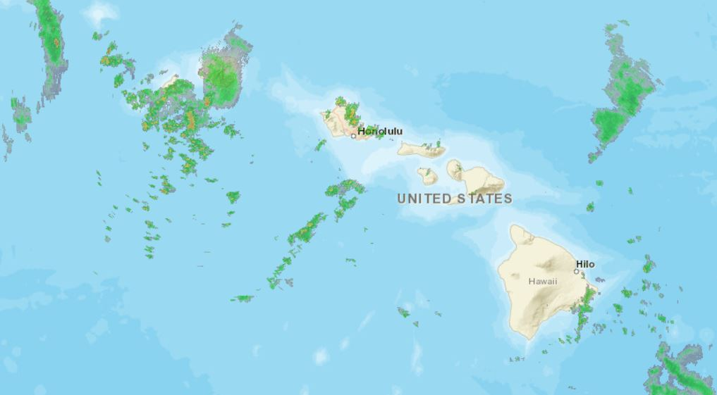
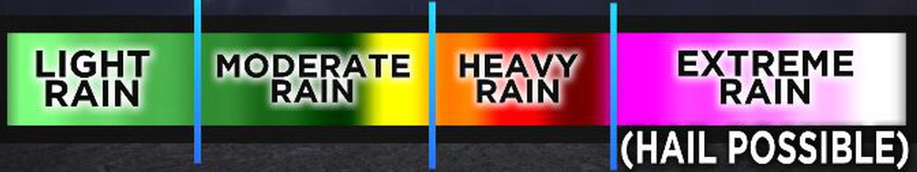
WEEKLY FORECAST
March | Tuesday 9th | Wednesday 10th – Friday 12th | Saturday 13th
State of Hawaii | Mostly cloudy. Frequent showers windward. Showers likely leeward. Slight chance of thunderstorms. Locally heavy rainfall possible. Lows 65 to 70. Southeast winds 10 to 15 mph. | Mostly cloudy with scattered to numerous showers. Slight chance of thunderstorms on Wednesday. Highs 78 to 83. Lows 64 to 69. Southeast to south winds 5 to 15 mph. Becoming variable 5 to 15 mph Friday. | Partly cloudy. Cooler and locally windy. Scattered showers windward. Isolated showers leeward. Highs 77 to 82. Lows 63 to 68. Northeast winds 15 to 30 mph.
Per National Weather Service (NWS):
An upper-level low will continue to bring showers and thunderstorms to the region through Wednesday, with high pressure to the northeast maintaining a trade wind flow. Some weakening in the trade wind flow is expected into Friday. Trade winds will strengthen from Friday into the weekend.
Weather formation over state as of 12:30PM on 3/10/21 (source: NWS)

Slide 10
Operations

Slide 11
Problem . Impact . Solution . Timeline (P.I.S.T) Board (3/10/21)
Problem/Issue | Impact | Solution | TIME
Haleiwa town flooded | Damaged and flooded commercial and residential buildings. Potential displaced residence | Rapid needs assessment Mass Care response Damage assessments | 03/13
Oil spills, wastewater and hazardous material discharge | 55-gallon oil drums leakage in Haleiwa Wastewater discharge from waste treatment plants at Papaikou and Kahuku Brown water advisories on Maui, Oahu and Kauai | Containment and damage assessments Public messaging Plan for cleaning operations | TBD
Reservoirs Reaching Capacity | Could lead to overtopping or failure that could threaten populated areas. | Close monitoring of at-risk reservoirs through visual and technological resources. Prepare for alert, warning and evacuation operations. | Ongoing
Timely disaster assessment to achieve federal assistance
ESF
5 6 DEM
10, USCG 15
2, 3, 5, 6, DLNR, 15

Slide 12
Proposed Incident Priorities
3/13/2021
Priority 1 - Save lives and minimize suffering.
Priority 2 - Support and provide emergency shelter.
Priority 3 - Communications/public messaging (coordinated).
Priority 4 - Maintain situational awareness of threats and operations.
Priority 5 - Support requests for assistance.

Slide 13

Incident-specific Objectives
# | Objectives | Agency
1 | Identify hazards in each county to determine the need for life safety response actions. | ESF1, ESF6, ESF7, ESF8
4a | Coordinate additional resources for isolated communities in Maui and Kauai. | DOH, ESF1, ESF2, ESF6, ESF7, ESF8, ESF13, ESF20, Counties
2a | Collect damage and impact assessment information in support of the county. | All
3 | Provide and coordinate appropriate public information promptly. Safety messages | HAH, HHEM, ESF7, ESF8, ESF15, Counties
5 | Ensure the safety and security of all response personnel and state-identified key area and facilities per COVID-19 Protocols. | ESF8, ESF16, Counties
6a | Gain and maintain capability and capacity to provide food, water, emergency shelter, fuel, and sanitation to impacted individuals. Note:all work assignments | ESF3, ESF6, ESF7, ESF12, ESF13, Counties
7a | Clear and sustain all critical transportation routes for essential services. | State Depts, ESF13, ESF20, Counties
8 | Support the treatment and collection and/or disposal of all hazardous materials to minimize and/or mitigate environmental impacts. | ESF7, ESF16
9 | Support Identify debris management priorities, staging areas, and locations to support operations in the county. operations. Note: Future Ops assignment Take of for next 24 | ESF1, ESF3, ES8, ESF10
10 | Determine and follow up on county unmet needs. Note: put under esf-6 | ESF5, ESF6

Slide 14
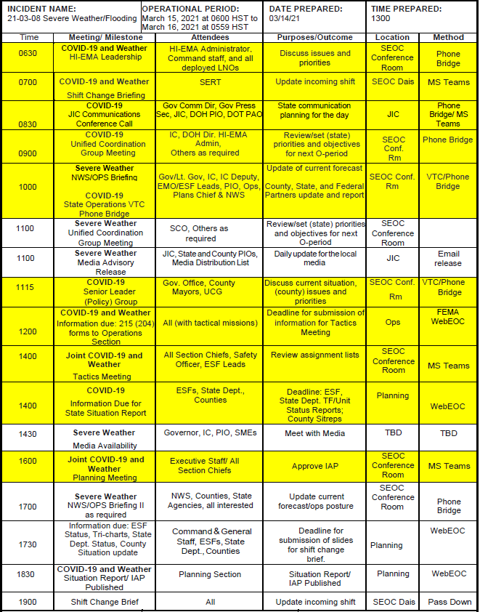
Operational
Rhythm
3/14/2021
Operational Period: March 15, 2021 at 0600 HST to March 16, 2021 at 0559 HST

Slide 15
Closing Comments

