Slide 1
Hawaii Army National Guard (HIARNG)
Senior Enlisted Career Management Advisory Panel (SECMAP)

Slide 2
Agenda
Problem Statement
Facts
Assumptions
Purpose
Enlisted AGR Management Advisory Council (EAMAC)
Business Rules
Roadmap
Composition and Responsibilities
Preference Sheet
Agenda
Post Board

Slide 3
Problem Statement
Codify and publish a progressive and deliberate tool to encourage and facilitate assignments for operational development, with special emphasis on Inactive Duty for Training (IDT) positions in the grades of E8 to E9

Slide 4
Facts
E8 and E9 IDT positions are filled through the traditional Enlisted Promotion System (EPS) vacancy fill process using a vacancy fill request (VFR) form
No collaboration or cross-talk among MSCs to discuss assignments or professional development
Systemic issues affecting promotion and management board continue, including delinquent and overinflated evaluation reports and non-submission of SGM-A selection packets
Reactive backfill process; no platform to discuss current and future E8 and E9 assignments and coordinate transitions seamlessly based on projected and emergent vacancies

Slide 5
Assumptions
Favoritism or rigged system
MSCs/Sep Units and other stakeholders are disenfranchised with no seat at the table
Senior NCOs are not involved in the process

Slide 6
Purpose
The Senior Enlisted Career Management Advisory Panel (SECMAP) is a Senior Noncommissioned Officer (NCO) leadership development tool designed to provide progressive, purposeful, and deliberate assignments for operational development, with special emphasis on Inactive Duty for Training (IDT) positions in the grades of E8 to E9. The SECMAP analyzes each Senior NCO's assignment history, performance, and potential to facilitate professional growth while addressing the organization's requirements. The SECMAP aims to expose Senior NCOs to various assignments and obtain a broader military perspective before advancing or assuming positions of higher responsibility.

Slide 7
Senior Enlisted Career Management Advisory Panel (SECMAP)
Responsibilities
HIARNG CSM / SECMAP Chair
Publish agenda for discussion NLT 1 month before SECMAP convene date.
Approval authority for all E8/MSG/1SG and E9/SGM/CSM IDT assignments.
MSCs (29 IBCT, 103 TC, 298 MFTR), Separate Units (JFHQ,HMRD), and Directorate Sergeants Major (G1, G3, G4, G6)
Identify primary and alternate representatives.
Present subject-matter insight and valuable information during discussions.
Discuss and secure approval from command teams within their levels of command prior to SECMAP convene date.
Recommend vacancy fill option for each vacancy.
Observe decorum and maintain the integrity of proceedings until official publication or announcement.

Slide 8
Senior Enlisted Career Management Advisory Panel (SECMAP)
Responsibilities
G1 SGM
Facilitate discussions.
Prepare briefing slides and compile results for signature and distribution.
Publish meeting minutes.
G1 Enlisted Promotion Manager
Validate vacancies and EPS Lists.
Ensure compliance with EPS regulations.
Process vacancy fill requests.

Slide 9
Senior Enlisted Career Management Advisory Panel (SECMAP)
Responsibilities
Senior NCOs
Review reference materials to include career maps and MOS progression charts.
Submit preference sheets with the FY26 EPS packet.
Maintain accuracy of personnel and training records.
Branch Mentors
Provide information and guidance to NCOs.
Be familiar with applicable references to include career maps and progression charts.

Slide 10
Process and Business Rules
Schedule and Composition
  Quarterly, same day as IDT, 1700 on Saturday
  FY25 schedule will be published with the policy
  SECMAP representatives will be appointed
Agenda
  Current and Future status of E8 and E9 positions (1SG, CSM, MSG, SGM)
  Professional Development – new policies / MOIs (EPS, SGM-A Selection, EQRB)
  New Business
Preference Sheet
  E7 to E9 NCOs must submit NLT 16 Jul 25
CLASP
  AGRs identified for 1SG/CSM positions are subject to final approval through the EAMAC
Notes:
14 months – known loss – discuss in EAMAC
MEB – identify at what point a position is discussed in EAMAC; notification for unfit; IPB; right before 199 is issued

Slide 11
Process and Business Rules
EPS List
  The authorized reference document is the approved and published EPS List at the time of the SECMAP convene date
Integrated Disability Evaluation System (iDES).
  IDT Senior NCOs referred to iDES may be reassigned and replaced before determination of unfit for continued service.
  Recommending MSC must present compelling reason for backfill before final iDES disposition, to include inability to participate in mandatory training events as documented on SM’s DA Form 3349 (Physical Profile).
Disqualifiers
  Under stabilization in current position or rank (18 months).
  Approved separation (non-regular retirement, medical).
  Processing through the Disability Evaluation System (DES).
  Suspension of favorable personnel action (Flag).
  Subject of involuntary separation proceedings IAW AR 135-178.
Notes:
14 months – known loss – discuss in EAMAC
MEB – identify at what point a position is discussed in EAMAC; notification for unfit; IPB; right before 199 is issued

Slide 12
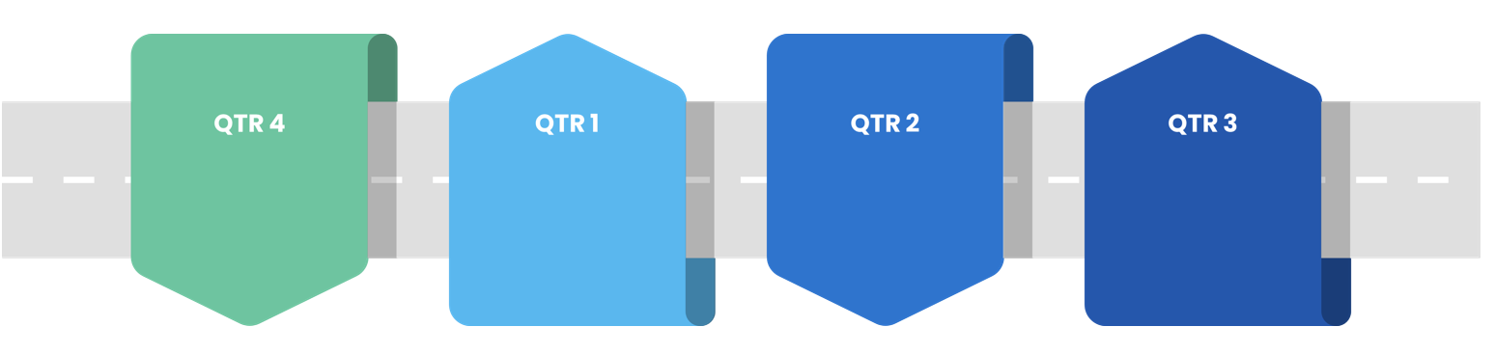
Senior Enlisted Career Management Advisory Panel (SECMAP) Roadmap
Jul:
Aug: FY26 EPS
SECMAP #2
Sep:
Oct: EQRB
Nov:
Dec:
Jan:
Feb:
Mar:
April:
May: Policy approval
Jun: SECMAP #1

Slide 13

SECMAP
HIARNG
CSM
RECOMMENDATIONS: TWO WEEKS
RESULTS: TWO WEEKS / NEXT IDT
SECMAP
Quarterly
HIARNG CSM
MSC CSMs / SEP UNIT 1SGs
G Staff
EPM
Working Group / SECMAP Prep
Monthly
MSC CSMs / SEP UNIT 1SGs
Commanders
Branch
Mentors
G Staff

Slide 14
Agenda
Senior NCO Management – presented by each MSC / Sep Unit
Professional Development
  FY26 EPS MOI
    Changes
    Baseline
  FY26 SGM-A Selection Board
  CY25 EQRB
New Business
Notes:
14 months – known loss – discuss in EAMAC
MEB – identify at what point a position is discussed in EAMAC; notification for unfit; IPB; right before 199 is issued

Slide 15

JFHQ

Slide 16
JFHQ

Slide 17
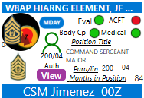
JFHQ
HIARNG Command Group
Senior Ops NCO
200-02 E8/00F5O
Vacant
Pending fill for IG NCO (1SG Balmonte)

Slide 18
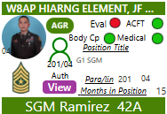
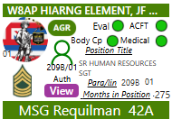
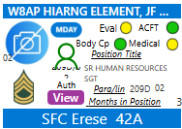
JFHQ
G1
Education NCO
210A-02 E8/00F5O
Vacant
Pending fill: LAT for 1SG Takasawa

Slide 19
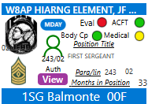
JFHQ
HHC
Projected vacancy
Backfill?

Slide 20

29 IBCT

Slide 21

HHC, 29 IBCT

Slide 22
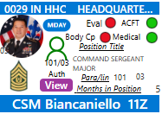
HHC, 29 IBCT
Command Group

Slide 23
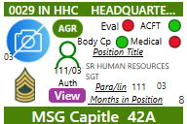
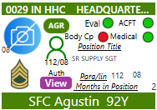
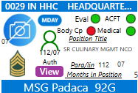
HHC, 29 IBCT
BDE Current Ops
Intelligence MSG
102-05 E8/35Z5O
Vacant
Signal Ops Sec Ch
115-05 E8/25U5O
Vacant

Slide 24

1-299 CAV

Slide 25
1-299 CAV
CMD and STAFF

Slide 26
1-299 CAV
TROOPS

Slide 27

1-487 FAR

Slide 28
1-487 FAR
CMD and STAFF

Slide 29
1-487 FAR
BATTERIES

Slide 30

227 BEB

Slide 31
227 BEB
CMD and STAFF

Slide 32
227 BEB
COMPANIES

Slide 33

29 BSB

Slide 34
29 BSB
CMD and STAFF

Slide 35
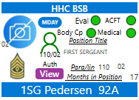
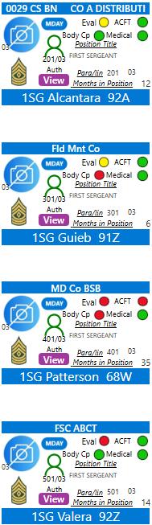
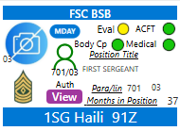
29 BSB
COMPANIES
Separated 27 Apr 25 / Medical
VFR not received a/o 13 May 25

Slide 36
103 TC

Slide 37

HHC, 103 TC

Slide 38

1950 CCT

Slide 39

297 EN FFT

Slide 40

111 AB

Slide 41

117 MPAD

Slide 42

B/1109 TASMG (-)

Slide 43

230 ENG (-)

Slide 44

B/2-211 AVN

Slide 45

C/1-183 AVN

Slide 46

DET 1/G/3-126 AVN

Slide 47

DET 1/G/1-189 AVN

Slide 48

DET 1/A/3-140 AVN

Slide 49

B/777 ASC (-)

Slide 50

298 MFTR

Slide 51
HMRD

Slide 52
FY26 EPS MOI

Slide 53
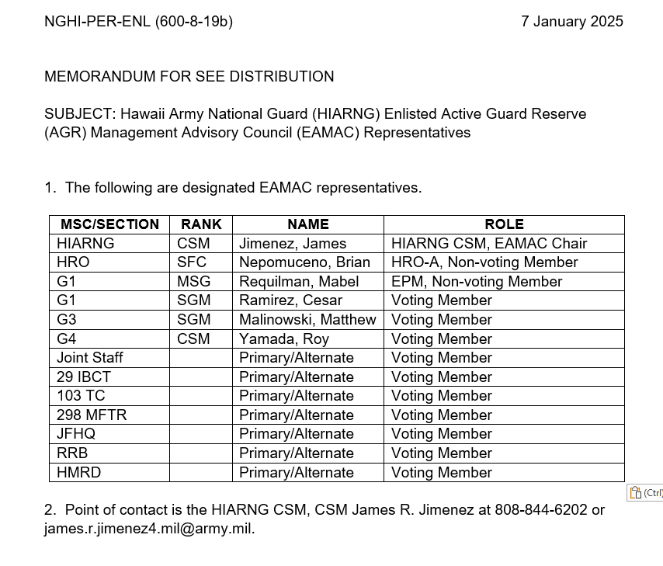
SECMAP Appointment

Slide 54
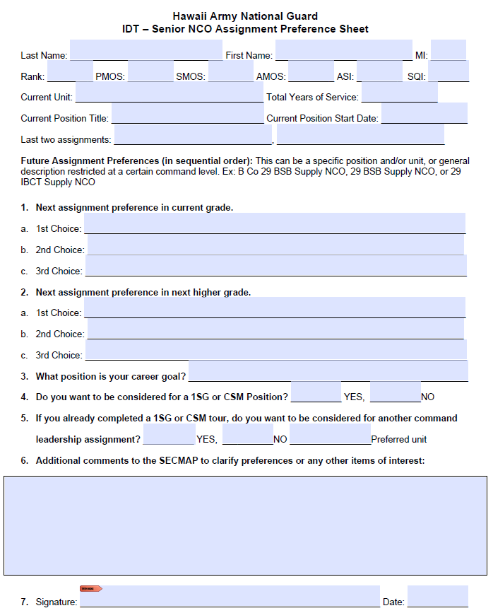
Preference Sheet

Slide 55
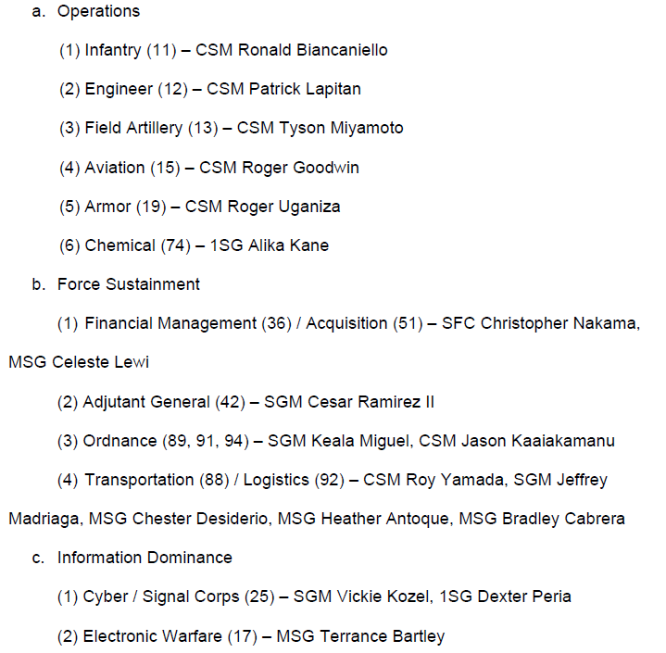
Branch Mentors
Notes:
FTMM – can be discussed / approved then forward to EAMAC for decision
BAWG Chair: Back brief to Chief of Staff
Impasse: Provide names and advantage/disadvantage
Add Broadening schools (i.e. Pre-Command)
BAWG: Branch Advisory Working Group. Position based appointment for each branch. Proceeding slides depict each BAWG’s composition.
FTMWG: Chair: Chief of Staff. Members: MSC Commander, G Staff, HRO, OPM
Council of Colonels: Chair: Chief of Staff. Members: MSC Commander, G Staff, HRO, OPM
SLDB: Chair: HIARNG CG. Members: Chief of Staff, MSC Commanders, G Staff, HRO, OPM

Slide 56
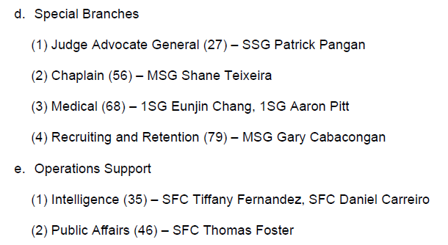
Branch Mentors
Notes:
FTMM – can be discussed / approved then forward to EAMAC for decision
BAWG Chair: Back brief to Chief of Staff
Impasse: Provide names and advantage/disadvantage
Add Broadening schools (i.e. Pre-Command)
BAWG: Branch Advisory Working Group. Position based appointment for each branch. Proceeding slides depict each BAWG’s composition.
FTMWG: Chair: Chief of Staff. Members: MSC Commander, G Staff, HRO, OPM
Council of Colonels: Chair: Chief of Staff. Members: MSC Commander, G Staff, HRO, OPM
SLDB: Chair: HIARNG CG. Members: Chief of Staff, MSC Commanders, G Staff, HRO, OPM

Slide 57
References
AR 600-8-19
NGR 600-200
Memorandum of Instruction for Fiscal Year (FY26) Enlisted Promotion System (EPS) Boards, 29 April 2025.

