Slide 1

CUI
AVS Account Request

Slide 2
This guide provides step-by-step instructions for requesting a new account through the Army's Access Validation Service (AVS) and Enterprise Security Management Platform (AESMP). Following these instructions will ensure a smooth and compliant account creation process for accessing necessary resources.

Slide 3
What is the New Process with AVS?
What type of account access do I need?
NIPR? SIPR? iPerms? G-Army?
Go to the AVS Portal (Link in the next slides)
Submit a (2875) Baseline SAAR Request
2875 Goes to Direct Supervisor for Signature
2875 Goes to ISSM/ISSO for Signature
2875 Goes to Security Manager for Signature
AVS Portion is Complete
YOU ARE NOT DONE YET!!!

Slide 4
What is the New Process with AVS?
How does my account access get created?
Go to AESMP (Link in the next slides)
Submit a New System Access Request (NSAR) Ticket
Ticket is routed to the G6 Help Desk for account creation
Save your Ticket Number
G6 Help Desk will notify you when your account has been created
NOW YOU ARE DONE!!!

Slide 5
Click-by-Click Instructions
The next slides will provide you with the click-by-click instructions on how to complete the AVS and AESMP process.
Please follow these instructions to make this process quick, smooth, and without rejections.

Slide 6
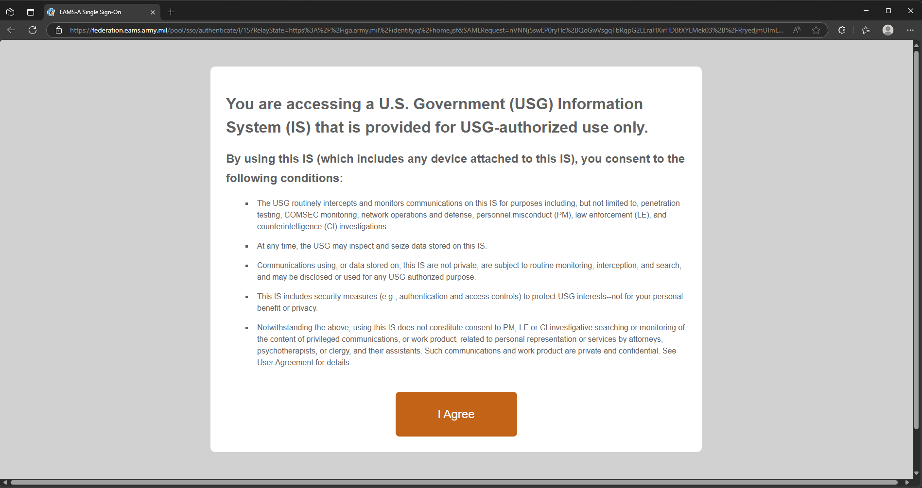
Go to https://iga.army.mil/identityiq/home.jsf

Slide 7
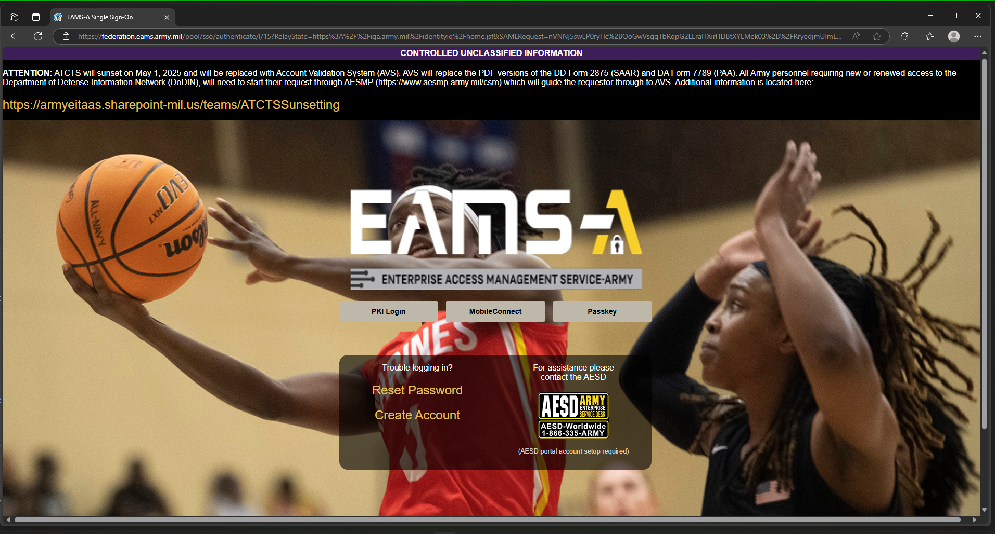

Slide 8
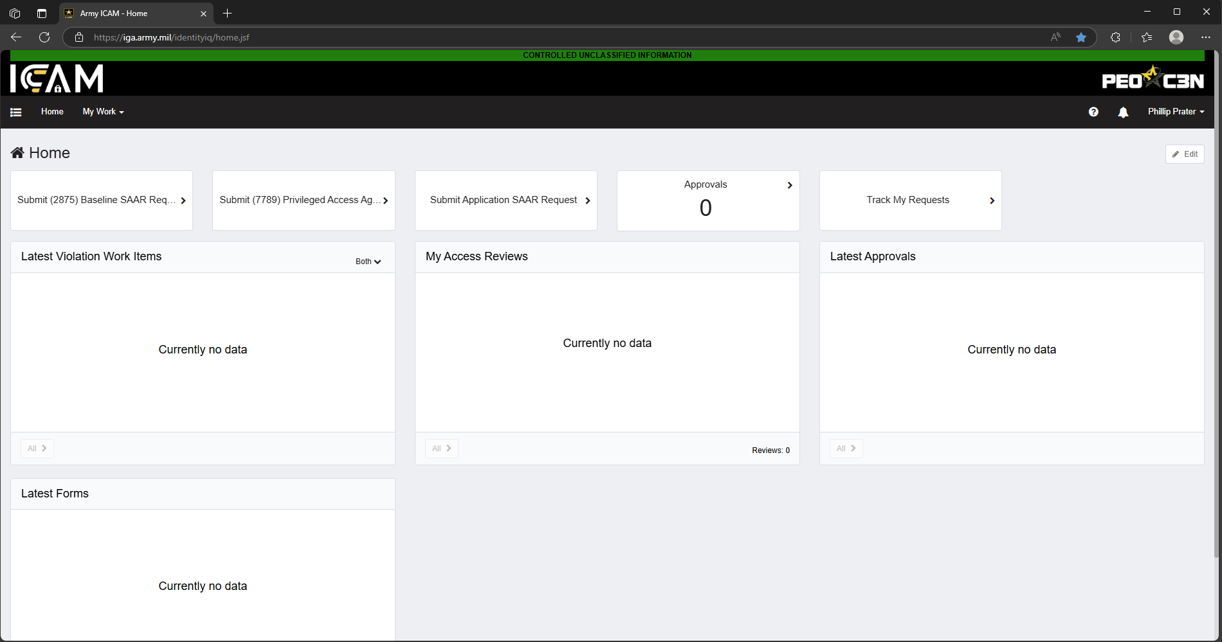

Slide 9
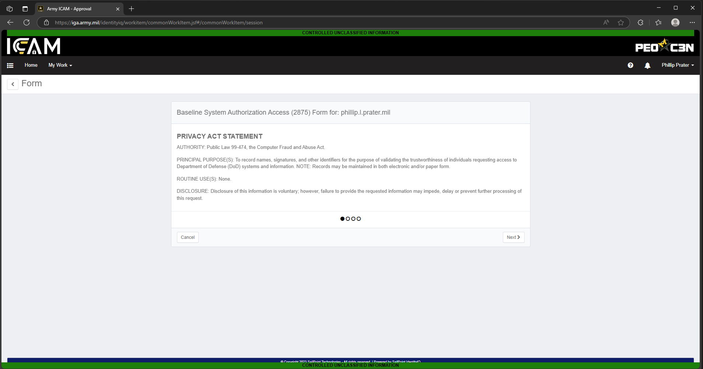

Slide 10
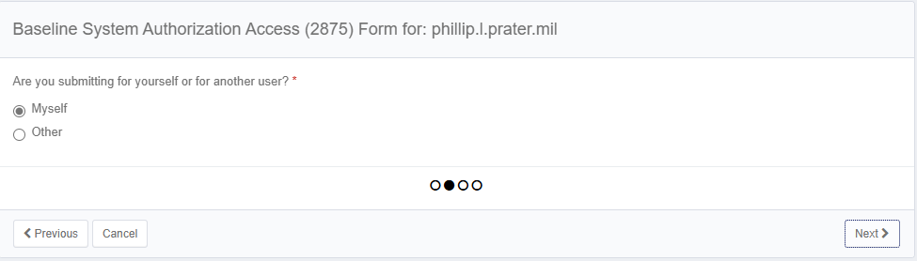

Slide 11
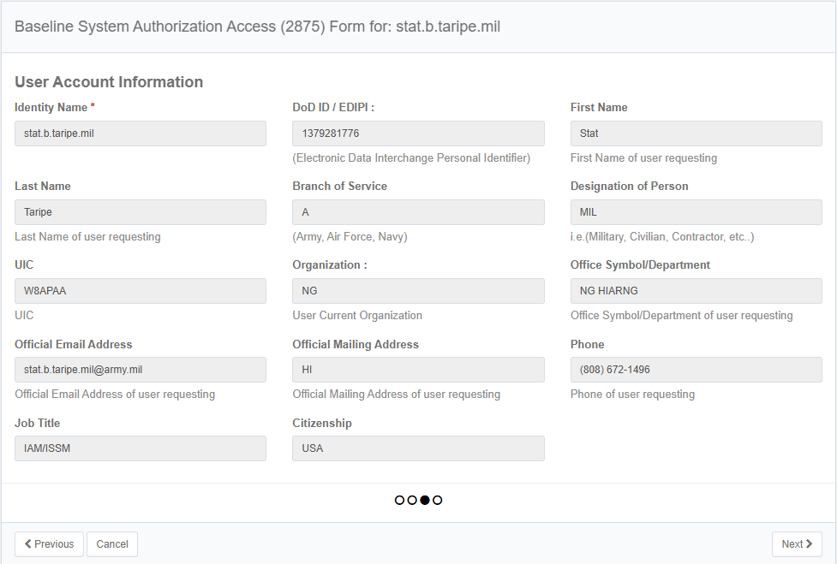
Review this information and make sure it is all correct

Slide 12
Training sites
Here are the links for all required training to input into AVS
Cyber Awareness Training: https://cs.signal.army.mil/UserMngmt/CyberAwareness_2025/launch.asp
Mandated Army IT User Agreement: https://cs.signal.army.mil/UserMngmt/UserAgreement.asp
IF you are accessing SIPR, you will need the Derivative Classification Training: https://securityawareness.usalearning.gov/derivative/index.htm

Slide 13
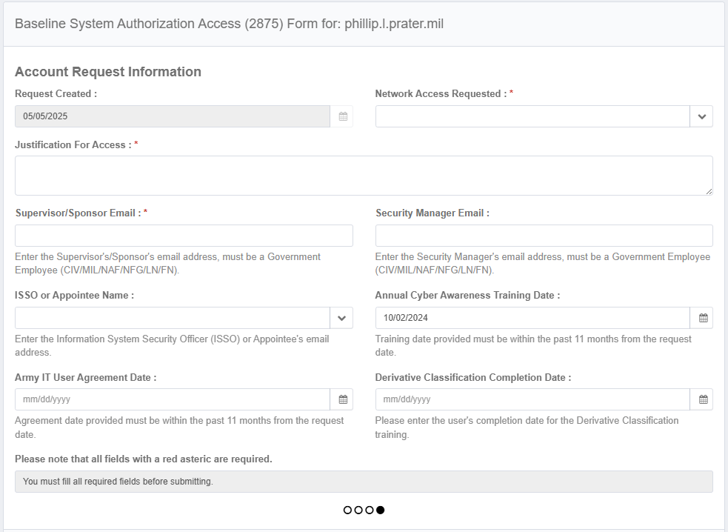

Slide 14
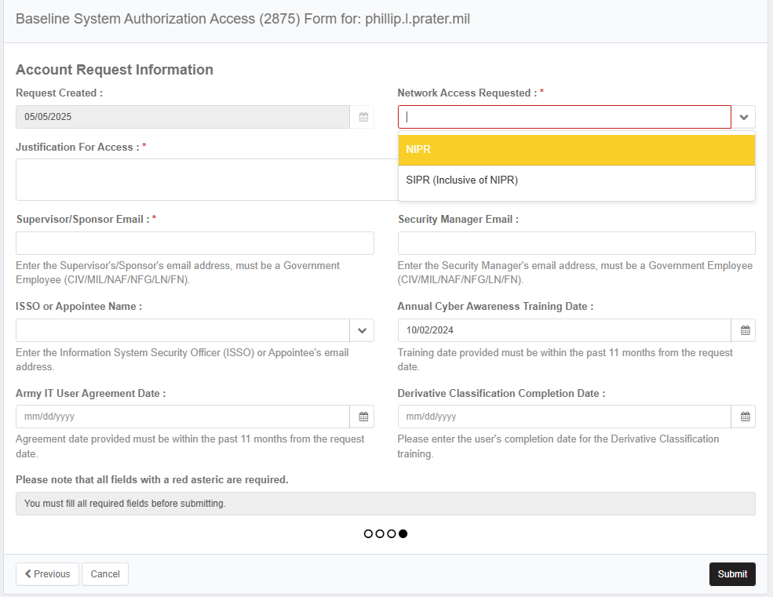

Slide 15
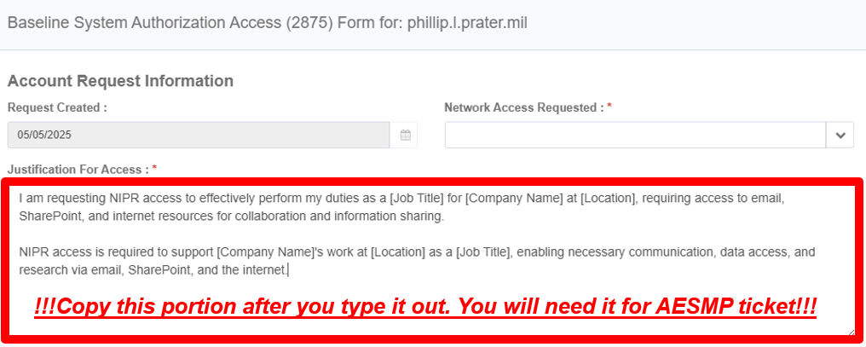
I am requesting NIPR access to effectively perform my duties as a [Job title] at [Location], requiring access to email, SharePoint, and internet resources for collaboration and information sharing.
NIPR access is required to support [Company Name]’s work at [Location] as a [Job title], enabling necessary communication, data access, and research via email, Sharepoint, and the internet.

Slide 16
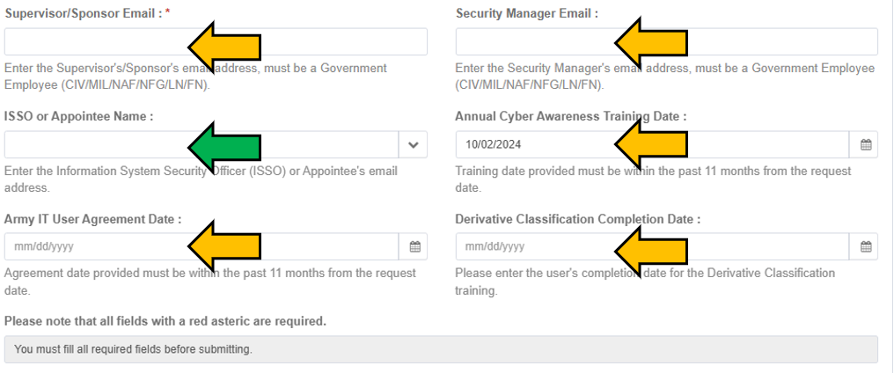
For ISSO (GREEN ARROW),
use one of the following:
Primary: stat.b.taripe.mil@army.mil
Secondary: jordan.a.estacio.mil@army.mil
Tertiary: xiaolan.lin.mil@army.mil
For Security Manager (RED ARROW),
use one of the following:
Primary: natasha.a.lorenzo.mil@army.mil
Secondary: lance.y.chinen.mil@army.mil
Tertiary: eric.t.shimodoi.mil@army.mil
Ensure to fill out all boxes with yellow arrows

Slide 17
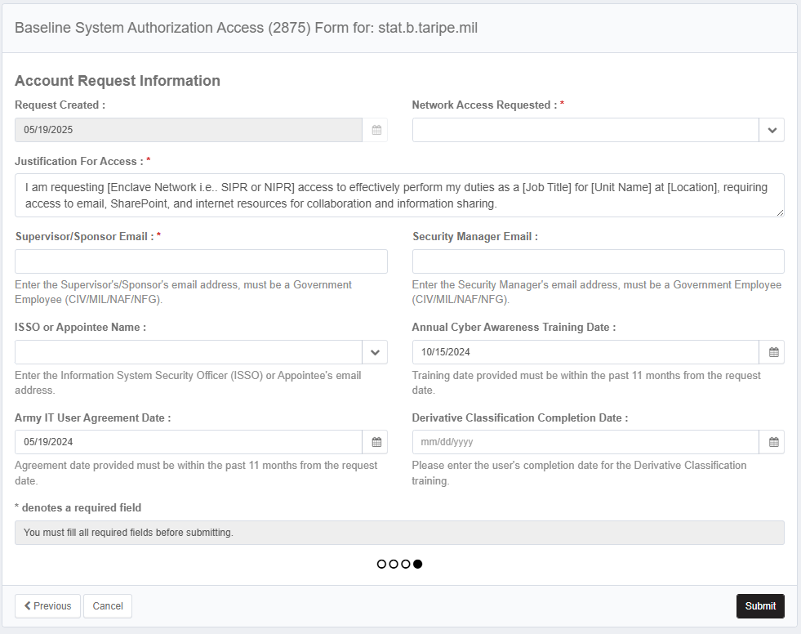
Hit Submit once all boxes are filled.

Slide 18
AVS Portion is Done!
If you already have a NIPR account, you don't need to go to AESMP to request for an account. You are done. If you ARE a new user, you will need to go to AESMP to request for the account once you have a profile in AVS, otherwise go to the next step
Now the next part is AESMP!

Slide 19
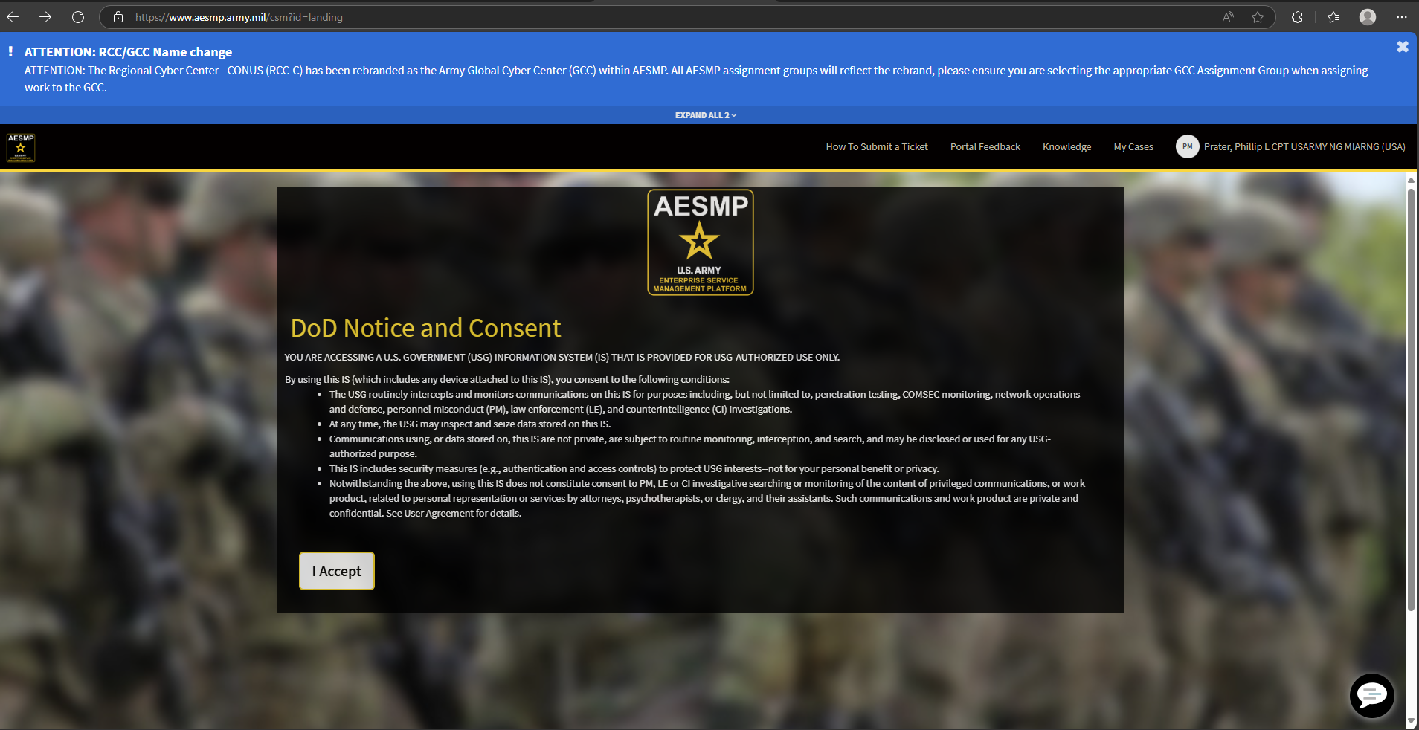
Go to https://www.aesmp.army.mil/

Slide 20
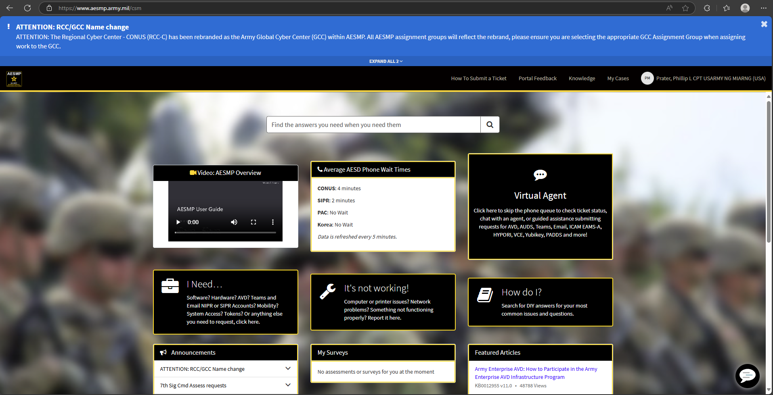

Slide 21
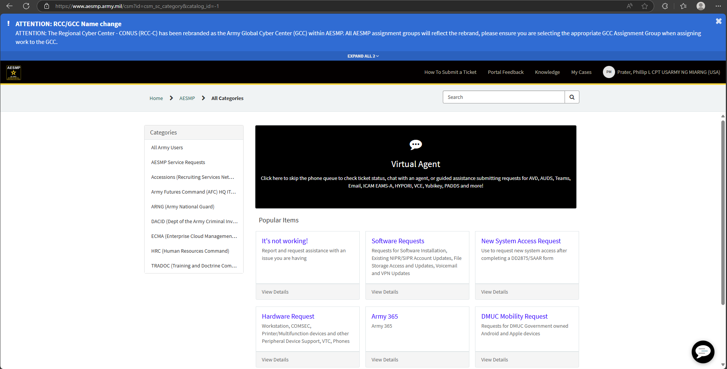

Slide 22
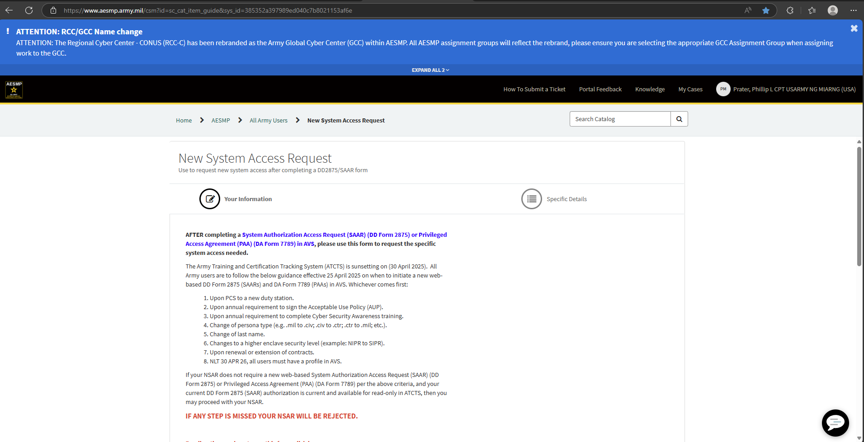
Scroll Down

Slide 23
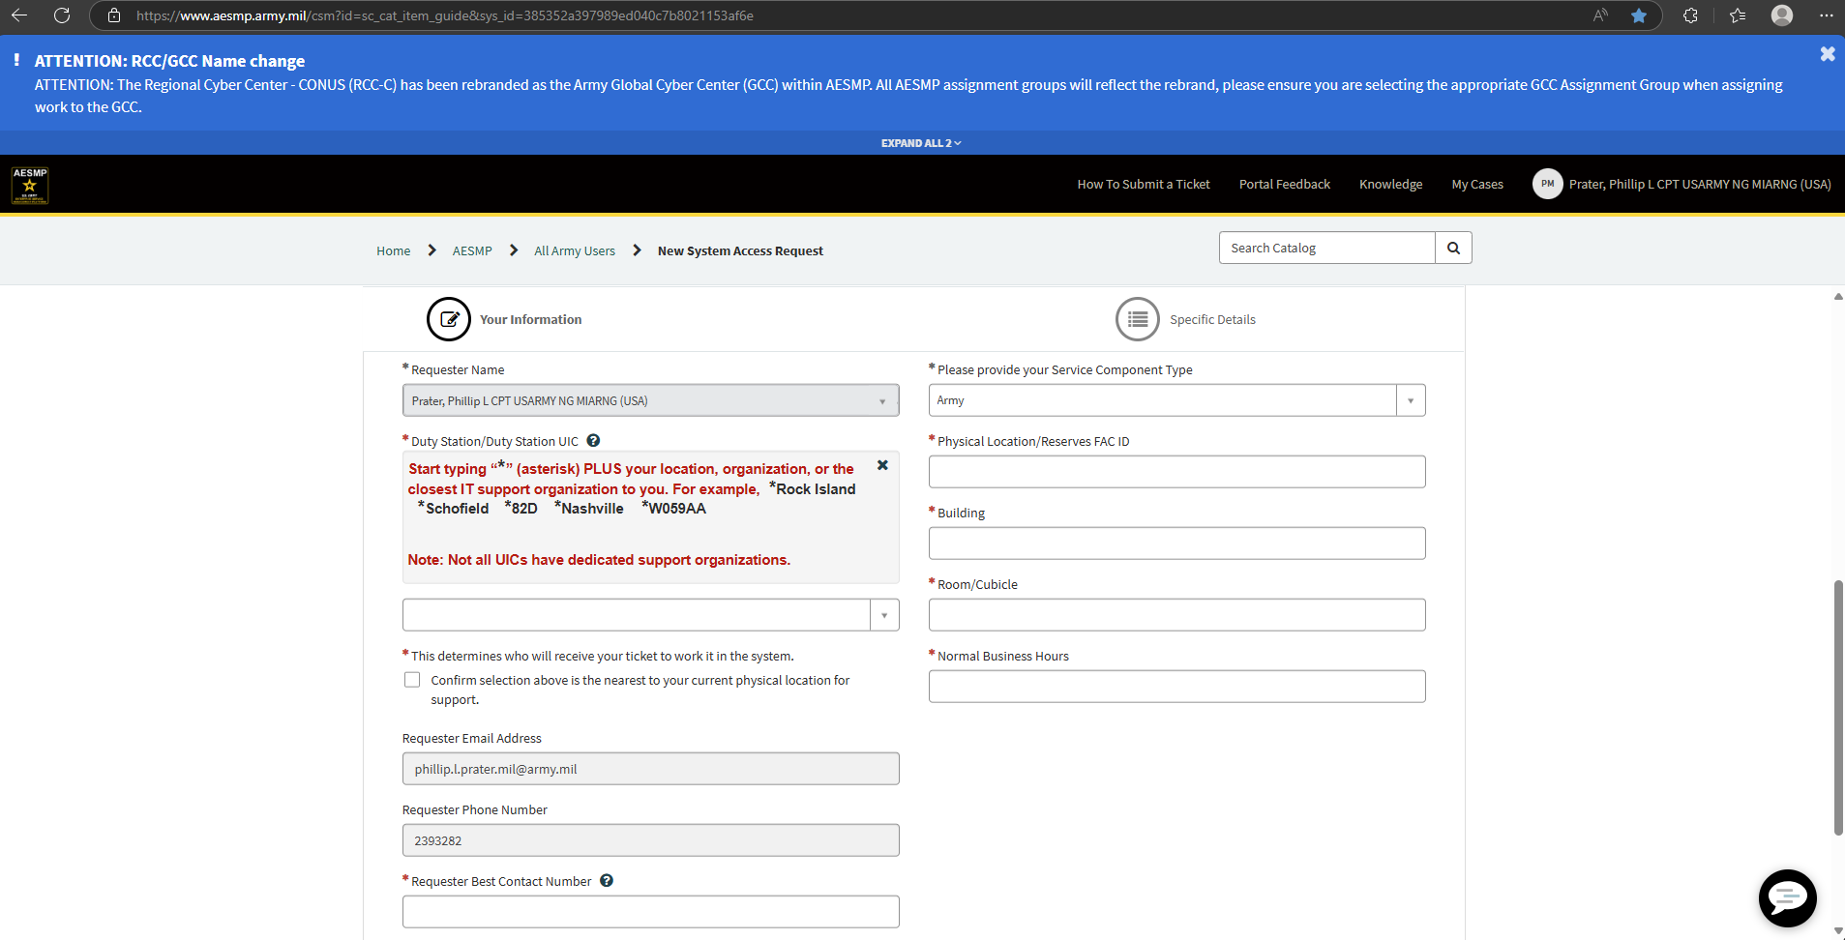
See slide 24 for details
Fill every box that has an arrow.
There’s a note on the red arrow.

Slide 24
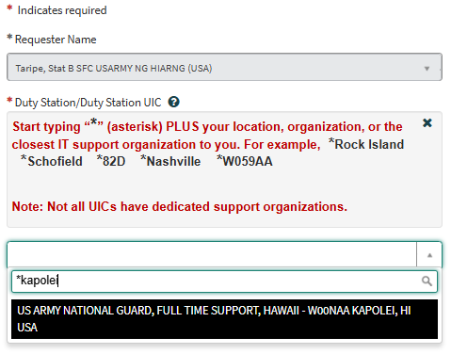
For the UIC section type in the following: “*Kapolei”
The UIC for W00NAA is the only UIC you will select.

Slide 25
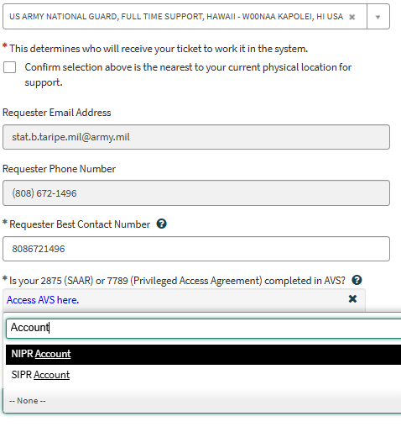
You must choose what system you are wishing to be granted access to. Start typing the system name i.e., “NIPR” or “SIPR”

Slide 26
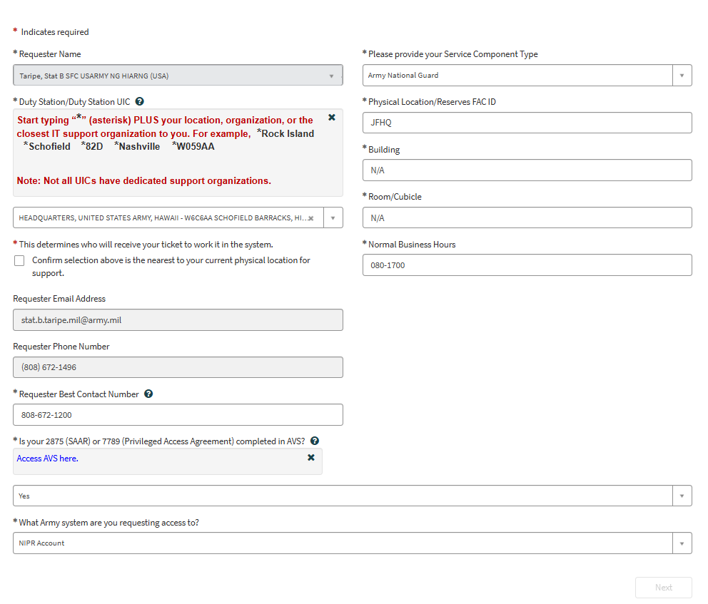
!!!!EXAMPLE!!!!
!!!!EXAMPLE!!!!

Slide 27
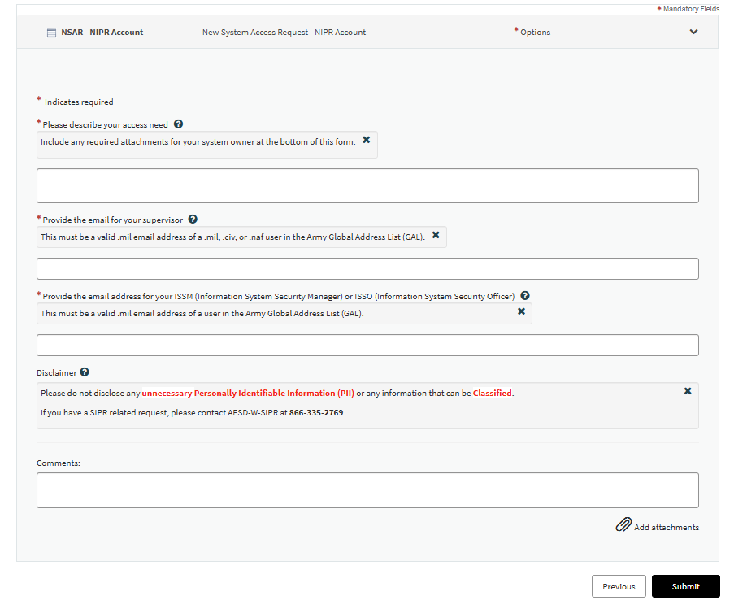
!!!This portion must be identical to what you put into AVS!!!
For ISSO, use one of the following:
Primary: stat.b.taripe.mil@army.mil
Secondary: jordan.a.estacio.mil@army.mil
Tertiary: xiaolan.lin.mil@army.mil

Slide 28
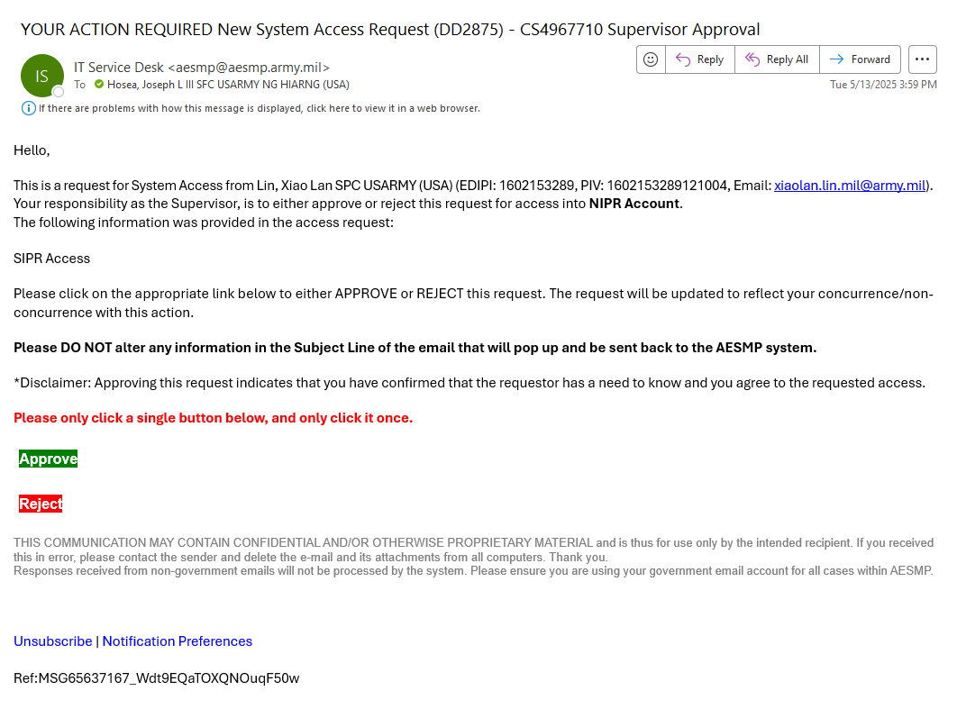
Follow up with your
Supervisor or Sponsor
Once you submit the AESMP ticket, contact your Supervisor or Sponsor to approve your access. Your Supervisor will receive an e-mail that will look like the screenshot below.
Ensure that when they reply, the e-mail is NOT encrypted.
NOTE: There is a known issue with the “approve” button on this e-mail. Nothing would happen after pressing the button. If so, please review the next slide for resolution

Slide 29
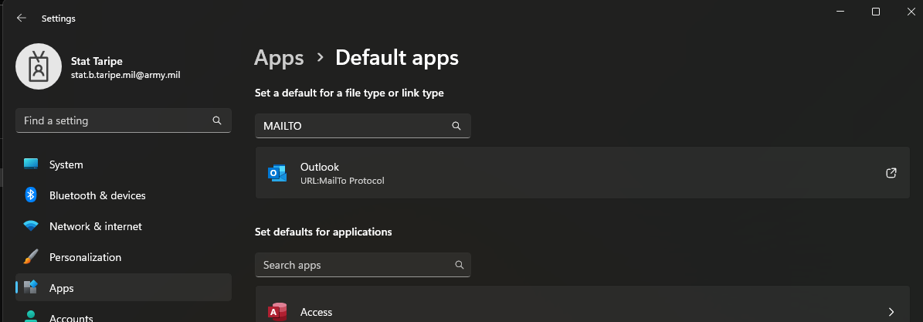
Approval Button Fix
Search for “default apps” on your Desktop search bar
Type “MAILTO” in the “Set a default for a file type or link type”
Ensure that “Outlook” is your default app by clicking here and following the prompts
Once you’re done, go back to the e-mail and click “approve” again

Slide 30
Follow up with your
Supervisor or Sponsor
When the Supervisor signs, the AESMP ticket will automatically go through the following personnel in order:
  The Security Manager
  The ISSO
  The System Owner
    NOTE: The System Owners are the HIARNG DCSIM staff. If your ticket has been approved by the Supervisor, Security Manager, and ISSO and it has been more than 48 hours, please contact the following personnel to follow up on your request:
      Primary: SPC Jordan Estacio jordan.a.estacio.mil@army.mil
      Secondary: SPC Xiaolan Lin xiaolan.lin.mil@army.mil
      Tertiary: SFC Joseph Hosea joseph.l.hosea.mil@army.mil
      SIPR primary: WO1 Stat Brent Taripe stat.b.taripe.mil@army.mil
      SIPR secondary: Ms Vickie Kozel vickie.e.kozel.mil@army.mil
      REMINDER: note your AESMP case number when you follow up with the personnel above. Case number will look like this CS####### where “#” represents a number. You can find it after you hit “submit” in slide 27 or you can also see it in the subject line in your supervisor’s e-mail in slide 28.

Slide 31
Now you are DONE!!!
Take note of your Case Number and If you have any questions, please contact us!
Tel: 808-672-1200
G6/DCSIM Help Desk
https://armyeitaas.sharepoint-mil.us/sites/NGHI-G-6

