Slide 1
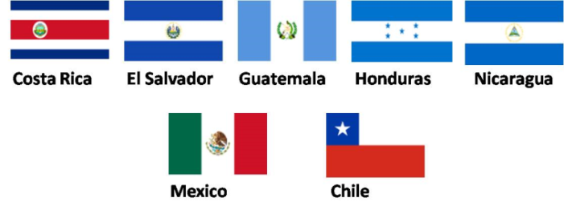

Hispanic Heritage Month
September 15th – October 15th
“Hispanics: a legacy of history, a present of action, and a future of success."
Puerto Rico

Slide 2
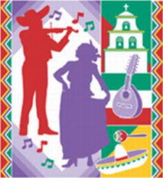
Hispanic Heritage Month
The day of September 15 is significant because it is the anniversary of independence for Latin American countries Costa Rica, El Salvador, Guatemala, Honduras and Nicaragua. In addition, Mexico and Chile celebrate their independence days on September 16 and September18, respectively. Also, Columbus Day or Día de la Raza, which is October 12, falls within this 30 day period.

Slide 3

Hispanic Heritage Month
Each year, Americans observe National Hispanic Heritage Month from September 15 to October 15, by celebrating the histories, cultures and contributions of American citizens whose ancestors came from Spain, Mexico, the Caribbean and Central and South America.
The observation started in 1968 as Hispanic Heritage Week under President Lyndon Johnson and was expanded by President Ronald Reagan in 1988 to cover a 30-day period starting on September 15 and ending on October 15. It was enacted into law on August 17, 1988, on the approval of Public Law 100-402.

Slide 4
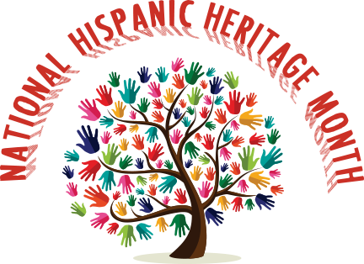
Hispanic Heritage Month
During National Hispanic Heritage Month (September 15 to October 15) we recognize the contributions made and the important presence of Hispanic and Latino Americans to the United States and celebrate their heritage and culture.
Hispanics have had a profound and positive influence on our country through their strong commitment to family, faith, hard work, and service. They have enhanced and shaped our national character with centuries-old traditions that reflect the multiethnic and multicultural customs of their community.
The term Hispanic or Latino, refers to Puerto Rican, South or Central American, or other Spanish culture or origin regardless of race. On the 2010 Census form, people of Spanish, Hispanic and/or Latino origin could identify themselves as Mexican, Mexican American, Chicano, Puerto Rican, Cuban, or "another Hispanic, Latino, or Spanish origin.“

Slide 5


Hispanic Heritage Month
According to this Census, 50.5 million people or 16% of the population are of Hispanic or Latino origin. This represents a significant increase from 2000, which registered the Hispanic population at 35.3 million or 13% of the total U.S. population.
Please share in this special annual tribute by learning and celebrating the generations of Hispanic Americans who have positively influenced and enriched our nation and society.

Slide 6
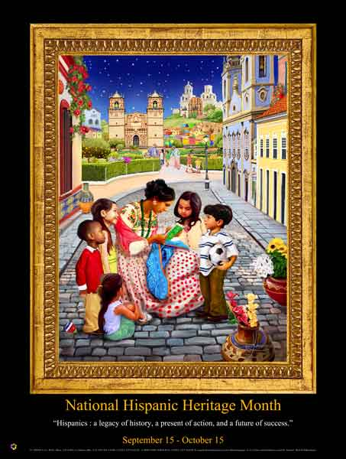
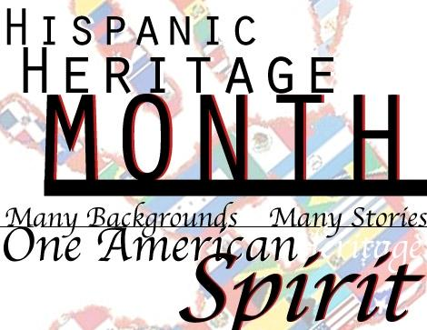
Hispanic Heritage Month

Slide 7
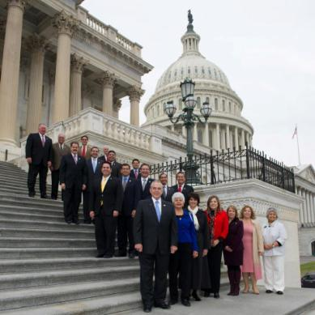
Hispanic Heritage Month
Congressional Hispanic Caucus (CHC)
The CHC is dedicated to voicing and advancing, through the legislative process, issues that affect Hispanics in the United States, Puerto Rico and U.S. Territories.
Rep. Rubén Hinojosa
Rep. Linda T. Sánchez
Rep. Xavier Becerra
Rep. Jim Costa
Rep. Raúl Grijalva
Senator Robert Menendez
Rep. Ed Pastor
Rep. Tony Cardenas
Rep. Gregorio "Kilili" Sablan
Rep. José Serrano
Rep. Nydia Velázquez
Rep. Raul Ruiz
Rep. Juan Vargas
Rep. Filemon Vela
Rep. Ben Ray Luján
Rep. Michelle Lujan
Rep. Joaquin Castro
Rep. Henry Cuellar
Rep. Luis Gutierrez
Rep. Grace Napolitano
Rep. Pedro Pierluisi
Rep. Lucille Roybal-Allard
Rep. Pete Gallego
Rep. Albio Sires
Rep. Gloria Negrete McLeod
Rep. Loretta Sanchez
Rep. Joe Garcia

Slide 8
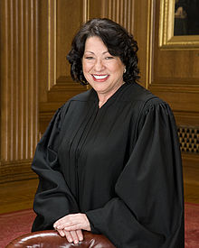
Hispanic Heritage Month
Notable Hispanics
The Honorable Sonia Sotomayor was born in Bronx, New York, on June 25, 1954. She earned a B.A. in 1976 from Princeton University, graduating summa cum laude and receiving the university's highest academic honor. In 1979, she earned a J.D. from Yale Law School where she served as an editor of the Yale Law Journal. She served as Assistant District Attorney in the New York County District Attorney's Office from 1979–1984. She then litigated international commercial matters in New York City at Pavia & Harcourt, where she served as an associate and then partner from 1984–1992. In 1991, President George H.W. Bush nominated her to the U.S. District Court, Southern District of New York, and she served in that role from 1992–1998. She served as a judge on the United States Court of Appeals for the Second Circuit from 1998–2009. President Barack Obama nominated her as an Associate Justice of the Supreme Court on May 26, 2009, and she assumed this role August 8, 2009. The Honorable Sotomayor is the first Hispanic woman Associate Supreme Court Justice.
The Honorable Sonia Sotomayor

Slide 9
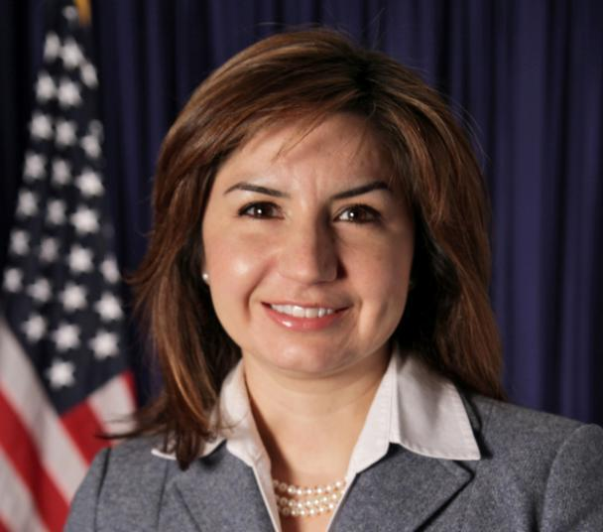
Notable Hispanics
Hispanic Heritage Month
Veronica E. Villalobos Office of Diversity and Inclusion, OPM

Slide 10
Notable Hispanics
Hispanic Heritage Month
Veronica E. Villalobos Office of Diversity and Inclusion, OPM
Ms. Villalobos was appointed to the Senior Executive Service in October 2010. She currently holds the position of Director, Office of Diversity and Inclusion, with the U.S. Office of Personnel Management (OPM). In that capacity, she manages OPM’s government-wide diversity effort to develop, drive and monitor strategies and initiatives designed to create a more diverse and inclusive Federal workforce.
Prior to her current position, Ms. Villalobos was employed at the U.S. Equal Employment Opportunity Commission (EEOC or Commission), as one of the agency’s first Honor Program Attorneys. From 2008 through 2010, she served as the Director of the Office of Equal Opportunity where she was responsible for EEOC’s EEO Complaint Processing and Affirmative Employment Programs. In spring of 2010, she detailed to OPM as Special Counsel to Christine Griffin, OPM Deputy Director and Chair of the Inter-Agency Work Group on Diversity (Work Group). She coordinated the Work Group’s efforts to develop a Government-wide Strategic Plan to create a Federal workplace that represents all segments of society.

Slide 11
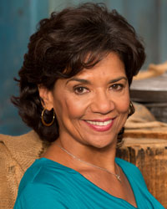
Hispanic Heritage Month
Notable Hispanics
Sonia Manzano has been a presence on Public Television since the 1970's.
Raised in the South Bronx, Sonia Manzano attended the High School of Performing Arts. A scholarship took her to Carnegie Mellon University in Pittsburgh, and in her junior year, she came to New York to star in the original production of the off-Broadway show, Godspell.
Within a year Sonia Manzano was cast as "Maria" on Sesame Street. After ten years as an actress, Sonia Manzano began writing scripts for the series and has thirteen Emmy Awards as part of the Sesame Street writing staff. Sonia also wrote for the Peabody Award winning children's series, Little Bill, for Nickelodeon and for a short time wrote a parenting column for the Sesame Workshop web site called "Talking Out Loud."
Sonia Manzano

Slide 12
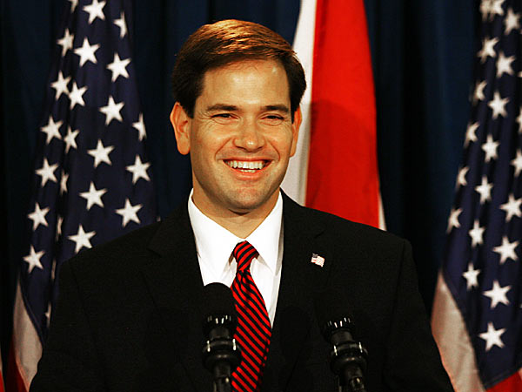
Notable Hispanics
Hispanic Heritage Month
Senator Marco Antonio Rubio

Slide 13
Hispanic Heritage Month
Notable Hispanics
Marco Antonio Rubio is the junior United States Senator from Florida, serving since January 2011. He previously served as Speaker of the Florida House of Representatives (2007–2009). A native of Miami, Florida, Rubio is a graduate of the University of Florida and the University of Miami Law School. In the late 1990s, he served as a City Commissioner for West Miami and was elected to the Florida House of Representatives in 2000, representing the 111th House district. He was elected Speaker in November 2006.

Slide 14
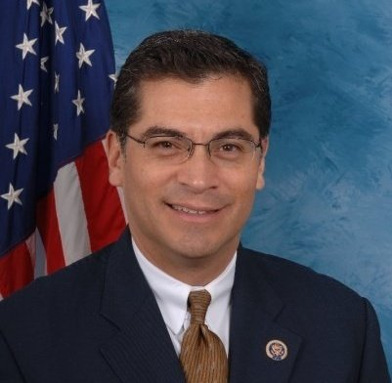
Hispanic Heritage Month
Notable Hispanics
Congressman Xavier Becerra

Slide 15
Notable Hispanics
Hispanic Heritage Month
Xavier Becerra was born in Sacramento, California, the son of working-class immigrants. He graduated in 1976 from C.K. McClatchy High School located in central city Sacramento. He went on to earn his B.A. in economics from Stanford University and his J.D. from Stanford Law School. He was initially a lawyer, working on cases involving individuals with mental impairment. He was also a staff member for California State Senator Art Torres and the Deputy Attorney-General of California. Becerra served one-term as a member of the California State Assembly before successfully running for Congress.

Slide 16
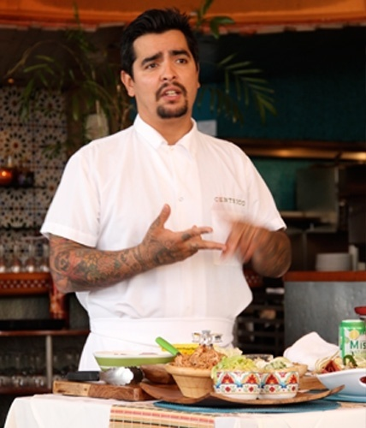
Hispanic Heritage Month
Notable Hispanics
Aarón Sanchez Award-Winning Chef

Slide 17
Notable Hispanics
Hispanic Heritage Month
Executive Chef and Owner of Centrico & Mestizo – Food Network Star & Cookbook Author - Co-star of Food Network’s hit series, Chopped and Heat Seekers.
Aarón is the owner and executive chef of Centrico restaurant,
located in New York City, and Mestizo, located in Kansas City. He is also the culinary visionary behind Tacombi Tacqueria in New York City and Crossroads at House of Blues nationwide. The son of celebrated Mexican cooking authority Zarela Martinez, Aarón’s passion, commitment and skills have placed him among the country’s leading contemporary Latin Chefs.

Slide 18
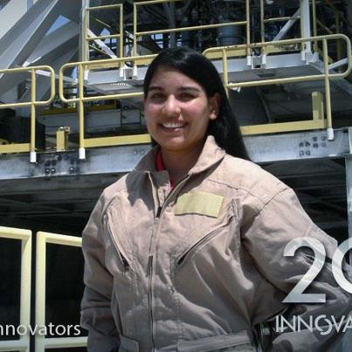
Hispanic Heritage Month
Notable Hispanics
Rosa Obregon

Slide 19
Notable Hispanics
Hispanic Heritage Month
Rosa Obregon is literally a rocket scientist! The Mexican-American Obregon is the lead mechanical engineer at NASA’s John C. Stennis Space Center in Mississippi, the nation’s largest rocket engine test facility and is the only Latina on site with clearance to test rocket engines.

Slide 20
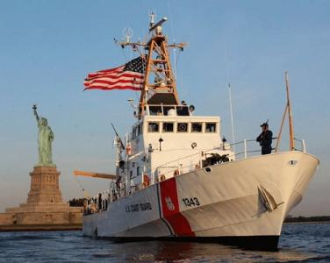
Hispanic Heritage Month
Notable Hispanics
In 1991 LTJG Katherine Tiongson took command of USCGC Bainbridge Island, becoming the first Hispanic-American female to command an afloat unit in the U.S. Coast Guard. She was also the first Hispanic-American female intelligence officer in the Coast Guard. In 1991
LTJG Katherine Tiongson
USCGC Bainbridge Island

Slide 21
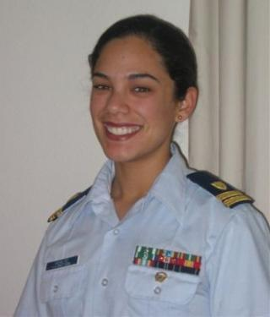
Hispanic Heritage Month
Notable Hispanics
In 2002, Lieutenant Junior Grade Angelina Hidalgo became the second Hispanic-American female to command an afloat unit and was the second Hispanic female intelligence officer. USCG
LTJG Angelina Hidalgo

Slide 22
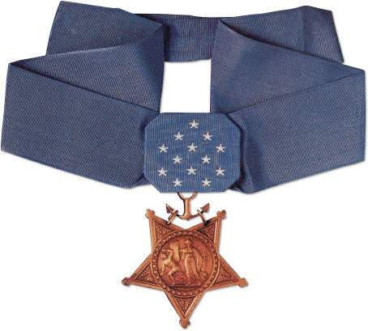
Hispanic Medal of Honor Recipients
Hispanic Heritage Month
Thirty-nine Hispanic-Americans are among the more than 3,400 Medal of Honor recipients to be awarded this decoration from the President, in the name of Congress, since its creation in 1861

Slide 23
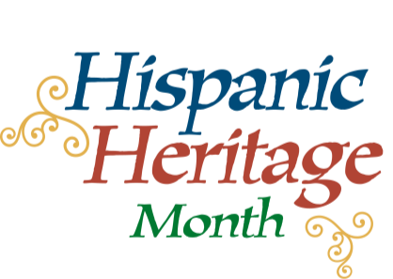
Hispanic Heritage Month
“Hispanics have served with honor and distinction in every conflict since the Revolutionary War, and they have made invaluable contributions through their service to our country.” President Barack Obama

Slide 24
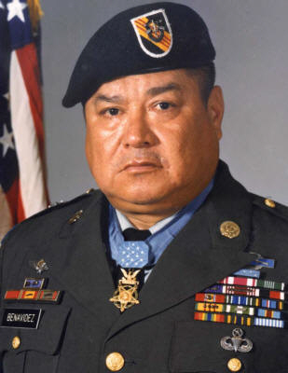
Hispanic Medal of Honor Recipients
Hispanic Heritage Month
For conspicuous gallantry and intrepidity in action at the risk of his life above and beyond the call of duty. On May 2nd 1968 Master Sergeant (then Staff Sergeant) Roy P. Benavidez, distinguished himself by a series of daring and extremely valorous actions while assigned to Detachment B56, 5th Special Forces Group (Airborne), 1st Special Forces, Republic of Vietnam.
Master Sergeant Roy P. Benavidez

Slide 25
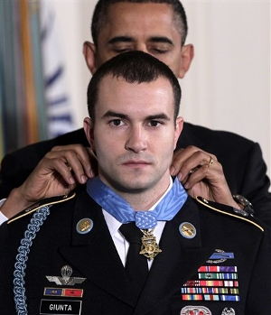
Hispanic Medal of Honor Recipients
Hispanic Heritage Month
Specialist Salvatore A. Giunta United States Army For conspicuous gallantry and intrepidity at the risk of his life above and beyond the call of duty…..
Specialist Salvatore A. Giunta

Slide 26


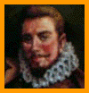



Hispanic Heritage Month
Some Notable Hispanics
San Miguel de Gualdape, founded in Georgia in 1526, 81 years before Jamestown, which was settled in 1607
Christopher Columbus – Discovered America
Francisco Vasquez de Coronado, led an expedition through the present-day states of New Mexico, Oklahoma and Kansas.
Bernardo de Galvez - provided the army of General George
Washington and General George Rogers Clarke with
gunpowder, rifles, bullets, blankets, medicine and supplies,
and fought against the British
Plcido Domingo and Jose Carreras – Giants in opera stars

Slide 27






Hispanic Heritage Month
Some Notable Hispanics
Fernando Bujones & Faustino Diaz – Stars in ballet
Jeremy Hernandez, - A young Hispanic hero who saved the lives of 52 children from a bridge-collapse, August 2, 2007
Sara Martinez Tucker – Under Secretary of Education
James P. Delgado – Maritime archaeologist and explorer
Gustavo Dudamel, born in 1981 in Venezuela - World’s most precocious young orchestral conductor of his generation
Dr. France Anne Cordova – Chief Scientist of NASA, President of Purdue University

Slide 28




Hispanic Heritage Month
Some Notable Hispanics
Judith Zaffirini, an award-winning communications specialist, has served in the Texas Senate
Cesar Millan – World-renowned dog-behavior specialist
Vivian Villareal – Top professional female pool players in the world
Lydia Villa-Komaroff – President for Research Administration at Northwestern University

Slide 29
Hispanic Heritage Month
Revolution War
Spain placed her navy in the service of Washington’s revolutionaries by blocking certain areas of the sea.
In 1781 Spain loaned 88,000 gold dollars to John Jay, then emissary to Spain, for use in the war. Jay guaranteed Spain’s domain in North America.
In 1781 Manuel Cajígal, then governor of Cuba, ordered a public collection of money in Havana and sent arms, munitions and clothing. Twelve ships left Havana to deliver the items assuring the victory in Yorktown by the American revolutionaries.

Slide 30
Hispanic Heritage Month
The Civil War
More than 10,000 Hispanics fought on both sides of the American Civil War. Those that went into battle for the Union, like Admiral David Farragut, and Medal of Honor winner Seaman Phillip Bazaar are better known, but those who did battle for the Confederacy waged war with equal passion even though they are not as famous.
The most famous Confederate units that had a large Hispanic involvement were the 1st Florida Cavalry Regiment, the 2nd Texas Mounted Rifles; the 33rd Texas Cavalry Regiment, the Louisiana Zouaves Battalion, and the Spanish Guard of Mobile. Other Southern corps with numerous Hispanics in their ranks were the 6th Missouri Infantry Regiment, the 55th Alabama Infantry Regiment, Hood's Texas Brigade and the Spanish Legion of the European Brigade.

Slide 31
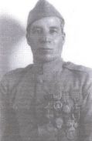
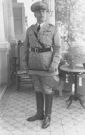
Hispanic Heritage Month
WWI
Private Marcelino Serna (April 26, 1896-February 29, 1992) was an undocumented Mexican immigrant who joined the United States Army and became the most decorated soldier from Texas in World War I. Serna was the first Hispanic to be awarded the Distinguished Service Cross.
Major General Luis R. Esteves, U.S. Army- In 1915, Esteves became the first Hispanic to graduate from the United States Military Academy ("West Point"). Esteves also organized the Puerto Rican National Guard. MG also fought with distinction in WWI

Slide 32

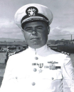
Hispanic Heritage Month
WWII
Between 250,000 and 500,000 Hispanic Americans served in the U.S. Armed Forces during World War II, out of a total of 12,000,000.
Lieutenant José Antonio Muñiz, USAAF, served with distinction in the China-Burma-India Theater. During his tour of duty he flew 20 combat mission against the Imperial Japanese Army Air Force and shot down a Mitsubishi A6M Zero.
Captain Marion Frederic Ramírez de Arellano, (1913–1980) USN, the first Hispanic submarine commanding officer. He led the effort to rescue five Navy pilots and one enlisted gunner off Wake Island, and contributed to the sinking of two Japanese freighters and damaging a third. For his actions, he was awarded a Silver Star Medal and a Legion of Merit Medal.

Slide 33
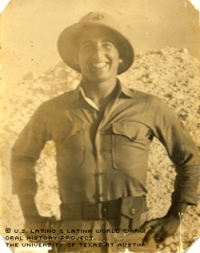
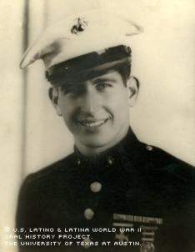
Hispanic Heritage Month
In 1945, when Kwajalein of the Marshall Islands was secured by the U.S. forces, Sergeant Fernando Bernacett from Puerto Rico was among the Marines who were sent to guard various essential military installations. Bernacett, a combat veteran of the Battle of Midway, guarded the airport and POWs, as well as the atomic bomb as it was transported to Japan.

Slide 34
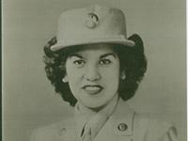
Hispanic Heritage Month
Eva Jacques came up a bit short when she enlisted to serve in World War II; she was 4'11", one inch short of the minimum height. But she had two great advantages: three years of college and she spoke Spanish and English, so the Army Air Force waived their height requirement. She spent two years in the Pacific Theater,
1944 in New Guinea and 1945 in the Philippines, as an administrative aide. Living conditions in New Guinea were exceptionally primitive, but the camaraderie among the troops made up for the persistent mosquitoes and absence of basic amenities. Though she was far from the action, she did escape disaster once, when a plane on which she was to take on a tour of New Guinea crashed in the jungle.

Slide 35
Hispanic Heritage Month
Hispanics in Hawaii – 214 Years of Meaningful Contributions
In August of 1899, San Ciriaco, a huge hurricane, punished Puerto Rico for two days with winds of 110mph – 150mph. It left the island completely devastated, its agrarian society destroyed, and most of its agricultural workers suddenly unemployed.
The Hawaii Sugar Planters Association (HSPA) was looking for experienced workers for their plantations. When they found out about the hurricane, they started recruiting workers in Puerto Rico. Between 1900 and 1901, the HSPA brought 5,000 Puerto Ricans workers to toil on Hawaii’s plantations. We call the descendants of these early residents “Local Ricans” – Puerto Ricans born in Hawaii.
As a result of this migration, some Puerto Rican traditions were adapted to their new environment. The traditional "arroz con gandules" is called “gandule rice in the Hawaiian Islands. And “pasteles” have become "pateles." You will see many roadside vendors selling "pateles" as you drive around the islands. No matter what you call them, they're good eating!

Slide 36
Hispanic Heritage Month
History Making Hispanics
Flying ace: Col. Manuel J. Fernández, Jr., who flew 125 combat missions in th
Korean War.
Medal of Honor recipient: Philip Bazaar, a Chilean member of the U.S. Navy, for
bravery during the Civil War. He received his Congressional Medal of Honor in 1865
Admiral, U.S. Navy: David G. Farragut. In 1866, he became the first U.S. naval
officer ever to be awarded the rank of admiral. The first Hispanic American to
become a four-star admiral was Horacio Rivero of Puerto Rico, in 1964.
General, U.S. Army: Richard E. Cavazos, 1976. In 1982, he became the army's first
Hispanic four-star general.
Secretary of the Navy: Edward Hidalgo, 1979
Astronaut Ellen Ochoa first left Earth in July 1991 and became the world's first
Hispanic female astronaut.

Slide 37
Hispanic Heritage Month
Did You know?
“According to the U.S. Census Bureau, Hispanics are the fastest-growing minority group in the U.S. and comprise approximately 15 percent of the population.”
That Luiz Walter Alvarez won the Nobel Prize in Physics, in 1968, for his discoveries about subatomic particles. Later, he and his son proposed the now-accepted theory that the mass dinosaur extinction was caused by a meteor impact?
That Nilo Cruz won the Pulitzer Prize for Drama in 2003, for his play Anna in the Tropics?
That Heavyweight boxing champ John Ruiz, defeated Evander Holyfield 2001?
That Antonia Novello was the first Hispanic to serve as Surgeon General?

Slide 38
Hispanic Heritage Month
Did You know?
That Joseph Marion Hernández, was the first Hispanic member of the U.S. Congress in1822? He was a delegate from the Florida territory.
That Alberto Gonzales with the first Hispanic U.S. Attorney General? He was appointed in 2005.
That Geraldo Rivera was named the Broadcaster of the Year in 1971?
That Horacio Rivero of Puerto Rico, was the first Hispanic American to become a four-star admiral in 1964
That Justice Benjamin Nathan Cardozo was the first Hispanic American to serve on the US Supreme Court,. He served on the US Supreme Court from 1932-1938.
About 53,000 Hispanic-origin people were on active duty in 2003 in the United States.

Slide 39
Hispanic Heritage Month
Did You know?
In 2010, Hispanics numbered more than 50 million in U.S., and they command $1 trillion in buying power.
Hispanics compromise more than 15% of U.S. population, an increase of 42% since 2000 census.
Hispanic growth rate of 24.3% was more than three times growth rate of total U.S. population.
Hispanics are the largest minority in U.S.
One in 7 people in the United States is of Hispanic origin.
Hispanics are concentrated in the U.S. Southwest. 60% live in California, Arizona, New Mexico, Colorado, and Texas.
Only 56% of Hispanics 25 years-of-age and over have graduated from high school, compared to 83% of the total U.S population.

Slide 40
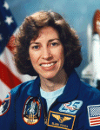
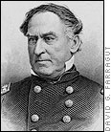
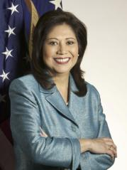
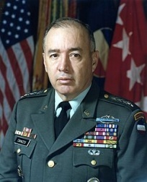
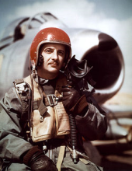
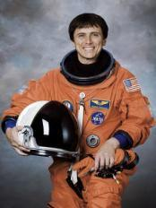
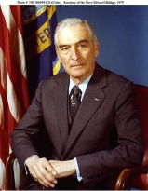
Hispanic Heritage Month
Ellen Ochoa
ADM David G. Farragut
Secretary of Labor Hilda Solis
General Richard E. Cavazos
Col. Manuel J. Fernández, Jr.
Edward Hidalgo
Franklin Chang-Diaz

Slide 41
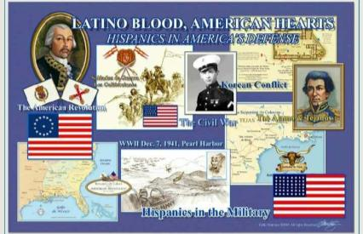
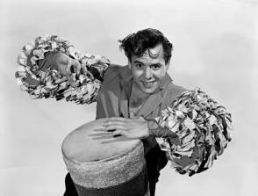
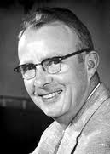
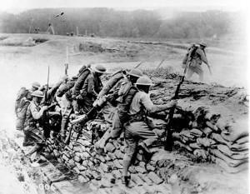
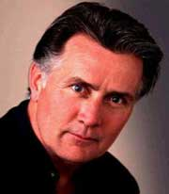
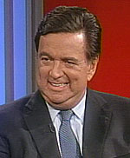
Hispanic Heritage Month
Luis Walter Alvarez
Desi Arnaz
Hispanics in WWI
Gov. Bill Richardson
Martin Sheen-Ramon Estevez

Slide 42
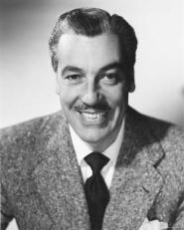
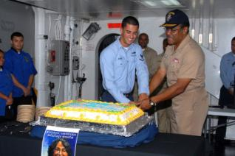
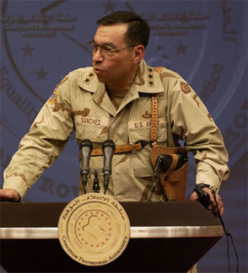
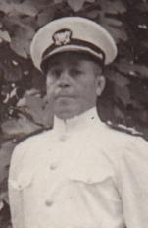
Hispanic Heritage Month
Vice Adm. D.C. Curtis 3rd Class Petty Officer Ryan Paigo observance Hispanic American Heritage Month
Cesar Romero
General Ricardo Sanchez,
Chief Gunner's Mate
Joseph B Avile

Slide 43
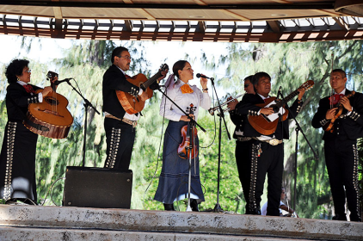
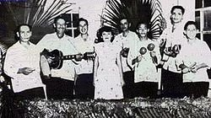
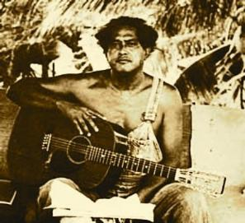
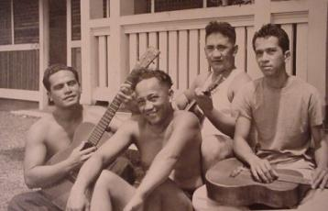
Hispanic Heritage Month
The first “Ricans” arrived in Hawaii in 1900
H
A
W
A
I
I
Hispanic Entertainers Today
Hawaii Mexican Cowboy
Hawaii Mexican Cowboy Musicians

Slide 44
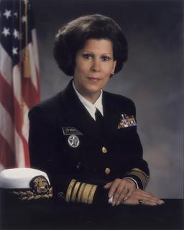
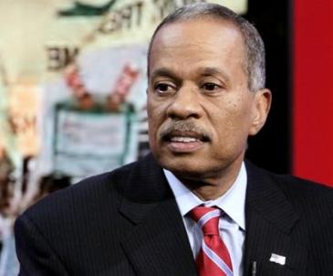
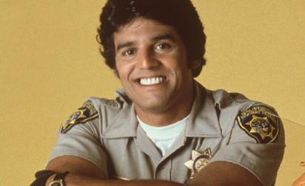
Hispanic Heritage Month
Antonia Novello
Juan Williams
Erik Estrada

Slide 45


Hispanic Heritage Month
Celebrate!

