Slide 1
Technicians Returning to Duty (RTD)
SPC Sylvester, Stephen

Slide 2
agenda
Preparation for return to duty
Process for return for duty
Flowchart
Breakdown for flowchart
SF-52
DCPDS creating RTD/ Attaching documents
Documents required
Military Service Deposit (MSD)

Slide 3
Preparation for returning to duty
Standard Form (SF) 52 for returning to duty
Copy of any amendments or modifications to original orders (if applicable)
USERRA “RTD” Election Form
Application for Reservist Differential Payments (if applicable)
Request for USERRA Retroactive TSP Contributions Form
TSP-41 Form
  Visit the HRO website for all forms at: http://dod.hawaii.gov/hro/docs-and-pubs/userra/

Slide 4
Process for return to duty

Slide 5
Processing RTD Actions Flowchart
1. Submit all modified orders that may have changed your RTD date listed on your USERRA RTD election form.
2. Complete your personal information on the USERRA RTD election form.
3. Read the “Hawaii National Guard-Technician Information and Election Rights”. This handout will provide you with more detailed information on the following items in the election form.
*4. Determining Your Effective Date for RTD actions if military orders are longer than 30 days:
Based on your restoration period described above, the effective date of the RTD action will be the first day the technician physically returns back to a “technician duty status”. For example, Joe Smith’s orders end date falls on a Sunday (non-technician duty day) and he elects to use 4 days of annual leave and also has up to 180 calendar days to return to work; he decides to use his 4 days of annual leave but chooses to return the day after his annual leave, his effective RTD date is Friday.
If *presidential leave is used after the completion of your orders, your effective date will be the first day on presidential leave.
Based on your restoration period described above, if leave is not used at the end of your orders, your effective date will be the first “technician duty day” within the allotted time described above; you must physically return to your technician position within the restoration period listed in the guidelines described above.
5. Complete paragraphs 2 through 12 of the USERRA RTD election form, sign and date.
Complete your SF 52 using the “How to Complete SF 52, RTD” power point instructions located on the HRO website.
6. Submit all documents listed below to the Human Resources Office one pay period prior to the effective date:
A completed SF-52 (Request for Personnel Action) specifying the effective date.
A copy of any amendment/modification to previous orders (if applicable).
Copy of DD Form 214, copy 2,4 or 7 only. (if applicable)
A completed USERRA RTD Election checklist.
Application for Reservist Differential Payments (if applicable).
Request for USERRA Retroactive TSP Contributions Form (if applicable).
TSP 41 (if applicable)

Slide 6
Process workflow
1. Submit all modified orders that may have changed your RTD date listed on your USERRA RTD election form.
As a technician you are required to submit the initial orders which placed you active duty/ AUS. You are also required to submit all addendum or modification to the initial order you may while on Absent-US.
*Note: Please apply for your DD-214, and submit member copy 2,4, or 7. Employees planning to retire, HRO will require them.

Slide 7
Userra rtd election form
2. Complete the checklist on the USERRA RTD election form.
Sections within election form include:
Reemployment/ Restoration Rights
Status
Reservist Differential
FEHB
Premium conversion
FSA
FLTCIP
FEDVIP
NGAUS
TSP
Retirement
Acknowledgement
USERRA RTD Election Form.docx

Slide 8
Election rights handout
3. Read the “Hawaii National Guard-Technician Information and Election Rights”. This handout will provide you with more detailed information on the following items in the election form.
Technician Rights and Benefits When RTD from Entering into a AUS status_revised.pdf

Slide 9
4. Effective date for RTD
Presidential Leave – Only applicable if military service consists of 42 consecutive days and is in connection with Global War on Terrorism (GWOT) contingency. Entitled to five work days of excused absence without charge to leave. For more information, please refer to Hawaii National Guard Technician Information and Election Rights, para 6.
Restoration Period is the amount of time given to a technician before they have to report back to their technician position. Military leave cannot be used during restoration period; military leave may only be used during the duration of the military orders.

Slide 10
5. Complete your SF 52 using the “How to Complete SF 52, RTD” power point.
*Instructions located on the HRO website:
HING Human Resources Office | USERRA

Slide 11
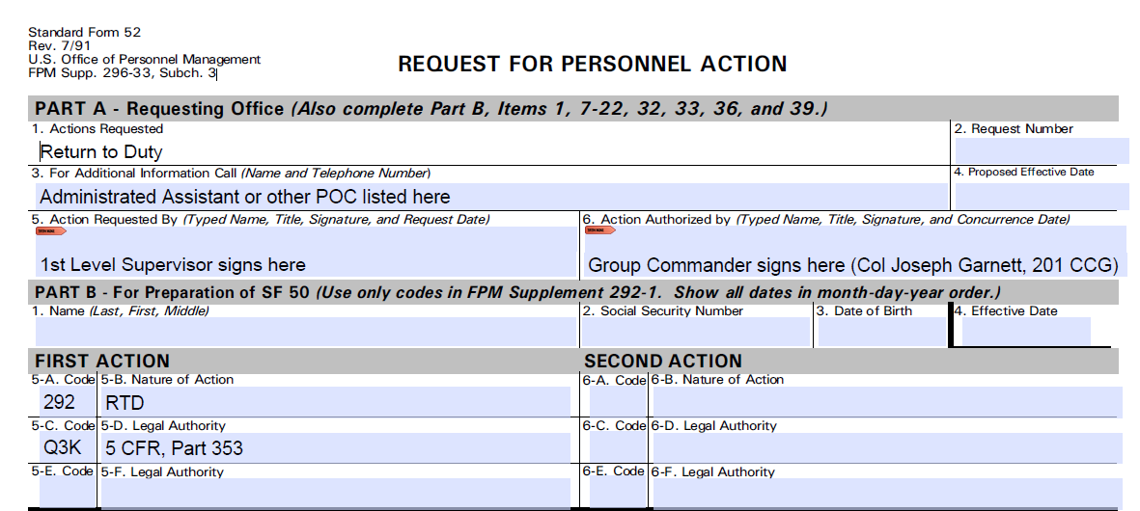
Return to duty sf-52 part a & part b
Rtd sf-52
Part a & part b
Effective Date of RTD:
Time depends on restoration period
If entitled to presidential leave
Determine your restoration period by reviewing the guidance below:
If military orders time frame is 1-30 days= effective date is the next technician duty day
If military orders time frame is 31-180 days= effective date will be within 14 calendar days.
If military orders time frame is 181+ days= effective date will be within 90 calendar days.

Slide 12
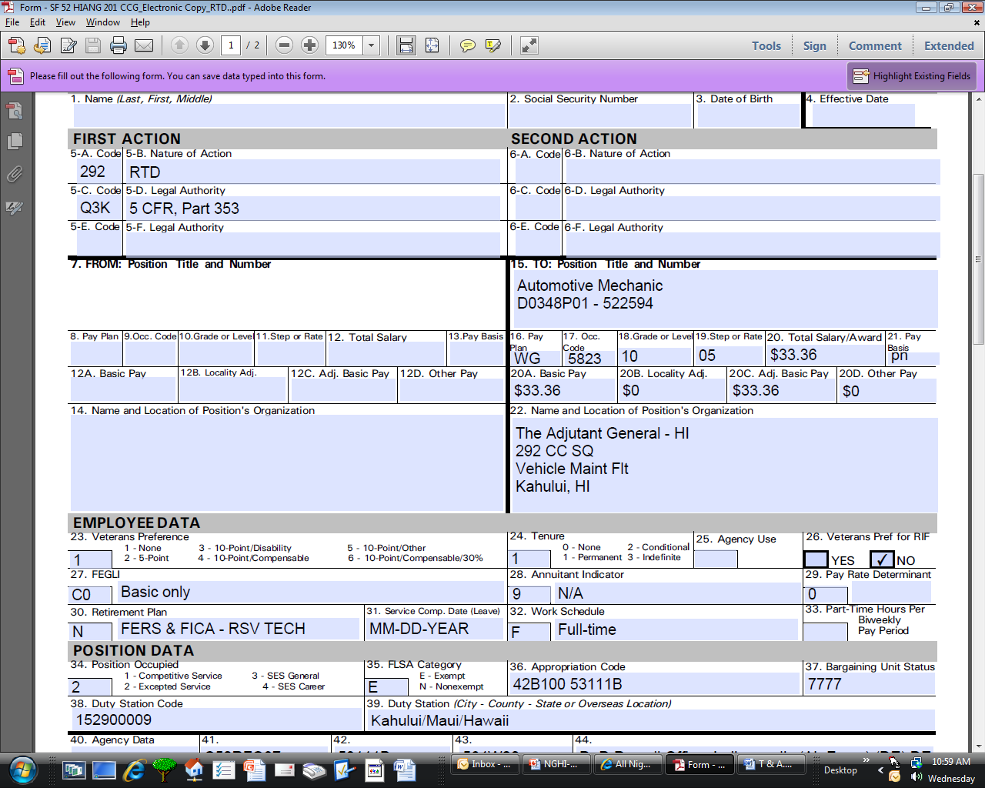
RTD sf-52 part b continued
Your SF-50 Data can be obtained from "MyBiz" at:
https://compo.dcpds.cpms.osd.mil/

Slide 13
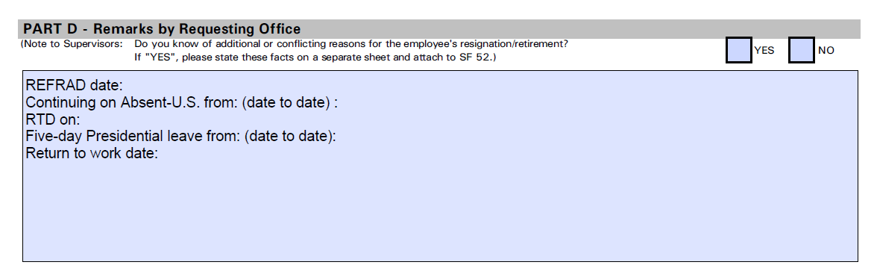
Rtd sf-52 part d
List the REFRAD date based on the Order.
List your dates if continuing on restoration period of Absent-U.S.
RTD will be the first day of your Presidential leave (pay status).
List five calendar days of Presidential leave being used (includes non-workdays occurring during this period).
RTW will be the day you physically return back in a PAY & DUTY status.

Slide 14
Recap on timeframes for restoration rights/ sf52
    If military service was less than 31 days, you must report back to work on the next scheduled workday following release from military service and expiration of 8 hours after a time allowing for a safe transportation back to residence.
    If military service was for more than 30 days but less than 181 days, you must apply for reemployment within 14 calendar days following release from military service.
    If military service was for more than 180 days, you must apply for reemployment within 90 calendar days following release from military service.

Slide 15
5-day presidential leave
    Active duty in connection with Global War on Terrorism (GWOT)
    Entitled to receive 5-days of excused absence (Presidential Leave) upon return from each period of GWOT deployment.
    Deployment had to be at least 42 consecutive days.
    Entitled to 5-days of excused absence only once on a 12-month period from the last time frame it was used.
    Must follow reemployment rights under USERRA & granted upon return to Federal civilian service.
    Must report for duty at the end of the 5-day period.

Slide 16

Supervisors input for defense civilian personnel data system
(dcpds)

Slide 17
Rtd (noa 292) dcpds iNput

Slide 18
Rtd (noa 292)
CLICK ON THE PLUS SIGN “REQUEST FOR PERSONNEL ACTION”
DOUBLE CLICK ON “REQUEST FOR PERSONNEL ACTION”

Slide 19
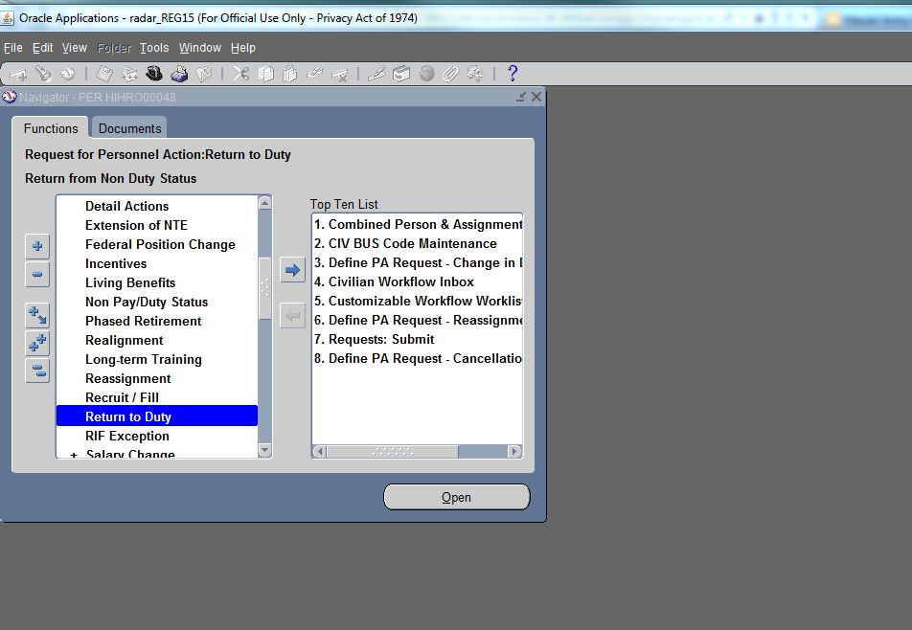
Rtd (noa 292)
SCROLL TO FIND “NON PAY/DUTY STATUS” AND DOUBLE CLICK.

Slide 20
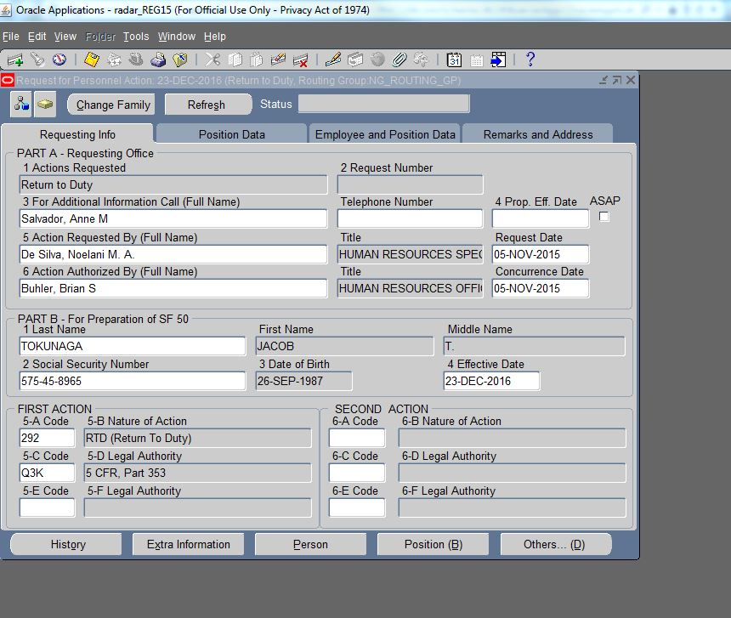
Rtd (noa 292)
FILL PART A-REQUESTING OFFICE
FILL PART B-FOR PREPARATION OF SF 50.
MUST SPECIFY EFFECTIVE DATE BY REQUESTER.
5-A CODE: 292-RTD (ALWAYS)
5-C CODE: Q3K-5CFR, PART 353 (ALWAYS)

Slide 21
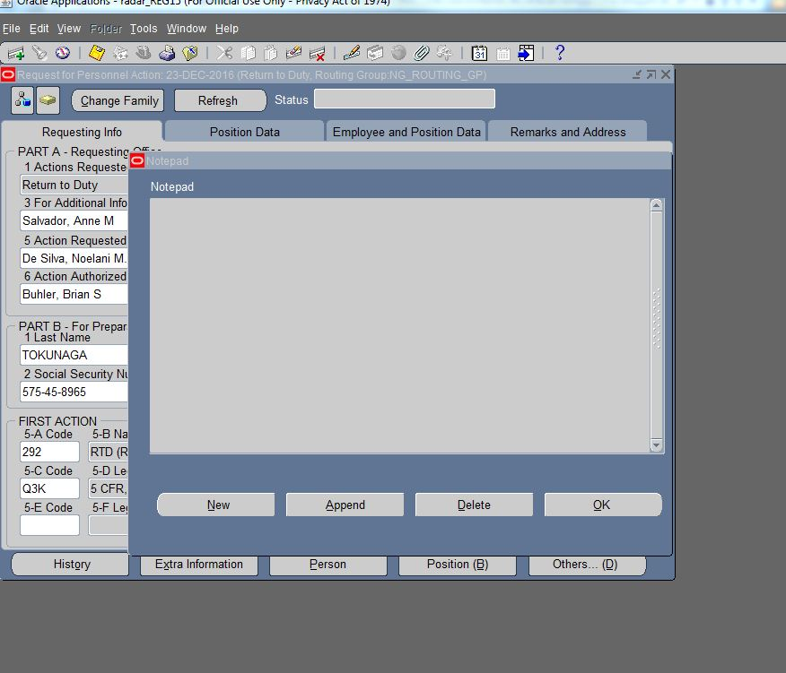
Attaching documents
CLICK ON THE NOTE PAD ICON (THIS WILL ALLOW YOU TO ATTACH DOCUMENTS)

Slide 22
Attaching documents cont.
You may add the following information into the Notepad:
Ensure HRO has the following:
1.Military Orders
2.USERRA Checklist
a.What your employee wants to do with their FEHB
b.TSP 41 (if applicable)
c.FEGLI Election Form (if applicable)
Supervisor Contact Information:
Email Address:
Phone Number:
CLICK ON “OK” AFTER YOU HAVE ADDED NOTES.
CLICK ON NEW.

Slide 23
Attaching documents cont.
CLICK ON “SAVE” ICON
CLICK ON “YES” ICON.

Slide 24
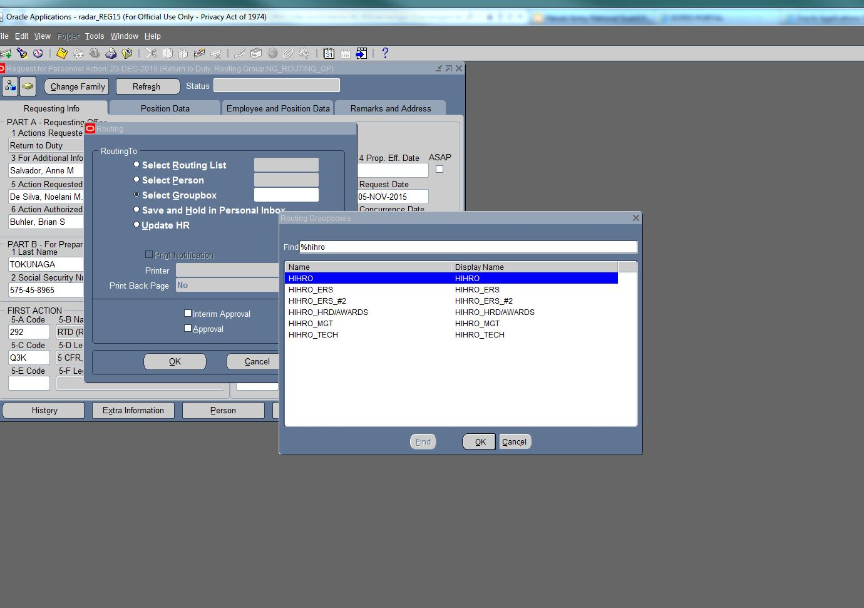
Type “HH” and it should show your inbox selections where to send the RPA to. Send to “HIHRO group box”.
If you still have a few changes to make to the RPA, save the action to your inbox/group box until ready for submission to HRO.
SELECT GROUP BOX

Slide 25
CLICK ON “OK” ICON.
CLICK ON “OK” ICON.

Slide 26
Attaching documents cont.
TO ADD DOCUMENTS, CLICK ON THE “PAPER CLIP” ICON.

Slide 27
TYPE THE TITLE OF DOCUMENT AND DESCRIPTION.

Slide 28
Example
SF 52 RTD
RTD, EFFECTIVE
SAMPLES

Slide 29
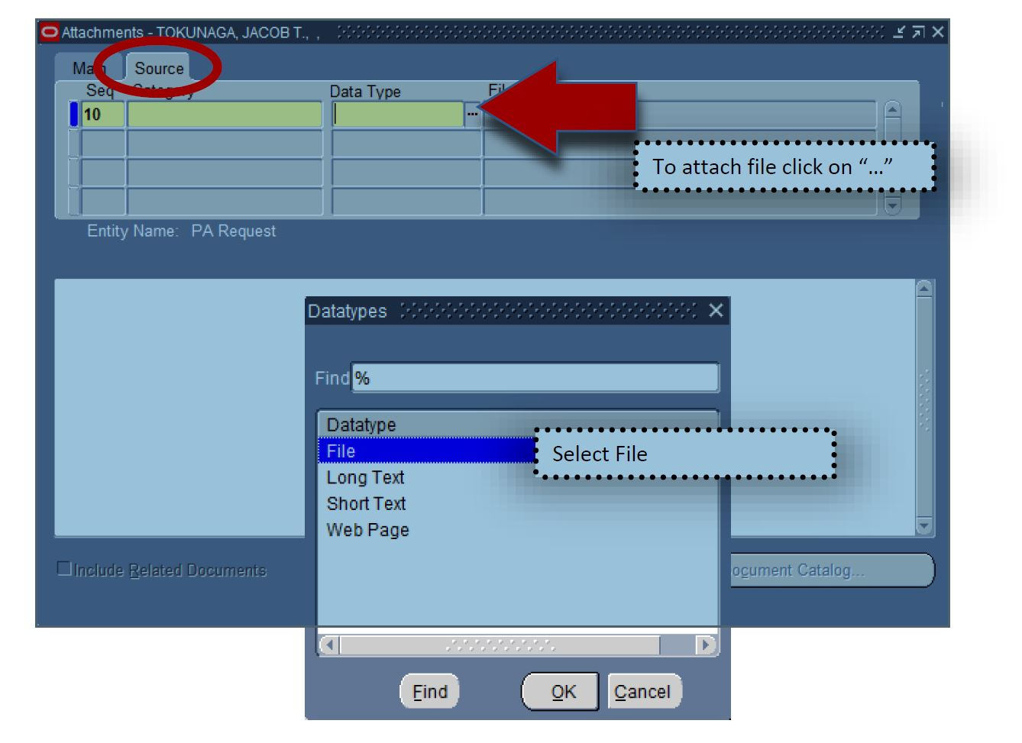
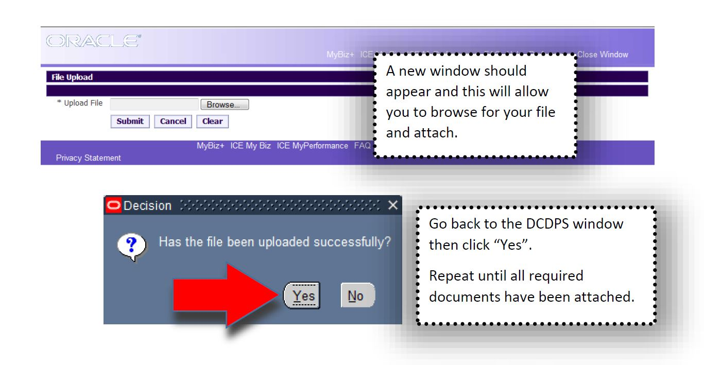
Document has been attached

Slide 30
Documents for return to duty
Application for Reservist Differential
Request for Retro TSP contributions
TSP-41 (if applicable)

Slide 31
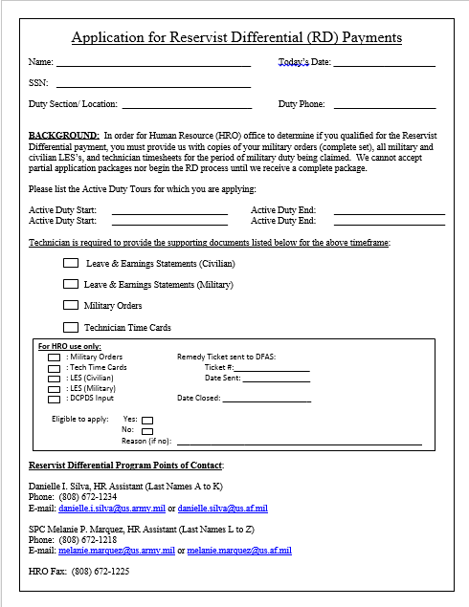
Application for reservist differential
Reserve differential – If your salary as a technician is more than if you were on military orders, you may qualify for Reserve Differential; qualification for reserve differential could affect determining the start of your effective date. Under reserve differential, only compensatory time will affect your effective date. See Hawaii National Guard Technician Information and Election Rights, para 8.
More info: Information for Reservist Differential Payment.docx

Slide 32
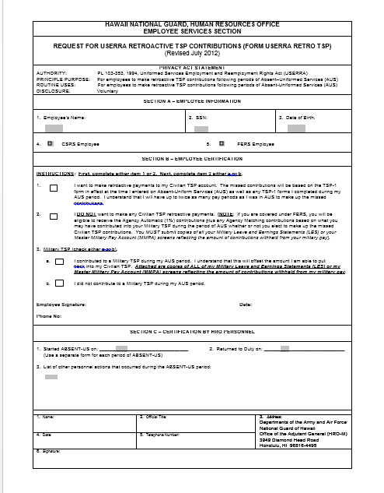
Request for Retroactive tsp contributions
Section A 1-3 Fill: Name, SSN, DOB
Indicate CSRS or FERS retirement
Section complete whether you want to make contributions or not.
Section B question 3
Indicate whether you had contributed to your military TSP while on orders.
Sign and Date
If you indicate that you contributed to your Military TSP during AUS period
You must submit copies of ALL of my Military Leave and Earnings Statements (LES) or Master Military Pay Account (MMPA) screens reflecting the amount of contributions withheld from my military pay. To receive the Agency Matching.

Slide 33
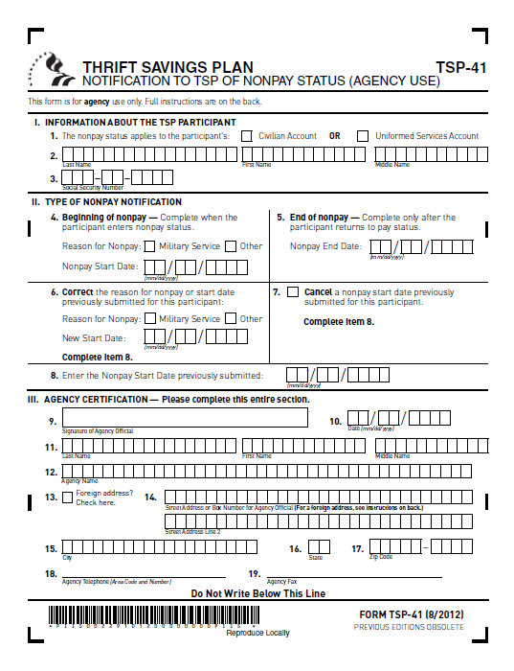
Tsp-41
Section 1
Indicate civilian account
Last name, First name, Full middle name
Social Security Number
When returning to duty if you know you had a TSP loan you will be required to submit this form.
Failure to do this could allow a participant who is ineligible for a TSP loan to receive one, or could result in serious, costly tax consequences for a participant who already has a TSP loan.
TSP-41.pdf
Section 2
Only enter RTD date

Slide 34
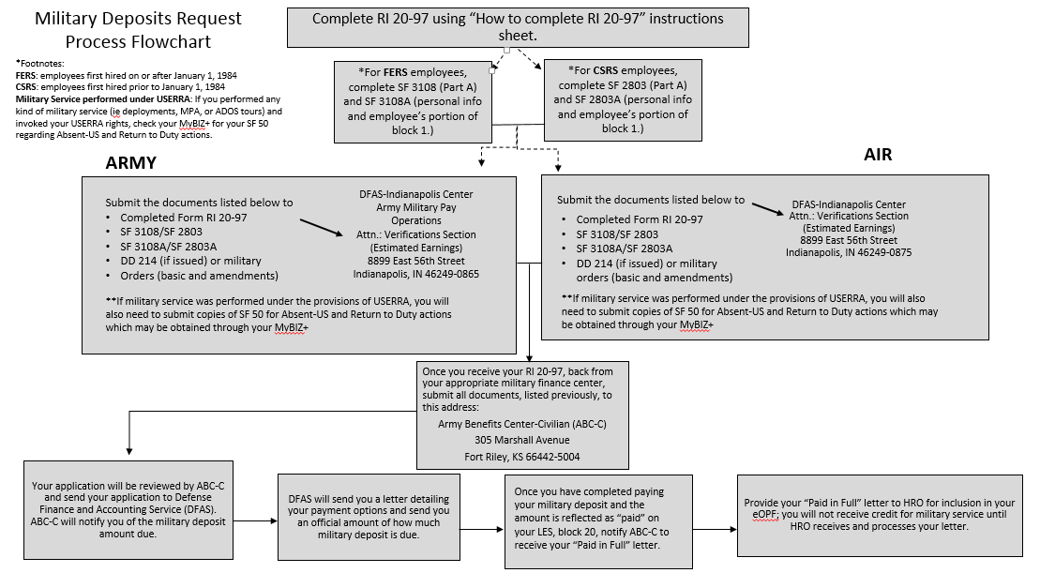
Military Service Deposit

Slide 35
Military service deposit process
Step 1: Wait for your SF-50 for your RTD to be processed, you can find this information on mybiz.
Step 2: Once processed for RTD go onto www.opm/gov/form/standard-forms: and file according to you retirement system either FERS or CSRS.
Complete your RI 20-97 and attached your DD-214 or complete orders, and you will also need to send a copy of your AUS and RTD actions.
You can find this information on the ABC-C website : ABC-C | FERS Deposit/Redeposit Service

Slide 36
Poc hro-m http://hawaii.gov/dod/staff-offices/hro
USERRA PROCESSING INQUIRIES:
SPC SYLVESTER, STEPHEN (# 672-1236)
  Human Resources Assistant (Assist technicians with last names: A-F)
  Stephen.k.sylvester & stephen.sylvester@us.af.mil
SPC Charla L. Quiambao(# 672-1781)
  Human Resources Assistant (Assist technicians with last names: U-Z)
  charla.l.quiambao.mil@mail.mil & charla.quiambao@us.af.mil
SRA Melanie P. Marquez (# 672-1218)
  Human Resources Assistant (Assist technicians with last names: G-I, R-T)
  melanie.marquez@us.army.mil & melanie.marquez@us.af.mil
Ph # 672-1234 (main line) or
Ph # 672-1006 AND Fax # 672-1225
Option 1= Personnel Officer (HRO)
Option 2= Classification & Staffing Section
Option 3= Benefits, Training, Appraisals & Awards
Option 4= AGR Branch
Option 5= Other inquiries

Slide 37
Questions?

